Slide 1
Equitable Services to Private Schools under ESSA
Grants for Education Management System (GEM$)
June 2023

Slide 2
ESSA Equitable Services: Six Key Points
In key ESEA programs, the law provides for equitable participation of private school students, teachers and other educational personnel, and, in some cases, families….Outreach through written offer to participate; Title I funds follows the eligible student; Titles II, III, and IV to schools within district boundaries
Consultation must be timely and meaningful…Planning meeting and ongoing communication; spring notice, plan before you apply, incorporate needs of private school students and seriously consider private school views
Funds generated for equitable services must be equal on a per-pupil basis…Allocation is calculated in application based on reported numbers

Slide 3
ESSA Equitable Services: Six Key Points
A public agency must control funds. Private schools do not receive funds…You hire, purchase, supervise, and inventory materials
Services must be secular, neutral, and non-ideological; supplemental; and costs must be allowable, necessary, and reasonable…You determine what meets federal grant guidelines
Private school officials have the right to file a formal complaint…if key elements above are not adhered to

Slide 4
Guidance and Resources
Equitable Services Webpage: www.doe.mass.edu/federalgrants/resources/equitableservices-essa/
  USED guidance – question and answer
  DESE resource guide – step-by-step guide
  Sample offer of consultation to private schools
  Suggested timelines related to equitable services
ESSA statute
  Title I, Sec. 1117(a)(3)(B), and
  Title VIII, Sec. 8501(a)(3)(B)…for Title IIA, IIIA, and IVA programs
ESSA Ombudsman
  Alex Lilley
  ESEAequitableservices@mass.gov

Slide 5

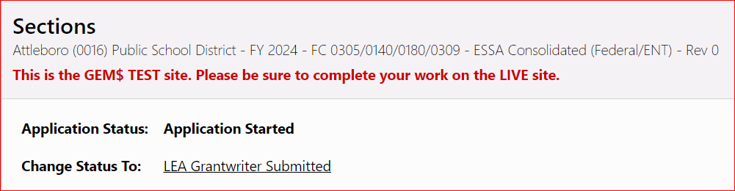
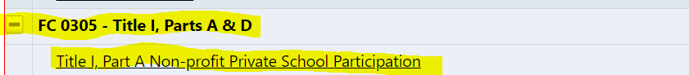
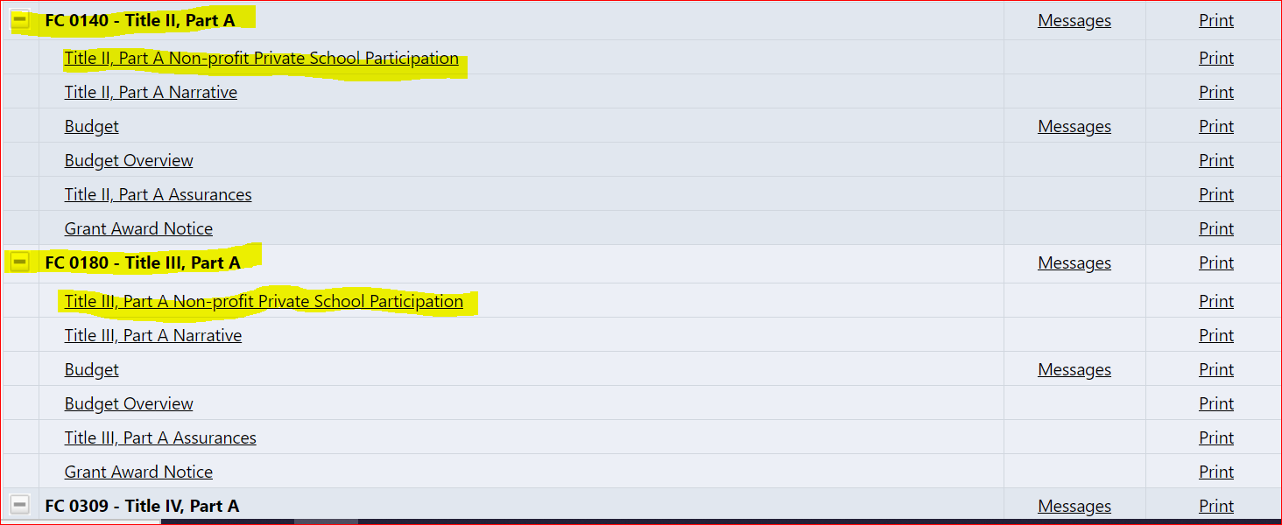
ESSA Equitable Services in GEM$
Tip: To begin filling out any part of the application, you must ensure it is at “Application Started” status first.

Slide 6
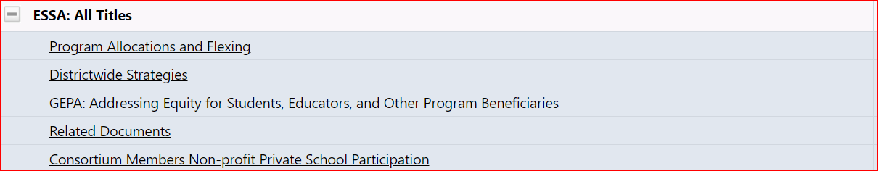
ESSA Equitable Services in GEM$
Consortium Members

Slide 7
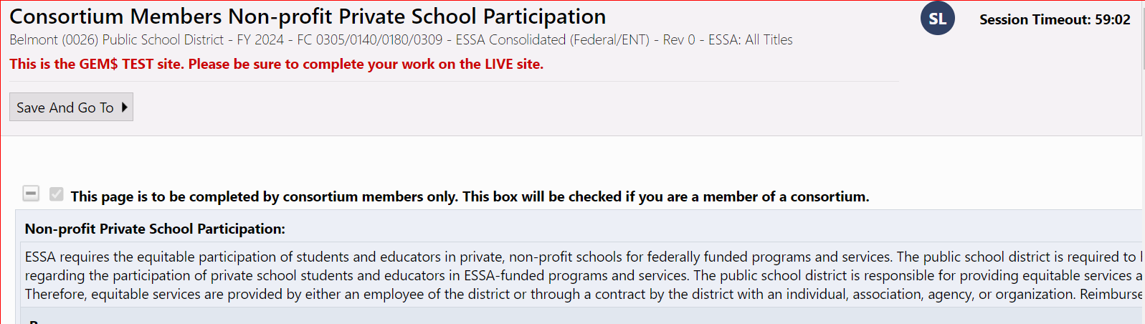
ESSA Equitable Services in GEM$ Consortium Members

Slide 8
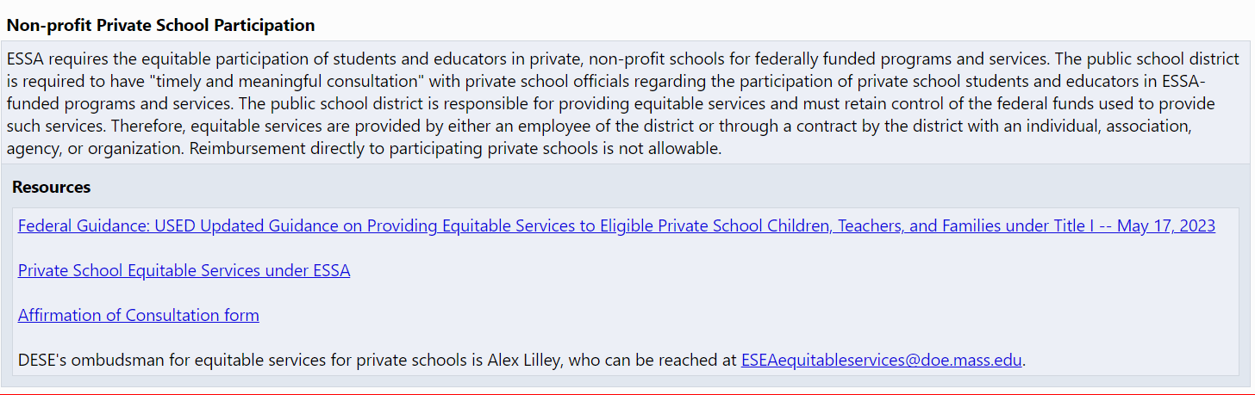
Let’s look at Title I, Part A Equitable Services Page:
ESEA private school requirements and helpful resources at the top of the page.

Slide 9
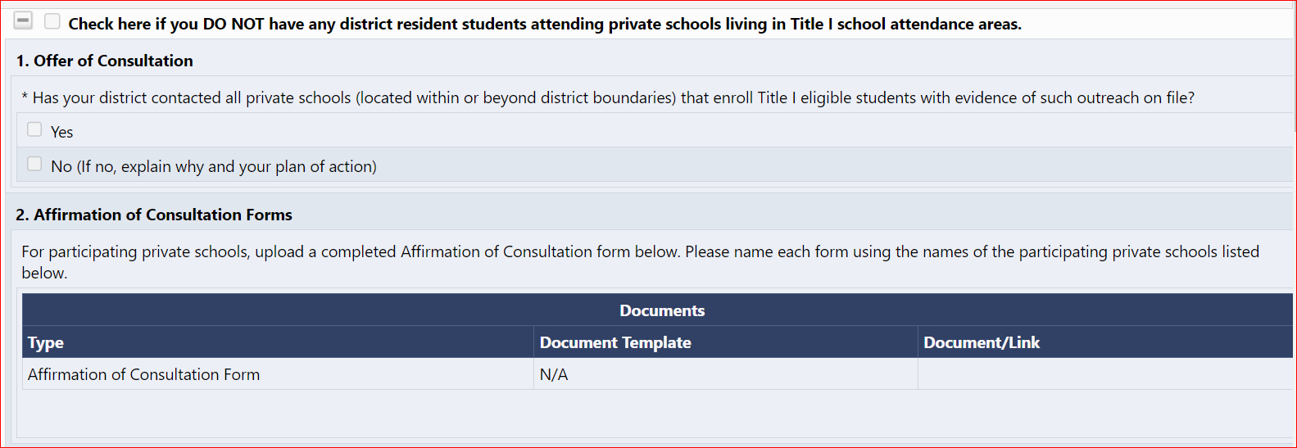
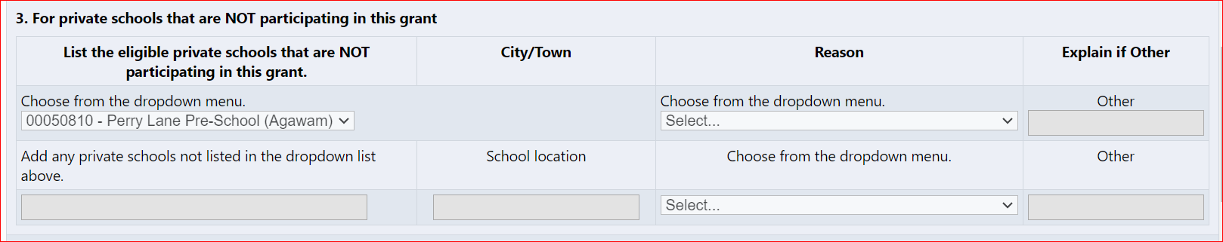
Title I, Part A Equitable Services Page cont…

Slide 10
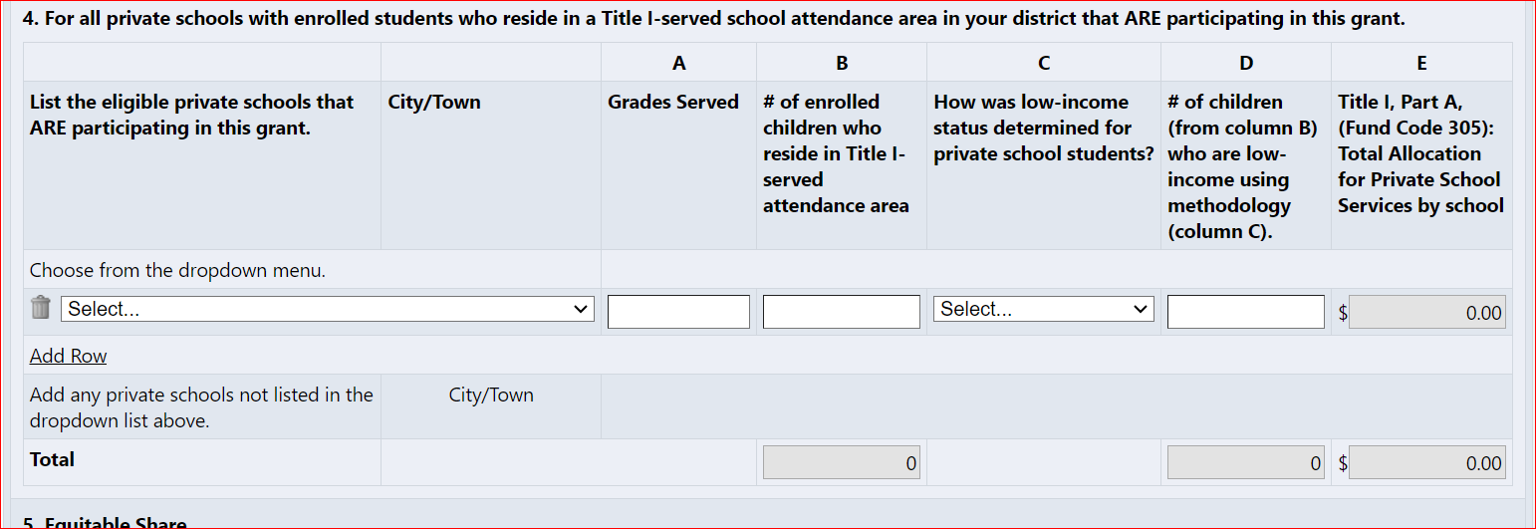
Title I, Part A Equitable Services Page cont…

Slide 11
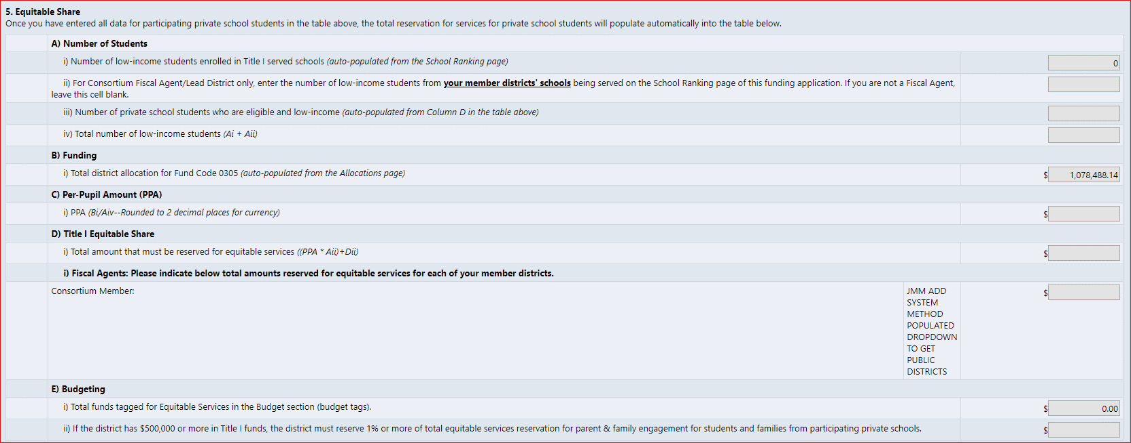
Title I, Part A Equitable Services Page cont…

Slide 12
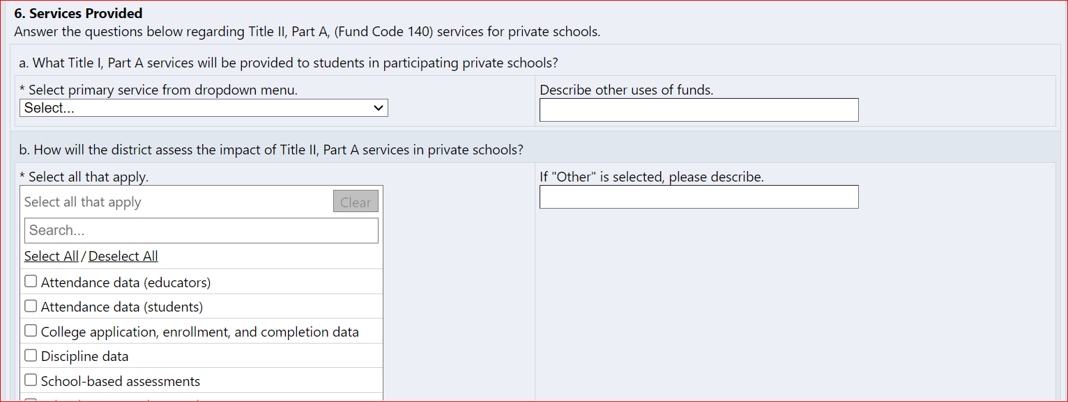
Title I, Part A Equitable Services Page cont…

Slide 13
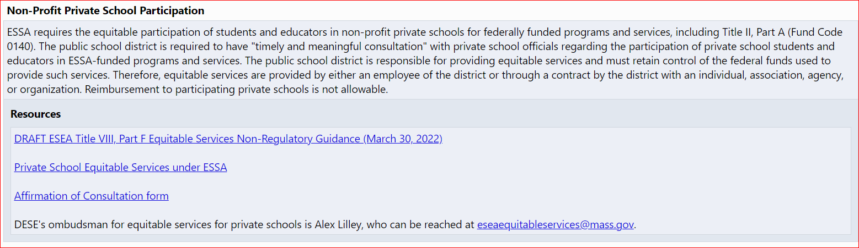
Title II, III, IV Part A Equitable Services

Slide 14
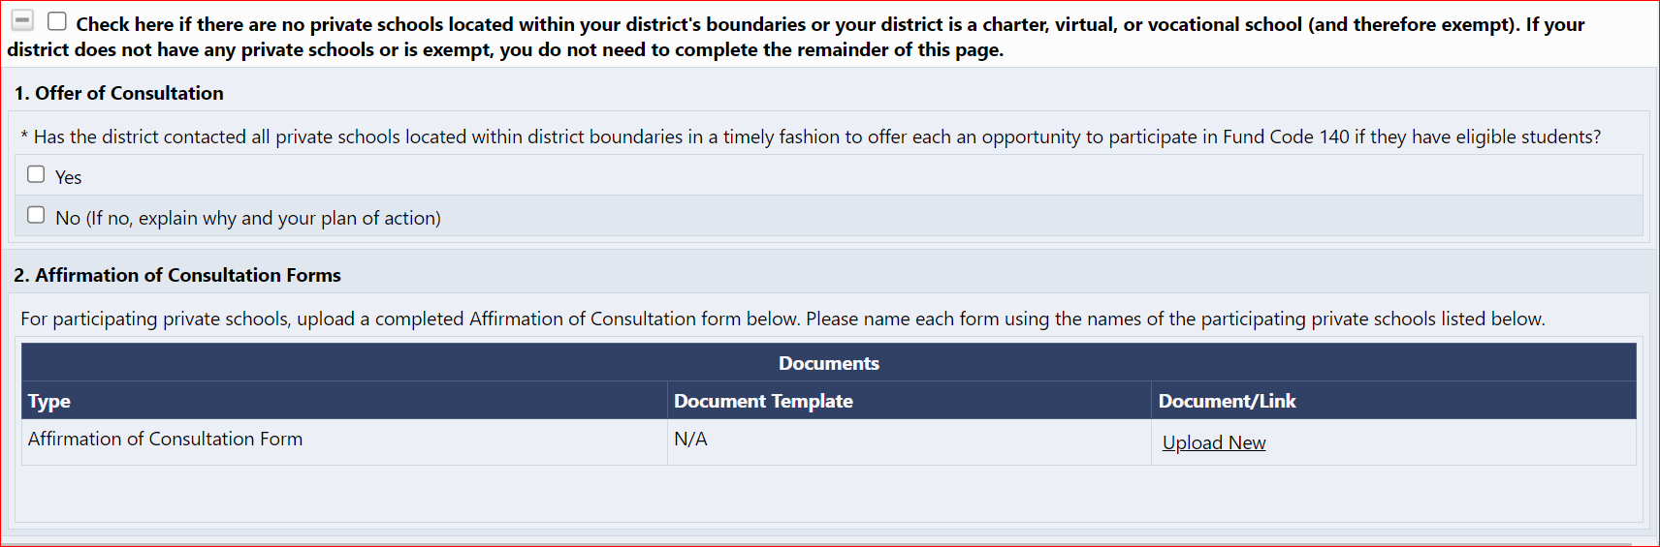
Title II, III, IV Part A Equitable Services cont…

Slide 15
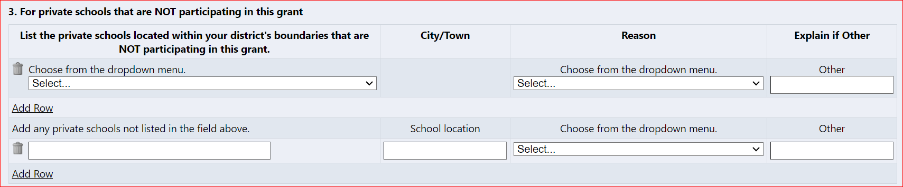
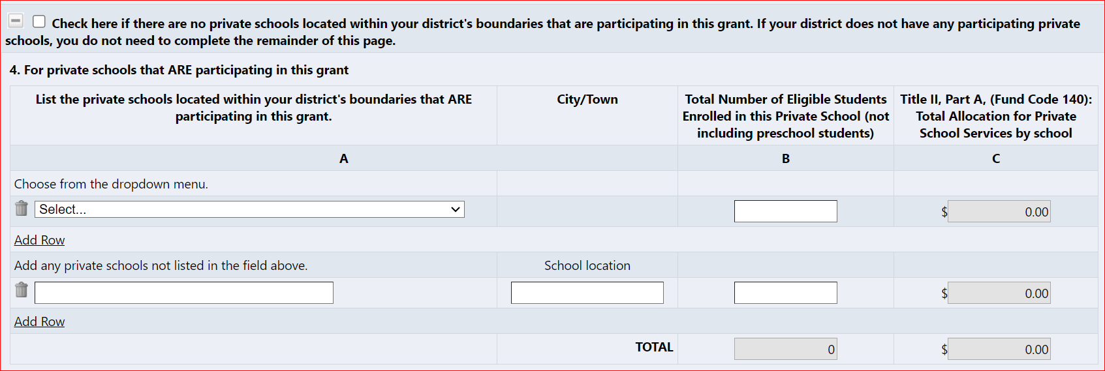
Title II, III, IV Part A Equitable Services cont…

Slide 16
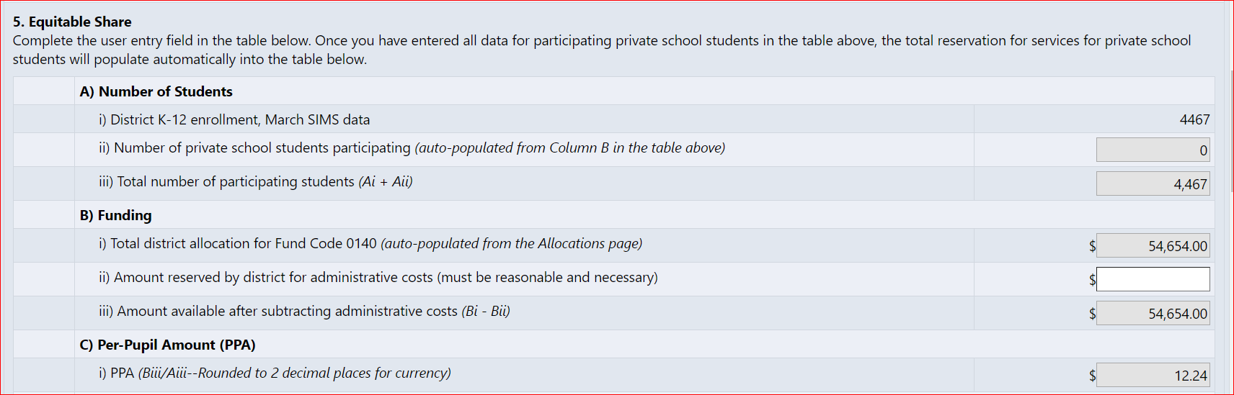
Title II, III, IV Part A Equitable Services cont…

Slide 17
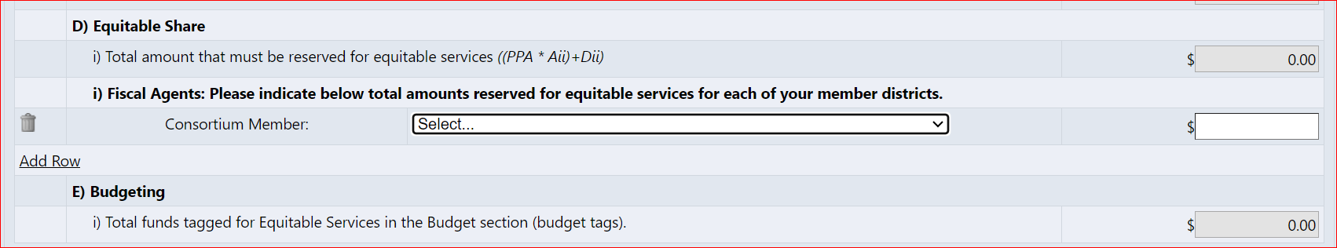
Title II, III, IV Part A Equitable Services cont…

Slide 18
Demonstration in GEM$
DEMO

Slide 19

Questions

Slide 20
Thank You
Federal Grant Programs Office
Federal Grant Liaison Contact List
ESSA Ombudsman
  Alex Lilley
  ESEAequitableservices@mass.gov
Phone: 781-338-6230
www.doe.mass.edu/federalgrants

