Slide 1
Lunch and Learn Federal Programs Update
June 26, 2023

Slide 2
Updates from Malden (soon to be Everett)

Slide 3
DESE’s Educational Vision
DESE's Educational Vision - Spring 2023
What outcomes do we envision as a result of our work?
Our vision is that as a result of their public education in Massachusetts, students will attain academic knowledge and skills, understand and value self and others, and engage with the world.
This will enable students to be curious and creative, shape their path, feel connected, and be empowered.
3

Slide 4
DESE's Strategic Objectives – Spring 2023
DESE's Strategic Objectives – Spring 2023
DESE partners with districts, schools, and programs to:
Strategic Objective 2 - "Deeper Learning"
Strategic Objective 3 - "Diverse and Effective Workforce"
Develop and sustain a workforce that is diverse, culturally responsive, well-prepared, and committed to continuous improvement, so that all students have equitable access to effective educators.
Promote deeper learning so that all students engage in grade-level work that is real-world, relevant, and interactive.
Cultivate systems to support the whole student and foster joyful, healthy, and supportive learning environments so that all students feel valued, connected, nourished, and ready to learn.
Strategic Objective 1 - "Whole Student"
4
Notes:
The Department’s new educational vision sets an ambitious and long-term expectation of the learning experiences for students across the Commonwealth. The Department is deeply committed to providing aligned supports to districts, schools, and programs so that this vision may become a reality. As such, DESE has identified three key strategic objectives that it will focus on strengthening over the next four years.

Slide 5
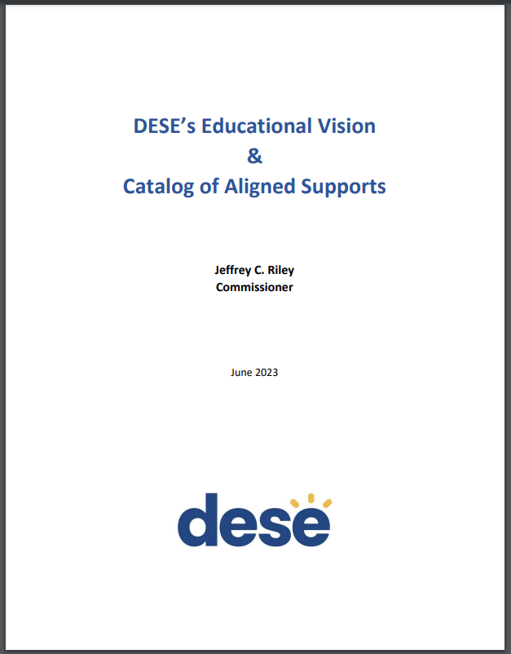
DESE's Educational Vision - Helpful Resources
Educational Vision
Catalog of Aligned Supports
www.doe.mass.edu/commissioner/
5

Slide 6
ESSER Updates

Slide 7
Federal COVID Relief Funding – Sequencing of ~$3 billion over ~3 years
Today
Federal Coronavirus Relief Fund
$181.8 million
(CARES Act) Federal ESSER-I Fund
$194.4 million
(CRRSA Act) Federal ESSER-II Fund
$739 million
(American Rescue Plan) Federal ESSER-III Fund
$1.66 billion
(American Rescue Plan) Federal “ARP IDEA” (supplemental to the regular IDEA grants)
$63.2 million
FY21
6/30/21
Begin FY22
12/31/21
9/30/22
9/30/23
9/30/24
7
Notes:
Also over $48 million to private schools, and $260 million to approved private special education schools.

Slide 8
ESSERs I, II, and III: Claimed vs. Unclaimed through June 9, 2023
99.99%
21%
69%
8

Slide 9
Looking at ESSERs II and III only: through June 9, 2023
59%
41%
July 2021
through Sept 2024
54%
9

Slide 10
Claims/Draw Down Status
You can see claims status reports for your district via our monthly Federal Grant Programs newsletter
Not on the list? Email FederalGrantPrograms@mass.gov!
DESE will be reaching out to low-spend/low-claim districts in the near future
10

Slide 11
ESSER Reminder 1 – Maintenance of Equity
ESSER-III requires all districts to Maintain Equity for their highest poverty schools (highest quartile) this fiscal year.
There is no disproportionate reduction in combined State and local per pupil funding compared to all schools served by the LEA in that fiscal year
There is no disproportionate reduction in the number of FTE staff per pupil compared to all schools served by the LEA in that fiscal year
DESE is collecting waivers (if necessary) for districts not in compliance. Most were collected during the data collection period, and we have a few more to go
11

Slide 12
ESSER Reminder 2 – Changes to Use of Funds Plans
Many districts are making changes to their ESSER-III plans
If a district is making substantial changes to their approved ESSER III plan, USED has set an expectation that stakeholder outreach should be done.
If the changes are insignificant, stakeholder outreach would not be necessary.
12

Slide 13
ESSER Reminder 3 – Davis-Bacon Prevailing Wages
Applies to all facilities contracts more than $2,000 paid in whole or in part with federal grant dollars (except IVAQ FC 209)
Paying prevailing wages under Massachusetts law is not sufficient.
Where a project receives both federal and state/local funding, the project may be subject to both Davis-Bacon prevailing wage requirements and state or local laws that similarly require payment of prevailing wage rates set by the state or locality.
Where both federal and state/local prevailing wage requirements apply, contractors must pay whichever rate is higher for each job classification and meet whichever requirements are more protective of workers.
Davis-Bacon prevailing wage rates are set by county and can be found on https://sam.gov (see guidance on how to find applicable federal wage rates here).
Davis-Bacon requires that districts receive certified payroll records weekly and other monitoring of contractors/subcontractors to ensure accurate weekly payment of required wage rates and retention of those records, among other responsibilities.
13

Slide 14
News from Washington

Slide 15
Late Liquidation for ESSER II
First, let’s get some clarity around terminology:
Obligation (a formal commitment to spend funds, but this can vary depending on the kind of commitment)
Service delivery
Liquidation (claim/draw down from DESE)
15

Slide 16
Obligation Deadlines
When Congress appropriates money for a grant program, it usually contains an obligation deadline
CARES ESSER-I: 9/30/2021
CRRSA ESSER-II: 9/30/2022
ARP ESSER-III: 9/30/2023
16

Slide 17
Wait…what?
17

Slide 18
“Tydings amendment” saves the day
For most US Dept. of Ed. Programs, the General Education Provisions Act (1967) extends the obligation date set by Congress by 12 months.
CARES ESSER-I: 9/30/2022
CRRSA ESSER-II: 9/30/2023
ARP ESSER-III: 9/30/2024
18

Slide 19
Obligation Deadlines
The US Department of Ed has no authority to extend an obligation date past the already-extended Tydings date, unless they are explicitly granted waiver authority by Congress
We have seen no indication that Congress will consider granting such waiver authority to USED
19

Slide 20
Obligations depend on what you’re spending $ on
If you’re spending federal $ on this… | The obligation is considered made…
Employees | When service is performed
Public utility services | When service is performed
Travel | When travel is taken
Rentals | When rental is first used
Acquisition of real or personal property | When you make a binding written agreement (contract or work/purchase order)
Services by a contractor (not an employee) | When you make a binding written agreement (contract or work/purchase order)
20

Slide 21
Liquidations
The federal Uniform Grant Guidance gives DESE 4 months (120 days) to draw down funds after a federal grant obligation period ends
For ESSER-I, this would be January 28, 2023
DESE needs at least 30 days to account, so we ask districts to draw down funds from us within 90 days
21

Slide 22
Liquidations
Fortunately, unlike with obligation deadlines, USED does not need authority from Congress to waive/extend liquidation deadlines
For ESSER grants, USED is allowing certain properly obligated expenses to be performed/services delivered during the “approved budget period, which is the obligation period + liquidation period!
22

Slide 23
Late Liquidation for ESSER-II – June 2023 Update
The federal government announced up to an additional 14 months to liquidate funds, but only in select cases. It is NOT a blanket provision that can be used for all situations.
Districts must:
Obligate funds by 9/30/2023
Provide evidence that funds were obligated on time
Provide a compelling rationale for why late liquidation is needed, beyond simply needing additional time, how long is needed, and why
Provide assurance that you have the capacity to liquidate funds within the extended period
Districts can submit requests starting Aug. 1 through Sept. 30
23
Notes:
for each late liquidation request to ensure that expenditures have been obligated in a timely manner, that there is a justification for the request beyond simply needing additional time to spend down funds, and an assurance that districts have been assessed for risk and have sufficient “capacity for liquidating funds within the extended period.”

Slide 24
Obligations depend on what you’re spending $ on
If you’re spending federal $ on this… | The obligation is considered made…
Employees | When service is performed
Public utility services | When service is performed
Travel | When travel is taken
Rentals | When rental is first used
Acquisition of real or personal property | When you make a binding written agreement (contract or work/purchase order)
Services by a contractor (not an employee) | When you make a binding written agreement (contract or work/purchase order)
24

Slide 25
Other Updates from Washington

Slide 26
ESSA Title I in MA – FY19 - FY23

Slide 27
FY24 ESSA Title I in MA increased 10.6% from last year

Slide 28
ESSA Titles II, III, IV in MA – FY19 - FY23

Slide 29
FY24 – Title IIA up .7%; III up 11.5%; IV up 3.8%

Slide 30
“Debt Ceiling Deal” – Impact on FY25
Fiscal Responsibility Act of 2023 signed into law on June 3rd
No ESSER funds were rescinded
State FY25 federal spending will be capped at FY24 levels
The bill also includes a provision encouraging Congress to pass timely FY 2024 appropriations by imposing a one percent cut to any continuing resolutions that extend funding past January 1, 2024.
For FY25 – plan for 1% cut, and hope for level funding
30

Slide 31
Thank You!

