Slide 1
Fiscal Policies and Practices in GEM$: Tying it all Together – Chart of Accounts and Budgeting
June 26, 2023

Slide 2
Presenters
Kathy Cross, Federal Programs Coordinator, Resource Allocation Strategy and Planning
Robert O'Donnell, Director of School Finance

Slide 3
Agenda
New Grants Chart of Accounts in GEM$ - Rob O’Donnell
Budget Functionality (Demo) – Kathy Cross
Questions

Slide 4
1. New Grants Chart of Accounts in GEM$

Slide 5
DESE’s chart of accounts (COA) governs how districts report their expenditure data on an annual basis
Function codes
1000 Administration
Object codes
01 Professional salaries
02 Clerical salaries
2000 Instruction
3000 Pupil services
4000 Maintenance
5000 Fixed charges
6000 Community services
7000 Capital and equipment
8000 Debt service
9000 Out-of-district tuition
03 Other salaries
04 Contractual services
05 Supplies and materials
06 Other expenses

Slide 6
The object and function categories in GEM$ are aligned with the EOYR chart of accounts
We added this feature to GEM$ in response to requests from the field to align the two systems
GEM$ includes dropdown menus for object codes and function codes (organized by function categories)
Designed to align with your local accounting systems, streamline grant budgeting, and facilitate EOYR reporting

Slide 7
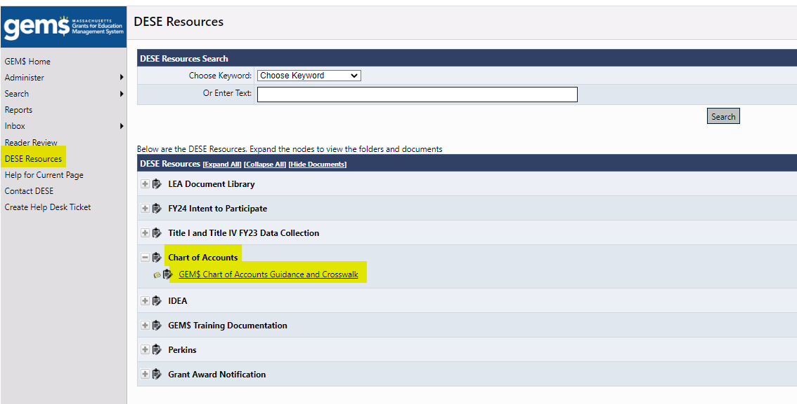
Refer to the GEM$ Chart of Accounts Guidance and Crosswalk under DESE Resources

Slide 8
When developing your budget, first choose the appropriate object category
Object Codes: What are you purchasing?
(01M) Professional Salaries (MTRS)
(01NM) Professional Salaries (Non-MTRS)
(02) Clerical Salaries
(03) Other Salaries
(04C) Contracted Services
(04MC) Contracted Services (major)
(05) Supplies and Materials
(06) Other Expenses
(07) Equipment
(08) Indirect Costs
(09) MTRS

Slide 9
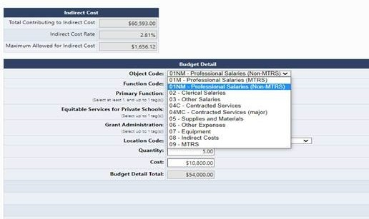
Use the Object Code dropdown to select the correct object code

Slide 10
Next, select the functional category that fits the purpose of the expenditure
District Administration (ADMN) | 1000 Administration
Guidance, Counseling, and Testing (GUID) | 2000 Instruction
Instructional Equipment (IEquip)
Instructional Leadership (LDRS)
Instructional Materials and Technology (MATL)
Other Teaching Services (TSER)
Paraprofessionals (PARA)
Professional Development (PDEV)
Teachers (TCHR)
Pupil Services (SERV)
Operations and Maintenance (OPMN) | 4000 Maintenance
Benefits (BENE) | 5000 Fixed charges
Fixed Charges (FIXED)
Community Services (COMM) | 6000 Community Services
Capital (CAPT) | 7000 Capital and Equipment
Equipment (CAPT)
Out-of-District Expenditures (OODD) | 9000 Out-of-district expenditures

Slide 11
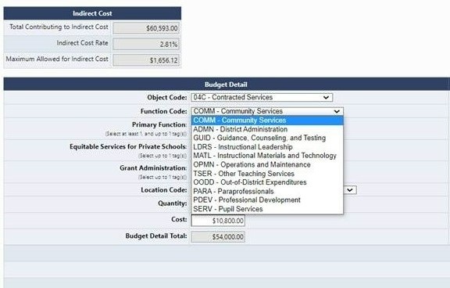
Use the Function Code dropdown to select the correct function code category

Slide 12
DESE EOY object and function codes
Object codes (11)
(01M) Professional Salaries (MTRS)
Function categories (19)
Community Services (COMM)
(01NM) Professional Salaries (Non-MTRS)
(02) Clerical Salaries
(03) Other Salaries
(04C) Contracted Services
(04MC) Contracted Services (major)
(05) Supplies and Materials
(06) Other Expenses
(07) Equipment
(08) Indirect Costs
(09) MTRS
District Administration (ADMN)
Guidance, Counseling, and Testing (GUID)
Instructional Leadership (LDRS)
Other Teaching Services (TSER)
Professional Development (PDEV)
Pupil Services (SERV)
Teachers (TCHR)
Operations and Maintenance (OPMN)
Paraprofessionals (PARA)
Instructional Materials and Technology (MATL)
Out-of-District Expenditures (OODD)
Benefits (BENE)
Capital (CAPT)
Fixed Charges (FIXED)
Equipment (CAPT)
Instructional Equipment (IEquip)
Indirect Costs (INDIRECT)
MTRS

Slide 13
The object code that you select will dictate the function categories you can choose
Object code | Function categories
(01M) Professional Salaries (MTRS) | Community Services (COMM)
 | District Administration (ADMN)
 | Guidance, Counseling, and Testing (GUID)
 | Instructional Leadership (LDRS)
 | Other Teaching Services (TSER)
 | Professional Development (PDEV)
 | Pupil Services (SERV)
 | Teachers (TCHR)

Slide 14
Function categories include multiple function codes (refer to the crosswalk)
Function categories | Function codes
District Administration (ADMN) | 1210 - Superintendent 1220 - Assistant Superintendents 1230 - Other District-Wide Administration 1410 - Business and Finance 1420 - Human Resources
Guidance, Counseling, and Testing (GUID) | 2710 - Guidance/Adjustment Counselors 2720 - Testing and Assessment 2800 - Psychological Services

Slide 15
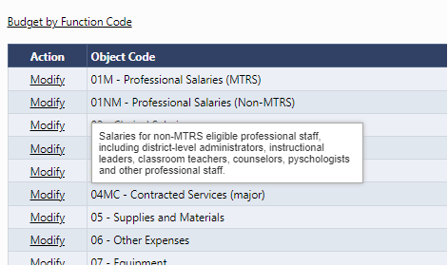
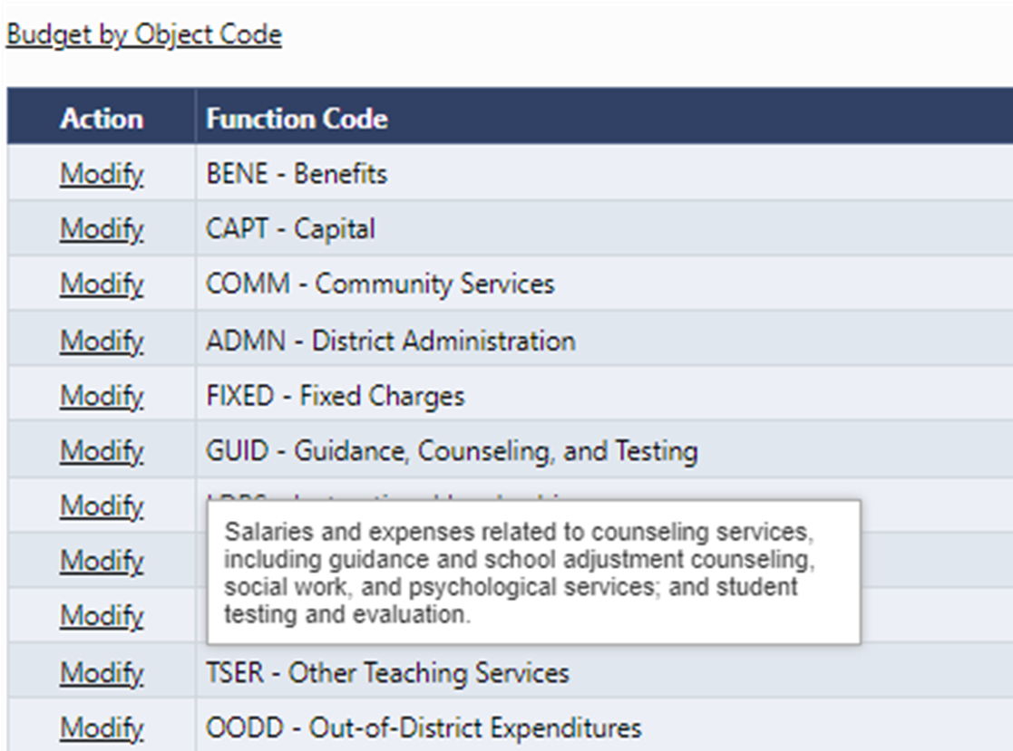
Use the hover definitions to see detailed descriptions of each object and function code

Slide 16

Examples of how to classify grant expenditures
Stipends for Teacher PD in early literacy and math curriculum − $75,000
  Object: 01M - Professional Salaries MTRS
  Function: PDEV - Professional Development
Contracts for evidence-based mentoring and counseling for young men (BAM) and women (WOW) programs − $1,119,336
  Object: 04MC - Contracted Services (if not replacing services usually provided in-house)
  Function: GUID - Guidance, Counseling, and Testing

Slide 17
Examples of how to classify grant expenditures
Health benefits − $ 207,612
  Object: 06 - Other Expenses
  Function: BENE - Benefits
Travel reimbursement for teachers attending a professional development training − $800
  Object: 06 - Other Expenses
  Function: PDEV - Professional Development

Slide 18
For districts that claim indirect, use object code (08) to determine the amount you can claim based on your approved rate
Indirect costs account for overhead incurred on a grant, like HR, payroll, accounting, etc.
Districts are allowed to charge indirect up to the expenditures eligible to be charged multiplied by the district’s approved rate
The calculation appears in the indirect box as the budget is created
A validation will prevent a district from budgeting more indirect than is allowed

Slide 19
Generally, contracts over $25,000 may not be included for calculating maximum indirect
Contracts over $25,000 do not generate the same level of indirect costs because the vendor is paying for the overhead
Districts can only count the first $25,000 of the contract toward their indirect calculation
One exception are contracts for independent contractors or contracted employees who serve as a nurse, speech pathologist, or other auxiliary staff and who use payroll, HR, and other overhead services
Federal Guidance:
  USED’s 2019 Cost Allocation Guide for State and Local Governments
  USED, Office of the Chief Financial Officer, Indirect Cost Overview

Slide 20
2. Budget Functionality

Slide 21
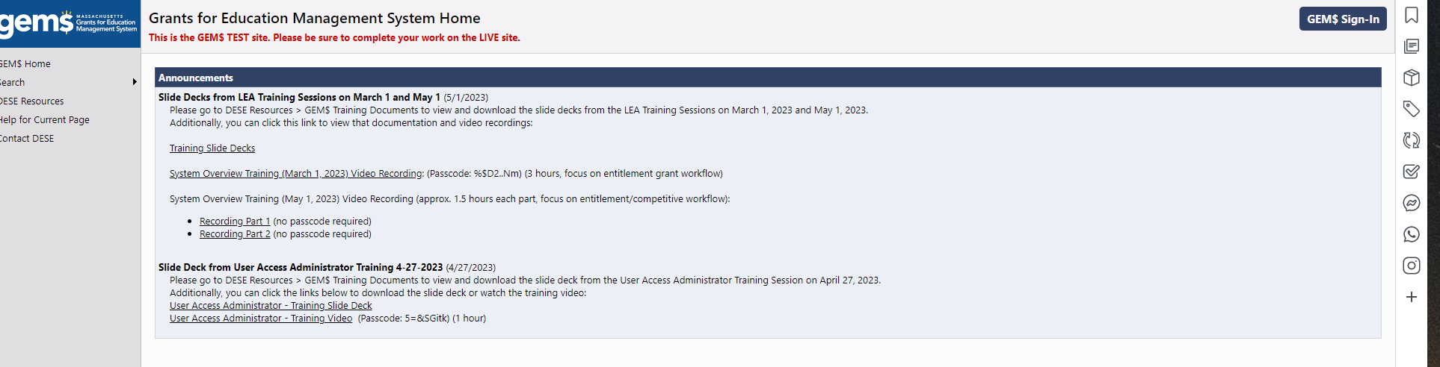
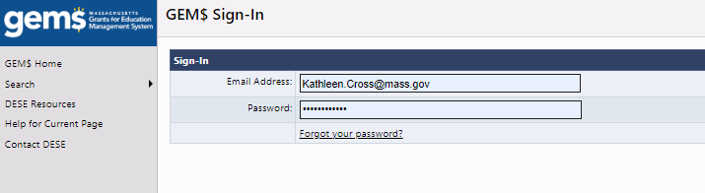
Reviewing Budget Functionality in GEM$
How to find the budget
  Once on the GEM$ site: mass.egrantsmanagement.com, sign in using your user name and password:

Slide 22
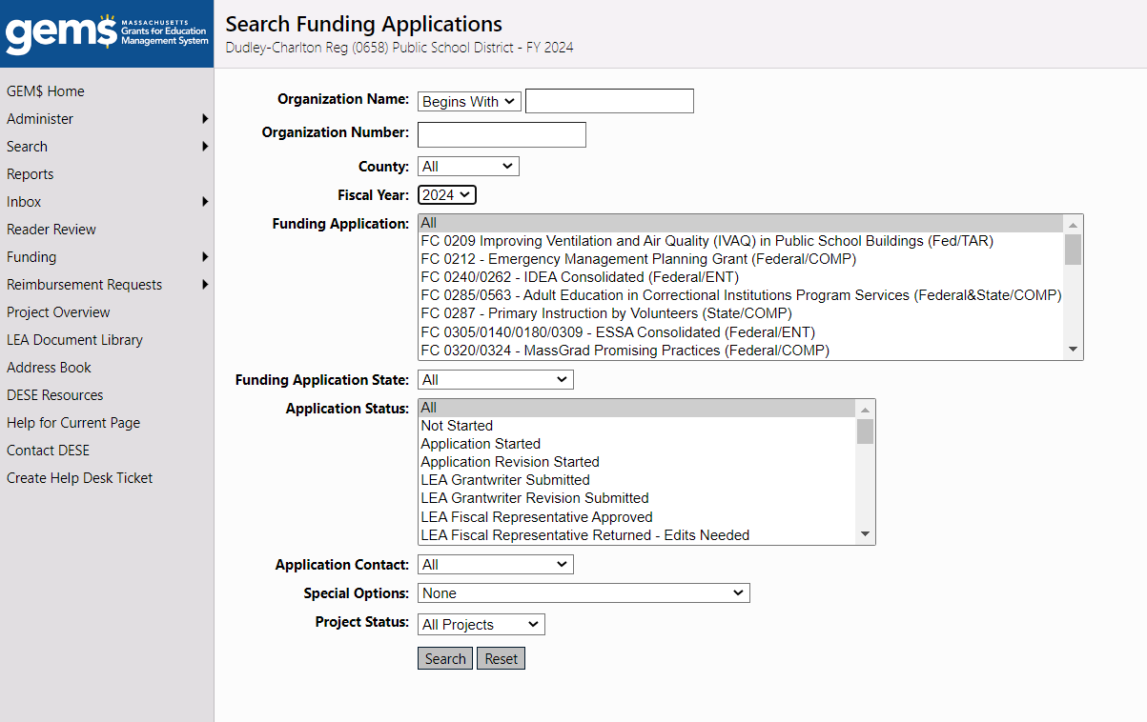
Reviewing Budget Functionality in GEM$ (cont’d)
Search for Funding Applications and select the correct fiscal year
You can then filter by:
  Grant name/fund code
  Status in the workflow (“Grantwriter
  Submitted” means it’s ready for Fiscal
  Representative sign off))
  Or any other filter on the page

Slide 23
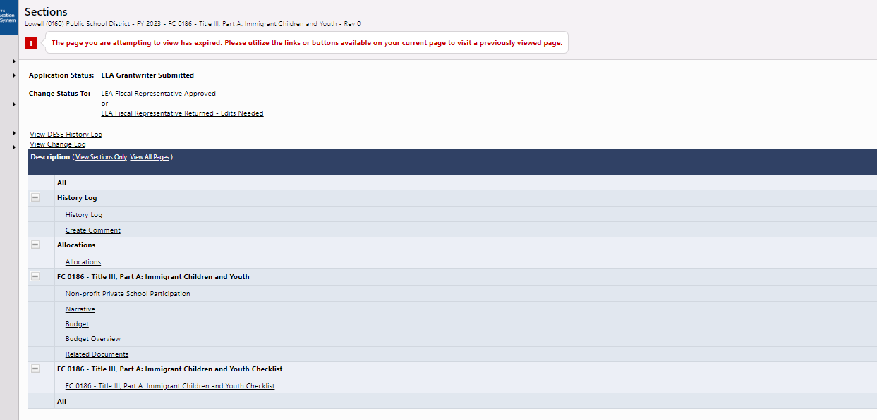
Reviewing Budget Functionality in GEM$ (cont’d)
  When you open the grant that you want to review, you will see the “Sections” page, which is the table of contents for a funding application.
    Navigate to the Budget or Budget Overview

Slide 24
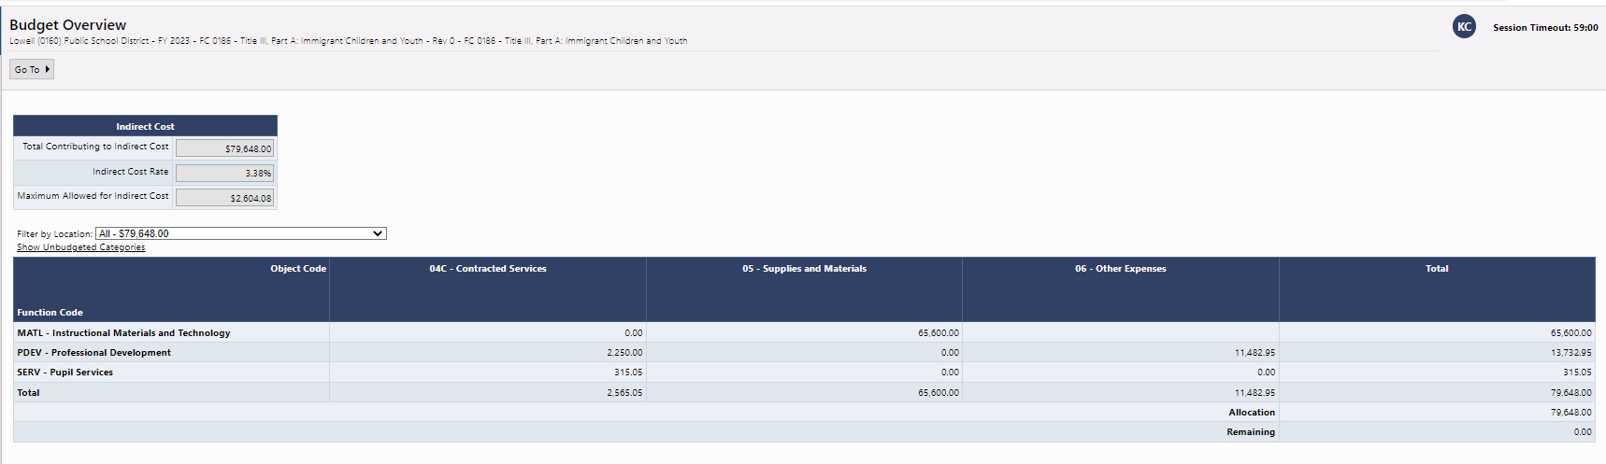
Reviewing Budget Functionality in GEM$ (cont’d)
  The Budget Overview gives you a big picture view of the budget by Function (down the first column) and object (across the top) codes.
    Default view shows only objects and functions that contain a budgeted amount
    Clicking on “Show Unbudgeted Categories” allows you to see all possible function/object combinations

Slide 25
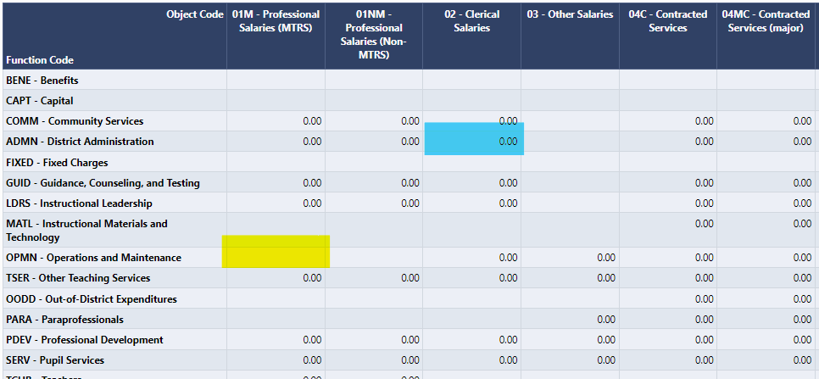
Reviewing Budget Functionality in GEM$ (cont’d)
Not all function/object combinations are available and these may differ by which expenses are allowable for particular grants. Use the Budget Overview to review your choices.
  Blue: If a cell is populated by with an amount,
  even if 0.00, then that function/object is
  available for the grant (here, Clerical Salaries
  for District Administration)
  Yellow: If a cell is completely blank (here
  Professional Salaries for Operations and
  Maintenance) that expense is not available
  for this grant and will not appear in the
  dropdown choices on the Budget page.

Slide 26
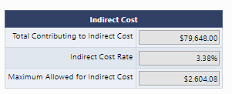
Reviewing Budget Functionality in GEM$ (cont’d)
You will also notice the Indirect Cost box at the top of the page, which keeps a running tab of the maximum allowable indirect cost that each grantee may claim

Slide 27
  GEM$ has a few special object and function codes that track items peculiar to grantmaking
MTRS – Massachusetts Teacher Retirement System Surcharge
Function Code | Object Code | Explanation
MTRS | 09 - MTRS | For federal grants only. Regulations require a 9% surcharge on salaries paid from federal grants to members of the Massachusetts Teacher Retirement Board. The 9% surcharge is budgeted in this Function/Object combination. You will need to track 9% of these expenditures, although there is a validation that will prevent you from submitting a budget that incorrectly budgets the 9% and will tell you what the correct amount is.
Numerous function codes; see Budget Overview | 01M – Professional Salaries MTRS | For federal grants only. In order to calculate the 9%, salary expenditures for MTRS need to be budgeted in the 01M Object code for the appropriate function. You will need to track 9% of these expenditures, although there is a validation that will prevent you from submitting a budget that incorrectly budgets the 9%.

Slide 28
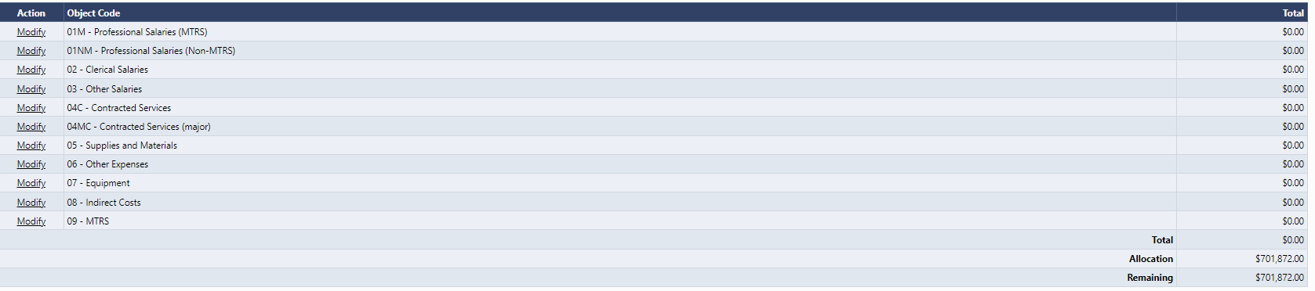
Anatomy of a Budgeted Item in GEM$
The Default View shows you Object Codes as an entry point:

Slide 29
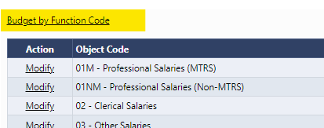
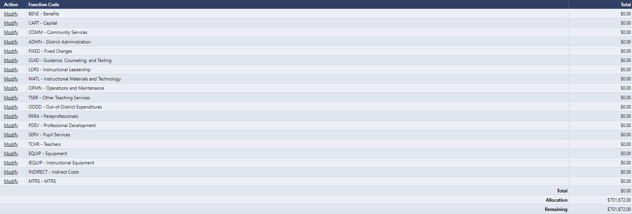
Anatomy of a Budgeted Item in GEM$ (cont’d)
Select “Budget by Function Code” to see the functions as an entry point:

Slide 30
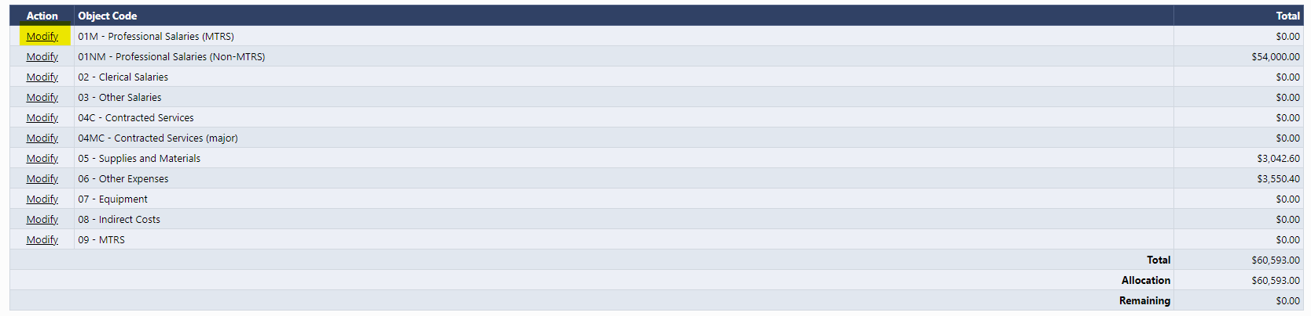
Anatomy of a Budgeted Item in GEM$ (cont’d)
In either view, choose “Modify” to enter an expense.
Note that this view shows your allocation for this grant, how much you have budgeted, and how much remains to be budgeted.
.

Slide 31
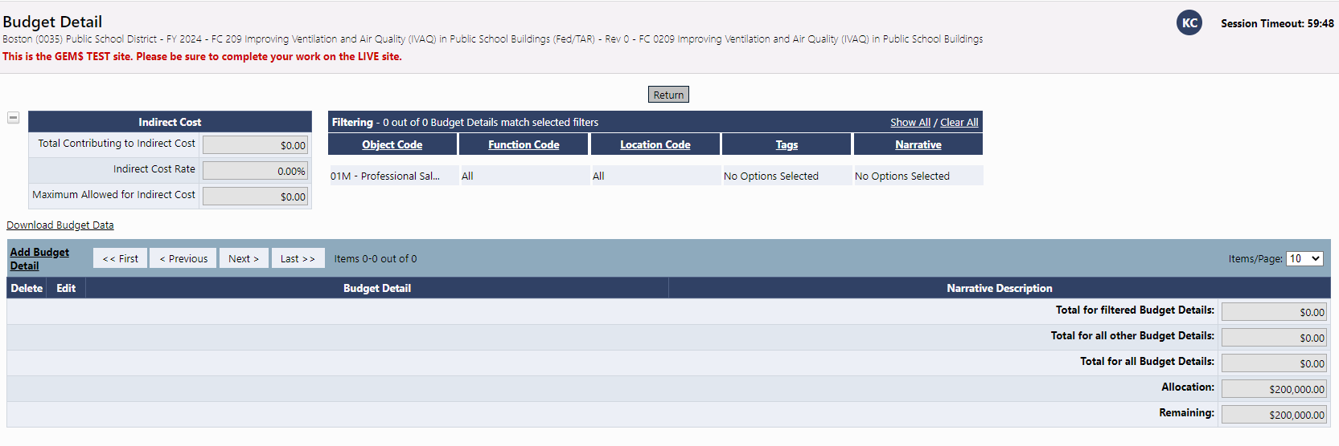
Anatomy of a Budgeted Item in GEM$ (cont’d)
When you click on “Modify” you will get the “Budget Detail” screen. Most important is the “Add Budget Detail” link.

Slide 32
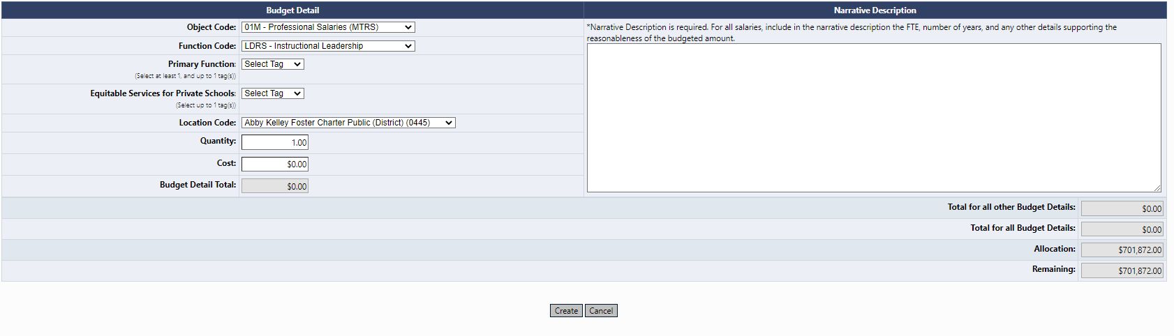
Anatomy of a Budgeted Item in GEM$ (cont’d)
1
6
2
3
4
5

Slide 33
Anatomy of a Budgeted Item in GEM$ (cont’d)
Adding a Budget Detail (see previous slide for numbered screenshot):
Items to provide | Comments
1. Object and Function Codes | Even if you click “Modify” for a particular object code, you have the ability to change to a different object code when you get to the Create Budget Detail page.
2. Budget Tags | Allows DESE to collect needed information about each expenditure via dropdowns. Not always required (see parenthetical) for each expenditure.
3. Location Code | Defaults to the district, but also allows budgeting at the school level as an option.
4. Quantity | This multiplies by the cost cell to get a Budget Detail Total. You may use a quantity of one and then explain/itemize in the narrative box.
5. Cost | Cost per item.
6. Narrative Description | Required for all expenditures. Tell us about the expenditure, FTE, over how many years (e.g., salary for 2 years for 4 FTE). Add information that allows reviewers to make determinations that the expense is reasonable, allowable, and necessary.

Slide 34
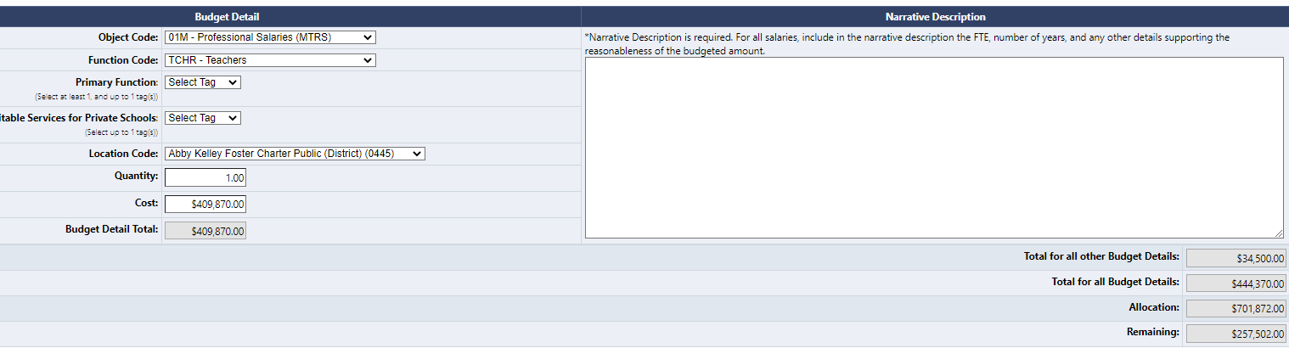
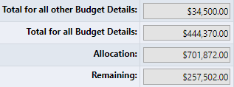
Anatomy of a Budgeted Item in GEM$ (cont’d)
These boxes show:
What you’ve budgeted already
The total of this expense plus those already budgeted
Your total allocation
What remains unbudgeted

Slide 35
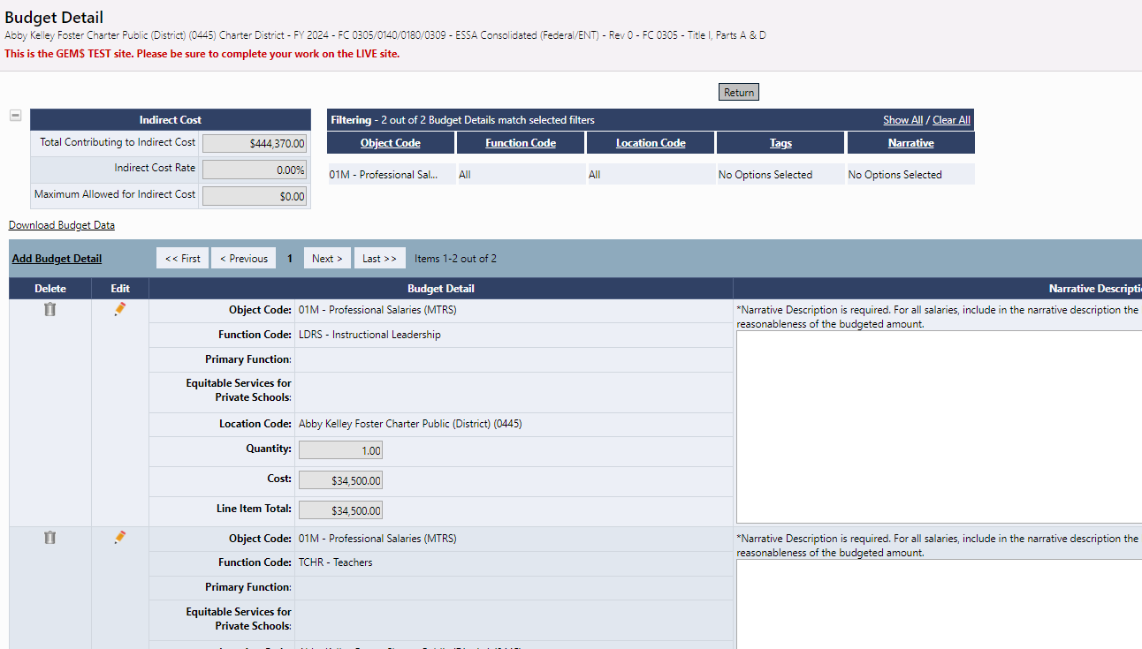
Anatomy of a Budgeted Item in GEM$ (cont’d)
Robust Filtering Offers Many Ways to Review Your Budgeted Expenses
You can filter all expense by:
Object Code
Function Code
Location Code
Budget Tags
Narrative (missing)
Or any combination
of the above

Slide 36
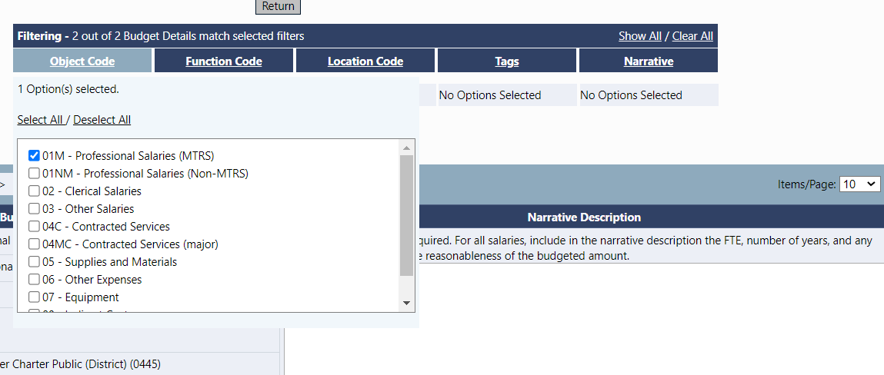
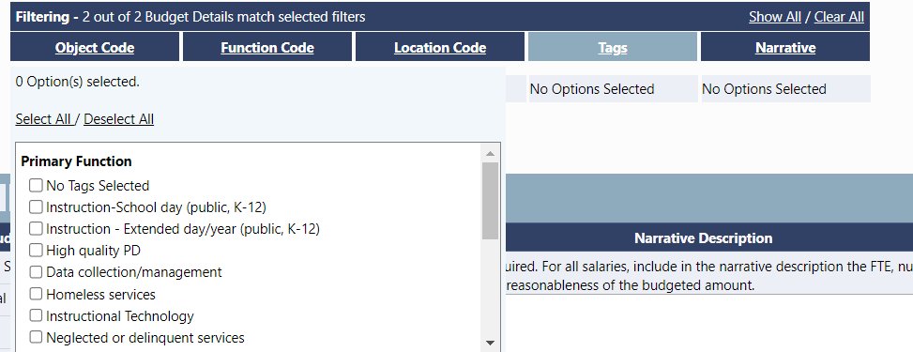
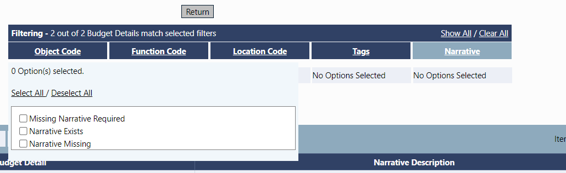
Anatomy of a Budgeted Item in GEM$ (cont’d)
Filtering options

Slide 37
Validations
GEM$ has many validations built into the system that will not allow a funding application to be submitted until errors have been corrected.
Fiscal validations include:
  Budgeting more or less than a district’s allocation
  Forgetting to complete required budget details
  Over- or underbudgeting MTRS
  Overbudgeting indirect costs

Slide 38
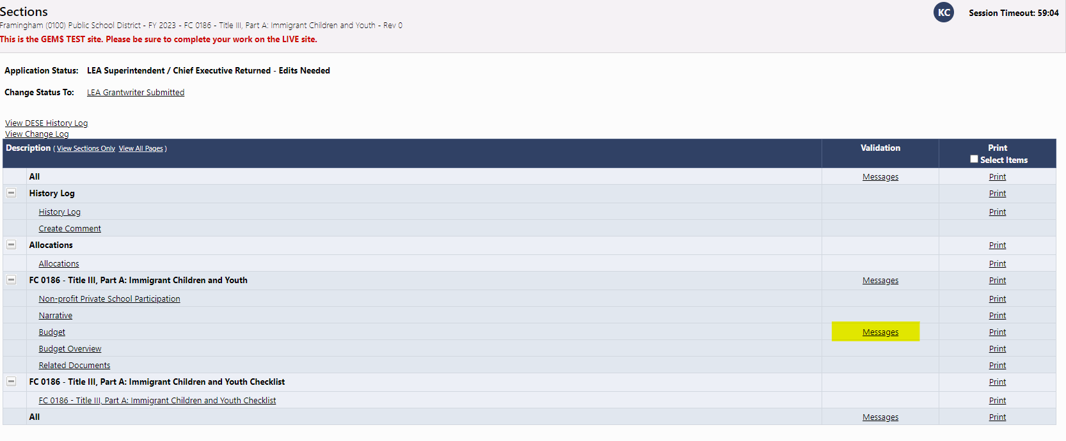
Validations (cont’d)
Error messages appear on the “Sections” page:

Slide 39
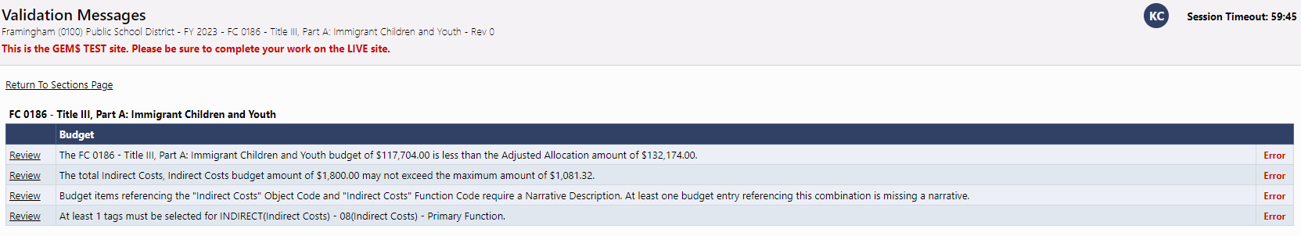
Validations (cont’d)
Clicking on the “Messages” tells you where and what the problem is:

Slide 40
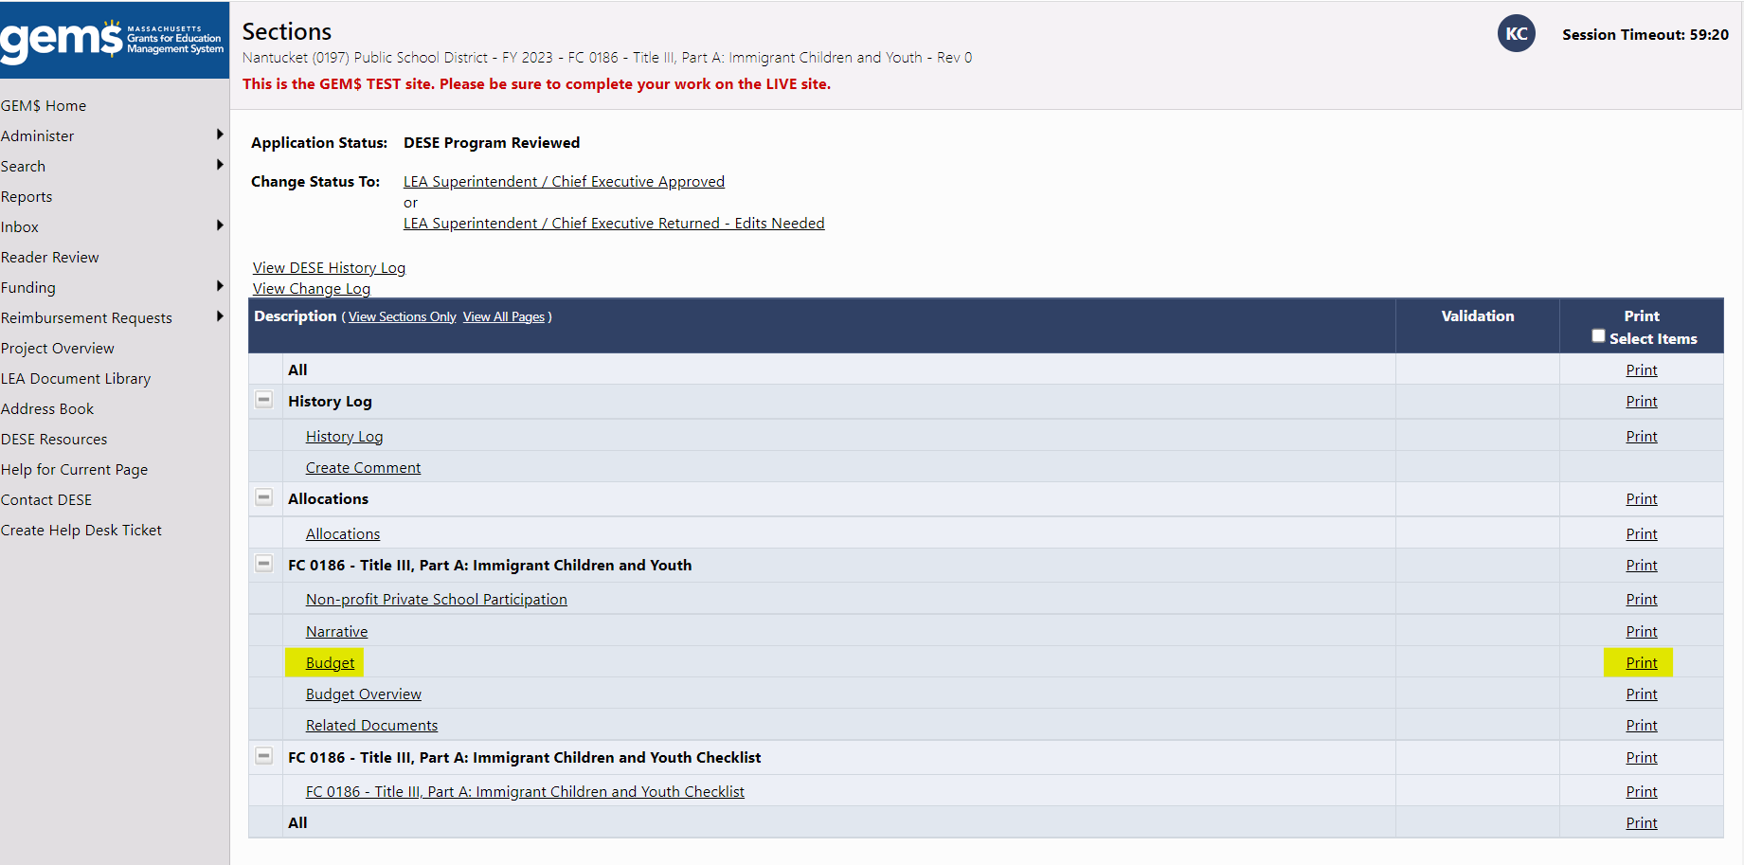
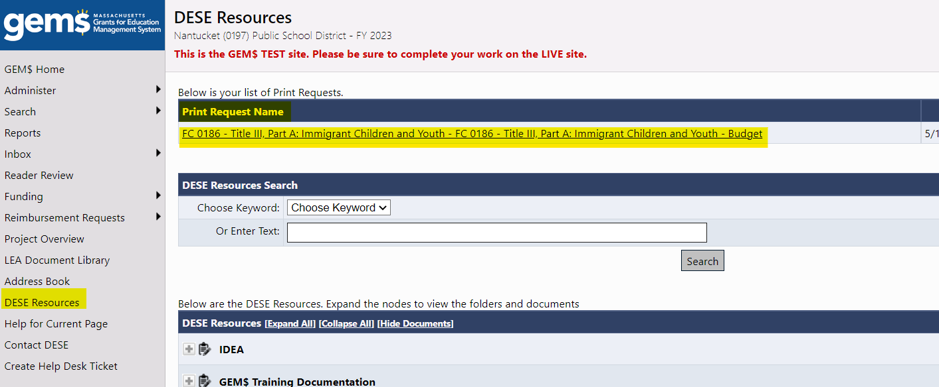
Printing
Printing of any page or all pages, including the Budget, can be done from the Sections page:
A pdf is generated, which may
show up in the DESE Resources
page (select from the left menu)

Slide 41
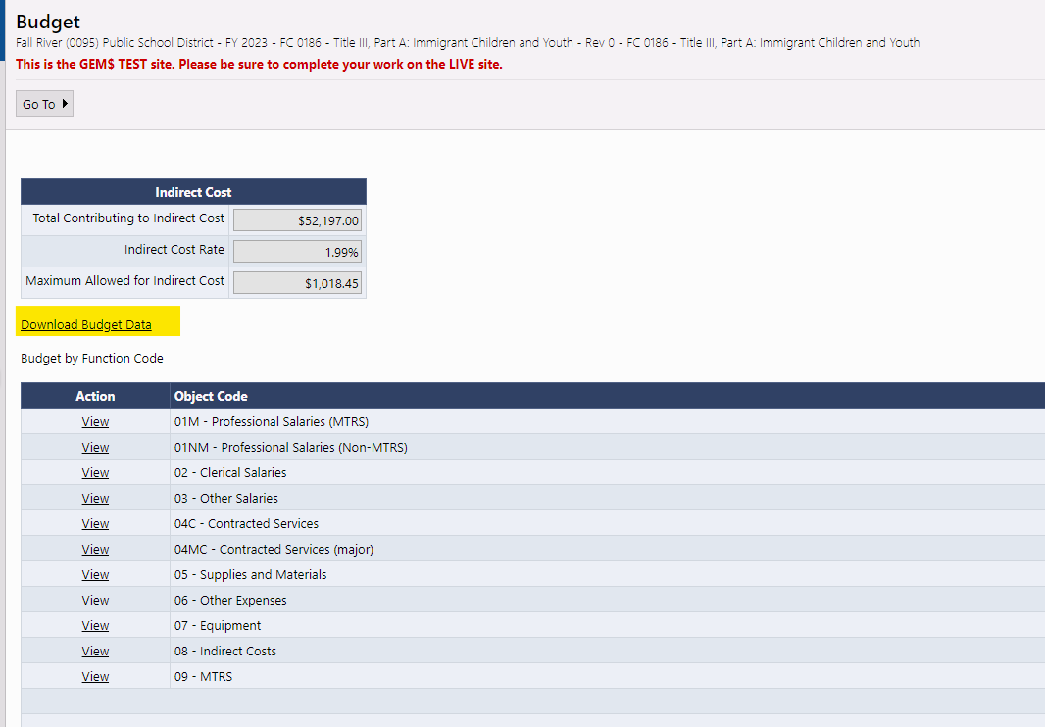
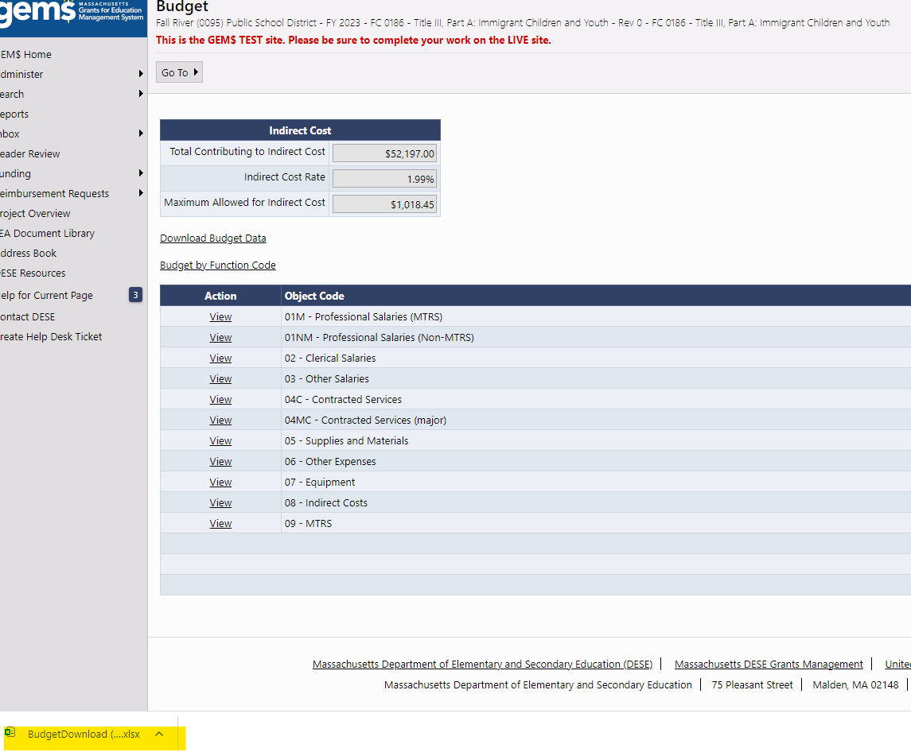
Downloading (and Uploading)
Additionally, budgets can be downloaded as an Excel spreadsheet from the Budget page.
The Excel Spreadsheet is generated in a new tab that appears at the bottom left of your screen:

Slide 42
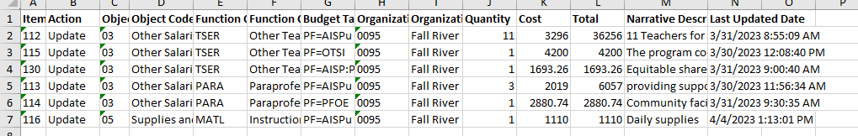
Downloading (and Uploading) (cont’d)
The Excel Spreadsheet contains all of the items entered for each budget detail created:
Once we have at least a year of experience with the new system, we intend to begin deploying the GEM$ functionality that allows applicants to upload budgets into the system. More to come . . .

Slide 43
3. Questions

Slide 44

Contact Information:
Kathy Cross, Kathleen.Cross@mass.gov
Rob O’Donnell, Robert.F.O'Donnell@mass.gov

Slide 45
Fiscal Policies and Practices in GEM$: Tying It All Together
Reimbursements, Amendments, Obligation, Liquidation, Grant Closeout
GEM$ Conference - Worcester
June 26, 2023

Slide 46
Presenters
Jenn Ahern, Supervisor, Grants Management
Kathy Cross, Federal Programs Coordinator, Resource Allocation Strategy and Planning

Slide 47
Overview: Reimbursement Requests in GEM$

Slide 48
Grant Reimbursement Requests
  Reimbursement based on line-item expenditures
    No longer entering lump request amount, reimbursement will be based on reported expenditures (GEM$)
  Access to request reimbursement once the grant has been approved (GEM$)
    No payment request windows
    Final opportunity to draw funds will be in July (most)
    Multi-Year/Carryover grants will allow reimbursement requests through 11/30 of Year 3.
  Grants housed in EdGrants in will follow the old requesting process
    July is the final window to request funds
  Reimbursement requests will adhere to the amendment guidelines
Notes:
You must be an LEA Fiscal Rep to create, edit, and submit reimbursement requests. Other LEA Users will not even see the Create Reimbursement Request link – they can view existing requests but cannot create new ones or edit existing reimbursement requests.

Slide 49
Amendments are Required when:
there is any significant change in program objectives; or
there is any increase or decrease in the total amount of the grant; or
an increase in a line of the budget exceeds $100 or 10% of the line (whichever is greater), or exceeds $10,000
amendment validations will be built into the reimbursement request form
Notes:
Validations – bullet 2 and 3. decrease – reimb request will not allow you to draw more than the new amount;

Slide 50
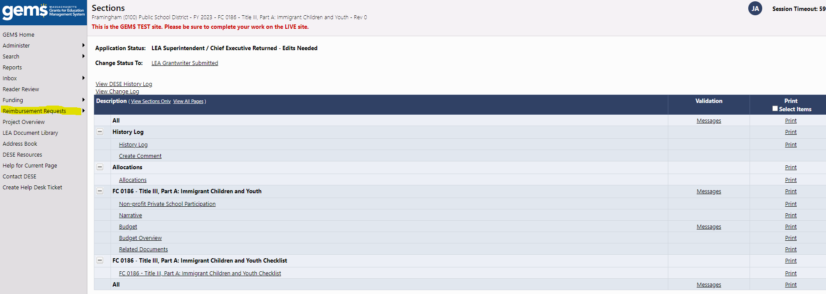
Request Reimbursement
Search> Funding Applications> Select District> Reimbursement Requests

Slide 51
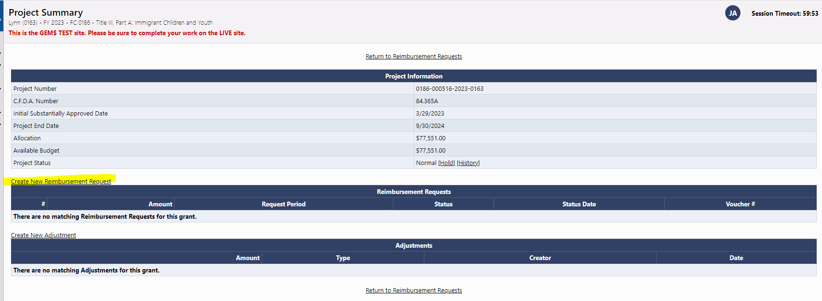
Create Reimbursement Request

Slide 52
Demonstration of Reimbursement Request
DEMO Reimbursement Request
Notes:
Show the hovering/budgeted amount; explain where to find link/link will not be visible if not yet DESE fiscal approved or if the amount is not set to available yet.

Slide 53
Obligation and Liquidation & Grant Closeout Process

Slide 54
Grant Closeout Process
Grants housed in EdGrants will close out in EdGrants
  For example, FY2023 305, 140, etc. will continue in EdGrants until the FR-1 is filed and the grant is closed
  DO NOW: Determine which FR-1s are delinquent and submit asap
GEM$ closeout process will utilize the Financial Expenditure Report (FER)
  Financial Expenditure Report (FER) will allow for one final reimbursement if filed by 8/25. (most)
  Financial Expenditure Report (FER) will allow for one final reimbursement if filed by 12/31 (multi-year/carryover)
Notes:
Take inventory of which FR-1s need filing; contact GM if the FR-1 is not allowing entry – these steps expire.

Slide 55
Grant Closeout Process Cont.
FER will allow for one final reimbursement request based on reported expenditures provided it is submitted on or BEFORE 8/25.
Grant Award Notification (GAN) will include important dates!

Slide 56
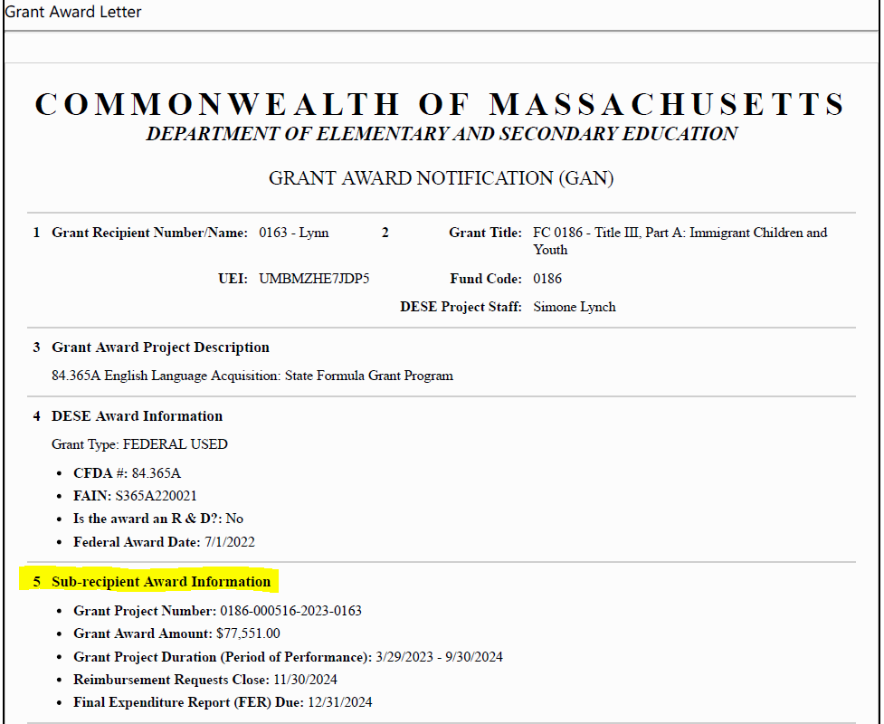
Grant Award Notice (GAN)
Notes:
Section 5 has all the important info! Dates! Amount! Increases will show here as well.

Slide 57
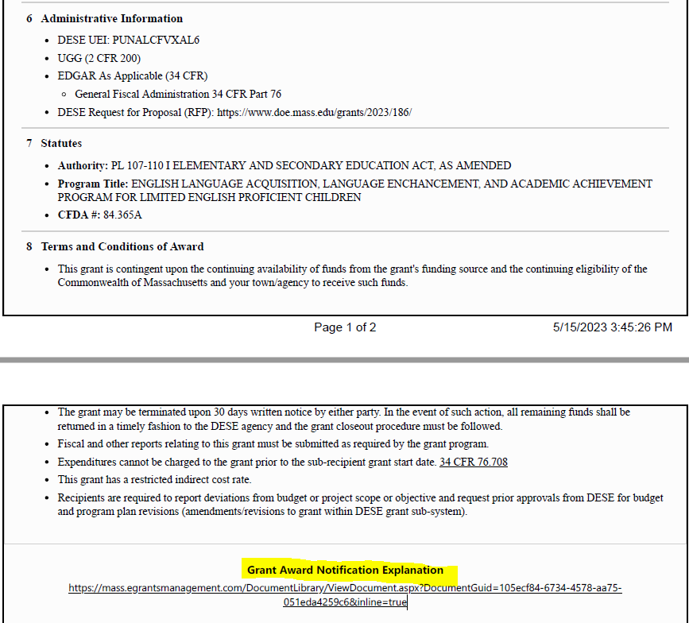
GAN Cont.
Notes:
GAN explained link

Slide 58
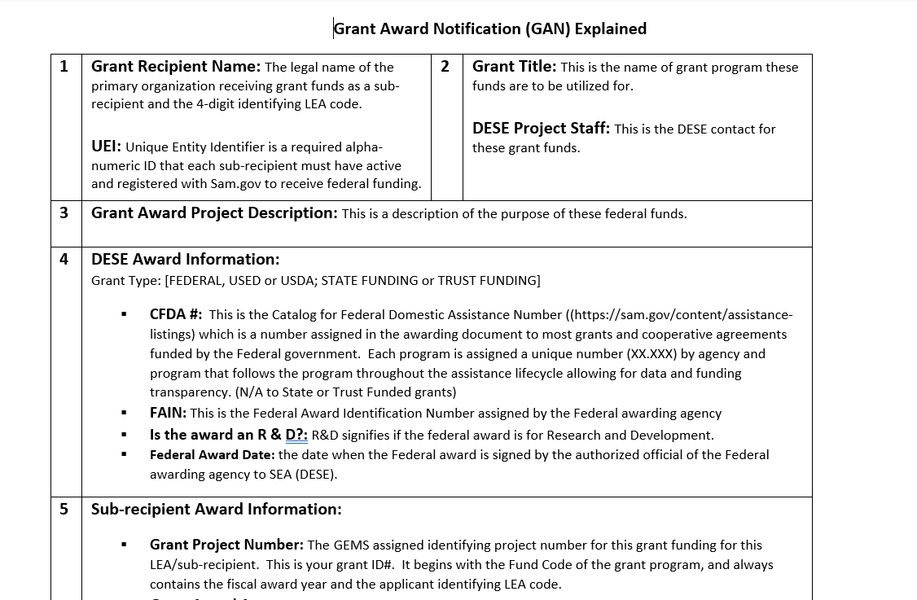
GAN Explained document

Slide 59
Obligation and Liquidation for Federal Grants
Best Practice = Obligate and Liquidate before the grant deadline.
Deadline for obligation depends on type of expense:
If the obligation is for: | The obligation is made:
Acquisition of real or personal property | On the date on which the State or subgrantee makes a binding written commitment to acquire the property.
Personal services by an employee of the State or subgrantee | When the services are performed.
Personal services by a contractor who is not an employee of the State or subgrantee | On the date on which the State or subgrantee makes a binding written commitment to obtain the services.
Performance of work other than personal services | On the date on which the State or subgrantee makes a binding written commitment to obtain the work.
Public utility services | When the State or subgrantee receives the services.
Travel | When the travel is taken.
Rental of real or personal property | When the State or subgrantee uses the property.
A pre-agreement cost that was properly approved by the Secretary [of Education] | On the first day of the grant or subgrant performance.

Slide 60
Obligation and Liquidation for Federal Grants (cont’d)
For contracts for services/goods, if necessary, grant recipients may take up to 90 days past the grant deadline for performance of the contract.
If you are not sure of deadlines, check your GAN!
Quick Reference Guide for Obligation/Liquidation: https://www.doe.mass.edu/federalgrants/resources/obligation-performance-liquidation.docx

Slide 61
Late Liquidation Requests for ESSER II
The United States Department of Education will be entertaining requests for late liquidation of ESSER II (CRRSA) expenses for up to an additional 14 months
  Requests need to be made on an expense-by-expense basis
  Each extension request must be justified
    Merely needing more time to spend funds is not adequate
    Justifications may include pandemic-related supply and labor shortages
    Continuity of services through the end of a school year
  Proof that the expense was properly obligated by the grant deadline (9/30/23) will be collected
  Requests will be made and documents uploaded in GEM$ as an Application Supplement (will be announced when open)
  DESE will send all properly documented and justified requests for extension to USED
  There is no guaranty that USED will approve all requests that are submitted

Slide 62
Questions

Slide 63
Contact Information:
Jenn Ahern, Jennifer.M.Ahern@mass.gov
Kathy Cross, Kathleen.Cross@mass.gov

