Slide 1
GEM$ and EdGrants: An overview of how to maintain multi-year grants that began in EdGrants, and how to transition from EdGrants to GEM$
Grants Management Staff
Melissa Williams
Linda Brandon
Alycia Royer

Slide 2
Transitioning from EdGrants to GEM$
There is NO automatic process to transition grants originally housed in EdGrants to the new system: GEM$
For a time, users will toggle between two systems until all the grants in EdGrants expire
Clarification on where the grant is housed can be found in the RFP posting
All grant activities that originated in EdGrants need to be completed in EdGrants (Amendments, Request for Funds, FR-1 filing)

Slide 3
Payments
Continue to draw funds via EdGrants for grants housed in EdGrants
Multi-year grants will continue to have separate Year 1, Year 2 and Year 3 windows
Final payment request window is July 20-31 for ALL grants except multi-year entitlement grants which have a brief August window

Slide 4
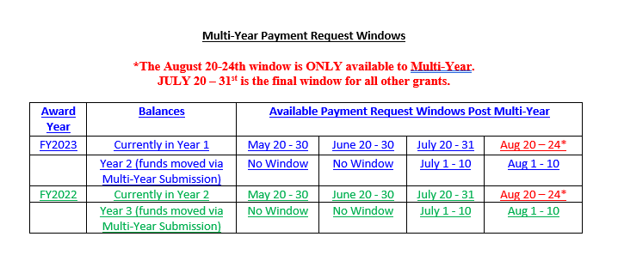
Multi-Year Entitlement Payment Request Windows

Slide 5
Final Report (FR-1) in EdGrants
Grants that originate in EdGrants MUST close out in EdGrants with submittal of a Final Report (FR-1)
Final Reports are due 60 days after the end of the grant project duration
Draw all funds needed prior to filing FR-1 and wait for the payment to clear before filing
DO NOW: Verify that all FR-1s for past fiscal years have been submitted (you can confirm if the FR-1 was successfully submitted if you see a timestamp next to the formlet in EdGrants)
Notes:
Final reports are due to be submitted 60 days after the project ends and are available the day after the grant ends. IF you have expended your funds before that period and it has been 60 days, you can call the mainline and we can release that FR1 to you.
The sooner they close out in EdGrants the sooner they can trasions over to GEM$.

Slide 6
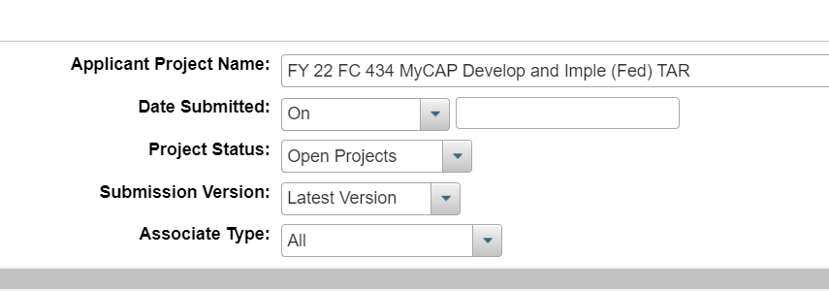
Final Report (FR-1) in EdGrants
To submit a Final Report, login to EdGrants Front Office and navigate to Submissions
Filter by desired project:

Slide 7
Final Report (FR-1) in EdGrants
Scroll down until you see Final Financial Report (FR-1) and click on the orange folder to open (Reminder: some grants will have multiple pages so click through until you see Final Financial Report):
Notes:
You may want to add that some of them have TWO pages so they might want to navigate to page TWO to find the FR1.

Slide 8
Final Report (FR-1) in EdGrants
Ensure information in Financial Report Summary is accurate and upload a signed FR-1 in Attachments section. Once complete, hit Submit on Submission Summary page.

Slide 9
FR-1 Due Dates
FR-1s are due 60 days after the end date of the grant:
State funded grants end on 6/30/2023 and are due by 8/31/2023
Federal funded grants (not multi-year) end on 8/31/2023 and are due by 10/31/2023
To check on end date see the RFP or the Project Record Card click on the magnifying symbol in the view column

Slide 10
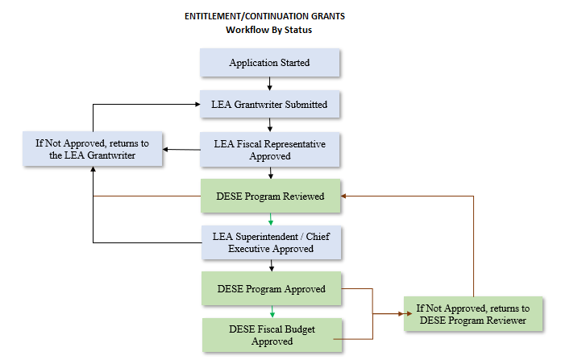
GEM$: User Access
LEAs will manage an assign their own user access.
User Access Administrator for each LEA
The address book within GEM$ will display user information for that organization

Slide 11
GEM$ General Reminders
There is NO Part I Signature Page in GEM$. The grant submission by the district level authorized personnel serves as the new signature page
Start date in GEM$ will be based on when the LEA Fiscal submits the grant (for non-competitive grants)
New budgets will align with the chart of accounts (COA) used in end of year report (EOYR)
Other organization types can use the COA tool – we are all learning this together! ☺

Slide 12
EdGrants vs GEM$
GEM$
DESE will not release an initial 10% payment. Grantees have access to the full grant award once grant has been DESE Fiscal approved
Once a payment is processed and issued, grantees can request additional funds immediately (not held to the monthly payment window like in EdGrants)
Reimbursement requests are based on budget line-item expenditures
Allows for expenditure transparency
EdGrants
DESE releases 10% Initial payment automatically to grantees
Grantees can only request funds during monthly payment request windows
Notes:
Another in-depth will held on payments later in the day.
a request of a line of the budget exceeds $100 or 10% of the line (whichever is greater), or exceeds $10,000 will prevent them from drawing down. They can draw what they need and file an amendment.
amendment validations will be built into the reimbursement request form

Slide 13
Transitioning Multi-Year Grants from EdGrants to GEM$
Multi-year grants in EdGrants will still access the monthly payment request windows (20th of the month through the last day of the month)
Multi-year grants in EdGrants will continue until the award expires.
Multi-year grants in EdGrants will use the FR-1 to close out the grants.
Notes:
NOTES: Remind the MY are the federal entitlement carryover grants – that’s it.
IF they ask abut ESSER Grants in EdGrants those will be in EdGrants. We do not anticipate them releasing this in FY24.

Slide 14
Transitioning Multi-Year Grants from EdGrants to GEM$
FY24 NEW award multi-year consolidated grants will go live in GEM$
All reimbursement requests, amendments/revisions, and grant closeout (Final Expenditure Report) will occur in GEM$

Slide 15
How to Reach Us
Via email – edgrants@mass.gov
Via phone – 781/338-6595

Slide 16
Questions

