Slide 1
ISAs
GEM$ & EdGrants
Presenters:
Eric Souza, Grants Management
Donna Shannon, Director of Financial Planning

Slide 2
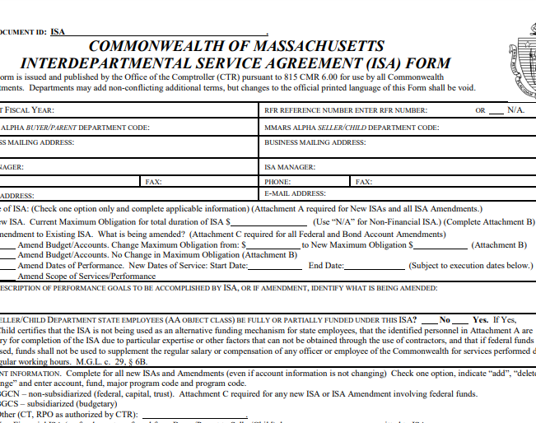
Why?
ISAs are required to be completed any time a program unit awards grant funding to State agencies (i.e., Sherriff’s departments) or State Community Colleges or Universities.
ISAs are initiated by grants management once there is a program approved grant that includes an ISA crosswalk in the grant queue for processing.

Slide 3
State Agency vs College/University ISAs
  There are two different ISA crosswalks based on applicant type:
    ISA crosswalk for State Colleges and Universities and
    ISA crosswalk for State agencies & Correctional Facilities
  Crosswalks are posted HERE: https://www.doe.mass.edu/grants/edgrants.html

Slide 4
State Agency vs College/University ISAs – how do they receive the funds?
State Agencies get true ISAs:
  This means a BGCN (for federal accounts) or BGCS (for state accounts) is entered onto MMARS for them by the Budget Office once they receive an approved and signed ISA document.
  These entities get the full award deposited into their ISA-child account and they expend against the object classes accordingly.
  To make changes to the object class amounts in their account, they must file an amendment to their ISA. In order to file an ISA amendment, they must first file an amendment in EdGrants or GEM$ so that program staff can approve and authorize their requested changes. The amendment will then trigger an amended ISA once GM gets to it in the queue.

Slide 5
State Agency vs College/University ISAs – how do they receive the funds?
State Colleges and Universities are not true ISAs:
  This means a CT (encumbrance) is set up on MMARS
  Grants Management is required to maintain a record of the ISA documentation that is retrievable in case of audit.
  Once your grant is Fiscally Approved in GEM$ you can begin to draw down your funds.
  For those still drawing in EdGrants:
    The applicants are responsible for drawing their funds down monthly in EdGrants as they expend their funds.
    Payment request windows are open the 20th of the month through the last day of the month and are available as long as the applicant has received the initial payment.
    Final opportunity to draw funds is July 20th – 31st for 2023 in EdGrants

Slide 6
Timelines
For state funded ISAs, we need to ensure that we have sufficient funding by MMARS object class to issue to child agencies or else, we need to ask ANF to process budget transfers. Since the budget transfer request can take weeks for ANF to approve, we need all the state funded ISA budget information to be ready by mid-June to enable us to have the budget transfer approved in time to issue ISAs for a 7/1 start date. This is especially important if the ISA grant funds payroll expenses.

Slide 7
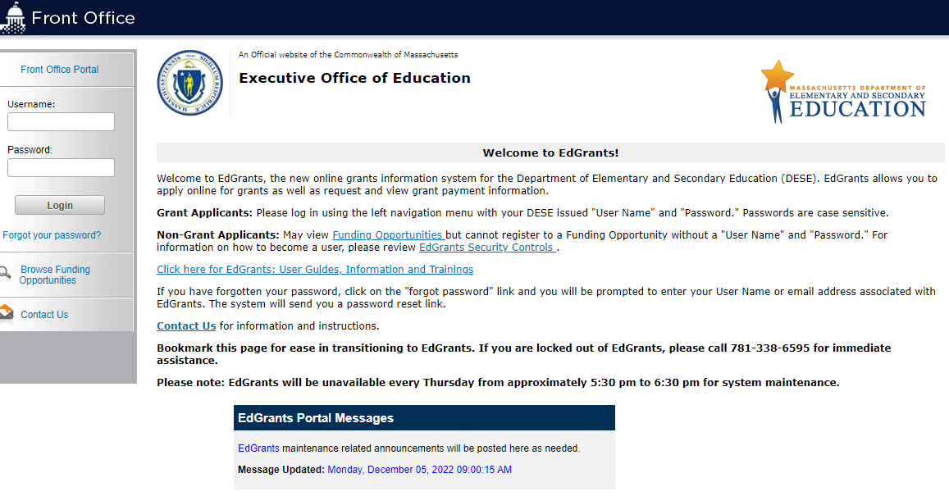
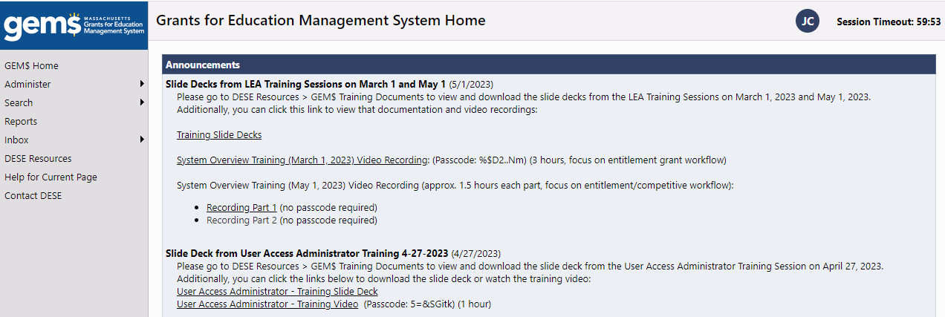
EdGrants vs GEM$
Old
New
Notes:
Check old FR1 in EG to make sure it done

Slide 8
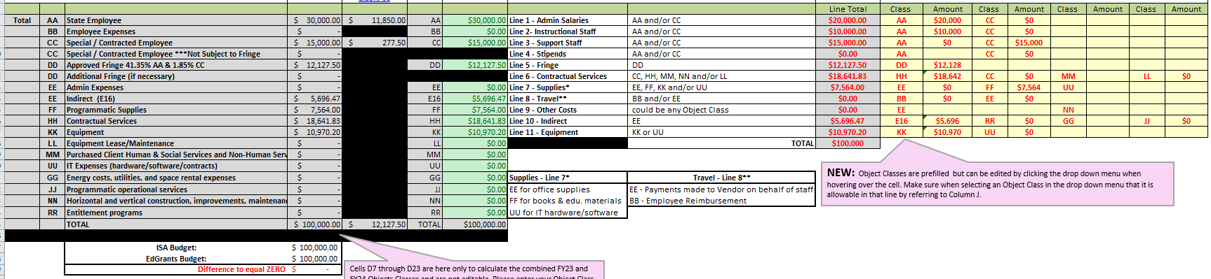
ISA Crosswalk For FY23 and earlier grants
  The ISA crosswalk was developed as a tool to help:
    grantees translate the Grants Budget into an ISA Budget

Slide 9
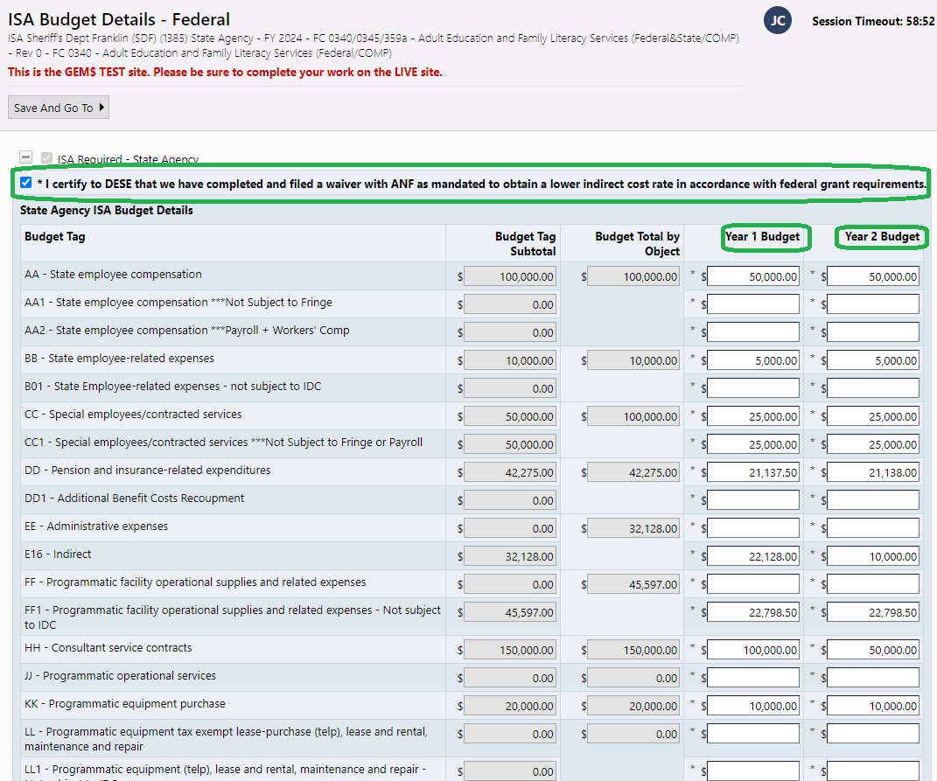
ISA For FY24 in GEM$
Crosswalks will be built into the "budget entry" and will NO LONGER be an attachment
Waivers will be certified by a checking off the highlight statement.

Slide 10
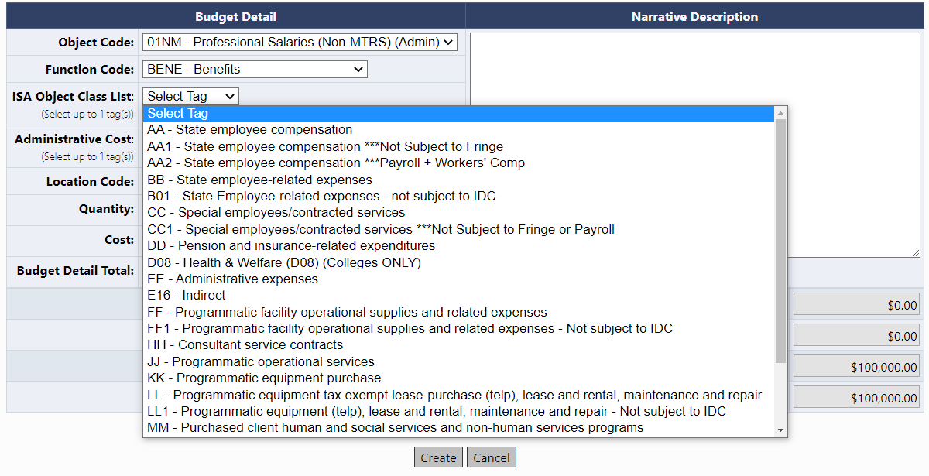
Tagging the budget with the ISA Object Class Code

Slide 11
Differences
College
County Houses Of Correction (CHOCs)
Simpler because funds are drawn down in EdGrants. No need to separate budget by year.
Multi year budget
Ensures funds are available in MMARS past 6/30

Slide 12
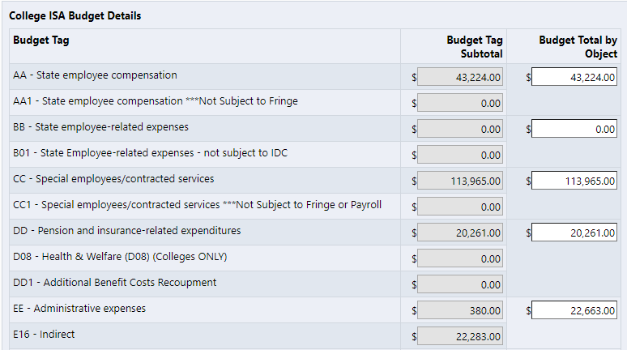
College

Slide 13
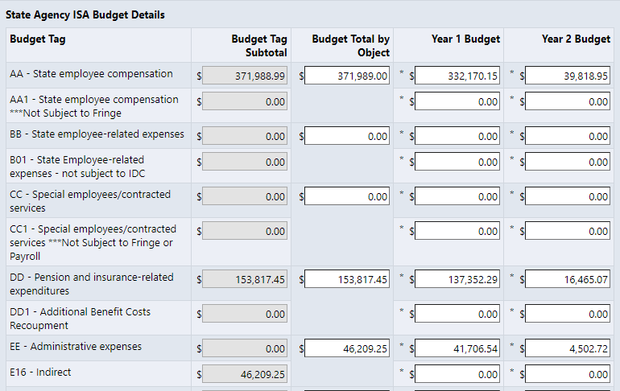
CHOC

Slide 14
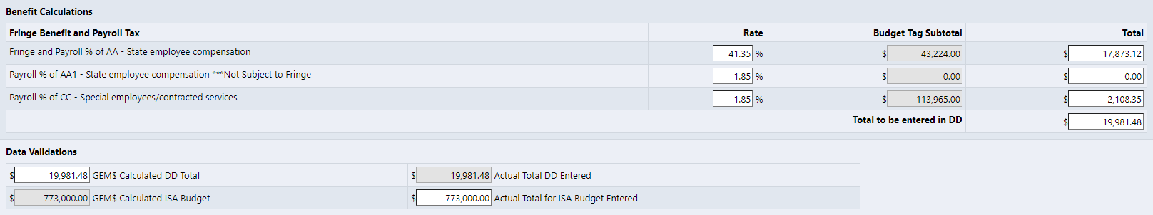

Approvable vs Not Approvable - Fringe
Approvable
Not Approvable
Notes:
You can go over the GEM$ calculated DD, but not less

Slide 15
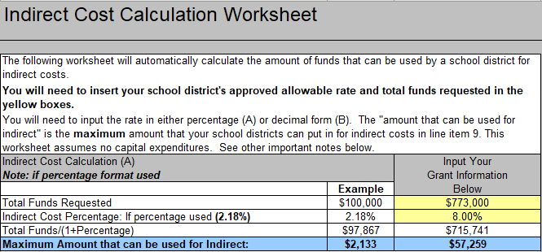
Indirect – How GEM$ Calculates It
Old Way (EdGrants)

Slide 16
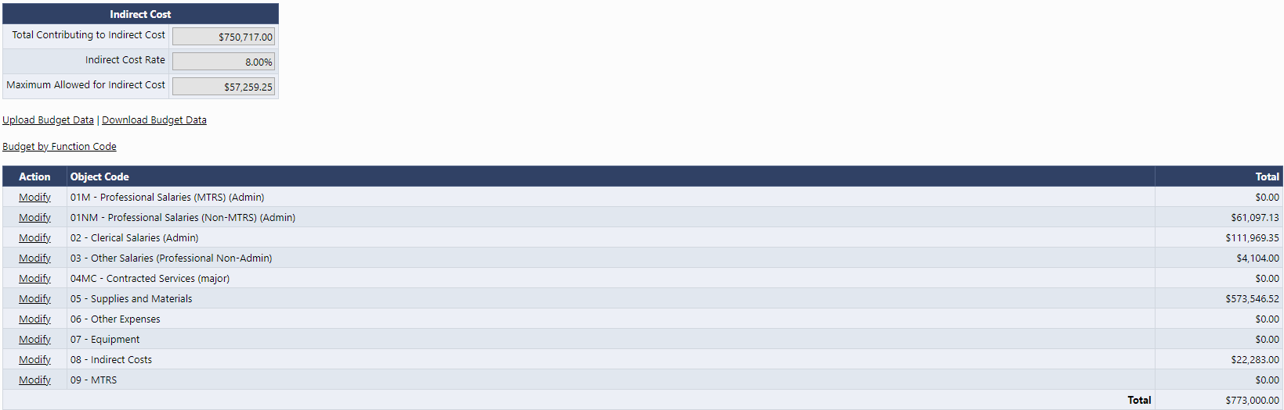
Indirect – How GEM$ Calculates It
GEM$

Slide 17
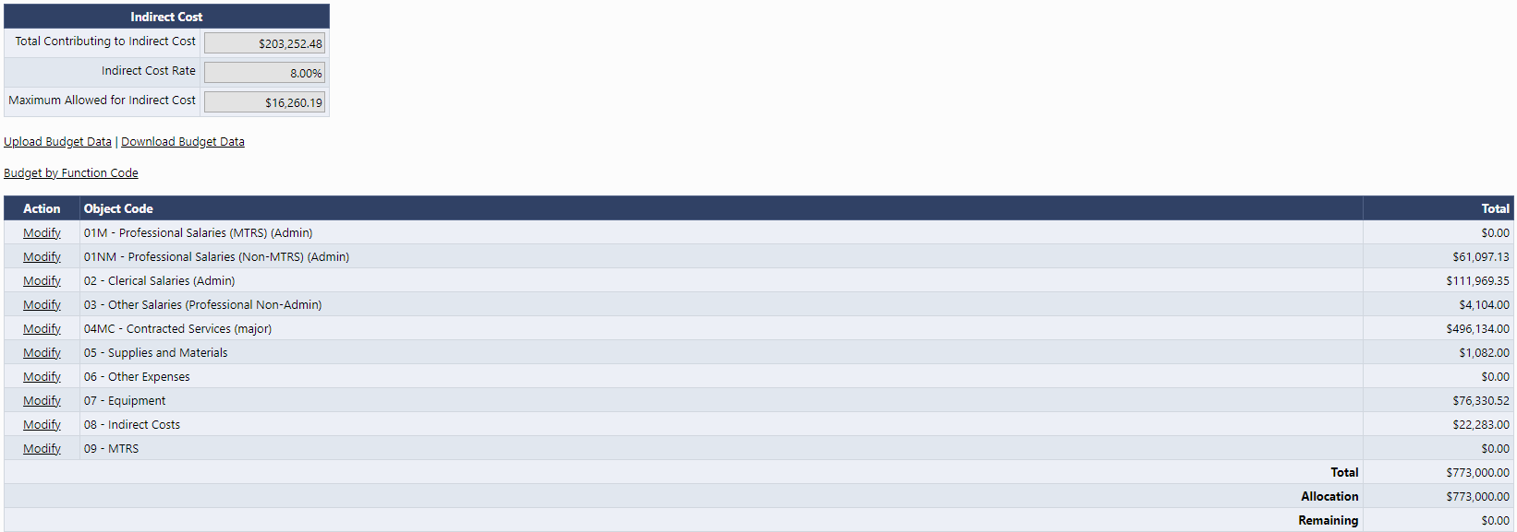
Indirect – How GEM$ Calculates It
Contracts Over $25K & Equipment

Slide 18
What this means?
Colleges
CHOCs
The indirect rate determines the max amount you can charge to indirect
For EdGrants: use indirect calculator to easily determine this #
For GEM$: as shown indirect is going to calculate at the top of the budget based on direct costs budgeted
This is the minimum amount you can budget.
This budget line is not available to draw and is "kept" by comptrollers
This # is determined by your Federal rate (link to comp) and the restriction placed by the funding
Example: Perkins (FC452) is 5%
Notes:
State Universities and Colleges for FY24 can budget for indirect costs using the FY23 approved rate listed on the DESE website.
Still be required to reapply for an approved indirect rate each Fiscal Year. The FY24 indirect cost application has been posted.

Slide 19
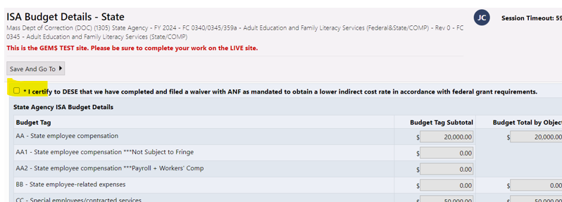
Indirect Cost Rate: State Agencies and Waivers
Adult Basic Ed grants have an 8% indirect cap.
Perkins Grants have a 5% admin cap, which is inclusive of indirect.
State Agencies receiving ABE or Perkins funds MUST file a waiver with Administration and Finance (ANF) so that Comptroller (CTR) reduces the auto-indirect rate applied to these grant funds in MMARS.
Once the waiver is approved by ANF, the state agency grant recipient MUST send a copy of the approval letter to CTR ASAP.
Notes:
**In the past Julia has said the filed waiver is enough for us to move forward and we do not need the actual approval letter.

Slide 20
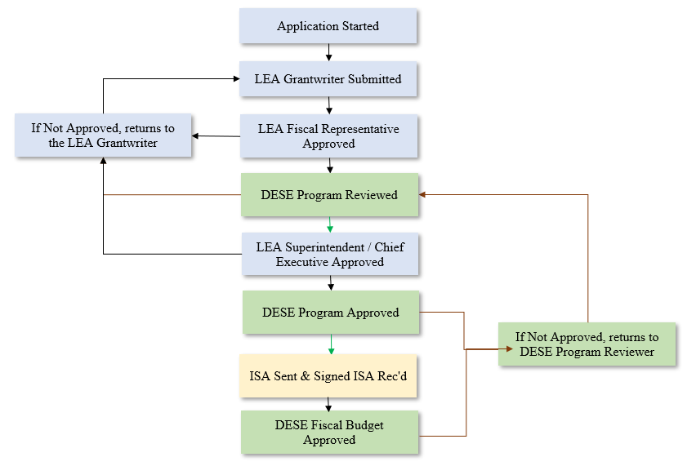
Workflow
Notes:
Note the name change for Superintendent/Chief Executive
The “User Access Administrator” (Mandatory) has control over all users in his/her district. This role’s responsibilities include keeping records of all district staff with designated roles in GEMS, which roles each holds, and de-activating access to GEMS within 24 hours of staff with a role(s) leaving employment with the district or moving to a position where GEMS access is unnecessary.
The “Grantwriter” (Mandatory) role will be designated for each grant. Multiple staff may be designated for this role for each grant, and each staff member may be given the role for multiple grants. The role is primarily responsible for completing the initial application, which will then be reviewed by the LEA Fiscal Representative.
The “LEA Fiscal Representative” (Mandatory) will most often be a business official, treasurer, or bookkeeper in the district who works with all funding applications. Multiple people, likely in the business office, may hold this role for a district. This role can edit/submit one or more funding applications and is the first level of approval for all applications (after receiving from the LEA Grantwriter). As part of this role’s responsibilities, the Fiscal Representative should review the budget expenditures to ensure they are allowable, as well as appropriately budgeted, including the correct object, function, and indirect expense categories. This role also can create and submit Reimbursement Requests.
The “LEA Superintendent/Chief Executive” (Mandatory) is most often the district Superintendent and his/her authorized designee(s). This role approves all funding applications, and for entitlement grants, including the Immigrant grant, will approve the grant after it has initial approval from the DESE Program Reviewer (see attached workflow chart). Approval by the LEA Superintendent or his/her authorized designee indicates that the Superintendent has read and approved all information contained in the grant and agrees to abide by all laws, regulations, and guidance applicable to the grant program.
The “LEA<Grant Name> Update” (Optional) role allows this person to edit a funding application but not submit to the next level. This role is most likely held by someone assisting the LEA Grantwriter, but not designated to move the application ahead to the LEA Fiscal Representative for approval.
An “LEA Data View” (Optional) role can view virtually anything in their district (no other districts), but cannot make changes to any application.
A person may have more than one role.
A role may be held by more than one person.

Slide 21
ISA Workflow (cont.)
Once the signed ISA is returned by the applicant the DESE Fiscal Approved step is processed.
State agency ISAs – the ISA is sent to Budget Office to set up on MMARS.
Colleges – the CT encumbrance is set up on MMARS.
At the end of the Fiscal Year, an FR-1 is required for all grantees to submit (in EdGrants). State agencies must file FR-1 based on actual expenditures in MMARS.

Slide 22
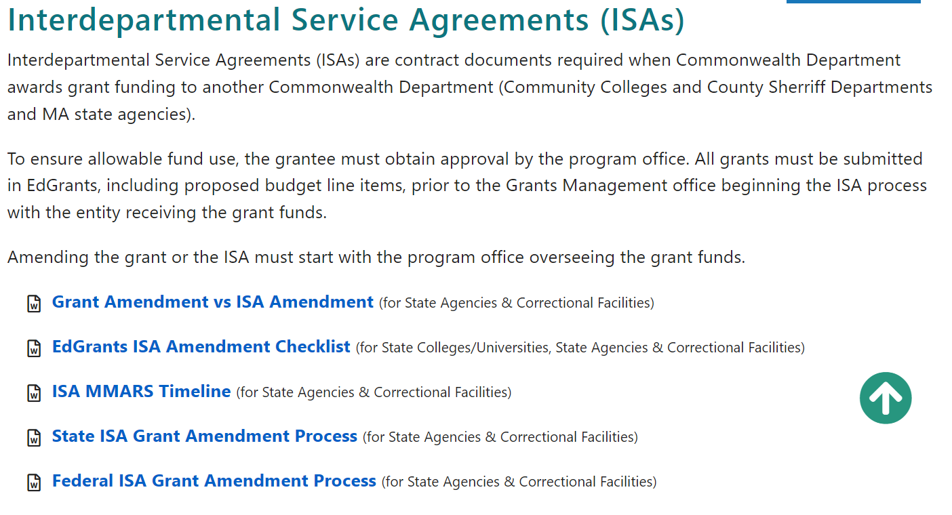
Posted Resources: https://www.doe.mass.edu/grants/

Slide 23

ISA GEM$ Overview / Demo

