Slide 1
Grants Education Management System (GEM$)
Department of Elementary & Secondary Education (DESE)
Training Module 1
General Site Navigation

Slide 2
Agenda
The Purpose of this Training
Users and Roles
  Funding Application Roles
System Navigation

Slide 3
Today’s Purpose
Beginning with grants in the 2023-24 fiscal year, grant applicants will use the GEM$ grants management system to apply for funds for education grants in Massachusetts.
The purpose of this presentation is to train new GEM$ users.
This slide deck and the contents of this training will also apply to funding applications that will go live at a later time.

Slide 4
Entitlement vs Competitive
Entitlement (formula) grants
For entitlement grants, the applicant will know the allocation before beginning to enter responses in the grant. The grantee will submit a budget to reflect the allocation. Examples include Title I, Title II, and IDEA grants.
Competitive grants (for grant competition in GEM$)
For competitive grants, the user will budget and enter data with no allocation designated. If awarded, the grantee will update their budget to reflect their awarded allocation. Examples include 21st Century, CTE Innovative Pathways Planning Grant and CTE Partnership Grant.

Slide 5
Other Grant Scenarios
Competitive Continuation grants include grants in their funding Year 2 (or later) of a multi-year award. In most cases, these grantees are aware of their funding amounts. Allocations are loaded for applicants before they begin to budget.
This scenario also applies to grants that were competed outside of the GEM$ system. Allocations are loaded before users begin entering budget data. Examples include grants for Adult Education (ACLS).
Targeted grants also fall into this category. Allocations are loaded for targeted grants before the GEM$ users complete a budget.

Slide 6
Users & Roles

Slide 7
User Access Training Resources
A detailed training session has been recorded for GEM$ user access and roles. The recording and slide deck are available for download on the home page of the GEM$ system.
To become a GEM$ user, you must be added to the system by a User Access Administrator.
You may locate the name and contact information for your organization’s User Access Administrator in the GEM$ system without logging in.

Slide 8
User Access for Go-Live (2)
To see if your organization has a User Access Administrator (logging in is not needed)
In GEM$, go to “Search > Organization’ and enter the name of your district.
Click on the name of your district.
Use the left navigation menu to access the “Address Book.”
Click on the name of the User Access Administrator to retrieve their email address and phone number.

Slide 9
Funding Application Roles
Every organization must have at least one user with the following roles in order to submit a funding application in GEM$:
LEA Grantwriter
  Users with this role may be an organization’s Program Director, Manager, or Lead Agency Representative.
LEA Fiscal Representative
  Users with this role may be an organization’s CFO, Fiscal Agent, Business Manager, or Bookkeeper.
LEA Superintendent – Chief Executive
  Users with this role may be an organization’s Executive Director, President, Director (signing authority for agency), CEO, Managing Director.
User Access Administrator
User Access Administration

Slide 10
Role Descriptions
Role | User Access Administration | Funding Applications
LEA Data View | None | View
User Access Administrator | Administer | View
LEA Superintendent | None | Edit and Superintendent Approve All Applications
LEA Fiscal Representative | None | Edit and Fiscal Approve All Applications
LEA <Grant Name> Update | None | Edit This Application; View Other Applications
LEA <Grant Name> Grantwriter | None | Edit and Submit This Application; View Other Applications
General Site Navigation

Slide 11
System Navigation

Slide 12
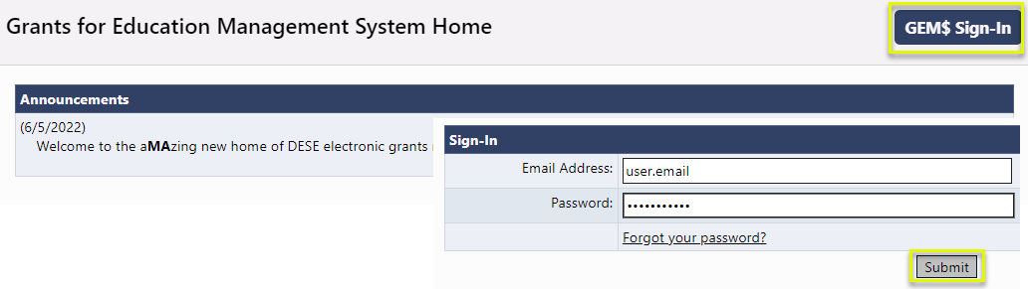
Accessing the System
The GEM$ site URL is https://mass.egrantsmanagement.com/
Click “GEM$ Sign-In.”
Enter your Email Address and Password. Click “Submit.”
When needed, use “Forgot your password?” to reset your password.

Slide 13
The Navigation Menu
Administer – Only available for users with admin permission
Inbox – Users’ record of system emails
Funding – Access to funding applications
Reimbursement Requests – Access to payment requests
LEA Document Library – A collection of documents from LEAs--not tied to funding applications
Address Book – an organization’s list of users with LEA and SEA roles
DESE Resources – A library of training and program guidance documentation (managed by DESE)
Help for Current Page – Page specific instructions
Contact DESE – Information to request system assistance

Slide 14
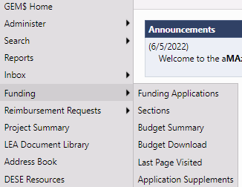
Navigation Menu and Tips
The left menu allows for quick navigation between GEM$ components.
From the menu, hover over menu items with arrows to view sub-menus.
Use GEM$ navigation links; not your browser’s Back button.

Slide 15

Session Timeout
The system timer is located in the
upper right corner of the screen.
The timer is set for 60 minutes.
Users will want to save often so as not to lose data entered when the timer expires.
To reset the session timer:
  Click on any link in the application.
  Use the “Go To” or “Save and Go To” navigation to another page or stay on the current page.

Slide 16
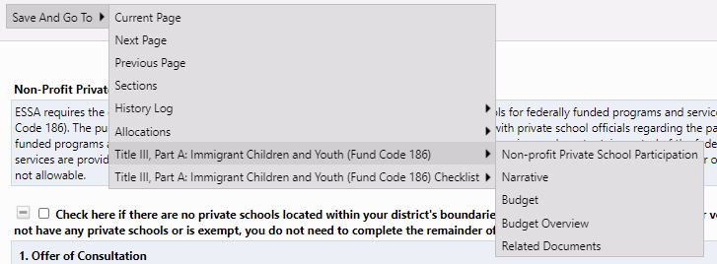
Saving and Navigation
Use the / Save and Go To menu options to save your work and to navigate between pages in a funding application.

Slide 17
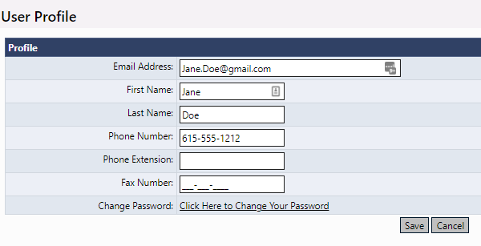
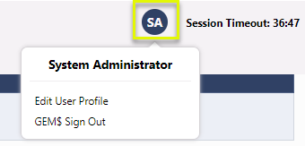
Modify User Profile
To modify your User Profile, click your initial avatar, then “Edit User Profile” to update your information or change your password.

Slide 18
Demonstration

Slide 19
Training Module 2
Funding Applications
Grants Education Management System (GEM$)
Department of Elementary & Secondary Education (DESE)

Slide 20
Agenda
Landing Pages and General Navigation
Site-Level Funding Applications
The Budget
Program Details
Related Documents
Submission and Review Workflow
Other GEM$ functionality

Slide 21
Landing Pages and General Navigation

Slide 22
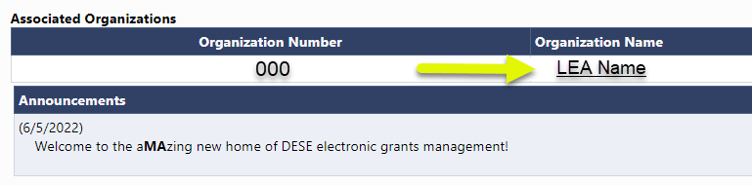
Organization Main Page
Once a user is logged into the system, the screen to access an organization (such as an LEA) is displayed.
To navigate to the LEA’s Funding Applications page, click the link for the LEA under “Organization Name.”

Slide 23
For Users in Multiple Organizations
For users who will use GEM$ for multiple organizations, GEM$ will display the names of the available organizations in a list under “Organization Name.”
Choose the appropriate organization from the main landing page to edit work for that organization.
To change to another organization, click on the “GEM$ Home” menu item in the upper-left corner of the navigation menu to return to the listing of the organizations to choose from.

Slide 24
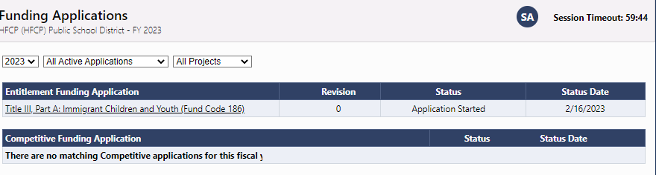
Funding Applications Main Page
Each organization has a main Funding Applications page.
Accessible from “Funding” on the left navigation once you have a district in your session
Launching point to all of a organization’s grant applications
Contains View filters
  Fiscal Year & Application Status filter

Slide 25
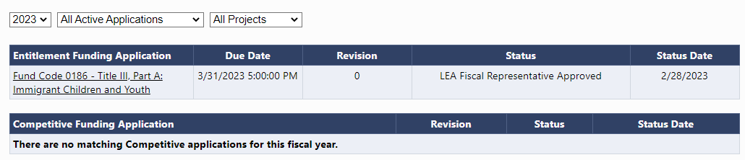
Funding Applications Main Page
Useful information on this page includes:
Entitlement versus Competitive application
Some applications display a Due Date.
Revision #
Application Status & Status Date

Slide 26
The Sections Page
The Sections page is an overview of a selected funding application.
It is the launching point to pages within the application.
You may view the sections as expanded or collapsed.

Slide 27
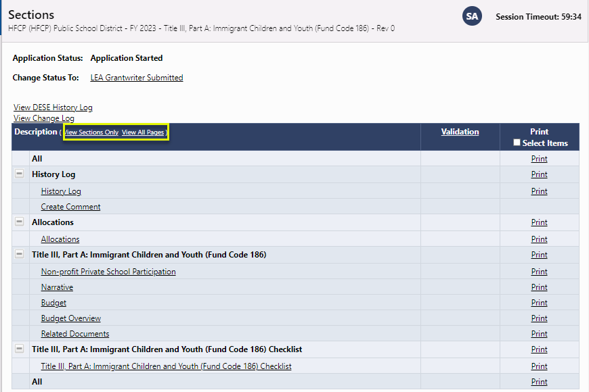
The Sections Page

Slide 28
Sections
“Sections” are a consistent structure across GEM$ applications and reimbursement requests.
  Status changes
  History Log and Comments
  Allocations
  Grant sections
  General sections
  Validation: Error and Warning messages
  Print
  Revision Details (on revisions > 0)
  Checklist for SEA qualitative review

Slide 29
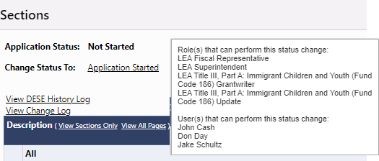
Understanding Statuses
The Sections page displays the current status of the application and the next possible status(es).
If the user lacks the correct permission, the status change confirmation screen will indicate so.
Hover on the status change link for hints on role(s) required to change status and user(s) who can perform the status change.
To begin work on a funding application, the user must click the link “Application Started.”

Slide 30
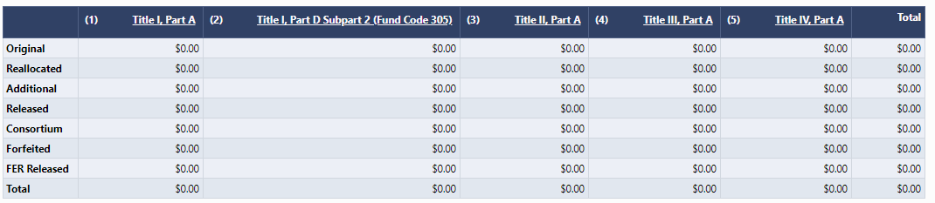
The Allocations Page
This page displays the allocation(s) for each grant in the funding application.
It is broken out by Allocation Type.

Slide 31
Funding Application Page Navigation
Go To / Save and Go To menu options allow navigation between any pages in the funding application.

Slide 32
Save and Go To…continued
Using Save and Go To refreshes session timeout.
Save and Go To Current Page: Saves changes to the page and keeps user on that page.
Save and Go To Next Page: Saves changes to the page and moves user to next page in that section.
Save and Go To Previous Page: Saves changes to the page and moves user to previous page in that section.
  If no previous or next page exist, the user is returned to Sections page.

Slide 33
Page Locking
GEM$ prevents multiple users from editing the same page simultaneously.
  User will see message indicating that the page is locked by another user.
  The lock is released after that user leaves the page or the session times out.

Slide 34
Demonstration

Slide 35
Site-Level Funding Applications

Slide 36
Site-Level Funding Applications
Most of the funding applications in GEM$ will be “district-level” (meaning parent-level) applications where the funding will exist in one budget.
For site-level grants, budgeting is done at the site level. Applicants will enter a budget for each site and the system will total the budgets for all of the sites into one district-level budget.
An example of this functionality is for 21st Century grants where an LEA may provide funding to an LEA who supports programs at multiple sites.

Slide 37
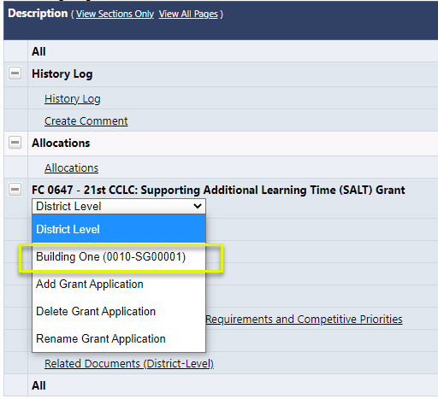
Site-Level Funding Applications (2)
The dropdown selector in the middle of the Sections page allows the user to toggle between the district (parent organization) view and the site-level view.

Slide 38
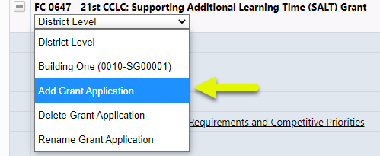
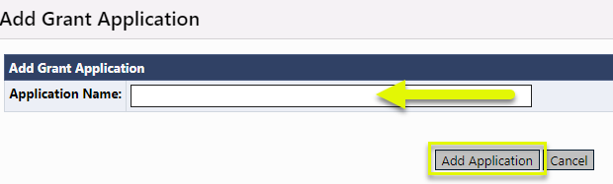
Site-Level Funding Applications (5)
To add, delete, and edit site names, use the options in the dropdown selector.

Slide 39
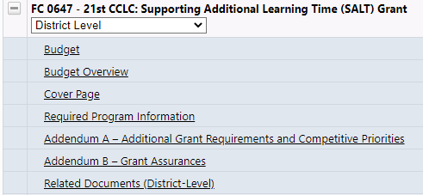
Site-Level Funding Applications (3)
When the selector is set to “District Level,” all of the pages displayed on the Sections page apply to the district (or parent-level organization).
The Budget link shown here will display a read-only page.

Slide 40
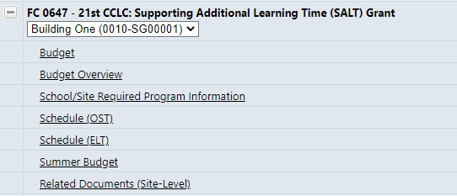
Site-Level Funding Applications (4)
When the selector is set to the name of the site, the links displayed will be to the pages that are required for each site.
Note that even if the organization only has one site, completing these pages for that site is required.

Slide 41
Demonstration

Slide 42
The Budget

Slide 43
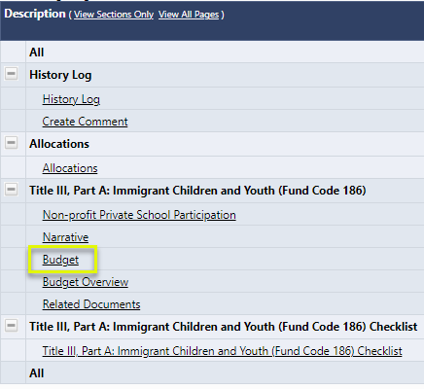
Budgeting
To begin budgeting, click on the “Budget” link on the Sections page.

Slide 44
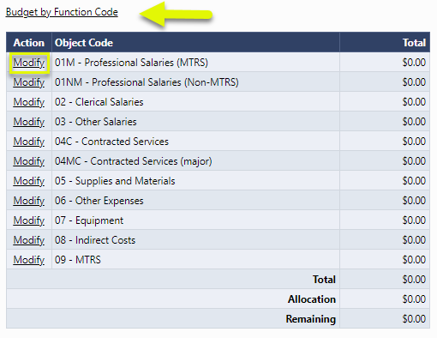
The Budget Page
Click on the “Modify” link to begin budgeting.
Note that users may choose to budget by Object Code or by Function Code.

Slide 45
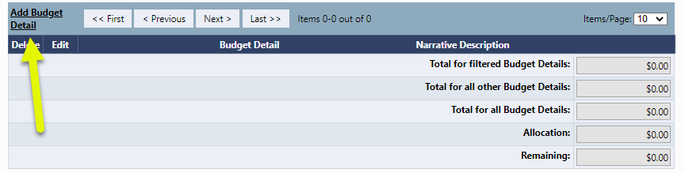
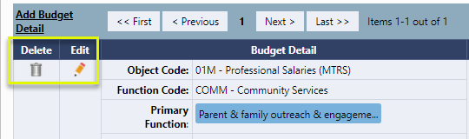
Budget Detail
Click on “Add Budget Detail” to create a new Budget entry. To edit an existing entry, use the pencil or the trash can icon.

Slide 46
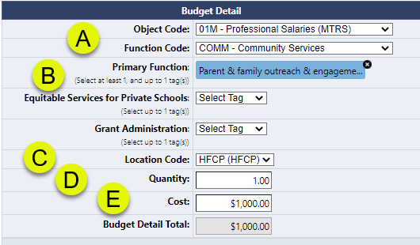
Add/Edit Budget Detail
Select the Object & Function Codes;
Some grants may have optional or required budget tags – some tags allow multiple selections;
The Location Code must be selected (defaults to the district);
Quantity defaults to 1;
Cost greater than $0.00 must be entered; the system calculates the Budget Detail total.

Slide 47
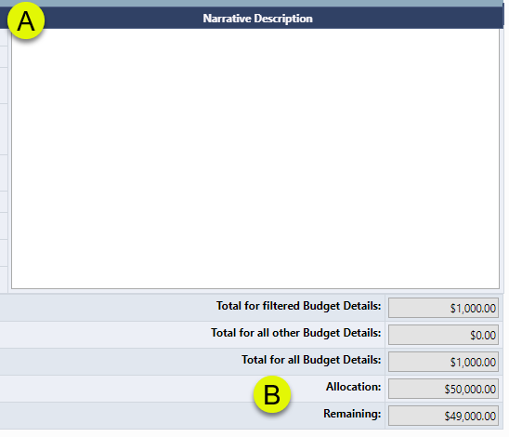
Budget Details (continued)
For most grants, Narrative Descriptions are required.
Note that the system tracks the funds budgeted against the allocation.

Slide 48
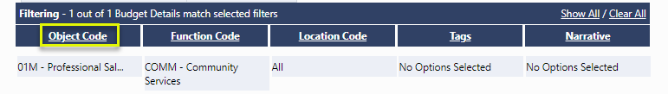
Budget Detail Filters
The hyperlinks in the Filtering portion of the Budget Details screen allow the user to view their budget entries using filtering.

Slide 49
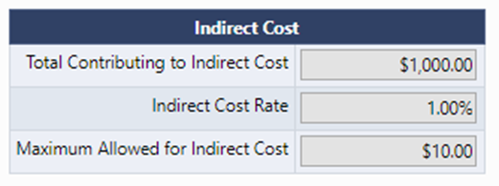
Indirect Cost
For grants that allow indirect cost:
As the user budgets, the system tracks the amount of allowable indirect cost, based on the LEA’s indirect cost rate.
The system accounts for budget items that do not contribute to indirect cost.
The user will not be able to submit the application if the amount budgeted for indirect cost exceeds what is allowable.

Slide 50
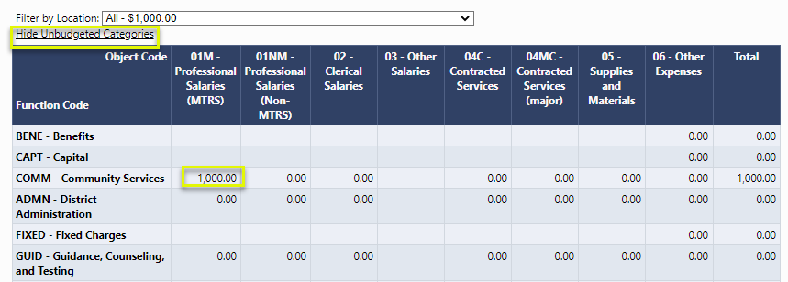
The Budget Overview
The Budget Overview screen is a convenient way to view the budget. This is a read-only page.
Use the Show/Hide Unbudgeted Categories to toggle the view of the budget.

Slide 51
Demonstration

Slide 52
Program Details Pages

Slide 53
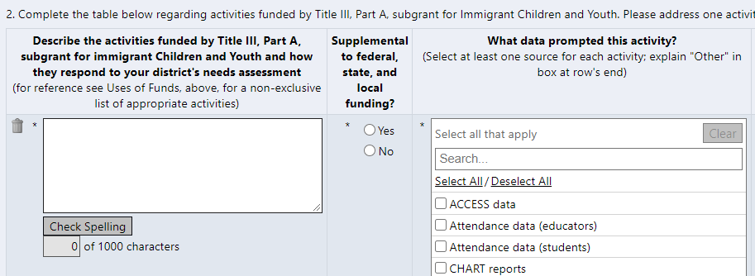
Program Detail Pages
Program Details pages provide information about an LEA’s application beyond what is captured in the budget.
Detail items marked with an asterisk are required in order to submit the application.

Slide 54
Program Detail Pages
Common Types of Data
  Numeric / Integer
  Short Text response
  Narrative – Rich or Plain Text
  Dropdown List / Radio Buttons
  Checkboxes
  Checkboxes that enable or disable a subsequent range of questions
  Date Picker
  Grids allowing multiple responses (“Add a Row”)
  Document Uploads
  Read-only fields calculating amounts based on entries in other fields
  Read-only LEA-specific values populated by GEM$

Slide 55
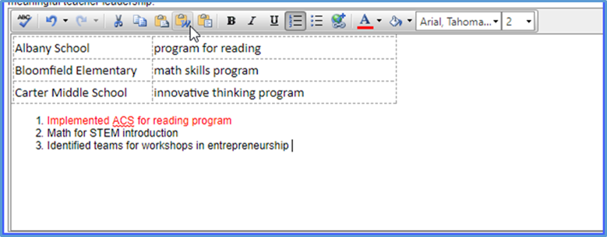
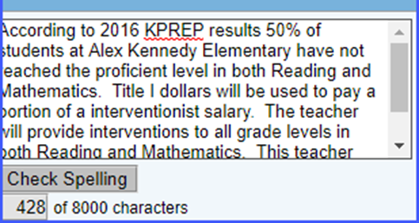
Text Boxes
Format Text from the toolbar
Copy and Paste formatted text
Spell Check
Large amounts of text
Copy and Paste text only
Spell check
Limited to # of characters

Slide 56
Related Documents

Slide 57
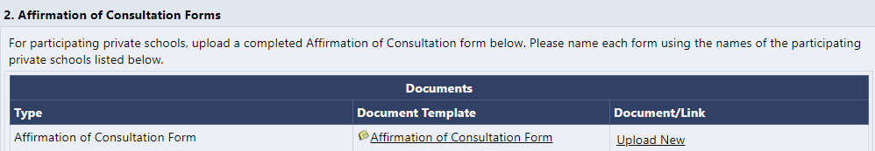
Related Documents
DESE may request that LEAs attach additional documentation to funding applications.
Documents may be required or optional.
DESE may provide a document template.

Slide 58
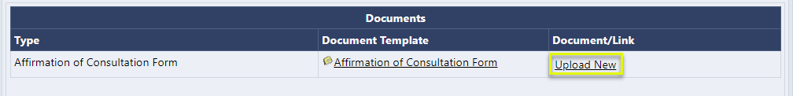
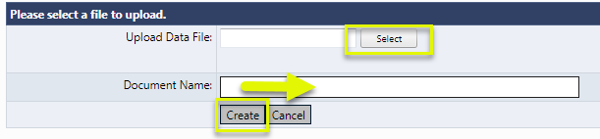
Adding a Related Document
To upload a Related Document:
Click the “Upload New” link.
Browse for the file to upload.
Enter a Document Name.
Click “Create.”

Slide 59
Demonstration

Slide 60
Submission and Review Workflow

Slide 61
Validations
Validations are checks built into the system based on business rule checks put in place to ensure the quality of the data being submitted.
The system automatically checks validation as the application is being submitted.
The presence of validation issues is indicated on the Sections page, in the Validation column.

Slide 62
Types of Validations
There are two types of validation messages:
  Errors: prevent submission of the application
  Warnings: point out potential issues but allow submission
  Examples of errors include:
  Not completing a required narrative question
  Budgeting more than the allocation
  Not uploading a required related document
  An example of a warning is:
  Not uploading an optional related document

Slide 63
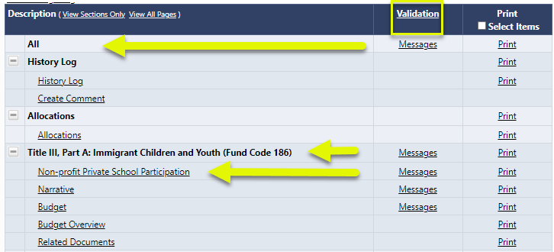
Viewing Validations
Validations can be viewed at the page, section, or application level.

Slide 64
Validations Clarifications
The system does not prevent the entering and saving of “invalid” data; it prevents the submission of invalid data.
Validation checks can span multiple pages.
“Invalid” data can become valid based on
subsequent input.

Slide 65
Editing, Submitting, and Reviewing
Once the application is complete, the LEA Grantwriter will move the application to “LEA Grantwriter Submitted.”
Then the LEA Fiscal Representative will review.
If the Fiscal Rep approves, the application will move to DESE review.
If DESE returns the application to the LEA for modification, the LEA Grantwriter will need to make the requested changes and resubmit the application.

Slide 66
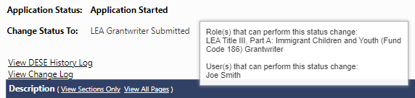
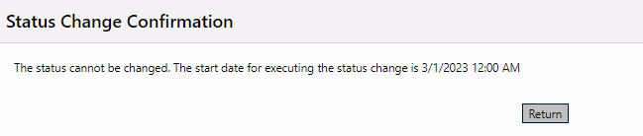
Submission and Review Workflow
The system performs prerequisite checks
  Does the user have permission?
  Does the time frame allow for this status change?

Slide 67
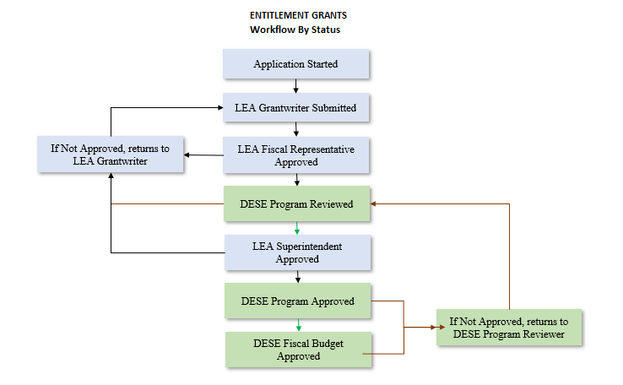
Funding Application
This workflow also applies to Competitive Continuation
and Targeted grants.
Examples include:
ACLS grants
Some CTE grants

Slide 68
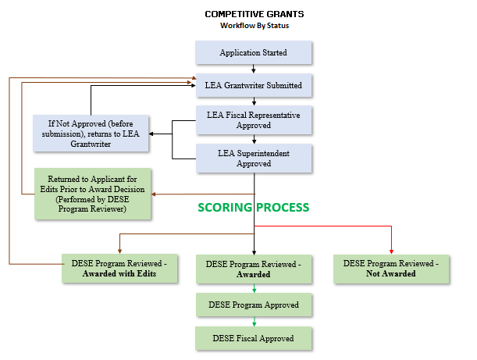
Scoring Process
This workflow also applies to New Competitive grants.
Note that Revisions will follow the Entitlement workflow.

Slide 69
Status Change Outcomes
The status change is noted in the History Log documenting the date, time, and username.
The next person in submission workflow is notified by email that the application now requires their attention.
The application may be locked down or unlocked (depending on the status change).

Slide 70
Demonstration

Slide 71
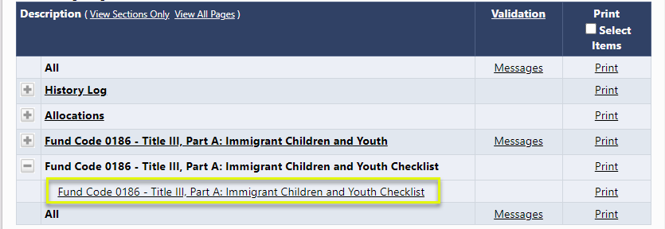
The Checklist
For funding applications that are using a checklist:
This checklist is a means of communication between DESE and LEAs regarding the allowability and allocability of the items submitted in the funding application.

Slide 72
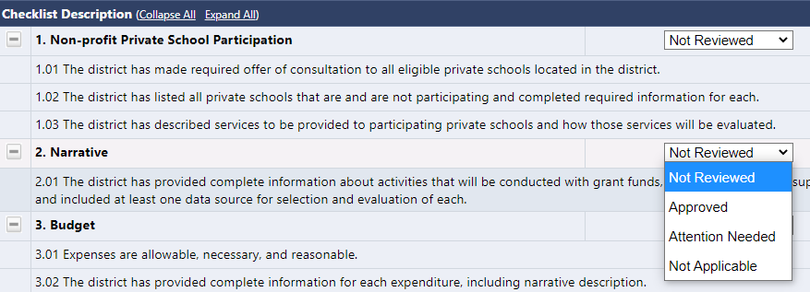
How The Checklist Works
After the LEA submits the application, DESE will review the application and mark each section as Approved, Not Applicable, or Attention Needed. If the application contains no items that are marked as Attention Needed, the application will be approved.

Slide 73
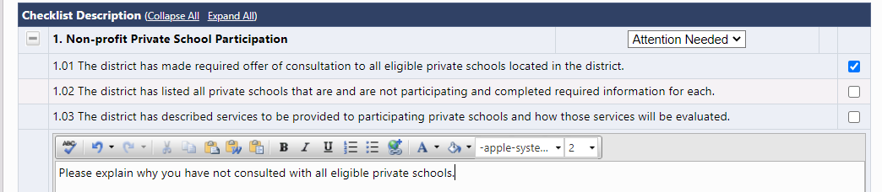
DESE Comments in The Checklist
If the application contains items that are marked as Attention Needed, the application will be returned to the LEA with a status that is not approved. The LEA will review the checklist for items that are marked Attention Needed and make the necessary changes to those items. Only the checked items in the sections marked Attention Needed are to be corrected and/or explained. Each section marked Attention Needed also has a place where DESE may provide notes to explain those items. The LEA should check for notes and additional comments.

Slide 74
Moving to the Next Status
Once the LEA has made the necessary adjustments, the LEA will resubmit the application for approval. If DESE determines that the item has been corrected, Attention Needed will be changed to Approved by the DESE Reviewer. If the items that were marked Attention Needed still have not been corrected, the application will be returned again to the LEA with a status that is not approved.
Applications that contain no items that are marked Attention Needed will be approved.

Slide 75
Demonstration

Slide 76
Other GEM$ Functionality

Slide 77
Create Comments
Comments can be used to facilitate ongoing notes and discussion between DESE and the LEA.
Comments can be made by anyone with access to the application at any time, regardless of application status.
Comments can be emailed to intended recipients.
Comments are saved within the funding application.
Comments are not visible to public users.

Slide 78
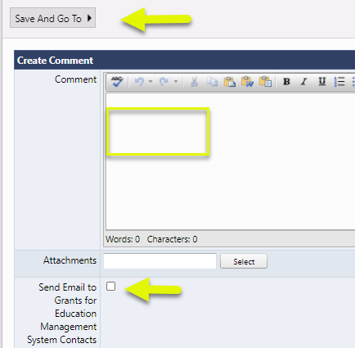
To Create a Comment
Click on “Create Comment” on the Sections page for the application you wish to comment.
Enter comment text.
Upload a document if desired.
If sending as an email, check the box.
Click “Save and Go To.”

Slide 79
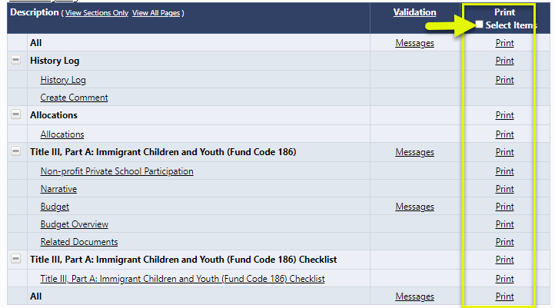
Printing
Users may print the application at the page, section, or full application level. They may also click the checkbox at the top of the column to select distinct pages.

Slide 80
Retrieving the PDF
The system will generate a PDF document, containing the selected pages.
Note the PDF will not include uploaded related documents.
The system will ask the user for an email address.
If the print job is small, the user may automatically retrieve the PDF document from the link at the top of the DESE Resources page.
If the print job is large, the system will send an email when the print job is ready to retrieve.

Slide 81
Demonstration

Slide 82

Reviewing Revision Details
Revision Details displays changes that have occurred to this current revision of the application relative to the previously approved application.
Each message contains a clickable “Review” link.
Clicking the link will show the user to the page where the change occurred.

Slide 83
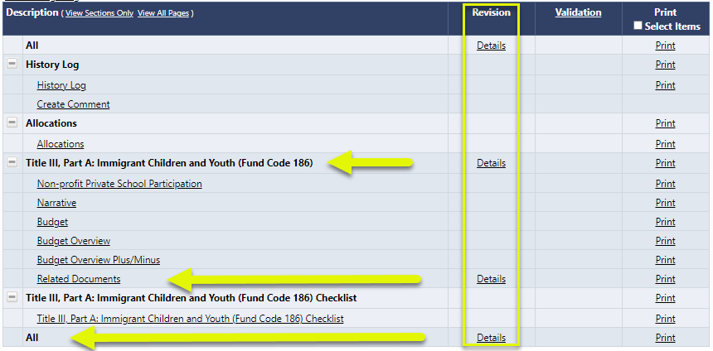
Viewing Revision Details
Revision Details can be viewed at the page, section, or application level.

Slide 84
Reviewing the Address Book
It is best practice to review the roles in your district at least annually to determine if changes need to be made. A quick way to see who has roles in your district is to access the Address Book.
The Address Book is accessed from the GEM$ main menu using the left-hand navigation.
Funding Application

Slide 85
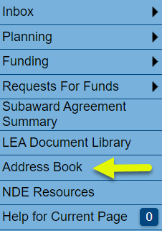
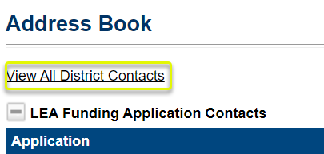
Reviewing the Address Book (2)
To review the Address Book:
Click on “Address Book” from the main menu.
Use the toggle link “View All District Contacts” and “Return to Address Book” to view user/role information within the LEA.
Funding Application

Slide 86
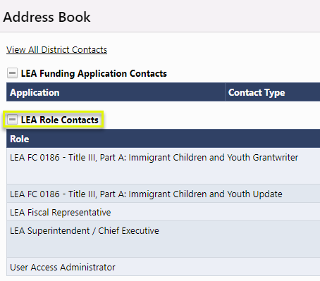
Address Book Headings
Here are some main headings of users within the Address Book that are most helpful to view user listings:
LEA Role Contacts lists all LEA roles with users who are assigned to each role.
Funding Application

Slide 87
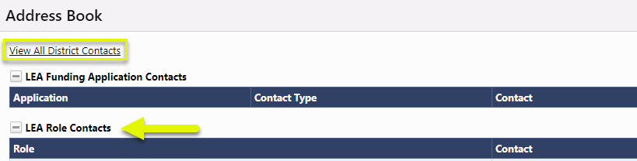
Address Book Headings
After clicking on View All District Contacts:
LEA Contacts lists all current LEA users arranged alphabetically by last name.
Funding Application

Slide 88
Address Book Headings
DESE Funding Application Contacts lists GEM$ users who have been designated as state-level contact(s) for each funding application by DESE. This is a good place to look if you have a program question about a specific funding application.
Note that user contact information (such as email address and phone number) becomes visible when clicking on the link for the name of the contact.
Funding Application

Slide 89
Demonstration

Slide 90
Grants Education Management System (GEM$)
Department of Elementary & Secondary Education (DESE)
Training Module 3
Reimbursement Requests

Slide 91
Agenda
Reimbursement Request (RR) Entry Screen
Project Summary / Reimbursement Request List
Creating and Completing Reimbursement Requests
Reimbursement Request Approval Steps
Search Reimbursement Requests

Slide 92
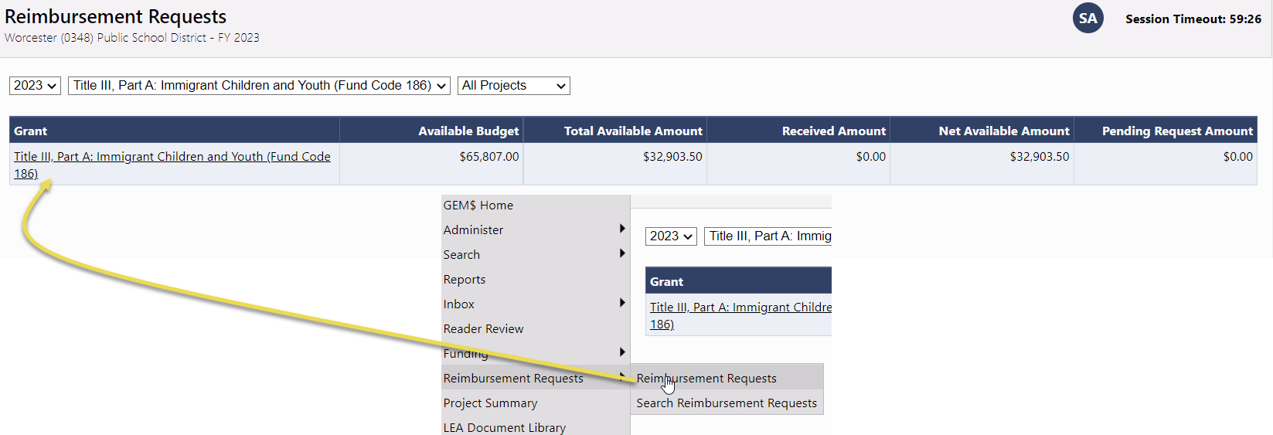
Reimbursement Request Entry Page
Access from Left Nav: Reimbursement Requests >> Reimbursement Requests
Choose FY, Funding Application, and Project Status (Note: All is available)
Available Budget: Lesser of Approved Budget and Pending Allocation
Total Available Amount: Factors in Funding % of Allocation Sources
Net Available Amount = Total Available – Received Amount
Pending Fund Requests shows an amount when there is an RR in progress or ‘None’ when no pending RR

Slide 93
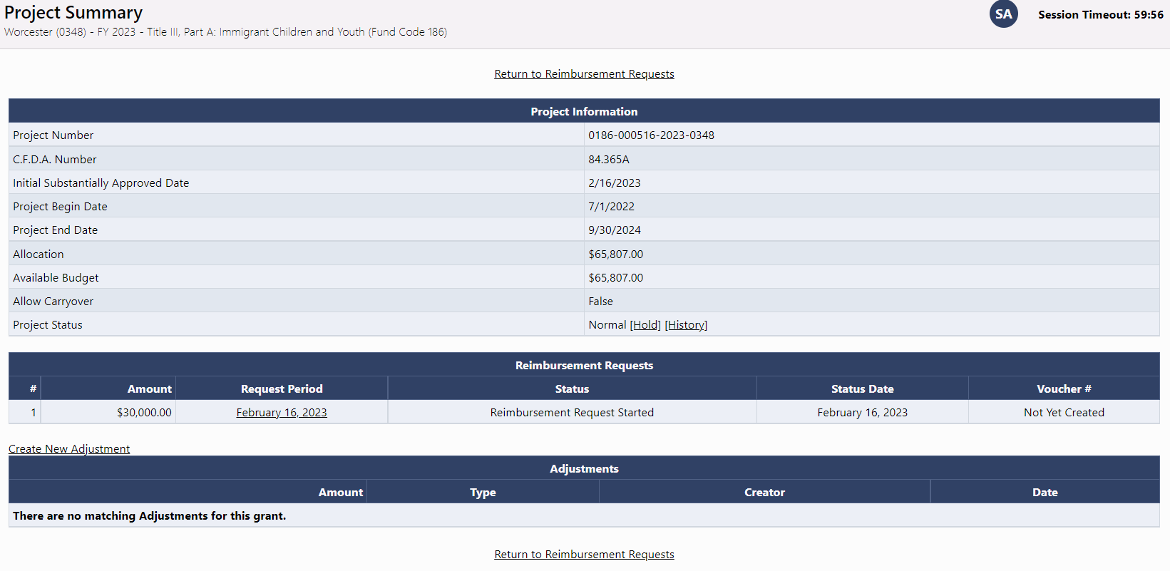
Project Summary / Reimbursement Request List
Displays general grant information
List of Requests for this grant
List of Adjustments for this grant
Project Hold Administration

Slide 94
Demonstration

Slide 95
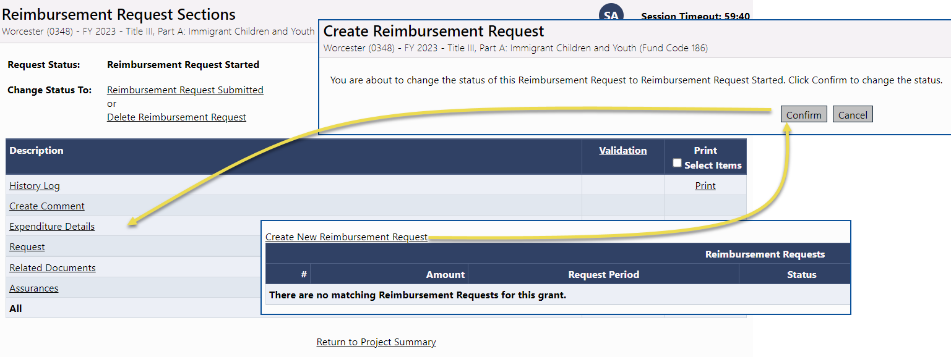
Creating and Completing Reimbursement Requests
Reimbursement Requests cannot be created until the grant budget is approved
One active reimbursement request per LEA/Grant/FY combination
General Framework consistent with Funding Application
  Sections
  History Log and Communication
  Validation
  Workflow

Slide 96
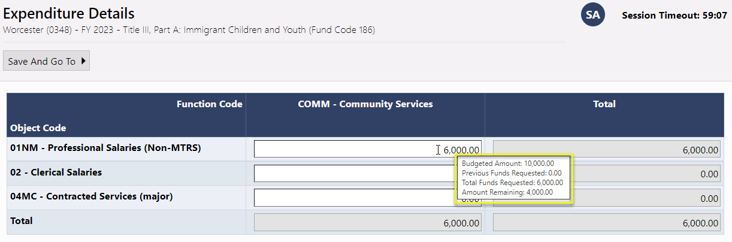
Expenditure Details Page
Report Project-to-date Expenditures by Object and Function Item
Only displays rows and columns that contain approved budget amounts
GEM$ validates expenditures against approved budget
Hover on cell to see approved budget amount
Disabled cells where no approved budget exists
Automatically populates expenditures from previous request
  Just update cells that have changed

Slide 97

Request Page – Fiscal Summary
System knows and automatically populates most fields
Total Cash Basis Expenditures comes from Expenditure Details page
Calculates amount of the request automatically using total expenditures minus cash received

Slide 98

Related Documents Page
LEA may be asked by DESE to upload backup documentation detailing their expenditures
Document types allowed include PDF, Word, Excel, PowerPoint

Slide 99

Validation
System automatically validates Reimbursement Requests as they are completed
Errors will prevent submission; warnings will be called out but allow submission

Slide 100

Submission and Review
Once an RR passes validation, the LEA Fiscal Representative may move it to Reimbursement Request Submitted
RR is then sent to DESE for DESE Fiscal Payment Review

Slide 101
Reimbursement Request Approval Steps
Status | Role Needed
Reimbursement Request Started | LEA Fiscal Representative
Reimbursement Request Submitted | LEA Fiscal Representative
DESE Fiscal Payment Approved | DESE Fiscal Payment Approver
Submitted to State Accounting System | DESE Fiscal Payment Batch Approver
State Accounting System Paid | Automated Status Change - Return File from MMARS Verifying Payment

Slide 102
Demonstration

Slide 103
Critical Notes about Reimbursement Requests
DESE is moving to a reimbursement only structure for all grants in GEM$
Reimbursement requests are created and submitted by the LEA Fiscal Representative
LEA must enter project-to-date expenditures
LEA will need to do a budget revision when they have expenditures in an unapproved Object Code / Function Code combination (cell) or they exceed their approved budget for a cell by more than 10%

Slide 104

Search Reimbursement Requests
LEAs have a search tool that will allow them to quickly find Reimbursement Requests

Slide 105
Demonstration

