Slide 1
Introduction to Comparability
October 8, 2024

Slide 2
Welcome to the Introduction to Comparability Webinar!
Housekeeping items before we begin:
The slides were emailed out prior to the webinar.
To preserve bandwidth, your video and microphone are turned off.
Use the Q and A feature at the bottom of the screen to ask questions (not Chat).
This session is being recorded and will be made available upon request.

Slide 3
Our time together
Intended Outcomes for Today:
Familiarity with key components of Comparability for Title I
How to use the automated Title I Comparability forms
Answers to your questions!

Slide 4
Save the Date
Federal Grants Virtual Conference
November 12th – 14th

Slide 5
What is Title I Comparability and why is it important?
An annual requirement for each school district receiving federal Title I, Part A funds
A school district may only receive Title I funds if it uses state and local funds to provide services in Title I schools that, taken as a whole, are at least comparable to the services provided in schools that do not receive Title I funds.
The comparability requirement is intended to ensure that school districts do not spend less from state and local sources in higher poverty / Title I-funded schools than they do in lower poverty / non-Title I-funded schools.

Slide 6
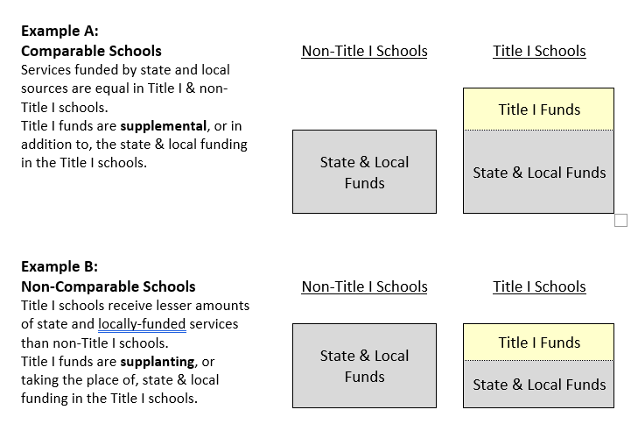
Understanding Comparability

Slide 7
How does a District Demonstrate Comparability?
Comparability is determined by looking at student/state-locally funded staff ratios and comparing them to schools within the same grade span within the district.
An automated excel form has been created for you to complete comparability.

Slide 8
Steps to Complete Comparability Using the Automated Excel Form
Identify the schools for which the district must demonstrate comparability.
Familiarize yourself with the comparability forms.
Collect and prepare enrollment and staffing data
Enter enrollment and staffing data into the comparability forms
Review automatically calculated information
Select comparison schools and determine if schools are comparable
Take action if schools are not comparable
Complete and file comparability documentation

Slide 9
Step 1: Who needs to complete Comparability?
All districts that receive Title I
However districts that are a single school district or have one school per grade span do not need to complete comparability BUT should download the form, select their district, and complete the summary sheet.

Slide 10
Step 2: Familiarize yourself with the comparability forms.
6 Tabs in the automated comparability excel form
Background: Background information about Title I Comparability
Instructions: How to complete comparability using this form
Detailed School Data: Select your school district and enter the data
Comparison Schools: A read only tab that will populate from information you input on the Detailed School Data tab
Summary Sheet: Will populate based on information you input on the Detailed School Data Tab
Staff Data: Districts must compile lists of state and locally funded staff working in each school.

Slide 11
Step 3: Collect and prepare enrollment and staffing data
State and local funded staff FTE count
EPIMS 1305 Principal
EPIMS 1310 Assistant/Vice Principal
EPIMS 2305 Teacher
EPIMS 2310 Teacher – support content instruction
EPIMS 2325 Long Term Substitute Teacher
EPIMS 2330 Instructional Coach
EPIMS 3329 Guidance Counselor
Data for Title I and non-Title I schools (The form will populate the district’s schools, Title I status, and grade spans from the prior years application – you will need to check that nothing has changed)
School Name
Grades Served
School Enrollment
Low Income Percentage
Notes:
Data Accuracy

Slide 12
Step 4: Enter enrollment and staffing data
On the Detailed School Data tab:
Select your district
Check to make sure all your schools are listed with the correct grade spans (Column 1 & 2)
Check Title I Status and update any Title I Status (Column 4)
Fill in Low Income Percentage, School Enrollment, and State and Locally Funded Staff FTE Count (columns 6, 7, and 8)
Ratio of Enrollment to Staff will calculate for you (column 9)

Slide 13
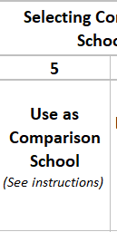
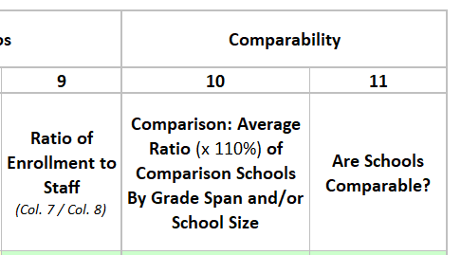
Step 5: Review automatically calculated information
Ratio of Enrollment to Staff will calculate for you (column 9)
Comparison Average Ratio (column 10) will populate for you
This will be based on what has been preselected as comparison schools for you
The form automatically make every Non-Title I school a comparison school (column 5) and every Title I school not a comparison school.
‘Are schools comparable?’ (column 11) may start to populate at this step

Slide 14
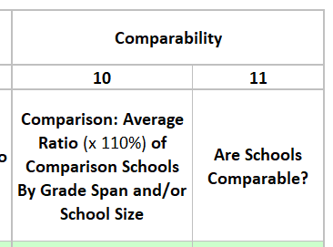
Step 5: Review automatically calculated information
Columns 10 and 11 will automatically calculate for you.
Column 10 calculates the average ratio of your comparison school ratios (x 110%) for each grade span
Column 11 will tell you if you schools are comparable
Schools need to have a lower ratio than the ratio they are being compared to.

Slide 15
Step 6: Choosing Comparison Schools
The form automatically make every Non-Title I school a comparison school and every Title I school not a comparison school (column 5)
Non-Title I schools should always be ‘yes’ in column 5
Comparability compares schools in the same grade span
All schools in a grade span may be Title I
Some schools in a grade span are Title I some are Non-Title I

Slide 16
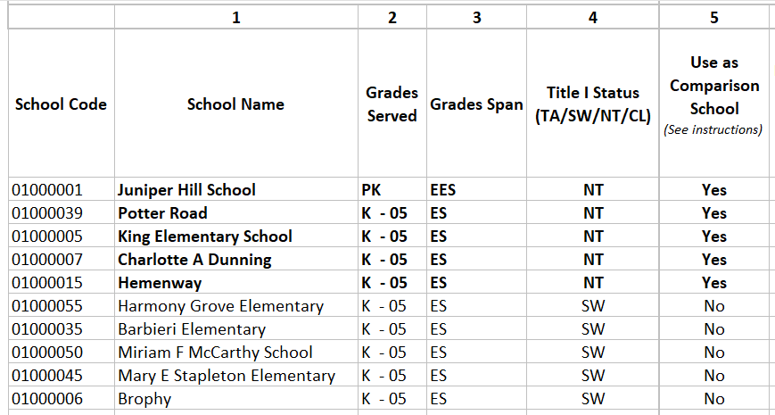
Step 6: Choosing Comparison Schools Grade Span with Title I and Non-Title I Schools
When a grade span contains one or more Title I schools and one or more non-Title I schools, the district will compare its non-Title I schools to its Title I schools.
Example: the form will take the average ratio x 110% of K-05 non-Title I schools and use that as the comparison ratio

Slide 17
Step 6: Choosing Comparison Schools Grade Span with all Title I schools
When all schools in a grade span are Title I, the district must establish a comparison group from of the lowest poverty Title I schools within the grade span.
A school district may form a comparison group representing no more than half of all the schools within the total grouping and that comparison group must come from the schools with the smallest incidence of poverty.
Any number of schools within the lower half of the total schools in the grade span based on poverty can be used as a comparison group as long as they are selected consecutively from the bottom up.
To adjust which schools are used as the comparison school you will change column 5.

Slide 18
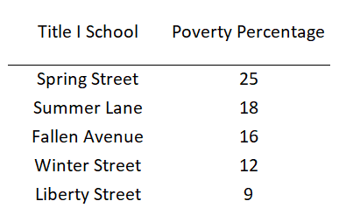
Step 6: Choosing Comparison Schools Example: Grade Span with all Title I schools
These 5 schools are all Title I
Up to 2 of them can be used as comparison schools
They must be chosen from lowest poverty to highest
Liberty Street may be the comparison school OR Liberty Street and Winter Street can be the comparison

Slide 19
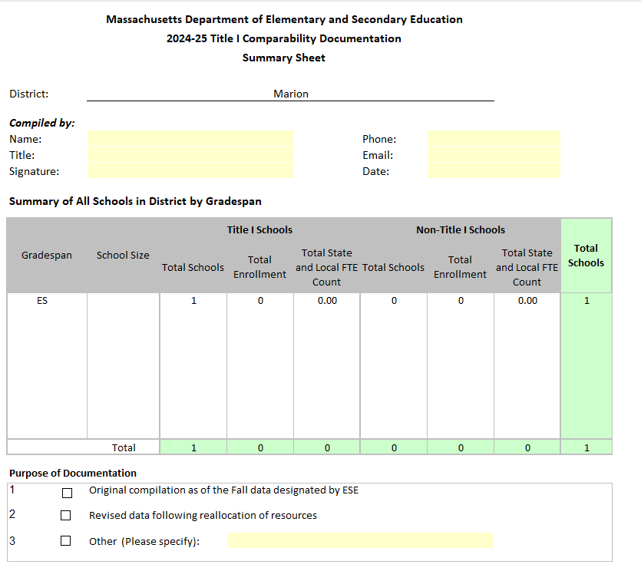
Examples: Single School District/One School Per Grade Span
Select the district on the ‘Detailed School Data’ tab.
Confirm that school(s) are correct
Complete ‘Summary Sheet’ tab

Slide 20
Examples: Look at Excel Form
Grade Span with Title I and Non-Title I Schools
All Schools Title I in a Grade Span

Slide 21
Step 7: Take action if schools are not comparable
If schools are found not to be comparable adjustments in staffing may need to be made and done as promptly as possible
Look to see if there are any exceptions that may be affecting your comparability
Contact your Federal Grant Liaison or Comparability Point Person to discuss

Slide 22
Exceptions to Comparability
If schools have special programs for a specific population those programs may be exception
Programs for students with limited English proficiency and/or disabilities
State or local supplemental programs for educationally at-risk students
More information on the Background tab
Exceptions will be looked at on a case-by-case basis and must be approved by DESE

Slide 23
What are the consequences of schools not being comparable?
Each school district submits an annual statement of assurances to DESE as part of its application for federal funds, including Title I, Part A funds. One of these assurances is related to Title I comparability.
All data, documents, and policies supporting the assurance and verifying compliance with the comparability requirement must remain on file at the district offices.
If such information does not demonstrate to state or federal reviewing officials/auditors that comparability of services provided with state and local funds exists between Title I and non-Title I schools, the following actions may result.
Immediate suspension of the Title I program at schools in non-compliance until such absence of comparability has been corrected.
Withholding of payments of Title I funds based upon the amount or percentage by which the school district is out of compliance.
Repayment of Title I funds of that project year through the date of suspension equal to the amount or percentage by which the school district has failed the meet the comparability requirement.

Slide 24
Step 8: Documentation
The Federal Grants Team collects Comparability documentation every 6 years as part of Monitoring for Title I, IIA, & IVA.
Please keep documentation on file at the district for each fiscal year.
The Federal Grants Team runs comparability from data submitted by districts as a part of SIMS towards the end of each fiscal year.
If questions arise from this review, the district may be contacted and asked to submit their comparability documents for that fiscal and the upcoming fiscal year.

Slide 25
Step 8: What documentation needs to be on file?
The district’s comparability procedure
Example on the Federal Grants Website
The completed automated excel form
Staff data - locally/state funded FTE
This can be completed in the excel form or you can downloaded MUNIS data

Slide 26
FY25 Timeline
Comparability Forms completed by October 31st
Adjustments to any schools not meeting comparability by November 30th

Slide 27
Questions?
Email: colleen.e.holforty@mass.gov
Phone: 781-338-3522
Federal Grant Liaisons: http://www.doe.mass.edu/federalgrants/liaisons.xlsx
Website: www.doe.mass.edu/federalgrants

Slide 28
Thank you for participating

