Slide 1
FY24 Title I Data Collection Application Supplement in GEM$
Federal Grant Programs Office
May 2024

Slide 2
Title I Data Collection in GEM$
Required of all districts that received FY24 Title I funds, in accordance with federal reporting requirements
District staff with the role of “LEA Grantwriter” for the ESSA Consolidated Grant will complete in GEM$
More than one person in your district can hold this role
Your district’s User Access Administrator assigns the roles

Slide 3
Timeline
The Title I Data Collection application supplement opens June 3 in GEM$
Title I data collection is due July 1, 2024
Your FY25 ESSA grants cannot be approved until the required Title I Data Collection application supplement is completed in GEM$

Slide 4
Step 1: Access the Application Supplement in GEM$

Slide 5
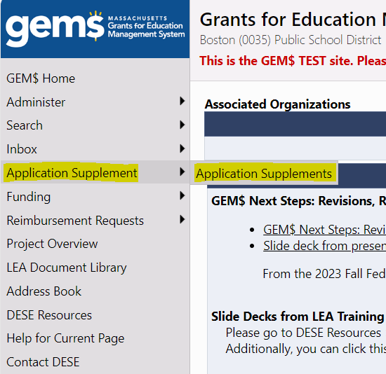
How to Access the Application Supplement in GEM$
Log into GEM$
Go to ‘Application Supplement’ on the left side navigation bar
Select ‘Application Supplements’

Slide 6
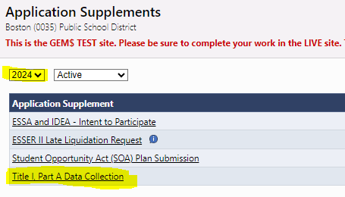
How to Access the Application Supplement in GEM$
Select Fiscal Year 2024
Click on Title I, Part A Data Collection

Slide 7
Step 2: Start the Application Supplement

Slide 8
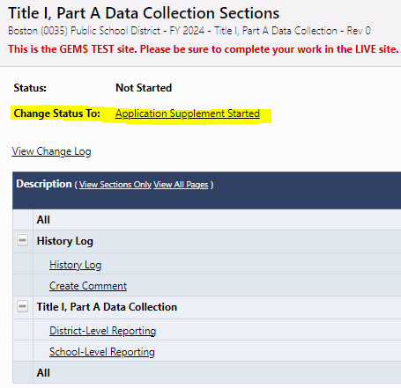
Starting the Application Supplement
You will not be able to enter data into the form until you change the status to Application Supplement Started at the top of the Sections page of the application supplement
You will then need to click into each section, District-Level Reporting and School-Level Reporting, and enter your data into the forms

Slide 9
Step 3: Enter District Level Data

Slide 10
Title I Data – District Level
Districts will report on the number of private school students served with Title I, per grade
For consortia, the lead district should report the total number of private school students served for all consortia member districts plus the lead district (member districts will not submit separately)
Districts will report on the number of students served in a local neglected facility (Title I, Part D) and types of services received, if applicable

Slide 11
Title I Data – District Level
Enter the number of private school students that received Title I services in FY24, per grade. If no private school students received Title I services, the district should check the box at the top to indicate this.

Slide 12
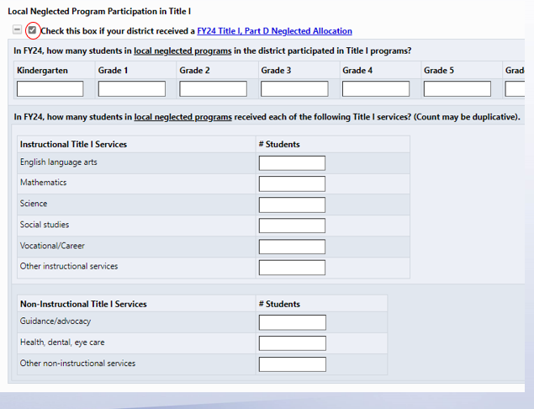
Title I Data – District Level
Districts with a Title I, Part D Neglected allocation must check the box to indicate this, and the form will expand below. Enter the number of students in the local neglected facility that participated in Title I services in FY24, by grade. Enter the number of students in the local neglected facility that received certain instructional and non-instructional services (these counts may be duplicative).

Slide 13
Step 4: Enter School Level Data

Slide 14
Title I Data – School Level
For each Title I school, districts will report on when the required parent notifications were sent, and the method of distribution
Report Cards
Parents’ right-to-know about teacher qualifications
For consortia, the lead district should list the Title I schools for all member districts plus the lead district (member districts will not submit separately)

Slide 15
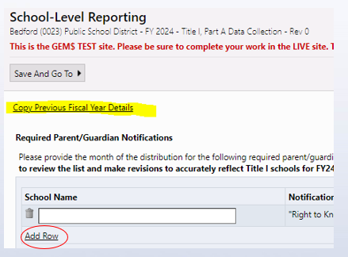
Title I Data – School Level
List all your Title I schools from FY24. Add rows as needed.
You have the option to copy the Title I schools that were listed on last year’s (FY23) Title I data collection form. Please be sure to revise the list if any of your Title I designated schools changed from last year.

Slide 16
Title I Data – School Level
After you have listed all your FY24 Title I schools on this form, use the dropdowns to select the date (month/year) and method of distribution (hard copy, electronic) for each required parent notification: “right to know” letter and 2023 school report card.

Slide 17
Step 5: Submit the Application Supplement

Slide 18
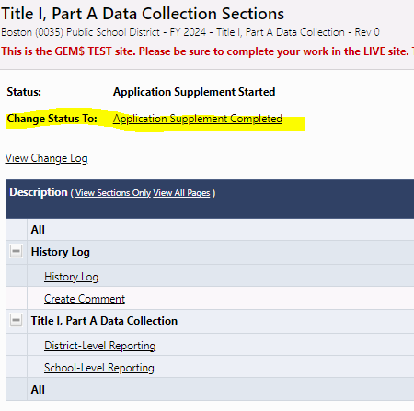
Submitting the Application Supplement
Once you are sure you have entered all the required data, return to the Sections page and change the status to Application Supplement Completed. Now you are done!
This application supplement does not require additional LEA sign-offs in GEM$
The deadline to submit is July 1, 2024
If data is incomplete or revisions are necessary, the DESE reviewer will return the application supplement to the ESSA Grantwriter to correct and re-submit

Slide 19
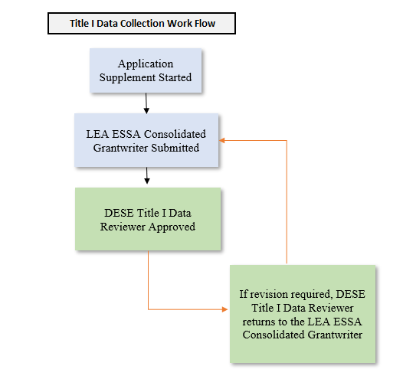
GEM$ Workflow for Title I Data Collection

Slide 20
Questions?
federalgrantprograms@mass.gov

