Slide 1
Title I, Part A New Directors Training
School Year 2024-25

Slide 2
Welcome to the Title I New Directors Overview!
Housekeeping items before we begin:
The slides, topical guide, and Title I Director Handbook were emailed out prior to the webinar.
Topical guide and handbook are posted on website: https://www.doe.mass.edu/federalgrants/titlei-a/default.html
To preserve bandwidth, your video and microphone are turned off.
Use the Q and A feature at the bottom of the screen to ask questions (not Chat).
This session is being recorded and will be made available upon request.

Slide 3
Our time together
Intended Outcomes for Today:
Familiarity with key components of Title I, Part A
How to access program resources & DESE program staff
Answers to your questions!

Slide 4
Topics to be covered
Title I programs - types, evaluation and monitoring
Family and community engagement- requirements and resources
Fiscal procedures and grant maintenance
Private schools and equitable participation
Networking and website resources

Slide 5
Title I, Part A
Title I, Part A of the Elementary and Secondary Education Act (ESEA)
Largest and one of oldest federally funded education programs
Additional funds to local school districts to assist low achieving students in higher poverty schools
Supplemental to resources normally provided by school district
Title IA Quick Reference Guide on Allowable and Unallowable Costs

Slide 6
Title I, Part A - Priorities
Strengthen the core program in schools and provide academic and/or academically-related support services to low-achieving students at the preschool, elementary, middle, and high school levels;
Provide evidence-based programs that enable participating students to achieve the learning standards of the state curriculum frameworks;
Elevate the quality of instruction by providing eligible staff with substantial opportunities for professional development;
Involve parents/guardians of participating public and private school children as active partners in their children's education at school through open, meaningful communication, training, and, as appropriate, inclusion in decision-making processes.

Slide 7
Targeted Assistance Programs
Targeted Assistance programs specifically serve those students who are failing or most at risk of failing to meet the state academic standards. The school must select those students based on set criteria determined by your district, and those students are considered your “Title I students.” The Title I funds can only serve those students or teachers of those students.
Typically, schools below 40% poverty are Targeted Assistance.

Slide 8
Student Selection Procedure
A written statement of the selection process for Title I, including:
Timing of selection – when does testing take place
Scoring process – assessments used, staff involved
How are rank-order lists produced
Statement of equal opportunity – all students are selected for Title I on the same basis (ELs, students on IEPs, etc.)

Slide 9
Student Selection Criteria
The school or district will set the criteria to determine Title I student eligibility. The criteria that you use must meet certain requirements:
•Multiple measures
•Educationally related
•Objective
•Universally applied
The criteria sheets will assign a point value for each assessment measure and then produce a composite score for each student.

Slide 10
Rank Ordered Lists
Rank-ordered lists are produced based on the composite scores.
Students ranked from highest to lowest academic need based on composite score
School should establish a cut-off point depending on funding and capacity
Include notes to indicate who is served and to note other student characteristics (EL, on IEP)
Lists are updated as changes in service occur

Slide 11
Schoolwide Programs
A schoolwide program uses Title I funds to upgrade the entire educational program of the school to raise the academic achievement of all the students. All students in the school are considered "Title I students."
A school is eligible for SW if the poverty percentage is 40% or above (waiver available).
Allows for more flexibility.

Slide 12
Schoolwide Plan
SW program plan must:
be developed with the input from parents and other stakeholders
be regularly monitored and revised as necessary
be coordinated with other federal, state, local programs
be based on comprehensive needs assessment
include strategies to:
provide opportunities for all children to meet state academic standards, particularly those most academically at risk
strengthen the academic program of the school, increase learning time, and provide an enriched and accelerated curriculum
About Title I Schoolwide Programs

Slide 13
Program Evaluation
Title I program evaluations are conducted at the end of a program year and are intended to measure the efficacy and impact of the district's Title I program.
All aspects of the Title I program must be included in evaluation of its impact, including academic assistance provided, family engagement activities and effectiveness of related policies, and private school services and N/D services (if applicable).
ESSA Program Evaluation Workbook

Slide 14
Program Evaluation
Key questions
Has the Title I program been effective?
What has worked well and what has not worked well in the Title I program?
How should the Title I program be refined?
Required documentation
Program evaluation procedure – describes how Title I program is evaluated (data used, stakeholders consulted, process to arrive at findings, how findings used for planning/improvement)
Program evaluation summary – summarizes findings, answers key questions

Slide 15
Monitoring
Federal Grants Monitoring (Titles I, IIA, IVA) uses same schedule as Integrated Monitoring - every 6 years
Timeline
Official notification from DESE Federal Grants Office in the fall
Documents due in winter
DESE report out to districts in spring
Required actions due in fall (if there are findings)
Desk-based review
Materials organized by specific documents requested and submitted via online CHAMP system
Federal Grants Monitoring

Slide 16
Title I Data Collection
District and school level data collected each year through an Application Supplement in GEM$
Report on private school students served (if applicable)
Report on N/D students served (if applicable)
Report on distribution of parent notifications
Due in June (for previous school year)
Required of all districts receiving Title I funds
Instructions: Title I Data Collection Application Supplement in GEM$

Slide 17
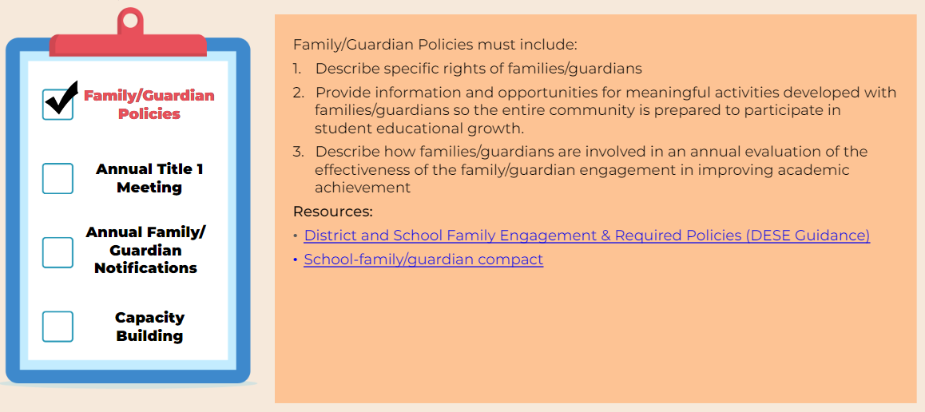
Family & Community Engagement- Checklist
District and School Family Engagement & Required Policies (DESE Guidance)
School- family/guardian compact

Slide 18
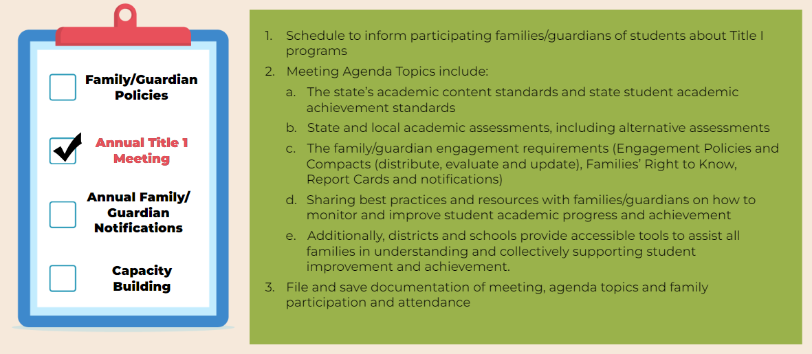
Family & Community Engagement- Checklist

Slide 19
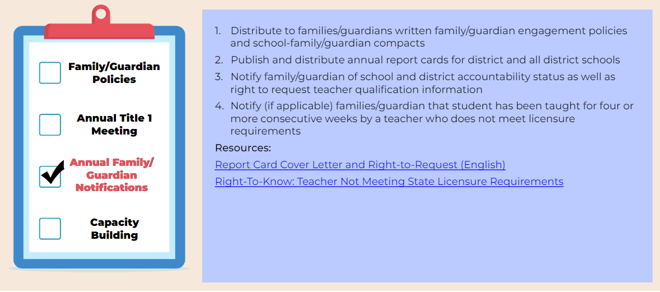
Family & Community Engagement- Checklist
Report Card Cover Letter and Right-to-Request (English) ​
Right-To-Know: Teacher Not Meeting State Licensure Requirements

Slide 20
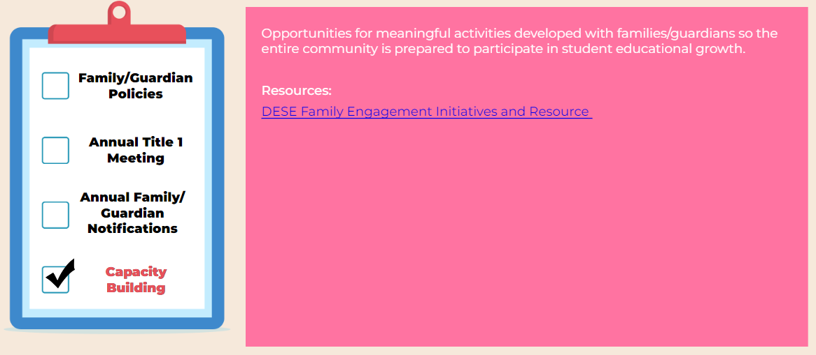
Family & Community Engagement- Checklist
DESE Family Engagement Initiatives and Resource

Slide 21
Family & Community Engagement Additional Resources
E -Learning Tool: ESSA Family Engagement Overview – NEW!
DESE Office of Student and Family Support Family Engagement Resources

Slide 22
Comparability: What is Title I Comparability and why is it important?
An annual requirement for each school district receiving federal Title I, Part A funds
A school district may only receive Title I funds if it uses state and local funds to provide services in Title I schools that, taken as a whole, are at least comparable to the services provided in schools that do not receive Title I funds.
The comparability requirement is intended to ensure that school districts do not spend less from state and local sources in higher poverty / Title I-funded schools than they do in lower poverty / non-Title I-funded schools.

Slide 23
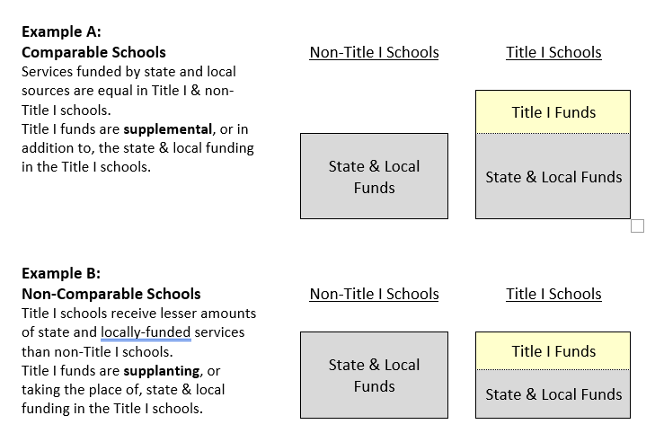
Comparability: Understanding Comparability

Slide 24
Comparability: Who needs to complete Comparability?
All districts that receive Title I
However districts that are a single school district or have one school per grade span do not need to complete comparability BUT should download the form, select their district, and complete the summary sheet.
Comparability Docs: https://www.doe.mass.edu/federalgrants/titlei-a/guidance/

Slide 25
Supplement not supplant
Supplanting is using federal funds to substitute or replace funding by district/state
Title I funds must be used to augment the regular education program – i.e., what is provided by the district with state and local funds
Supplement not Supplant Quick Reference Guide

Slide 26
Time and Effort: Who and When
Time and Effort documentation is required for all federal funded staff member and any federal funded stipend
Reports should reflect actual time and should only be logged after the work is completed.
Time and Effort Resources

Slide 27
Time and effort: Types
Semi-annual certifications are required for Title I personnel whose compensation is funded solely from the Title I grant.
Monthly reports are required for Title I personnel whose time is charged in part to Title I and in part to other revenue sources (split-funded staff).
Stipends (and other supplemental contracts) must also be reported on a monthly basis

Slide 28
Time and effort: Substitute System
Under the substitute system, semi-annual certifications can be used for staff that are funded through multiple sources or on multiple activities but maintain a consistent work schedule.
Districts choosing to use this system must complete and keep on file an Annual Management Certification form.
More information on this can be found on our website.

Slide 29
Grant Process: Applying for Title I in the consolidated ESSA application
All DESE’s RFPs are listed on Grants Management’s website
Eligibility
Contact Information
Requirements and Important Documents
Starting in FY24 all ESSA grants including Title I are in GEM$
Consolidated ESSA Application: Districts apply for Title I along with Title IIA, III, & IVA.

Slide 30
Grant Process: GEM$ Workflow
Important Reminders:
Start Date: The date the LEA Fiscal Representative initially approves the Grant to DESE.
Checklist: If your grant was returned to you, please check the Checklist for your liaison’s feedback
LEA Superintendent: The district’s actual Superintendent/Charter School Leader must be the one to sign off unless there is preapproval from DESE
DESE Fiscal Budget Approved: Your grant is fully approved, Grant Award Notice (GAN) has been generated, and you can request funds

Slide 31
Grant Process: GEM$ Signoffs
The Superintendent/Chief Executive role must be held and should be exercised by the actual organizational leader.
The Superintendent/Chief Executive must approve funding applications in GEM$ unless unavailable to approve for a length of time that would unreasonably delay submission of the funding application.
All funding applications require at least 2 sets of eyes from an LEA – the Superintendent and at least one other (either the LEA Fiscal Representative or the LEA Grantwriter, or both).
In no case should a funding application be created/approved by the same person holding all three LEA roles.
Note: The same person may be assigned all three roles in GEM$ (although this would be unusual) but cannot exercise all three roles on the same funding application.

Slide 32
Grant Process: LEA Requirements for GEM$ User Roles - Guidance and Forms
DESE has created a GEM$ LEA User Role Resource Guide designed to describe the capabilities and responsibilities that each role has in GEM$, as well as DESE’s expectations for how these roles will be used and managed by each LEA. In addition to the resource guide, DESE has created several forms (linked below) that must be used if a district wishes to assign new roles to staff. Some forms will be sent directly to DESE, others uploaded to GEM$, and the majority will solely be kept on file with the LEA. The GEM$ LEA User Role Diagram for Use of Forms provides an overview and instructions for using the forms. User Role Forms for all GEM$ Roles: GEM$ First User Access Administrator Form GEM$ Alternate User Access Administrator form GEM$ LEA General User form GEM$ LEA Superintendent Chief Exec form GEM$ Vendor Authorization User form The forms, as well as the resource guide, are also posted on the DESE Resources page of GEM$.

Slide 33
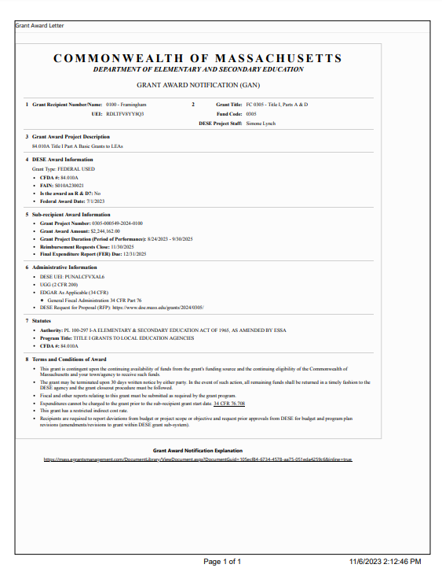
Grant Process: Grant Award Notice
The Grant Award Notice (GAN) for each grant will generate once the grant has reached DESE Fiscal Approved
Important information on the GAN:
Start Date
Award Amount
Grant Project Duration
Reimbursement Request Close Date

Slide 34
Grant Process: Multiyear
ESSA (Title I, IIA, III & IVA) are multi-year grants.
27 – month lifespan
Multiple fiscal years of ESSA will be active at the same time
The oldest funding should be used first (First in First out)
FY23 (In EdGrants)
FY23 Year 3 7/1/24 to 9/30/24
FY24 (In GEM$)
FY24 Year 2 7/1/24 to 6/30/25
FY24 Year 3 7/1/25 to 9/30/25
FY25 (In GEM$)
FY25 Year 1 Grant start date to 6/30/25
FY25 Year 2 7/1/25 to 6/30/26
FY25 Year 3 7/1/26 to 9/30/26

Slide 35
Grant Process: 15% Carryover Rule
85% of Title I must be spent in the first Federal Fiscal Year
Federal Fiscal Year ends 9/30
Example: 85% of FY25 Title I needs to be spent by 9/30/25
15% of Title I can be carried over into the second year
Simple waivers can be awarded every 3 years and allows districts to carryover more than 15%

Slide 36
Grant Process: Amendments/Revisions
FY23 and prior: Grants are in EdGrants and districts will need to contact their Federal Grant Liaison for any final amendments.
In GEM$, districts can initiate revisions.
Revisions follow the same workflow as the initial submission.

Slide 37
Grant Process: When is an amendment/revision needed?
There is any significant change in program objectives
There is any increase or decrease in the total amount of the grant
An increase in a line of the budget exceeds $100 or 10% of the line (whichever is greater) or exceeds $10,000

Slide 38
Grant Process: Final Reports
Final Reports should be completed 60 days after the final reimbursement request/end of the grant
Grants Management reviews and approves Final Reports
FR1: EdGrants
FER: GEM$
Final Financial Report
FY23 and prior for ESSA
If you are unable to see the FR1, please contact Grants Management
Final Expenditures Report
FY24 and on for ESSA
District initiate the FER

Slide 39
Who to Contact?
Federal Grant Programs
Grants Management
Programmatic questions
Allowable costs
Amendments/Revisions
Federal Grants Liaison List
Reimbursement requests
Filing FR1s/FERs
Email: EdGrants@mass.gov

Slide 40
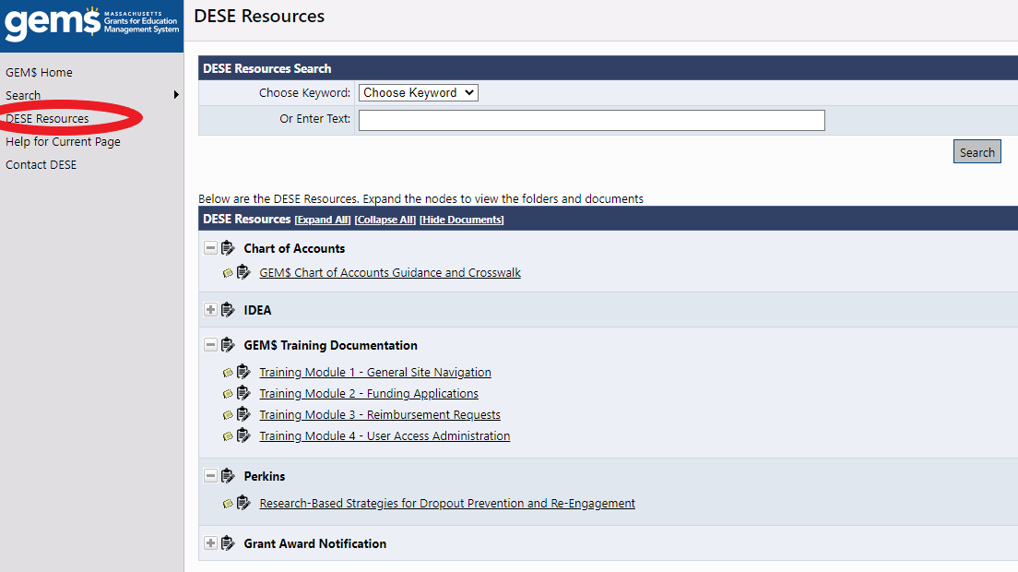
GEM$ Resources
DESE Resources:
Training documents
Chart of Accounts
User Role information & Forms

Slide 41
Private school participation – eligibility
Any district resident students who would’ve attended a Title I-served school, had they gone to their local public school
Funds must be "generated" by at least one of the eligible students at the school for there to be participation in Title I
Eligible families are surveyed for evidence of low-income status (can use FRPL program eligibility, scholarships...anything similar to low-income determination used for public school students)
Count of low-income determines allocation available for services to any of the eligible students (regardless of income status) with academic need for supplemental Title I assistance
For Title I only...follow eligible students to where they go to private schools...even outside of district boundaries

Slide 42
Private school outreach
Outreach (sent in spring prior to summer application)
Offers to consult regarding participation are sent to school administrators where eligible students attend (inside and outside of district boundaries)
Can send via email or snail mail
Must have record of response or at least receipt, if no response
See and utilize sample outreach letters on DESE website
Provide reasonable time for response/consideration, but provide deadline (follow-up as needed)
Services
Implement Title I services, oversight, and evaluation

Slide 43
Private school services
Consultation
Meet to discuss private school student needs, allocation available, means to meet needs, and ways to monitor progress and evaluate impact
Consultation is ongoing
Affirmation of Consultation with Participating Private Schools form must be signed by both parties and submitted with district grant application
Services
Title I programs in private schools are always Targeted Assistance programs
The district must maintain control of the funds at all times (never pay private school)
Anyone hired or supplies purchased is done by the district
Oversight and evaluation of the program are the responsibility of the district, in consultation with the private school

Slide 44
Private school participation resources
See website: District Level Equitable Services for Private Schools - Federal Grant Programs (mass.edu)
Sample offers of Consultation
Timelines for outreach and services
Resource guides and federal guidance
Affirmation of Consultation with Participating Schools form
ESSA Ombudsman contact information

Slide 45
Networking resources
Statewide directory of federal grant directors (directory administration): Profiles Search (mass.edu)
Federal Grants Newsletter (monthly)
Regional networking sessions
Seasonal meetings hosted by regional volunteers
DESE representative attends to assist information sharing
Announcement and registration in Federal Grants newsletter
CACE: CACE MA Title I Administrators – MA Title I Administrators (cacetitle1.org)
Membership-based group of Title I program directors – monthly meetings and conferences
CCNetwork – Region 1: About Us | Region 1 Comprehensive Center (region1cc.org)
Regional comprehensive technical assistance center sponsored by US Department of Education grant

Slide 46
Save the Date
Federal Grants Virtual Conference
November 12th – 14th

Slide 47
Questions?
Your liaison (email or phone): http://www.doe.mass.edu/federalgrants/liaisons.xlsx
Phone: 781-338-6230 (Federal Grants general line/Please always use your liaison as your first resource)
Email: federalgrantprograms@mass.gov
Website: www.doe.mass.edu/federalgrants

Slide 48
Thank you for participating

