Slide 1
Supporting new educators through induction & mentoring
Federal Grant Programs Conference
October 23, 2017
Notes:
Don’t forget to introduce yourself!

Slide 2
Agenda
Overview of 2017 Induction & Mentoring Report
Blackstone Valley Regional Vocational Technical High School
Q&A
New Bedford Public Schools
Q&A

Slide 3
What do we mean by “induction” and “mentoring”?
Mentoring: formally designed learning between a new educator and more experienced educator
Induction: includes various supports for new educators
Mentoring
Orientation
Training
Peer meetings
Notes:
Minute 1

Slide 4
What are districts required to do?
Provide trained mentors for new principals and teachers → they can obtain professional licensure
ESE offers some additiona guidance
Most decisions are up to the districts/schools
Notes:
There are some regulations, like mentors must have at least three years’ experience in the same role

Slide 5
Why do we provide induction & mentoring?
Clarifies policies, procedues and expectations
Boosts retention of educators
In turn, saves time and money
Improves student outcomes
More info is available in the…
Notes:
Citations for this available in the Induction & Mentoring Report

Slide 6
2017 Statewide Induction & Mentoring Report
276 school districts and educational collaboratives
Information about
Mentees & mentors
Program structure & funding
Program content
Outcomes, evaluation & improvement
Educator retention
Disaggregated by accountability levels, % of new teachers, & amount spent per mentee
Districts shared resources from their programs

Slide 7
2017 Statewide Induction & Mentoring Report
Estimated amount spent per mentee per year:
Notes:
Including this as an example because this is a grants conference, so it’s about funding

Slide 8
The New Teacher Induction Program
at
Blackstone Valley Tech
Spring ESE Statewide Conference
October 23rd, 2017
Presenter:
Kate Ruzanski

Slide 9
About me:
Teaching for 13 years, 10 years in current position
Spanish and Music Instructor
Passion for music and languages
Love food, travel, and football
Master’s in Administration and Leadership
8th year as Induction Program Coordinator
Go Pats!

Slide 10
About BVT:
Formed in 1964 to provide an exciting and rewarding career education option for students
1225 students from 13 towns; grades 9-12
18 Vocational Technical programs, one post-secondary program
Challenging and rigorous academic programs
9 Advanced Placement (AP®) programs
Career Readiness

Slide 11
Teachers:
Teachers - 94 total (academic/vocational; all highly qualified
Student to Teacher ratio = 12:1
Our Mission:
We create a positive learning community that prepares students for personal and professional success in an internationally competitive society through a fusion of rigorous vocational, technical, and academic skills

Slide 12
Sink or swim?
Notes:
personal experience/why I got started with the program

Slide 13
Why?
Our profession is overwhelming at first
New teachers need to feel supported
Even a veteran teacher needs support acclimating to a new culture and environment
Having a strong network of support is key

Slide 14
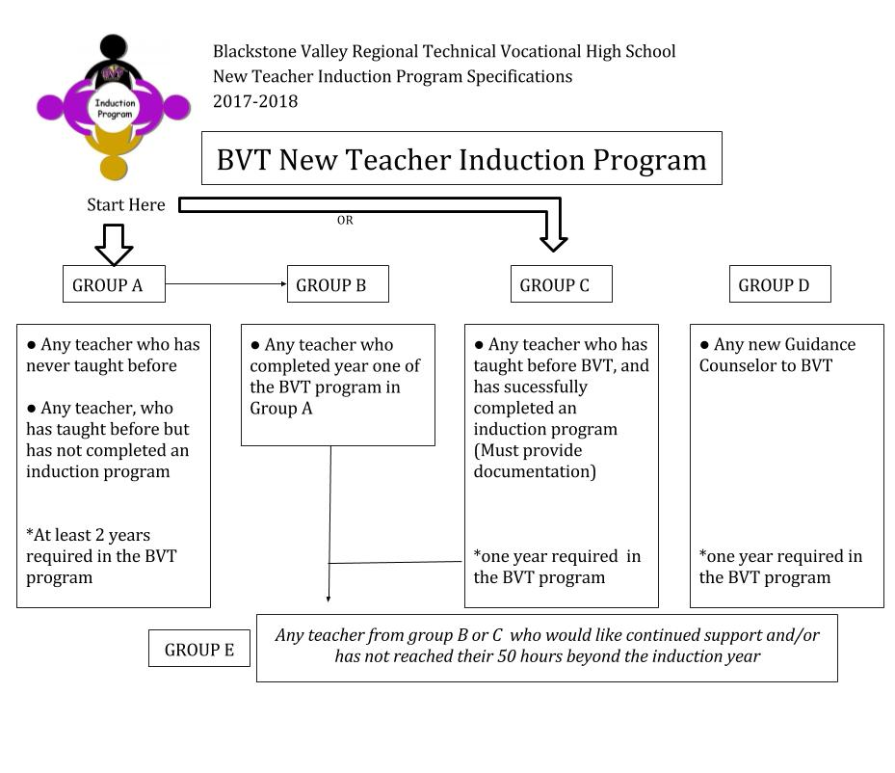
Group A - New to teaching
Group C - New to the district

Slide 15
New This Year:
New Teacher Induction Extension Program
Extra support for teachers who are no longer required to take part
Coordinators act as mentors
Opportunity to make up/complete mentoring hours (50 beyond the induction year)
Crucial year for many looking forward to gaining professional status
Check-ins, online forums, articles, checklists, reflections

Slide 16
Where we started
Mission and goals
What do you want teachers to get out of the program?
Administrative support
Assigned mentors
Timing - 1st day of school
Quality mentor pool
Matched according to location/area/experience
Monthly meetings for mentees
Focus areas
Mentor training
System of documentation

Slide 17
The New Teacher
Induction Program
The mission of the New Teacher Induction Program is to support,
encourage and guide teachers who are new to the Blackstone Valley
Tech School District, and provide them with collegial, non-judgmental
and intensive assistance in accordance with Massachusetts Guidelines
for Induction Programs.
The New Teacher Induction Program will improve the quality of
teaching. Leading by example, and demonstrating meaningful,
engaging, and high quality educational practices, coordinators and
mentors will work collaboratively with mentees to foster optimum
student success, in line with the BVT mission statement and
our tradition of excellence.
Support ◆ Training ◆ Retention

Slide 18
Where we started
Mission and goals
What do you want teachers to get out of the program?
Administrative support
Assigned mentors
Timing - 1st day of school
Quality mentor pool
Matched according to location/area/experience
Monthly meetings for mentees
Focus areas
Mentor training
System of documentation

Slide 19
Where we started
Mission and goals
What do you want teachers to get out of the program?
Administrative support
Assigned mentors
Timing - 1st day of school
Quality mentor pool
Matched according to location/area/experience
Mentor training
Monthly meetings for mentees
Focus areas
System of documentation

Slide 20
Mentors
What qualities do new teachers believe would make a good mentor?
“Willing to answer questions, accessible, caring, experience, patient, friendly, kind, helpful, straightforward, approachable...”

Slide 21
Mentor Training
Sharing the vision
Commitment
Detailed syllabus of expectations
Confidentiality
Bi-monthly meetings
Documentation protocol
Working through the packets
How to work with difficult people
How to manage time
Peer observation

Slide 22
Where we started
Mission and goals
What do you want teachers to get out of the program?
Administrative support
Assigned mentors
Timing - 1st day of school
Quality mentor pool
Matched according to location/area/experience
Mentor training
Monthly meetings for mentees
Focus areas
System of documentation

Slide 23
Mentees: Overview
Orientation
Monthly meetings
Support groups
Interactive and easily accessible resources
Tip sheets and guides
Scavenger hunt/exploring the community
The whole school gets involved!
Guest presenters from various areas (Student services, safety, Special Education etc.)
Peer observations

Slide 24
Focus Areas
Teacher’s professional responsibilities
Expectations
Teacher Evaluation trainings
District and school policies and procedures
Key resources
Classroom management
Effective parent communication
Time management
Emotional support
Assessment/ lesson planning
Special education policies and training
Learning and teaching strategies
Standards based curriculum
Technology
Organization
Peer observations

Slide 26
Monthly Meetings
Calendar Updates
Model teaching
Guest presenters
Time for questions and answers
Have more experienced teachers sharing and guiding the less experienced teachers
Professional development
Share PD opportunities with the mentees
Classroom management, planning etc.
They do not always know where to find PD

Slide 27
Adjustment to Practice
Surveys
Sometimes the teachers don’t know what to ask
Provide as many focus areas as possible
Tailoring the scope and sequence to meet the needs of the new teachers
Orientation questionnaire
Survey Monkey or other online format

Slide 28
Where we started
Mission and goals
What do you want teachers to get out of the program?
Administrative support
Assigned mentors
Timing - 1st day of school
Quality mentor pool
Matched according to location/area/experience
Mentor training
Monthly meetings for mentees
Focus areas
System of documentation

Slide 29
Documentation
Interactive log - one per mentor; Mentor’s responsibility to complete by the end of each month
Goal of at least 2 hours of communication time each month
Compiled log - coordinator responsibility
Hours from meetings and direct communication with mentor
Mentee’s responsibility:
Must attend 15 hours of meetings
Must communicate 2 hours/month with mentor

Slide 30
Additional Components
Bi-Monthly Activity Packets
Provided to mentors
Goals, mission and topics (Expectations/objectives)
Activity
Article, discussion, challenge activity
Discussion/reflection prompts
If mentees need to discuss other issues, we encourage it. The packets are just for the sake of discussion and to build better mentor/mentee relationships.

Slide 31
Peer Observation
At least one peer observation per year
Mentor observes mentee
Mentee observes another teacher
Completely informal
Never officially documented
less nerve-wracking
Pre- and post- conference forms
What to look for, areas for improvement
Release time is available/Subs
Mentee observation form

Slide 32
Keeping everyone informed
Mentors and Mentees all have access to a shared network folder created by the coordinators.
Communication log
Agendas
Calendars
Scope and Sequences
Important documents
Handouts

Slide 33
Buy-in and Funding
How do we get the mentors on board?
Shared vision
Administrator’s assistance
Repeat mentors - returning mentors
Faculty meeting presentation
Compensation
$300 – Title IIA
Goal is to get them to want to be a part of this program for the overall outcomes
Support and regular check-ins from coordinators

Slide 34
Reflections
Teacher retention is high -
between 2011-2017 we have not had a single teacher resign within their first 3 years of teaching to pursue careers outside education
Those who have left, most of them are still teaching
Very positive feedback from new teachers
End of year surveys
Always reflecting, reassessing and changing to fit the needs of the teachers
Amazing pool of mentors
Sharing knowledge, experience and vision
Each year we strive to do something bigger and better

Slide 35
Resources:
Kate Ruzanski
kruzansk@valleytech.k12.ma.us
-OR-
HeyMissR@gmail.com
New Teacher Induction: How to Train, Support, and Retain New Teachers - Annette L. Breaux and Harry K. Wong
Creating a Mentoring Culture - Lois J. Zachary
Mentoring Guidebook - Kathleen B. Burke
MTA Guidelines- Charting a Course: A Mentor Program Handbook; 2001

Slide 36
Questions?

Slide 37
New Bedford Public Schools

Slide 38
Questions?

Slide 39
Thank you!
Questions: EducatorDevelopment@doe.mass.edu
Report available at: doe.mass.edu/educators/mentor/reports.html

