Slide 1
FY19 EOYR summer workshops
July and August 2019
Notes:
Rob starts

Slide 2
Table of contents
01
General reminders
02
EOYR-EPIMS crosswalk and updates to the chart of accounts
03
Review of schedules
CONTENTS
04
NSS, edits, reports, amendments, audits, and Excess Cost Calculator
05
State budget news
06
Claiming for foster care transportation reimbursement

Slide 3
General reminders
General reminders
01

Slide 4
DESE contacts
Topic | Name | Email | Phone
General inquires | Aquarius Wise | awise@doe.mass.edu | 781-338-6526
Chapter 70 | Rob O’Donnell Rob Hanna | rodonnell@doe.mass.edu robert.hanna@doe.mass.edu | 781-338-6512 781-338-6525
School Choice | Rob O’Donnell | rodonnell@doe.mass.edu | 781-338-6512
Charter School Tuition and Reimbursement | Hadley Cabral Rob O’Donnell | hcabral@doe.mass.edu rodonnell@doe.mass.edu | 781-338-6586 781-338-6512
Circuit Breaker | Jay Sullivan Craig Delmonte Elena DeMelin | jsullivan@doe.mass.edu craig.delmonte@doe.mass.edu edemelin@doe.mass.edu | 781-338-6594 781-338-6536 781-338-6591
EOYR and District Spending Comparisons | Rob O’Donnell Craig Delmonte | rodonnell@doe.mass.edu craig.delmonte@doe.mass.edu | 781-338-6512 781-338-6536
Collaboratives and Regional Governance | Christine Lynch Ruth Hersh | clynch@doe.mass.edu rhersh@doe.mass.edu | 781-338-6520 781-338-6588
Transportation | Jay Sullivan | jsullivan@doe.mass.edu | 781-338-6594
Grants | Jenn Ahern | jahern@doe.mass.edu | 781-338-3215
Excess Cost Calculator | Caitlin Hogan | chogan@doe.mass.edu | 781-338-6511

Slide 5
Purpose of Report
Education reform compliance and state aid
Federal requirements and entitlements
Statistical analysis for determining:
  Per pupil spending
  Average teacher salaries
  School choice and non-resident vocational tuition rates
  Charter school tuitions
  Indirect cost rates
  Maintenance of effort
  Special education expenditures
  Edwin Analytics, RADAR, DART, and district reviews

Slide 6
EOYR due by Tuesday, October 1, 2019
Commissioner will only grant extensions under urgent and extenuating circumstances
Signed certification statement required
Regional districts must submit the transportation certification to qualify for reimbursement
Files will be downloaded from and uploaded to the Security Portal
Files should be available by August 16th

Slide 7
General items
Modified accrual
Revenues and expenditures reported by funding source
Round to the whole dollar
Use edits to resolve errors
Non-NSS line items are shaded
New and * indicates new reporting categories
! refers to item that we want to pay close attention to

Slide 8
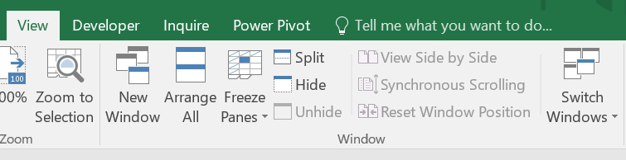
File management
Files are still generated as .xls EXCEL 2003
Sheets are protected
Freeze panes won’t work but view Split will:
Enable macros:
Retain the original filename for your working file
Press Ctrl + P to activate the print menu

Slide 9
Other reminders
DO make a backup copy of your EOYR file
DON’T cut and paste values
DON’T enter spaces to represent zeros
DON’T change formulas
DON’T enter negative numbers
DON’T mail a hard copy printout to us

Slide 10
EOYR-EPIMS crosswalk and updates to the chart of accounts
EOYR-EPIMS crosswalk and updates to the chart of accounts
02

Slide 11
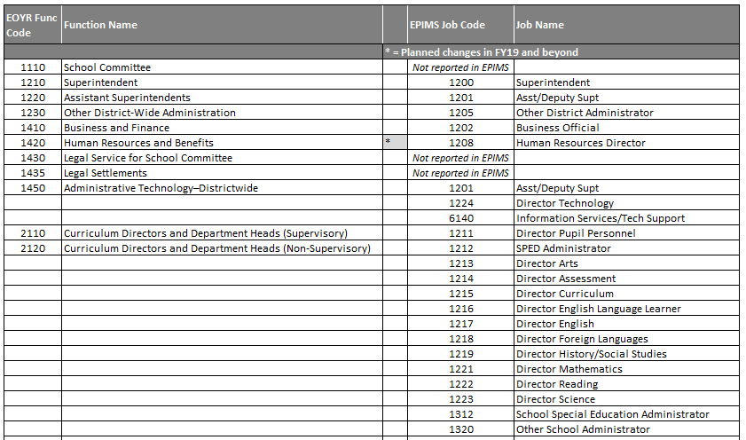
EOYR-EPIMS crosswalk
Improve alignment and data quality
Updated to reflect recent COA and EPIMS changes (see * for new EPIMS codes)
Notes:
New EPIMS codes: 1208 Human Resources Director, 3324 Educational Interpreters, 1210 Supervisor/Director of Guidance, 3333 Pathways Coordinator, 3332 Family Engagement Coordinator, 3331 School Resource Officer

Slide 12
EOY19: Technology function code changes
Current format makes it difficult to draw conclusions about districts’ technology investments statewide
Districts are making different reporting choices within the functions we do collect, comparisons amongst districts cannot be made
Like professional development, districts’ technology needs have changed dramatically in the years since the COA was put in place.

Slide 13
District level
Code | Update | Previous
1450 | Administrative Technology–Districtwide | Districtwide Information Management and Technology
4400 | Technology Infrastructure, Maintenance, and Support–Salaries | Networking and Telecommunications
4450 | Technology Infrastructure, Maintenance, and Support—All Other | Technology Maintenance
2250 | Administrative Technology and Support – Schools: | Non-Instructional Building Technology
2451 | Instructional Hardware –Student and Staff Devices (computers) | Formerly part of 2451 Classroom Instructional Technology
2453 | Instructional Hardware—All Other: | Formerly part of 2451 Classroom Instructional Technology
2455 | Instructional Software and Other Instructional Materials | Formerly 2455 Instructional Software and part of 2410 Textbooks, Related Software/Media/Materials
2130 | Instructional Technology Leadership and Training | New function
2345 | Distance Learning and Online Coursework | New function: Distance learning was formerly part of 2440 Other Instructional Services.
2410 | Textbooks | 2410 Textbooks, Related Software, Media, and Materials
Notes:
1. Only include software systems that are related to curriculum, lesson planning and assessment in the 2000 series. Grades, parent notification, attendance stay in 1450.
2. Support costs (staff) should be reported in 4400 Technology Infrastructure, Maintenance, and Support. If you have staff that supports both the central office and individual schools, report their salary here. If you have staff specifically assigned to schools, report them in 2250.

Slide 14
Grants reporting
Last year we moved to state fiscal year reporting of ALL grant expenditures: July 1 to June 30
Revenues will reflect payments drawn down during this period

Slide 15
Review of schedules
Review of schedules
03

Slide 16
Schedule 3: Instructional spending by school
School Finance regulations 603 CMR 10.03 (3)(a):
  Each school district shall utilize a financial accounting system that permits the reporting of all school district expenditures by fund source, object, and function, and permits the reporting of certain costs by program, grade level and school.
Complete Schedule 3 first
Include instructional spending from all funding sources
Athletic expenditures removed from Schedule 3

Slide 17
Schedule 1, Part I: Revenue
Sections:
  Local sources + E-Rate
  State aid: Pre-populated except for school construction
  Federal grants: DESE administered grants pre-populated
  State grants: DESE administered grants pre-populated
  Revolving and special funds: School choice receipts pre-populated
Report grant revenues from July 1 to June 30
Note: Districts must report federal and state grant revenues received directly or from other agencies
Notes:
Jay picks up here

Slide 18
Schedule 1, Part II A: School committee expenditures
School committee expenditures:
  Administration (1000)
  Instruction (2000): Populated from Schedule 3
  Pupil services (3000)
  Transportation (3300, 6900): Maintain depreciation schedule, reconcile with Schedule 7
  Maintenance (4000): Extraordinary maintenance <$150,000
  Rental (5300): Maintain rental schedule
  Crossing Guards (5550)
  Short-term Debt – (5400/5450) RANS/BANS
  Civic Activities and Community Services: Include adult education
  Fixed assets (7000)
  Long-term Debt (8000): Regionals only, do not include principal for bonded extraordinary maintenance, see Guidance for Reporting School Construction
  Tuition (9000): School choice and charter tuition included for regional school districts

Slide 19
Schedule 1, Part II B: City/town expenditures
Reporting city/town expenditures as allowed by state aid regulations 10.04:
  Administration (1000): Per pupil cost for FY18 is $118.09
  Transportation (3300, 6900): Reconcile with Schedule 7
  Extraordinary maintenance (4300): Extraordinary maintenance <$150,000
  Benefits and insurance (5200, 5250, 5260): Report administrative costs as 1420
  Rental (5300): Do not record lease/purchase costs, maintain rental schedule
  RANS (5400): Revenue anticipation notes (operating)
  BANS (5450): Short-term debt (capital)
  Long-term debt (8000): Do not include principal for bonded extraordinary maintenance or debt as part of capital assessment to regional districts, see Guidance for Reporting School Construction
  Tuition (9000): School choice and charter tuition included for municipal districts

Slide 20
Schedule 1, Part II C.2: Expenditures from federal grants, state grants, and special funds
Report expenditures by function:
  Federal grants from DESE or other state/federal agencies
  State grants from DESE or other state agencies
  Revolving and special funds:
    Circuit breaker
    School choice receiving tuition
    Private grants and gifts
    Athletic fund
    School lunch (include state and federal reimbursements)
All grant expenditures reported from July 1 to June 30

Slide 21
Schedule 2: Regional school assessments
Categories of reporting (*apportioned according to regional agreement):
  Minimum contribution
  Above minimum*
  Transportation*
  Capital costs*
Do not report E&D
Indicate whether you use the statutory or agreement method to assess costs
Resolve any differences with Schedule 1, line 10, column 7

Slide 22
Schedule 4: Special education expenditures by school committee, city/town, circuit breaker, and grants and placement
Report school committee, city/town, and circuit breaker expenditures by function:
  Instructional services (2000)
  Tuition (9000)
  Non public health (6800)
Grants and other funds reported on line 3930
Reconcile any differences with Schedule 1, column 2, special education

Slide 23
Schedule 7: Pupil transportation
Report expenditures from appropriated funds and the associated number of riders transported at public expense
  Include municipal and school committee costs
  Report by program
    Special education: Delineate in- and out-of-district costs and riders
    Vocational: Include out-of-district transportation costs and riders
  Report by reimbursable and non-reimbursable categories
  Report in accordance with 10.08 and 10.09 of the school finance regulations

Slide 24
Schedule 7: Pupil transportation (continued)
Transportation expenditures reported in columns 1 through 5 must have corresponding pupil rider data reported in columns 6 through 9
Expenditures and student counts for school choice and charter school students regardless of mileage must be reported in column 3 and 8
Report homeless transportation expenditures on lines 4283 and 4285
Report foster care transportation on line 4286
Maintain a depreciation schedule, if applicable.
Special education costs and riders are reported by columns, all other programs are reported on separate lines

Slide 25
Schedule 7: Pupil transportation (Continued)
Expenditures from fees deposited into revolving accounts must be reported on line 4320
Reimbursable expenditures are based on “portal to portal” measurement
Reimbursable expenditures are based on expenditures for transporting students living at least 1 ½ miles from school once daily to and from school
Resolve any differences with Schedule 1, function codes 3300 and 6900 for both school committee and city/town expenditures

Slide 26
Please complete the workshop evaluation
http://bit.ly/2tkdWuw

Slide 27
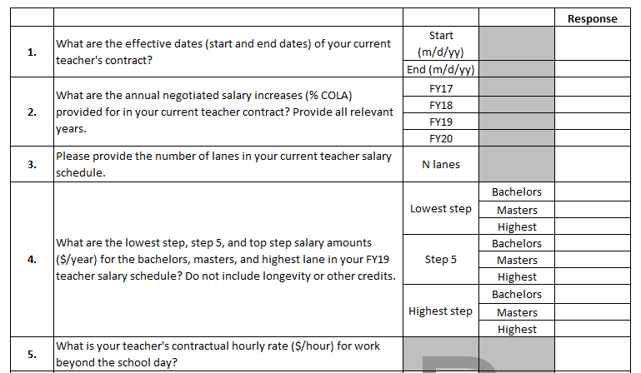
Schedule 18 collects teacher contract details
Notes:
Craig picks up here

Slide 28
Schedule 19: FY20 budget
Purpose:
  Determine school district’s compliance with FY20 NSS requirement
  Information and statistical reporting
  Cherry sheet estimates for school transportation
  Charter school rates

Slide 29
Schedule 19 A.1: School committee appropriation
Report by expenditure classification and programs
Include Adult Education in Community Services (6000)
School choice/charter school tuition is based on cherry sheet estimates, but the cells are not locked and districts can change the amounts as needed
DESE uses the most current choice/charter tuition in calculating FY20 net school spending, regardless of what is included on the EOYR
Only regions should report long-term debt

Slide 30
Schedule 19 A.2: City/town appropriation
Report only expenditures allowed under school finance regulations, section 10.04
Must be for services directly related to the school department and based on a written agreement
FY20 per pupil administrative cost average is $121.53
Long-term debt for municipal districts
Starting in FY20 we are classifying charter transportation tuition as a non-NSS item

Slide 31
Schedule 19 B: Estimated revenues
Purpose to track education reform compliance
Local sources: Include assessments and E&D funds for regional districts
General fund receipts
Revenues that are not used to offset NSS are highlighted in report
Do not include school choice receipts, grants, or any other revolving or special funds

Slide 32
Schedule 19 C: Estimated regional assessment
Categories of reporting (*apportioned according to regional agreement):
  Minimum contribution
  Above minimum*
  Transportation*
  Capital and debt*
  Assessment voted
  Budgeted E&D
Indicate whether you use the statutory or agreement method to assess costs

Slide 33
NSS, edits, reports, amendments, audits, and Excess Cost Calculator
NSS, edits, reports, amendments, audits, and Excess Cost Calculator
04

Slide 34
Comments and reports
Comments: Include comments, explanations, and problems
Reports tab:
  NSS compliance FY19 and FY20
  3 year comparative data (use to check your submission)
  Average teacher salaries
  Title I and IDEA maintenance of effort

Slide 35
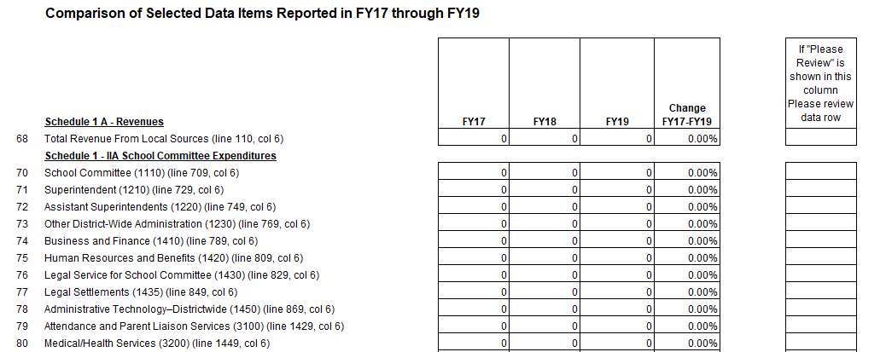
Use the three year comparison to identify reporting errors

Slide 36
FY19 Net School Spending
School committee expenditures from Schedule 1
Some categories use budgeted city/town expenditures:
  Administration (1000)
  Educational media (2500)
  Health (3200)
  Maintenance (4000)
  Rental (5300)
Notes:
Rob picks up here

Slide 37
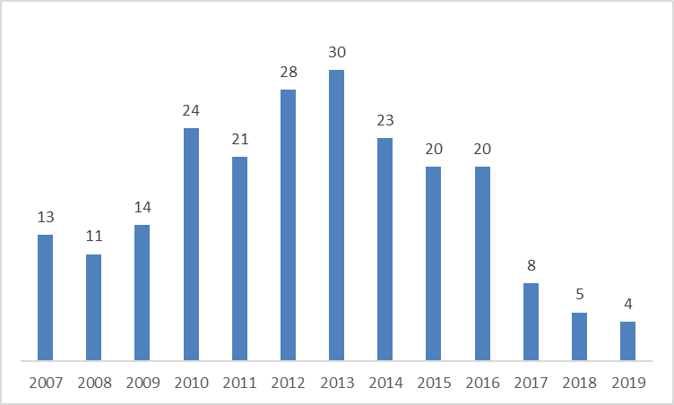
Number of districts that failed to meet NSS requirement

Slide 38
Edits
Edit 1 – Transportation fees and expenditures Schedule 1 compared to Schedule 7
Edit 2 – Correspondence of riders and transportation expenditures
Edit 3 – Regional district member but no assessment reported
Edit 4 – Correspondence of revenues and expenditures from grants and other funds
Edit 5 – Schedule 1 expenditures compared to Schedule 4
Edit 6 – Schedule 19 instructional spending by program
Edit 7 – Schedule 1 vs Schedule 7 transportation expenditures
Edit 8 – Schedule 4 grant expenditures
Edit 9 – MSBA one-time payments/purchase of land and buildings
Edit 10 – Schedule 18 check
Edit 11 – Employee separation costs
Edit 12 – IDEA Maintenance of Effort (MOE)
There is not an edit for every possible error
Notes:
Craig picks back up here

Slide 39
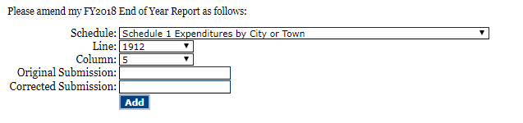
Amendment smart form on the security portal
Recommend Chrome or Explorer, do not use Firefox
Enter original numbers correctly
Going forward amendments will only be open for 1 year after the report is submitted
Amended workbooks will be posted to the Portal
Do not submit a new workbook; contact us first if you think the situation requires it

Slide 40
Audit requirement
EOYRs must be audited by an independent auditor (CPA) when they conduct the A-133 Single Audit for your city, town or regional school district
All audit reports should be emailed to: auditreports@doe.mass.edu
We are reviewing audit reports more systematically and following-up on amendments identified by the auditors if they are not submitted

Slide 41
NEW: Excess Cost Calculator
Use the Excess Cost Calculator to calculate the minimum amount of funds to be spent in FY20 on special education before (or concurrently with) using IDEA Part B section 611 and 619 funds
Excess cost must be calculated by the beginning of each school year
If a district determines that they will not or have not met the excess cost requirements, they must notify DESE and will be subject to repayment of IDEA Part B section 611 and 619 federal funds
The district should maintain all supporting documentation for future follow up with DESE’s Audit and Compliance unit
If no local or state funds are available for non-disabled children ages 3-5 and 18-21, then the excess cost requirement does not apply to students with disabilities in those age ranges

Slide 42
NEW: Excess Cost Calculator
The Excess Cost Calculator will be a separate tab on the EOYR workbook
We will cross validate some of the totals that you enter in the calculator with Schedule 1, but not all:
  E: Total Title III Parts A & B expenditures
  G: State and local funds for Title I and Title III programs
You will need to allocate your spending between elementary and secondary
This data is being collected for DESE’s Office of Special Education Planning and Policy

Slide 43
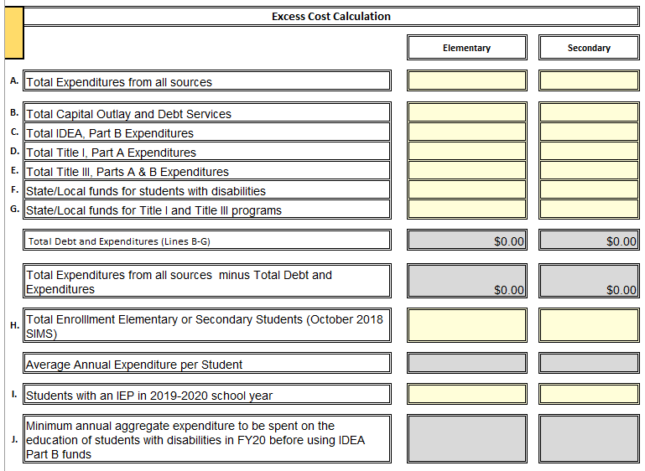
We will provide EOYR totals to help validate some, but not all categories

Slide 44
State budget news
State budget news
05
Notes:
Rob picks up here

Slide 45
FY20 state budget
Chapter 70
Charter school reimbursement
Circuit breaker
  Expect reimbursements to be funded at the statutory maximum (75%)
Transportation reimbursement
  Regional Transportation should be reimbursed at 80%
  Homeless Transportation should be reimbursed between 38%-40%
  Non Resident Vocational Transportation should be reimbursed at approximately 5%

Slide 46
Chapter 70 funding totals $5.176 billion, an increase of $268.4 million or 5.5% over FY19, including FBRC rate changes
$ Aid | Formula component
$136.3M | Full funding of foundation and base aid requirements, reflecting current rate of inflation
$30.0M | Further increase in foundation budget formula for health care, including benefits for retirees
-$1.4M | Additional increase in the factor for educating English language learners
$80.7M | Increased support to districts serving highest concentration of economically disadvantaged students
$13.5M | Minimum aid: House 1 $20/pupil, HWM and SWM $30/pupil PLUS hold harmless
$4.6M | Increase in funding to help districts meet rising out-of-district special education costs
$4.7M | Increase in funding to help districts meet rising in-district special education costs
$268.4M | Total aid increase

Slide 47
Charter school reimbursements are funded at $115 million, an increase of $25 million over FY19
Transition aid returns to a 3-year reimbursement schedule: 100%/60%/40%
$15 million targeted to address two specific items:
  $7.5 million in supplemental aid for districts with high charter tuition costs and relatively low Chapter 70 aid (Boston is the only eligible district)
  $7.5 million to mitigate the costs associated with significant and sustained charter school enrollment growth (distribution TBD)
Facilities component of the charter school tuition rate was increased to $938 per pupil, districts continue to be fully reimbursed for these costs
Notes:
Hand-off to Jay/Craig to talk about circuit breaker and transportation

Slide 48
Claiming for foster care transportation reimbursement
Claiming for foster care transportation reimbursement
06

Slide 49
Please complete the workshop evaluation
http://bit.ly/2tkdWuw

Slide 50




Thank you
THANK YOU
DESE District and School Finance Team
781.338.6585
sfinance@doe.mass.edu
www.doe.mass.edu
75 Pleasant Street, Malden, MA 02148

