Slide 1
FY19 Chapter 70
General Appropriations Act
July 26, 2018

Slide 2
Highlights
FY19 Chapter 70 is $4,907,573,321
  $161 million (3.4%) increase from FY18
Foundation budgets are increased by an inflation factor of 2.64%.
Implementing the Recommendations of the Foundation Budget Review Commission
GAA includes an increase to the “Benefits and Fixed Charges” foundation budget rate, based on the recommendations of the 2015 Foundation Budget Review Commission. It continues to implement a rate which acknowledges the rapid rise of healthcare costs relative to inflation, and builds in a component to recognize the cost of retiree healthcare.
  This increase phases in another 14% of the total recommendation.

Slide 3
Highlights (continued)
Implementing the Recommendations of the Foundation Budget Review Commission (continued)
GAA also converts the English language learner (ELL) rates into incremental rates for each grade level category. Similar to economically disadvantaged students (“eco dis”), ELL students are now included in grade level foundation components and then assigned an additional amount based on their English learner status. For example, an ELL elementary school student would be assigned the elementary base rate and the corresponding ELL incremental rate.
  For each grade level category, GAA set the increments at levels that closed the gap between prior rates and the new ELL targets by 65 percent. See slide 12 for the incremental rates for FY19.

Slide 4
Highlights (continued)
Economically Disadvantaged Students
Economically disadvantaged (“eco dis”) enrollment continues to replace free and reduced price lunch data, which is no longer available for all districts as a result of districts’ participation in the USDA’s Community Eligibility Program.
  This measure includes those students qualifying as a match in the following programs included in the Commonwealth's direct certification system, which is maintained in the Executive Office of Health and Human Services Virtual Gateway system: Supplemental Nutrition Assistance Program (SNAP), Temporary Assistance for Needy Families (TANF), Medicaid (MassHealth), and foster care. Due to an expansion of Medicaid programs being used to identify qualifying matches with foundation enrollments, the measure now aligns more closely with the criteria used for other programs administered by the Department and adds 24 thousand students to the measure statewide over FY18 levels.
The decile assignment is done in the same manner as the prior year. The foundation budget rate applied to a district’s economically disadvantaged students is based on a district’s concentration of those students
  Number of economically disadvantaged students / Foundation enrollment = % economically disadvantaged
  Districts are then sorted into deciles based on this calculation. Each decile group corresponds to a foundation budget rate. Decile 10 includes those districts with the highest concentration of eco dis students.
  The lowest decile rate is set at $3,619.57 and each subsequent decile increases by $40 up to the highest decile rate of $3,979.57. These levels reflect a rate reduction of $300 in response to the significant expansion of student matches towards the low income head count that existed in foundation enrollments prior to the shift to “eco dis”. Consistent with the changes in rates that were made during that shift, the rate adjustment was designed to maintain the level of resources available to districts to support the education of this population.

Slide 5
Highlights (continued)
The equity component of the formula continues to be phased-in. Those communities required to contribute more than their targets will have the gap between their required and target local contributions reduced by 100%.
All districts receive at least $30 per pupil in additional aid over the prior year.

Slide 6
Goal of the Chapter 70 formula
To ensure that every district has sufficient resources to meet its foundation budget spending level, through an equitable combination of local property taxes and state aid.

Slide 7
Chapter 70 aid is determined in three basic steps
A district’s Chapter 70 aid is determined in three basic steps:
  It defines and calculates a foundation budget, an adequate funding level for each district, given the specific grades, programs, and demographic characteristics of its students.
  It then determines an equitable local contribution, how much of that “foundation budget” should be paid for by each city and town’s property tax, based upon the relative wealth of the community.
  The remainder is funded by Chapter 70 state aid.
Local Contribution + State Aid = a district’s Net School Spending (NSS) requirement. This is the minimum amount that a district must spend to comply with state law.
Notes:
--Calculating the district’s foundation budget is the first step in determining aid.
--Aid is derivative of the city/town’s local contribution, allocated to each district to which it belongs. That is, the local contribution is calculated first, and then the remainder of the foundation budget is made up by the state in aid to each district.
--Compliance With Net School Spending Requirements (http://finance1.doe.mass.edu/chapter70/compliance.html)
The Commonwealth's school finance statute, Chapter 70 of the General Laws, establishes an annual "net school spending" requirement for each Massachusetts school district. Failure to comply with this requirement may result in non-approval of a municipality's tax rate, enforcement action by the Attorney General, or loss of state aid.
Detailed data about prior year expenditures and current year budgets are submitted annually on each school district's End-of-Year Pupil and Financial Report. Once a district's information has passed ESE review, its compliance report is published on this web site.

Slide 8
Districts receive different levels of Chapter 70 aid, because their community’s ability to pay differs
Notes:
Updated 7/18/18

Slide 9
Key Factors in School Funding Formula
Foundation Budget
Enrollment
Wage Adjustment Factor
Inflation
Local Contribution
Property value
Income
Municipal Revenue Growth Factor
These six factors work together to determine a district’s c70 aid.

Slide 10
Foundation budgets are an indication of student need
Notes:
Updated 7/8/18

Slide 11
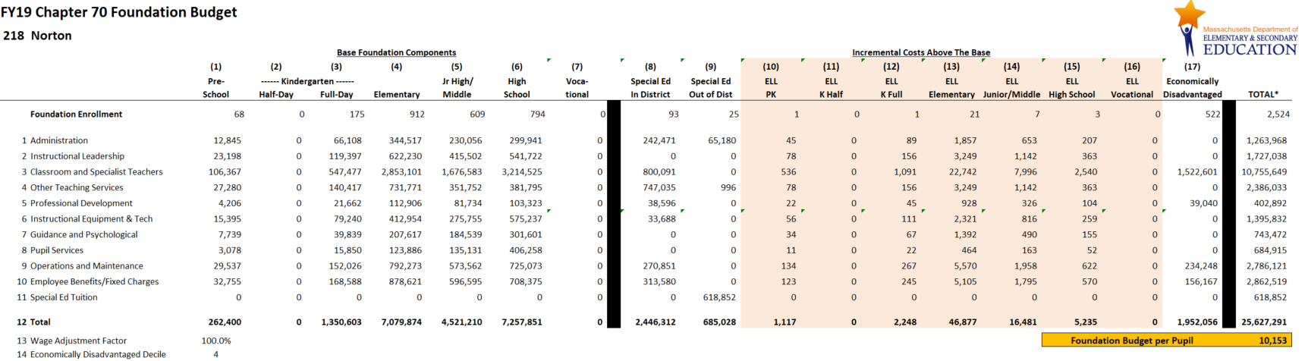
A district's foundation budget is derived by multiplying the number of pupils in 17 enrollment categories by cost rates in 11 functional areas.
All of your students are counted in categories 1-9. Special education and English language learner (ELL) and economically disadvantaged costs
are treated as “costs above the base” and are captured in 10-17.
Notes:
Updated 7/20/18

Slide 12
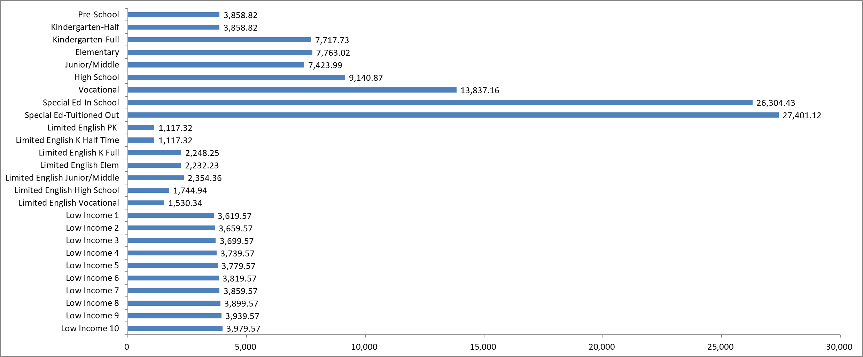
Foundation budget rates reflect differences in the cost of educating different types of students.
Notes:
Updated 7/20/18

Slide 13
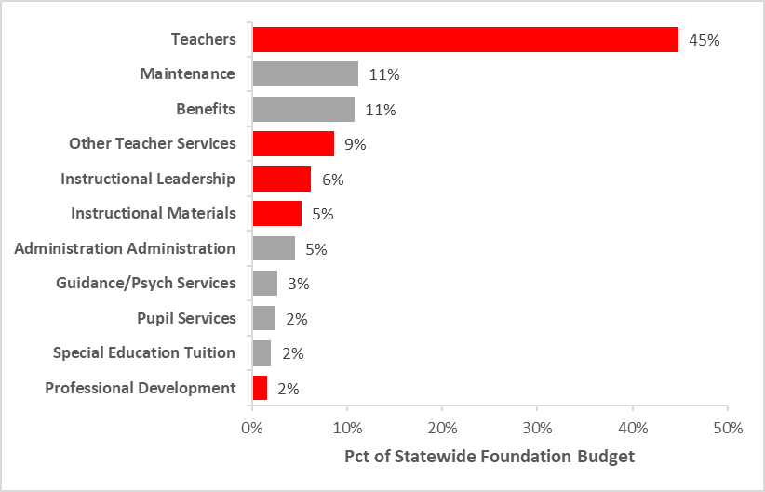
Instructional categories (in red) comprise 66% of the statewide foundation budget.
Notes:
Updated 7/20/18

Slide 14
Local Contribution
Establishing local ability to pay
The foundation budget is a shared municipal-state responsibility.
Each community has a different target local share, or ability to pay, based on its property values and residents’ incomes.
Prior to this policy, required local contributions had become less linked to ability to pay. A process was established in 2007 to move each community from its 2006 baseline to its new target.

Slide 15
How is the required local contribution calculated?
Determining each community’s target local share starts with the local share of statewide foundation.
Calculate statewide foundation budget.
Determine local share of statewide foundation.
Statewide, determine percentages that yield ½ from property and ½ from income.
Statewide Foundation Budget
$10.778B
41% State Aid
$4.419B
59% Local Contribution
$6.359B
Income Effort
1.4306%
$3.179B
Property Effort
0.3676%
$3.179B
Property and income percentages are applied uniformly across all cities and towns to determine the combined effort yield from property and income.
Notes:
--From MassBudget, “the state expects that each municipality can contribute the same share of local resources to the foundation budget by setting uniform contribution rates.”
--Local contribution/local share is a municipal measure.

Slide 16
Individual communities’ target local shares are based on local property values and income, and foundation budget.
To determine local effort, first apply this year’s property percentage (0.3676%) to the town’s 2016 total equalized property valuation
Then apply this year’s income percentage (1.4306%) to the town’s 2015 total residential income
Local Property Effort
+ Local Income Effort
= Combined Effort Yield (CEY)
Target Local Share = CEY/Foundation budget
  Capped at 82.5% of foundation
  In FY19, 100 of 351 communities are capped.
Notes:
Updated 7/23/2018

Slide 17
Getting Closer To the Target Contribution
Determining the Upcoming Year’s Local Contribution
Preliminary Contribution
Increase last year’s required local contribution by the municipality’s Municipal Revenue Growth Factor (MRGF)
  Calculated annually by the Department of Revenue
  Quantifies the most recent annual percentage change in each community's local revenues, such as the annual increase in the Proposition 2½ levy limit, that should be available for schools
Required Contribution
If the preliminary contribution is above the target, reduce by the effort reduction percent (100% in FY19).
If the preliminary contribution is below by less than 2.5%, the preliminary contribution becomes the new requirement.
If the preliminary contribution is below by more than 7.5%, an additional 2% is added to the preliminary contribution. For those below by between 2.5 and 7.5%, 1% is added.
Notes:
Updated 7/18/2018

Slide 18
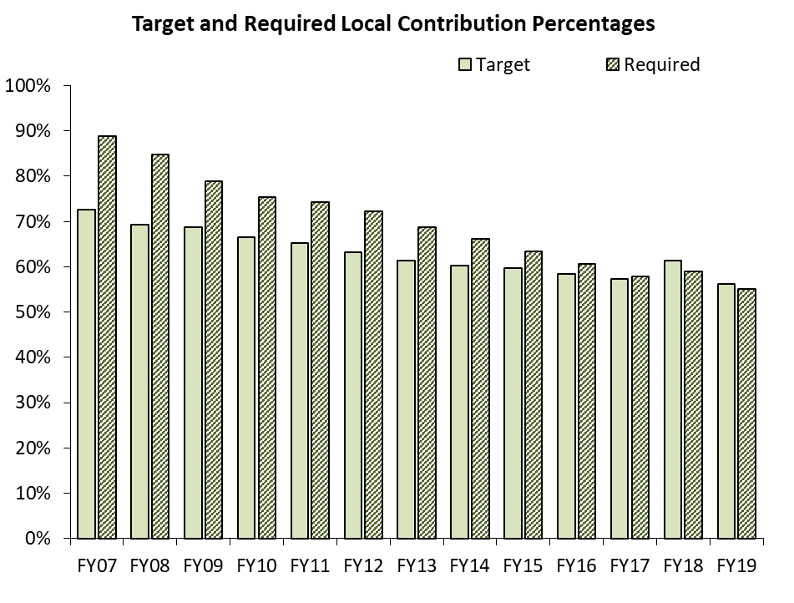
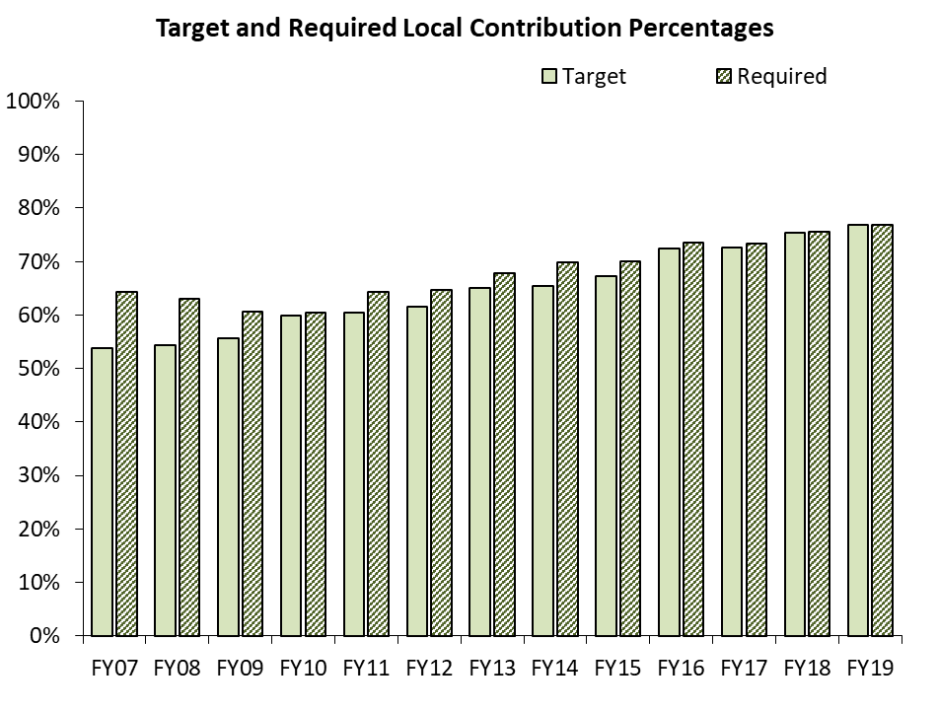
Each community transitions to its target local share at a different pace.
Framingham
Hampden
Notes:
Updated 7/20/18
--The six factors referenced earlier impact how quickly each community approaches its target. State revenue available to increase C70, and political preferences, also impact the result.

Slide 19
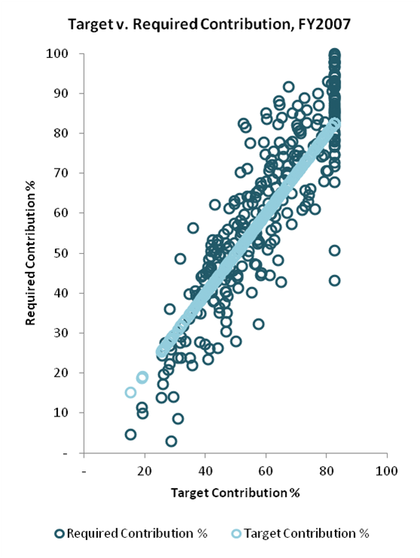
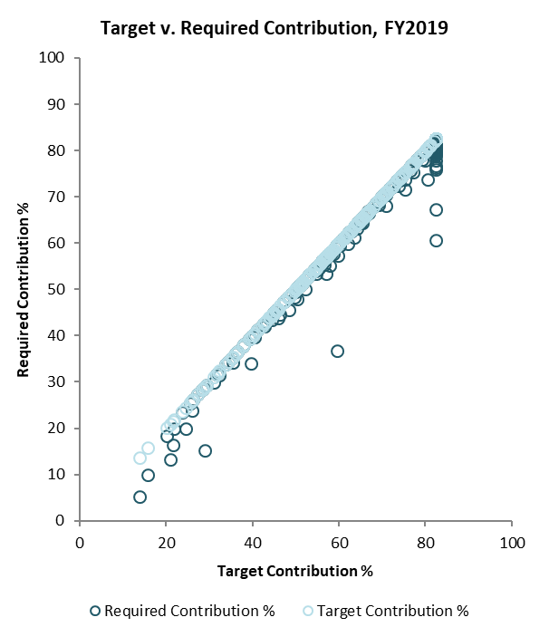
Reaching the Targets Over Time
All Municipalities
Notes:
Updated 7/23/18
--These two plots show the distribution of communities as they each approach their targets. In FY07, few districts were at their targets (yellow dots/line). The goal is for all communities to be on the line (at target). In FY14 (prelim), all communities required previously to spend at a level greater than their target were brought down to the yellow line.

Slide 20
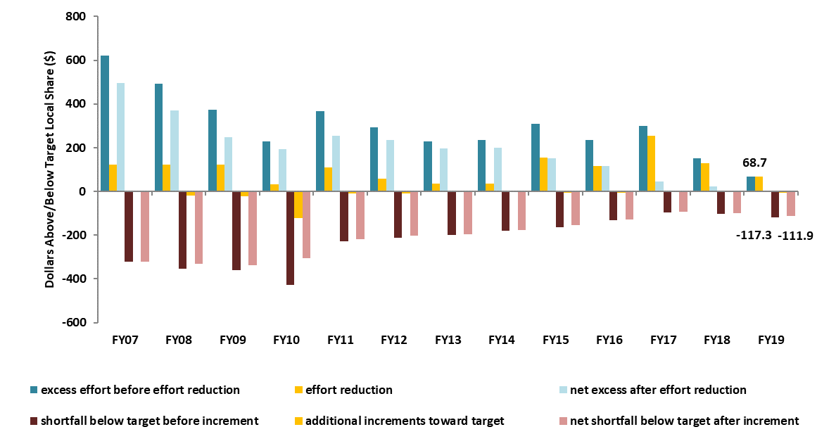
Progress towards Target Local Share
Notes:
Updated 7/20/18

Slide 21
How is the district’s required local contribution calculated?
Once the city or town’s required local contribution is calculated, it is allocated among the districts to which it belongs.
Town of Berkley
Notes:
Updated 7/20/18
--The last step before calculating aid is to distribute a town’s local contribution amongst all districts to which it belongs (i.e. a town district, an academic regional, a vocational, an agricultural school).
--This is done in direct proportion to the share of the town’s foundation budget belonging to each district.
--The major factor in changes in required local contribution is changes in foundation budget proportion attributable to each district. In other words, if Berkley were to lose students at the town district, while Somerset Berkley were to pick up kids, therefore its share of foundation budget were to grow, it would take a larger share of the town of Berkley’s total required contribution.

Slide 22
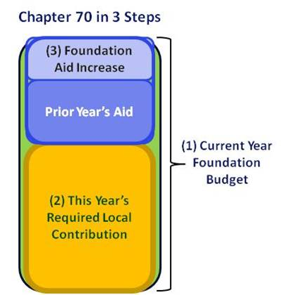
Calculating Chapter 70 Aid
Foundation aid is the core of Chapter 70. It provides additional funding for districts to spend at their foundation budgets.
Foundation Budget – Required Local Contribution = Foundation Aid
Start with prior year’s aid
    FY18 c70 (statewide: $4.746B)
Add together the prior year’s aid and the required local contribution.
If this year’s foundation aid exceeds last year’s total Chapter 70 aid, the district receives the amount needed to ensure it meets its foundation budget.
  157 districts

Slide 23
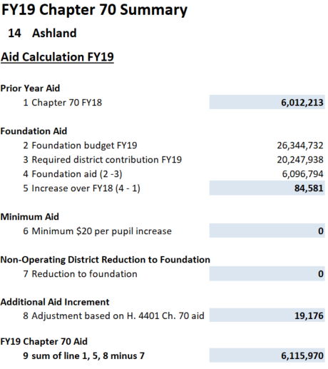
Calculating Chapter 70 Aid
Districts are held harmless to the previous year’s level of aid.
In FY19, “minimum aid” is also available.
District receives at least $30 per pupil in additional aid over FY18 (195 operating districts).
Notes:
Updated 7/18/18

Slide 24
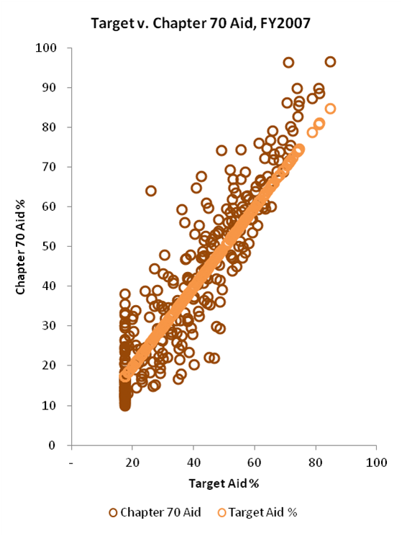
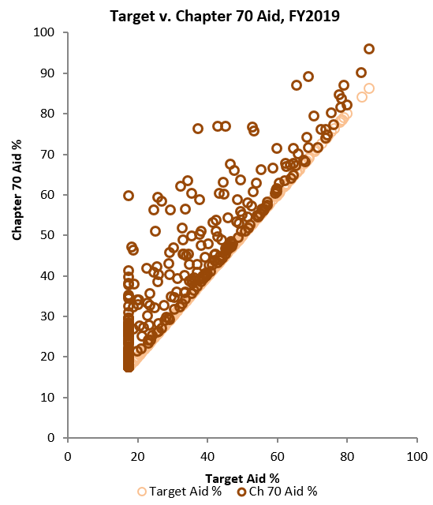
Progress towards Target Aid Shares
All Districts
Notes:
Updated 7/23/18

Slide 25
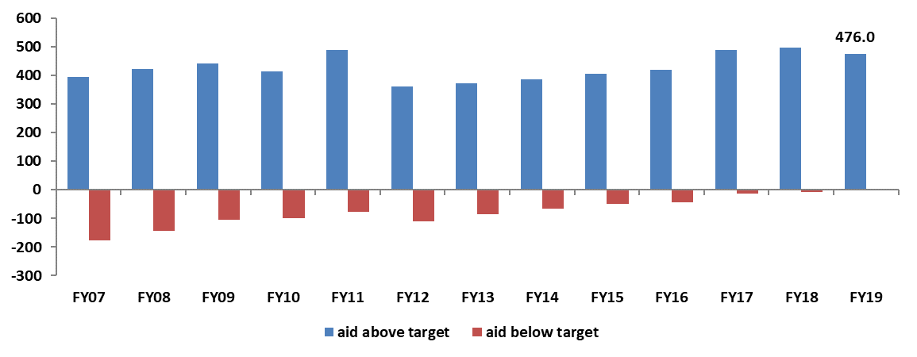
Progress towards Target Aid Share
Notes:
Updated 7/23/18

Slide 26
Net School Spending
Net School Spending requirements continue to be enforced.
FY 2019 Section 3 preamble, “The department of elementary and secondary education shall not consider health care costs for retired teachers to be part of net school spending for any district in which such costs were not considered part of net school spending in fiscal year 1994, and for any district that has not accepted the provisions of section 260 of chapter 165 of the acts of 2014, provided that any district for whom such costs are not so considered shall have included as part of net school spending an amount equal to the increase in the foundation budget for the district associated with health care costs of retired teachers.”

Slide 27
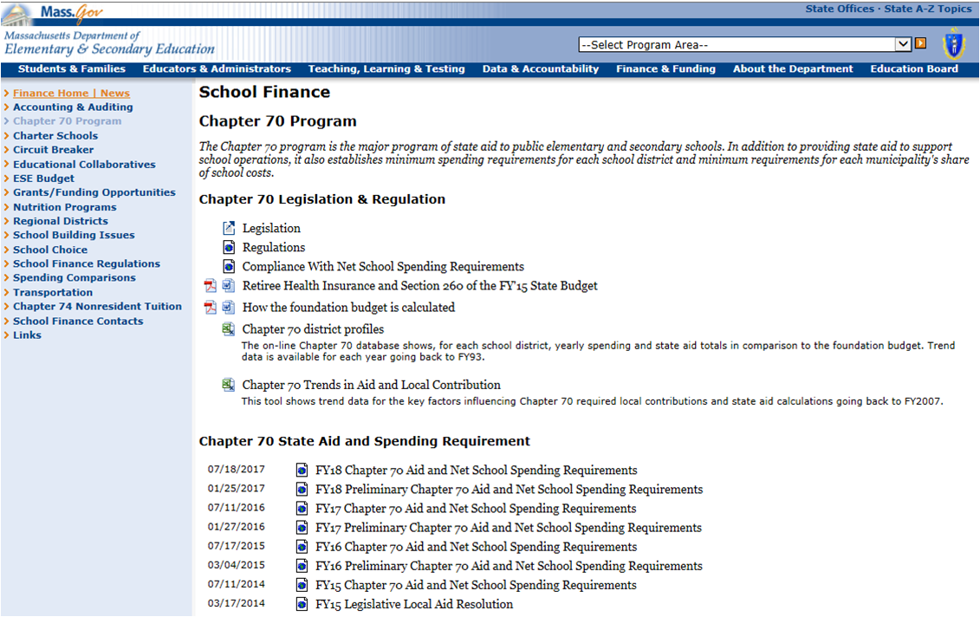
Chapter 70 Website http://www.doe.mass.edu/finance/chapter70/

Slide 28
Chapter 70 Contact Info
Rob O’Donnell
rodonnell@doe.mass.edu
781-338-6512
Rob Hanna
robert.hanna@doe.mass.edu
781-338-6525

