Slide 1
FY20 Chapter 70
General Appropriations Act
July 2019

Slide 2
Highlights
FY20 Chapter 70 is $5,176,002,652
  $269 million (5.5%) increase from FY19
The foundation budget inflation rate is 3.75 percent. Some rates are increased by additional amounts in areas identified by the Foundation Budget Review Commission (FBRC), see next slide.
The local contribution requirements for cities and towns with combined effort yields greater than 175 percent of foundation are set at 82.5 percent of foundation. This impacts 23 communities.
The equity component of the formula ensures that municipalities with preliminary contributions above target are brought down to target, closing 100% of the gap. This applies to 119 of the 351 cities and towns (34 percent).
All districts receive at least $30 per pupil in additional aid over the prior year.

Slide 3
Implementing FBRC recommendations
GAA continues implementation of Foundation Budget Review Commission (FBRC) recommendations
Increases the benefits and fixed charges rates to align with current Group Insurance Commission (GIC) premium rates for both active and retired municipal employees. Closes one-seventh of the gap between the FY19 rates and the new goal rates.
Increases the rate for out-of-district special education tuition to narrow the gap between the foundation budget and the circuit breaker eligibility threshold, which is four times the statewide average foundation budget per pupil. The goal rate is three times the FY19 statewide average foundation budget per pupil ($34,345), and the FY20 rate closes one-seventh of the gap toward this goal plus inflation.
Increases the increments for English learners (ELs), including vocational students, toward a new, uniform goal rate of $2,537 per pupil (FY20 dollars). Closes one-seventh of the gap toward the goal over FY19 rates plus inflation.
Implements a more progressive decile rate structure for economically disadvantaged students that expands the foundation budget for deciles 6 to 10. Closes one-seventh of the gap toward the goal over FY19 rates plus inflation. In decile 10, the goal rate is 100 percent of the average FY20 base rate.
In addition, GAA increases the assumed rate of in-district special education enrollment toward the goal of 4 percent for non-vocational students and 5 percent for vocational students. The FY20 rates are 3.79 and 4.79 for non-vocational and vocational students, respectively, which close one-seventh of the gap toward the goals.

Slide 4
Other highlights
Economically Disadvantaged Students (continued)
Economically disadvantaged (“EcoDis”) enrollment continues to replace free and reduced price lunch data, which is no longer available for all districts as a result of districts’ participation in the USDA’s Community Eligibility Program.
  This measure includes those students qualifying as a match in the following programs included in the Commonwealth's direct certification system, which is maintained in the Executive Office of Health and Human Services Virtual Gateway system: Supplemental Nutrition Assistance Program (SNAP), Temporary Assistance for Needy Families (TANF), Medicaid (MassHealth), and foster care.
Districts are assigned to deciles in the same manner as in FY19. The foundation budget rate applied to a district’s economically disadvantaged students is based on a district’s concentration of those students.
  Number of economically disadvantaged students / Foundation enrollment = % economically disadvantaged
  Districts are then sorted into deciles based on this calculation. Each decile group corresponds to a foundation budget rate. Decile 10 includes those districts with the highest concentration of EcoDis students.

Slide 5
Goal of the Chapter 70 formula
To ensure that every district has sufficient resources to meet its foundation budget spending level, through an equitable combination of local property taxes and state aid.

Slide 6
Chapter 70 aid is determined in three basic steps
A district’s Chapter 70 aid is determined in three basic steps:
  It defines and calculates a foundation budget, an adequate funding level for each district, given the specific grades, programs, and demographic characteristics of its students.
  It then determines an equitable local contribution, how much of that “foundation budget” should be paid for by each city and town’s property tax, based upon the relative wealth of the community.
  The remainder is funded by Chapter 70 state aid.
Local Contribution + State Aid = a district’s Net School Spending (NSS) requirement. This is the minimum amount that a district must spend to comply with state law.

Slide 7
Districts receive different levels of Chapter 70 aid, because their community’s ability to pay differs

Slide 8
Key Factors in School Funding Formula
Foundation Budget
Enrollment
Wage Adjustment Factor
Inflation
Local Contribution
Property value
Income
Municipal Revenue Growth Factor
These six factors work together to determine a district’s Chapter 70 aid.

Slide 9
Foundation budgets are an indication of student need

Slide 10
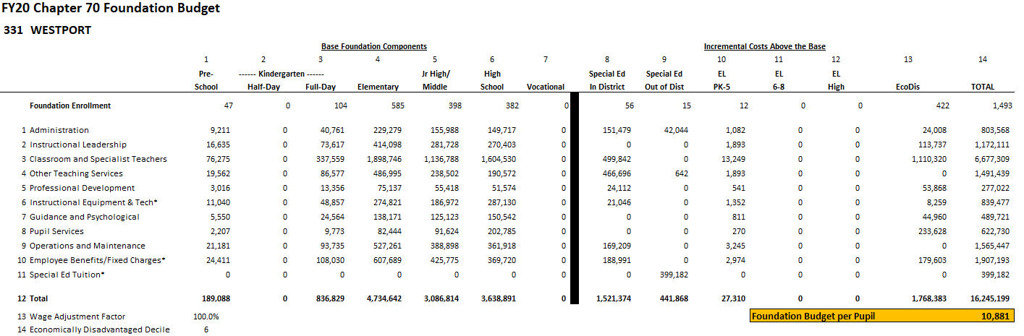
A district's foundation budget is derived by multiplying the number of pupils in 13 enrollment categories by cost rates in 11 functional areas.
All of your students are counted in categories 1-7. Special education, English language learner (EL), and economically disadvantaged costs
are treated as “costs above the base” and are captured in 10-13.

Slide 11
Foundation budget rates reflect differences in the cost of educating different types of students.

Slide 12
Instructional categories (in blue) comprise 69% of the statewide foundation budget.

Slide 13
Local Contribution
Establishing local ability to pay
The foundation budget is a shared municipal-state responsibility.
Each community has a different target local share, or ability to pay, based on its property values and residents’ incomes.
Prior to this policy, required local contributions had become less linked to ability to pay. A process was established in 2007 to move each community from its 2006 baseline to its new target.

Slide 14
How is the required local contribution calculated?
Determining each community’s target local share starts with the local share of statewide foundation.
Calculate statewide foundation budget.
Determine target local share
of statewide foundation.
Statewide, determine percentages that yield ½ from property and ½ from income.
Statewide Foundation Budget
$11.359B
41% State Aid
$4.657B
59% Local Contribution
$6.702B
Income Effort
1.4981%
$3.351B
Property Effort
0.3456%
$3.351B
Property and income percentages are applied uniformly across all cities and towns to determine the combined effort yield from property and income.

Slide 15
Individual communities’ target local shares are based on local property values and income, and their foundation budgets.
To determine local effort, first apply this year’s property percentage (0.3456%) to the town’s 2018 total equalized property valuation
Then apply this year’s income percentage (1.4981%) to the town’s 2016 total residential income
Local Property Effort
+ Local Income Effort
= Combined Effort Yield (CEY)
Target Local Share = CEY/Foundation budget
  Capped at 82.5% of foundation
  In FY20, 145 of 351 communities are capped.

Slide 16
Getting Closer To the Target Contribution
Determining the Upcoming Year’s Local Contribution
Preliminary Contribution
Increase last year’s required local contribution by the municipality’s Municipal Revenue Growth Factor (MRGF)
  Calculated annually by the Department of Revenue
  Quantifies the most recent annual percentage change in each community's local revenues, such as the annual increase in the Proposition 2½ levy limit, that should be available for schools
Required Contribution
If the preliminary contribution is above the target, reduce by the effort reduction percent (100% in FY20).
If the preliminary contribution is below by less than 2.5%, the preliminary contribution becomes the new requirement.
If the preliminary contribution is below by more than 7.5%, an additional 2% is added to the preliminary contribution. For those below by between 2.5 and 7.5%, 1% is added.

Slide 17
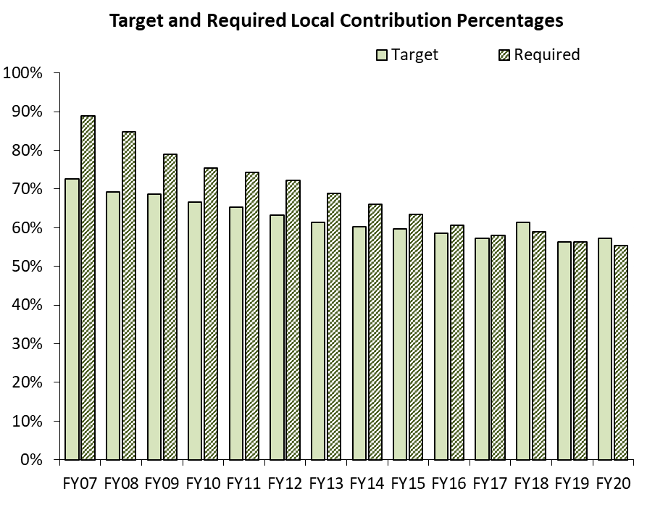
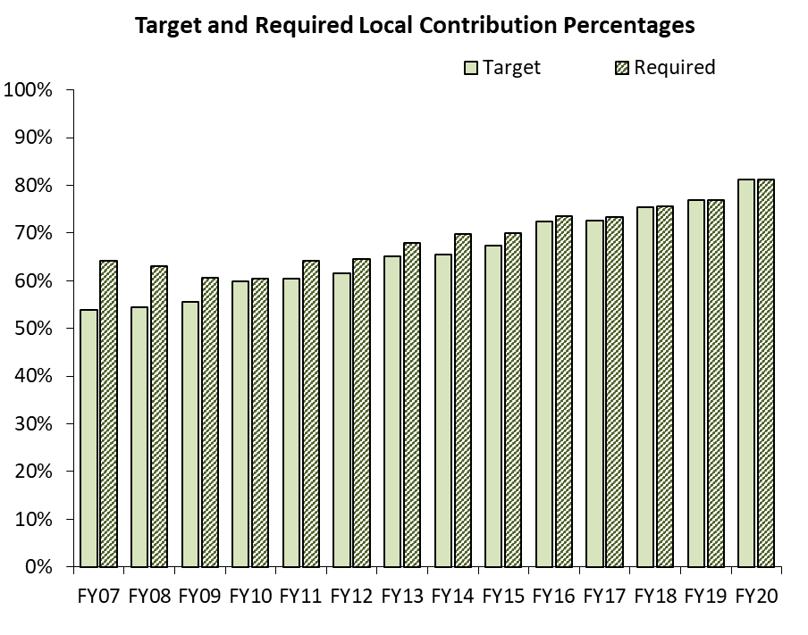
Each community transitions to its target local share at a different pace.
Framingham
Hampden

Slide 18
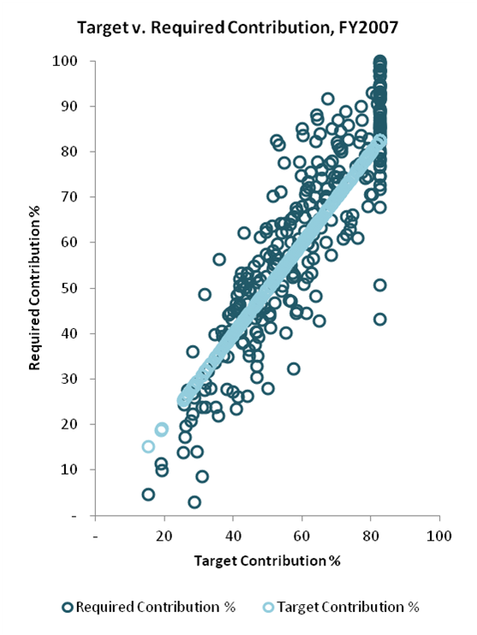
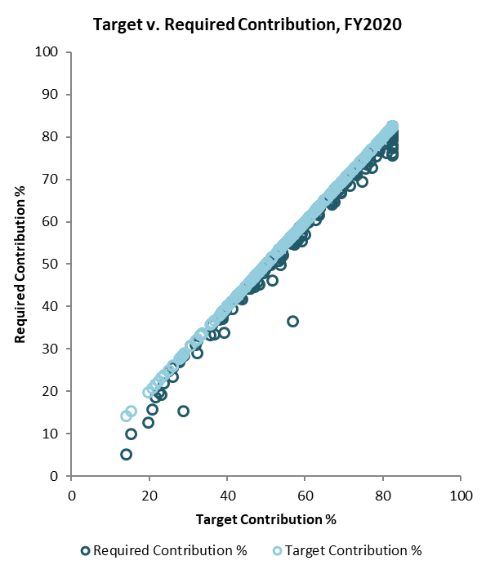
Reaching the Targets Over Time
All Municipalities

Slide 19
Progress towards Target Local Share

Slide 20
How is the district’s required local contribution calculated?
Once the city or town’s required local contribution is calculated, it is allocated among the districts to which it belongs.
Town of Dartmouth

Slide 21
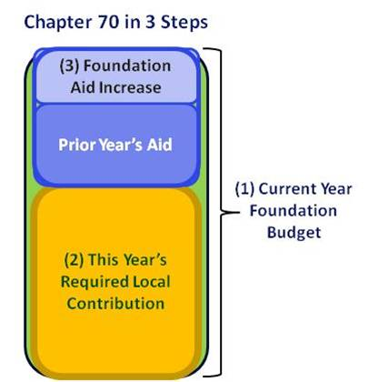
Calculating Chapter 70 Aid
Foundation aid is the core of Chapter 70. It provides additional funding for districts to spend at their foundation budgets.
Foundation Budget – Required Local Contribution = Foundation Aid
Start with prior year’s aid
    FY19 c70 (statewide: $4.907B)
Add together the prior year’s aid and the required local contribution.
If this year’s foundation aid exceeds last year’s total Chapter 70 aid, the district receives the amount needed to ensure it meets its foundation budget.
  144 districts

Slide 22
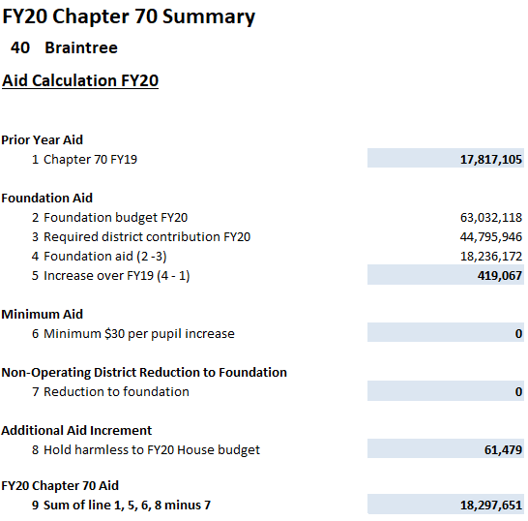
Calculating Chapter 70 Aid
Districts are held harmless to the previous year’s level of aid.
In FY20, “minimum aid” is also available.
District receives at least $30 per pupil in additional aid over FY19 (182 operating districts).

Slide 23
Progress towards Target Aid Share

Slide 24
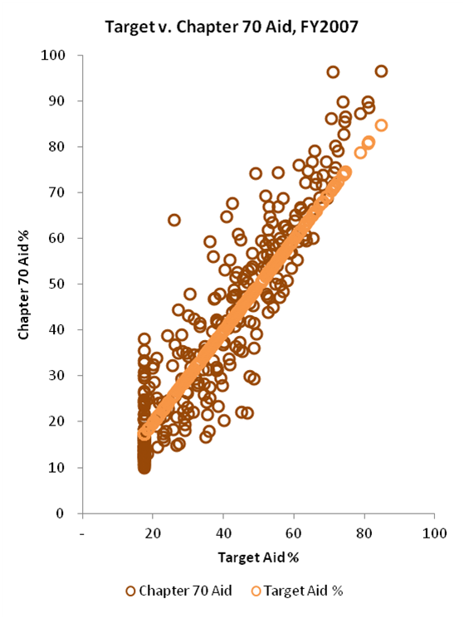
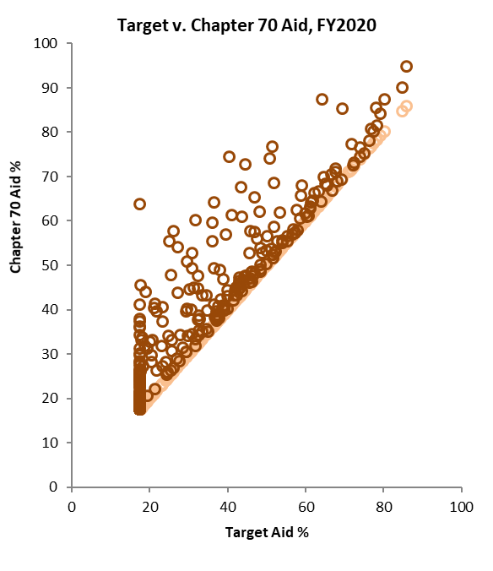
Progress towards Target Aid Shares
All Districts

Slide 25
Net School Spending
Net School Spending requirements continue to be enforced.
FY 2020 Section 3 preamble, “The department of elementary and secondary education shall not consider health care costs for retired teachers to be part of net school spending for any district in which such costs were not considered part of net school spending in fiscal year 1994, and for any district that has not accepted the provisions of section 260 of chapter 165 of the acts of 2014, provided that any district for whom such costs are not so considered shall have included as part of net school spending an amount equal to the increase in the foundation budget for the district associated with health care costs of retired teachers.”

Slide 26
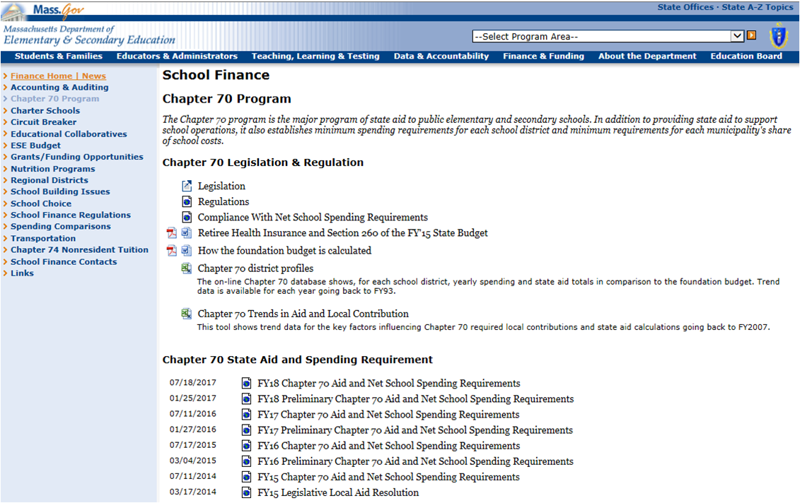
Chapter 70 Website http://www.doe.mass.edu/finance/chapter70/

Slide 27
Chapter 70 Contact Info
Rob O’Donnell
rodonnell@doe.mass.edu
781-338-6512
Rob Hanna
robert.hanna@doe.mass.edu
781-338-6525

