Slide 1
Preliminary FY21 Chapter 70 aid and Charter reimbursements (House 2)
January 22, 2020

Slide 2
1 Using state data to support resource analysis
FY21 House 2 proposed Chapter 70 funding
01

Slide 3
FY21 House 2 Chapter 70 implements the first year of the Student Opportunity Act (the Act)
The Act makes significant changes to the Chapter 70 formula, based in large part on the recommendations of the Foundation Budget Review Commission (FBRC)
Preliminary FY21 Chapter 70 is $5,479,534,540, a $303.5 million increase (5.9%) over FY20

Slide 4
The Act establishes new, higher foundation budget rates in 5 areas that will be phased-in over a 7 year period
Benefits and fixed charges
Guidance and psychological services
Special education out-of-district tuition
English learners
Low income students

Slide 5
House 2 includes rate changes above inflation toward the goal rates in these 5 areas
Proposed rate increases for benefits and fixed charges, guidance and psychological services, special education out-of-district tuition, and English learners close 1/7th of the gap
Proposed low income rate increases close 4/100th of the gap
  Increase intended to balance expansion in low income counts and implement foundation changes in “an equitable and consistent manner”
  Number of low income rate groups increased from 10 to 12
  Districts with higher concentrations of low income students benefit from higher rates

Slide 6
The goal rates in the law are expressed in FY20 dollars and are scheduled to be fully phased-in by FY27 plus inflation
 | Admin- istration | Instructional Leadership | Classroom & Specialist Teachers | Other Teaching Services | Professional Development | Instructional Materials, Equipment & Technology | Guidance & Psychological | Pupil Services | Operations & Maintenance | Employee Benefits/Fixed Charges | Special Ed Tuition | Total, all categories
Pre-School | 195.97 | 353.93 | 1,622.88 | 416.22 | 64.18 | 234.89 | 188.97 | 46.96 | 450.66 | 745.55 | 0.00 | 4,320.21
Kindergarten (half) | 195.97 | 353.93 | 1,622.88 | 416.22 | 64.18 | 234.89 | 188.97 | 46.96 | 450.66 | 745.55 | 0.00 | 4,320.21
Kindergarten (full) | 391.93 | 707.86 | 3,245.76 | 832.47 | 128.42 | 469.78 | 377.95 | 93.97 | 901.30 | 1,491.09 | 0.00 | 8,640.53
Elementary | 391.93 | 707.86 | 3,245.72 | 832.47 | 128.44 | 469.78 | 377.95 | 140.93 | 901.30 | 1,491.09 | 0.00 | 8,687.47
Junior/Middle | 391.93 | 707.86 | 2,856.25 | 599.25 | 139.24 | 469.78 | 377.95 | 230.21 | 977.13 | 1,610.72 | 0.00 | 8,360.32
High School | 391.93 | 707.86 | 4,200.34 | 498.88 | 135.01 | 751.65 | 394.09 | 530.85 | 947.43 | 1,422.01 | 0.00 | 9,980.05
Vocational | 391.93 | 707.86 | 7,140.62 | 498.88 | 223.21 | 1,315.37 | 394.09 | 530.85 | 1,773.15 | 1,789.60 | 0.00 | 14,765.56
Special Ed in-school | 2,704.98 | 0.00 | 8,925.75 | 8,333.85 | 430.57 | 375.82 | 0.00 | 0.00 | 3,021.59 | 3,392.84 | 0.00 | 27,185.40
Special Ed tuitioned-out | 3,450.56 | 0.00 | 0.00 | 52.71 | 0.00 | 0.00 | 0.00 | 0.00 | 0.00 | 0.00 | 32,761.24 | 36,264.51

Slide 7
The EcoDis deciles that we’ve used in recent years are replaced by 12 low income groups with set cut-offs
% Low-income | Increment goal rate
0-5.99% | $3,519.10
6-11.99% | $3,739.05
12-17.99% | $3,958.99
18-23.99% | $4,178.94
24-29.99% | $4,398.88
30-35.99% | $4,926.75
36-41.99% | $5,454.61
42-47.99% | $5,982.48
48-53.99% | $6,510.34
54-69.99% | $7,038.21
70-79.99% | $7,917.98
80%+ | $8,797.76

Slide 8
House 2 expands the count of low income students in accordance with the Act
Restores the definition of low income enrollment used prior to FY17, based on 185% of the federal poverty level, up from the 133% threshold used for the economically disadvantaged match
  Statewide low income enrollment for FY21 is 389,380, compared to 342,575 identified as economically disadvantaged in FY20
For FY21, a district’s low income enrollment is the higher of:
  The number of students matched through the Department’s current direct certification process OR
  The district’s FY16 low income percentage multiplied by its current foundation enrollment.
The law directs the Department to recommend a new methodology for identifying low income students for FY22 and beyond

Slide 9
The Act also increases the assumed in-district special education enrollment percentages
Increases the rate for vocational students from 4.75% to 5% and from 3.75% to 4% for non-vocational students
This increase is being phased in over 7 years so the factors used in FY21 are 4.82% and 3.82%, respectively

Slide 10
On top of the targeted rate increases, all foundation budget categories have been adjusted upward to account for inflation
A new employee benefits inflation rate is applied to the employee benefits and fixed charges category
  Based on the enrollment-weighted, three-year average premium increase for all GIC plans
  For FY21 the increase is 2.34%.
An inflation increase of 1.99% has been applied to all other foundation budget rates, based on the U.S. Department of Commerce’s state and local government price deflator

Slide 11
The Act also adds a new minimum aid adjustment to the formula
This provision provides hold harmless aid to 25 operating districts that otherwise would have lost aid due to the new foundation budget factors
  Determines the aid that these districts would have received if foundation budget rates were only increased by inflation
  If this amount is higher than the revised formula amount, districts get the higher amount
  For FY21, this amounts to $894,255 in aid for these 25 districts

Slide 12
The Act codified the aggregate wealth model for determining local contribution requirements
For municipalities with required contributions above targets, the requirement is reduced by 100 percent of the gap
Cities and towns with combined effort yields greater than 175% of foundation have required local contributions set at not less than 82.5 percent of foundation

Slide 13
1 Using state data to support resource analysis
Charter school tuition and reimbursements
02

Slide 14
Tuition rates for Commonwealth charter schools are based on the same foundation budget rates used in Chapter 70
Foundation budget rate increases being implemented in FY21 have been incorporated into our projected FY21 tuition rates
In addition, charter school low income enrollment for FY21 has been estimated in a manner consistent with the methodology used for districts

Slide 15
House 2 implements the 3-year (100%/60%/40%) schedule for transition aid tied to year over year tuition growth
Funding for first year reimbursements is prioritized over funding for second year reimbursements
The Act requires the 75% of the total state obligation to be funded in FY21, 90% in FY22, and 100% in FY23 and subsequent years
House 2 allocates $138.2 million appropriation for these reimbursements
  This appropriation level is expected to meet or exceed the 75% requirement when tuition assessments are updated to reflect actual enrollments and district spending levels
The facilities component of the tuition rate is held constant at FY20 levels at $938 per pupil, with this cost fully reimbursed by the state as in prior years

Slide 16
1 Using state data to support resource analysis
Calculating Chapter 70 local contribution requirements and state aid
03

Slide 17
Goal of the Chapter 70 formula
To ensure that every district has sufficient resources to meet its foundation budget spending level, through an equitable combination of local property taxes and state aid.

Slide 18
The updated formula includes three parameters to be specified in each year’s general appropriations act
In House 2, these are specified as:
  Total state target local contribution = 59%
  Effort reduction = 100%
  Minimum aid = $30 per pupil

Slide 19
There are 6 factors that work together to determine a district’s Chapter 70 aid
Foundation Budget
Enrollment
Wage Adjustment Factor
Inflation
Local Contribution
Property value
Income
Municipal Revenue Growth Factor

Slide 20
There are three primary steps in determining each district’s Chapter 70 aid
Determine an equitable local contribution requirement, how much of the foundation budget that should be paid for by each city and town’s property tax, based upon the relative wealth of the community
Define and calculate a foundation budget for each district, given the specific grades, programs, and demographic characteristics of its students
Calculate state aid, providing necessary funds to reach foundation or mandated minimum aid increases
Local Contribution + State Aid = a district’s Net School Spending (NSS) requirement
This is the minimum amount that a district must spend to comply with state law

Slide 21
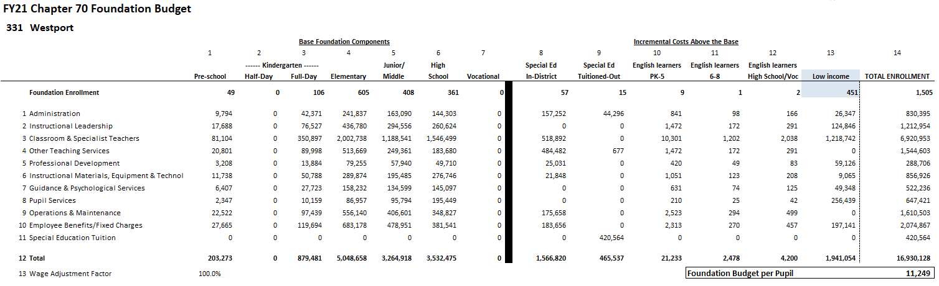
Each district's foundation budget is calculated by multiplying the number of pupils in 13 enrollment categories by cost rates in 11 functional areas
All of your students are counted in categories 1−7; special education, EL, and low income costs are treated as costs above the base and are captured in 10−13

Slide 22
Foundation budgets vary based on student needs

Slide 23
Determining each community’s target local share starts with the local share of statewide foundation
Calculate statewide foundation budget
Determine target local share
of statewide foundation
Statewide, determine percentages that yield ½ from property and ½ from income
Statewide foundation budget
$11.951B
41% State aid
$4.900B
59% Local contribution
$7.051B
Income effort
1.4789%
$4.675B
Property effort
0.3741%
$4.675B
Property and income percentages are applied uniformly across all cities and towns to determine the combined effort yield from property and income.

Slide 24
An individual community’s target local share is based on its local property value, income, and foundation budget
The sum of a community’s local property and income effort equals it’s Combined Effort Yield (CEY)
Target Local Share = CEY/Foundation budget (calculated at the city/town level)
  Capped at 82.5% of foundation (157 communities are capped)
2017 aggregate income X Statewide Income % 1.4789%
2018 EQV X Statewide Property % .3741%
CEY

Slide 25
Next the formula calculates each community’s preliminary local contribution (PLC) and makes adjustments relative to target to determine the required local contribution (RLC)
Preliminary contribution Required contribution
Increase last year’s required local contribution by the MRGF
If the PLC as a % of foundation< target
If the difference is < than 2.5%, the PLC is the new requirement
If the difference is > 7.5%, add 2% to the PLC
If the PLC as a % of foundation > target
Reduce PLC by 100% of the gap
If the difference is between 2.5% and 7.5%, add 1% to PLC
Municipal Revenue Growth Factors (MRGF) are calculated annually by the Department of Revenue. MRGFs quantify the most recent annual % change in each community's local revenues, such as the annual increase in the Proposition 2½ levy limit, that should be available for schools

Slide 26
Once a city or town’s required local contribution is calculated, it is allocated among the districts to which it belongs
Town of Dartmouth

Slide 27
Foundation aid provides additional funding for districts to spend at their foundation budgets
Foundation budget – Required local contribution = Foundation aid
Start with prior year’s aid
Add together the prior year’s aid and the required local contribution
If this year’s foundation aid exceeds last year’s total Chapter 70 aid, the district receives the amount needed to ensure it meets its foundation budget
(2) This year’s required local contribution
Prior year’s aid
(3) Foundation aid increase
(1) Foundation budget

Slide 28
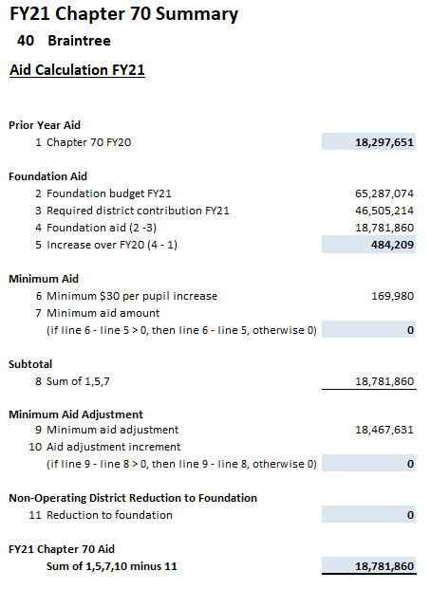
Calculating Chapter 70 aid: Districts are held harmless to previous aid levels and guaranteed at least a $30 per pupil increase
Districts are held harmless to the previous year’s level of aid.
183 districts receive at least a $30 per pupil minimum aid increase over FY20

Slide 29
Districts receive different levels of Chapter 70 aid because their community’s ability to pay differs

Slide 30
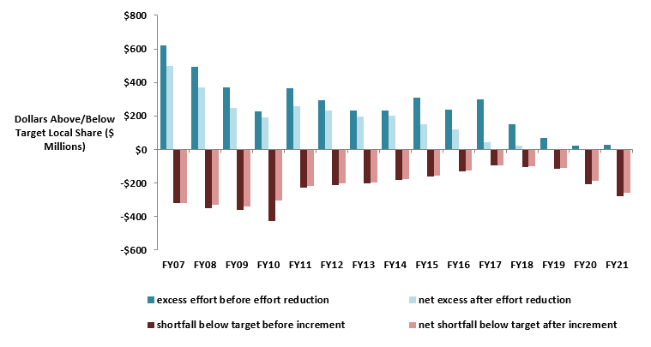
Changes to local contribution calculations started in FY07 have eliminated required excess effort and reduced effort shortfalls

Slide 31
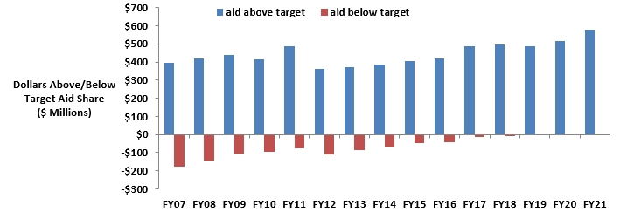
There are no longer any districts funded below target, while above target aid has increased

Slide 32



Questions
QUESTIONS?
Rob O’Donnell, Director of School Finance
Rob Hanna, Senior Fiscal Analyst
rodonnell@doe.mass.edu
781.338.6512
robert.hanna@doe.mass.edu
781.338.6525

