Slide 1
FY22 Chapter 70 aid and Charter reimbursements
July 16, 2021

Slide 2
1 Using state data to support resource analysis
FY22 Chapter 70 funding
01

Slide 3
FY22 budget implements the first year of the Student Opportunity Act (the Act)
FY22 Chapter 70 aid is $5,503,268,225, a $219.6 million increase (4.2%) over FY21
The Act establishes new, higher foundation budget rates in 5 areas:
  Benefits and fixed charges
  Guidance and psychological services
  Special education out-of-district tuition
  English learners
  Low-income students
FY22 Chapter 70 includes rate changes above inflation toward the goal rates in these 5 areas and closes 1/6th of the gap
Notes:
Updated 6/14/21

Slide 4
FY22 budget expands the count of low-income students in accordance with the Act
The Act restores the definition of low-income enrollment used prior to FY17, based on 185% of the federal poverty level, up from the 133% threshold used for the economically disadvantaged match from FY17 to FY21
  Statewide low-income enrollment for FY22 is 382,088, compared to 351,970 identified as economically disadvantaged in FY21
For FY22, a district’s low-income enrollment is the higher of:
  The number of students matched through the Department’s current direct certification process OR
  The district’s FY16 low-income percentage multiplied by its current foundation enrollment
Notes:
Updated 6/14/21

Slide 5
The Act also increases the assumed in-district special education enrollment percentages
Increases the rate for vocational students from 4.75% to 5% and from 3.75% to 4% for non-vocational students
FY22 rate increases close 1/6th of the gaps, so the factors used for FY22 are 4.83% and 3.83%, respectively
Notes:
Updated 6/14/21

Slide 6
On top of the targeted rate increases, all foundation budget categories have been adjusted upward to account for inflation
A new employee benefits inflation rate is applied to the employee benefits and fixed charges category
  Based on the enrollment-weighted, three-year average premium increase for all GIC plans
  For FY22 the increase is 2.78%.
An inflation increase of 1.41% has been applied to all other foundation budget rates, based on the U.S. Department of Commerce’s state and local government price deflator

Slide 7
The Act also adds a new minimum aid adjustment to the formula
This provision provides hold harmless aid to 16 operating districts that otherwise would have lost aid due to the new foundation budget factors
  Determines the aid that these districts would have received if foundation budget rates were only increased by inflation
  If this amount is higher than the revised formula amount, districts get the higher amount
  For FY22, this amounts to $3,531,289 in aid for these 16 districts
Notes:
Updated 6/14/21

Slide 8
The Act codified the aggregate wealth model for determining local contribution requirements
For municipalities with required contributions above targets, the requirement is reduced by 100% of the gap
Cities and towns with combined effort yields greater than 175% of foundation have required local contributions set at not less than 82.5% of foundation

Slide 9
Charter school tuition and reimbursements
Charter school tuition and reimbursements
02

Slide 10
Tuition rates for Commonwealth charter schools are based on the same foundation budget rates used in Chapter 70
Foundation budget rate increases being implemented in FY22 have been incorporated into our projected FY22 tuition rates
In addition, charter school low-income enrollment for FY22 has been estimated in a manner consistent with the methodology used for districts (see slide 4)

Slide 11
FY22 budget implements the 3-year (100%/60%/40%) schedule for transition aid tied to year over year tuition growth
Funding for first year reimbursements is prioritized over funding for second year reimbursements
The Act requires the 75% of the total state obligation to be funded in FY22, 90% in FY23, and 100% in FY24 and subsequent years
FY22 budget allocates $154.6 million appropriation for these reimbursements
  This appropriation level is expected to meet the 75% requirement when tuition assessments are updated to reflect actual enrollments and district spending levels
  The line item includes a $2.9 million earmark to provide additional reimbursement to 5 districts that are at their tuition caps
The facilities component of the tuition rate is held constant at FY21 levels at $938 per pupil, with this cost fully reimbursed by the state as in prior years
Notes:
Updated 6/15/21

Slide 12
Calculating Chapter 70 local contribution requirements and state aid
Calculating Chapter 70 local contribution requirements and state aid
03

Slide 13
Goal of the Chapter 70 formula
To ensure that every district has sufficient resources to meet its foundation budget spending level, through an equitable combination of local property taxes and state aid.

Slide 14
The updated formula includes three parameters to be specified in each year’s general appropriations act
In the FY22 budget, these are specified as:
  Total state target local contribution = 59%
  Effort reduction = 100%
  Minimum aid = $30 per pupil
Notes:
Updated 1/21/2021

Slide 15
There are 6 factors that work together to determine a district’s Chapter 70 aid
Foundation Budget
Enrollment
Wage Adjustment Factor
Inflation
Local Contribution
Property value
Income
Municipal Revenue Growth Factor

Slide 16
There are three primary steps in determining each district’s Chapter 70 aid
Determine an equitable local contribution requirement, how much of the foundation budget that should be paid for by each city and town’s property tax, based upon the relative wealth of the municipality
Define and calculate a foundation budget for each district, given the specific grades, programs, and demographic characteristics of its students
Calculate state aid, providing necessary funds to reach foundation or mandated minimum aid increases
Local Contribution + State Aid = a district’s net school spending (NSS) requirement
This is the minimum amount that a district must spend to comply with state law

Slide 17
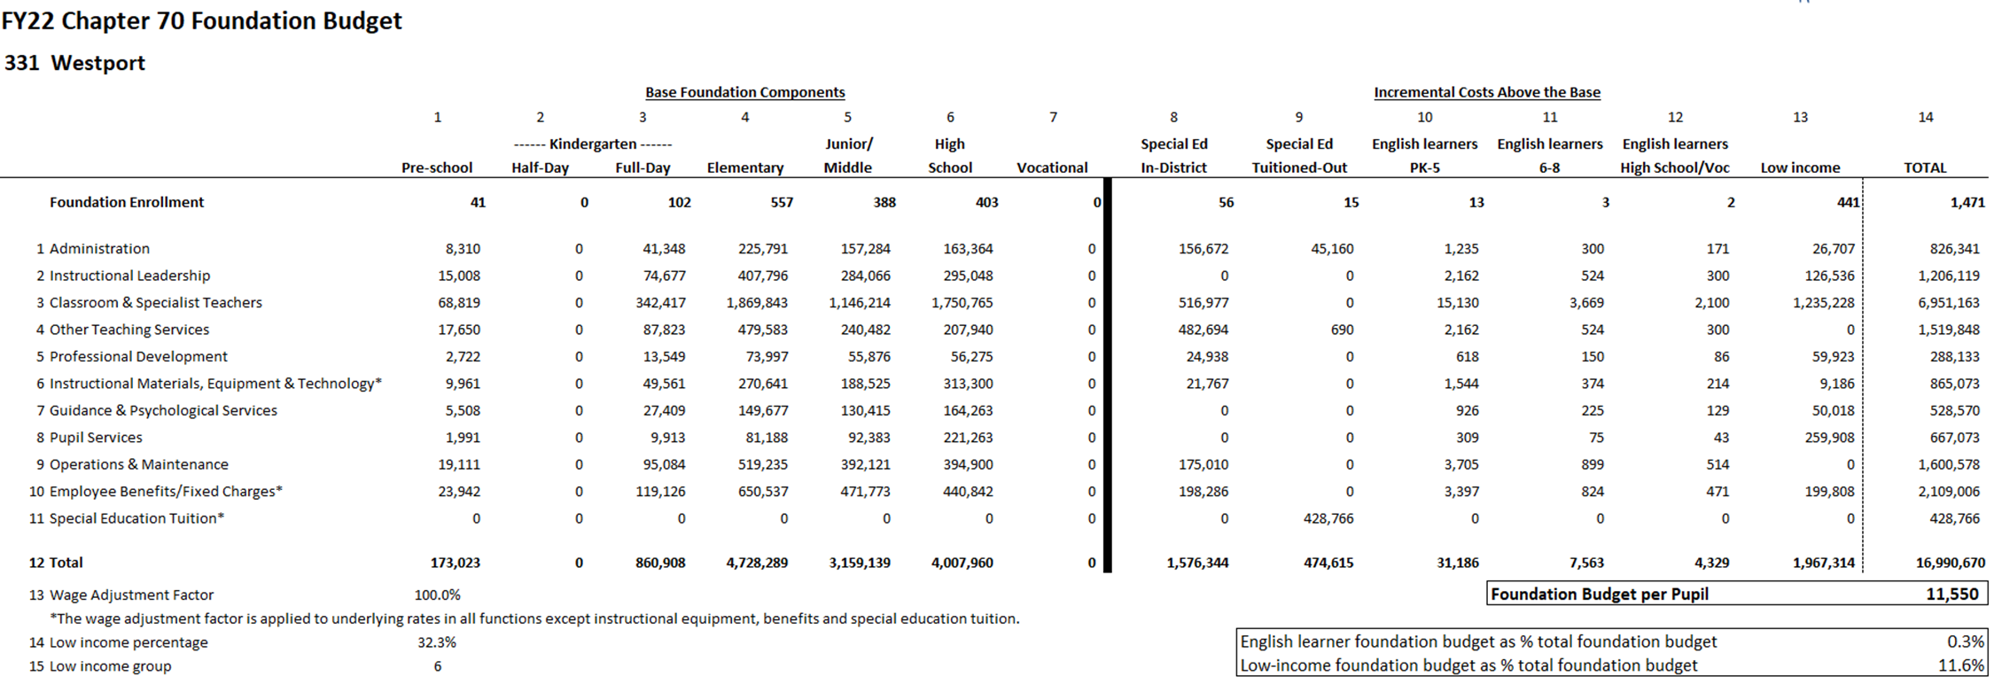
Each district's foundation budget is calculated by multiplying the number of pupils in 13 enrollment categories by cost rates in 11 functional areas
All of your students are counted in categories 1−7; special education, English learner, and low-income costs are treated as costs above the base and are captured in 10−13
Notes:
Updated 6/7/21

Slide 18
Foundation budgets vary based on student needs
Note: Chart excludes vocational and agricultural districts.
Notes:
Updated 6/7/21

Slide 19
Determining each municipality’s target local share starts with the local share of statewide foundation
Calculate statewide foundation budget
Determine target local share
of statewide foundation
Statewide, determine percentages that yield ½ from property and ½ from income
Statewide foundation budget
$11.926B
41% State aid
$4.890B
59% Local contribution
$7.036B
Income effort
1.4199%
$3.518B
Property effort
0.3326%
$3.518B
Property and income percentages are applied uniformly across all cities and towns to determine the combined effort yield from property and income.
Notes:
Updated 6/7/21

Slide 20
An individual municipality’s target local share is based on its local property value, income, and foundation budget
The sum of a municipality’s local property and income effort equals its Combined Effort Yield (CEY)
Target Local Share = CEY/Foundation budget (calculated at the city/town level)
  Capped at 82.5% of foundation (162 municipalities or 46% are capped)
2018 aggregate income X Statewide Income % 1.4199%
2020 EQV X Statewide Property % 0.3326%
CEY
Notes:
Updated 6/7/21

Slide 21
Next the formula calculates each municipality’s preliminary local contribution (PLC) and makes adjustments relative to target to determine the required local contribution (RLC)
Preliminary contribution Required contribution
Increase last year’s required local contribution by the MRGF
If the PLC as a % of foundation< target
If the difference is < than 2.5%, the PLC is the new requirement
If the difference is > 7.5%, add 2% to PLC
If the PLC as a % of foundation > target
Reduce PLC by 100% of the gap
If the difference is between 2.5% and 7.5%, add 1% to PLC
Municipal Revenue Growth Factors (MRGF) are calculated annually by the Department of Revenue. MRGFs quantify the most recent annual % change in each municipality’s local revenues, such as the annual increase in the Proposition 2½ levy limit, that should be available for schools

Slide 22
Once a city or town’s required local contribution is calculated, it is allocated among the districts to which it belongs
Town of Dartmouth
Notes:
Updated 6/7/21

Slide 23
Foundation aid provides additional funding for districts to spend at their foundation budgets
Foundation budget – Required local contribution = Foundation aid
Start with prior year’s aid
Add together the prior year’s aid and the required local contribution
If this year’s foundation aid exceeds last year’s total Chapter 70 aid, the district receives the amount needed to ensure it meets its foundation budget
(2) This year’s required local contribution
Prior year’s aid
(3) Foundation aid increase
(1) Foundation budget

Slide 24
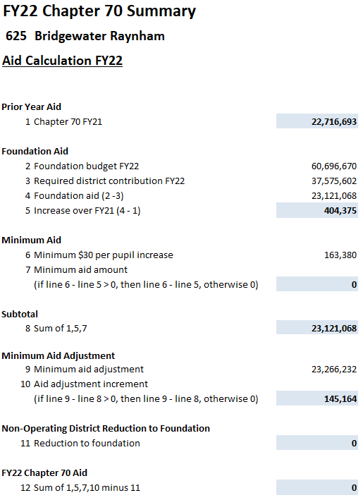
Calculating Chapter 70 aid: Districts are held harmless to previous aid levels and guaranteed at least a $30 per pupil increase
Districts are held harmless to the previous year’s level of aid
249 districts receive minimum aid increases of $30 per pupil over FY21
Notes:
Updated 6/7/21

Slide 25
Districts receive different levels of Chapter 70 aid because their municipality’s ability to pay differs
Notes:
Updated 6/14/21

Slide 26
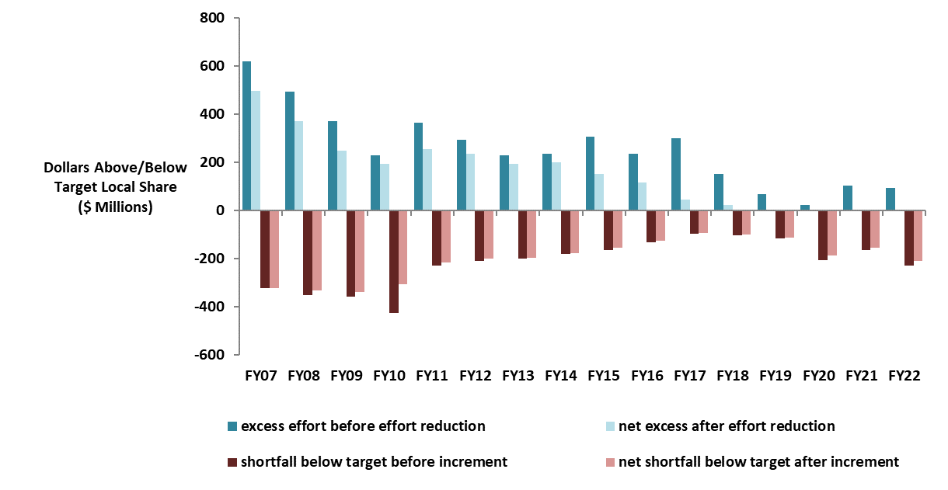
Changes to local contribution calculations started in FY07 have eliminated required excess effort and reduced effort shortfalls
Notes:
Updated 6/14/21

Slide 27
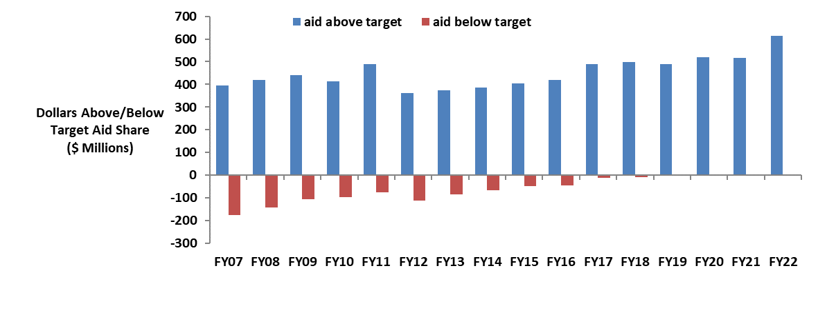
There are no longer any districts funded below target, while above target aid has increased
Notes:
Updated 6/14/21

Slide 28



Questions?
QUESTIONS?
Rob O’Donnell, Director of School Finance
Rob Hanna, State Aid Programs Manager
Robert.F.O’Donnell@mass.gov
781.338.6512
Robert.Hanna@mass.gov
781.338.6525

