Slide 1
Preliminary FY22 Chapter 70 aid and Charter reimbursements (House 1)
January 27, 2021

Slide 2
1 Using state data to support resource analysis
FY22 House 1 proposed Chapter 70 funding
01

Slide 3
FY22 House 1 Chapter 70 implements the first year of the Student Opportunity Act (the Act)
Preliminary FY22 Chapter 70 is $5,481,304,643, a $197.7 million increase (3.7%) over FY21
The Act establishes new, higher foundation budget rates in 5 areas:
  Benefits and fixed charges
  Guidance and psychological services
  Special education out-of-district tuition
  English learners
  Low income students
House 1 includes rate changes above inflation toward the goal rates in these 5 areas and closes 1/7th of the gap

Slide 4
House 1 expands the count of low income students in accordance with the Act
The Act restores the definition of low income enrollment used prior to FY17, based on 185% of the federal poverty level, up from the 133% threshold used for the economically disadvantaged match from FY17 to FY21
  Statewide low income enrollment for FY22 is 382,088, compared to 351,970 identified as economically disadvantaged in FY21
For FY22, a district’s low income enrollment is the higher of:
  The number of students matched through the Department’s current direct certification process OR
  The district’s FY16 low income percentage multiplied by its current foundation enrollment

Slide 5
The Act also increases the assumed in-district special education enrollment percentages
Increases the rate for vocational students from 4.75% to 5% and from 3.75% to 4% for non-vocational students
Proposed rate increases close 1/7th of the gaps, so the factors used for FY22 are 4.82% and 3.82%, respectively

Slide 6
On top of the targeted rate increases, all foundation budget categories have been adjusted upward to account for inflation
A new employee benefits inflation rate is applied to the employee benefits and fixed charges category
  Based on the enrollment-weighted, three-year average premium increase for all GIC plans
  For FY22 the increase is 2.78%.
An inflation increase of 1.41% has been applied to all other foundation budget rates, based on the U.S. Department of Commerce’s state and local government price deflator

Slide 7
The Act also adds a new minimum aid adjustment to the formula
This provision provides hold harmless aid to 18 operating districts that otherwise would have lost aid due to the new foundation budget factors
  Determines the aid that these districts would have received if foundation budget rates were only increased by inflation
  If this amount is higher than the revised formula amount, districts get the higher amount
  For FY22, this amounts to $3,675,918 in aid for these 18 districts

Slide 8
The Act codified the aggregate wealth model for determining local contribution requirements
For municipalities with required contributions above targets, the requirement is reduced by 100% of the gap
Cities and towns with combined effort yields greater than 175% of foundation have required local contributions set at not less than 82.5% of foundation

Slide 9
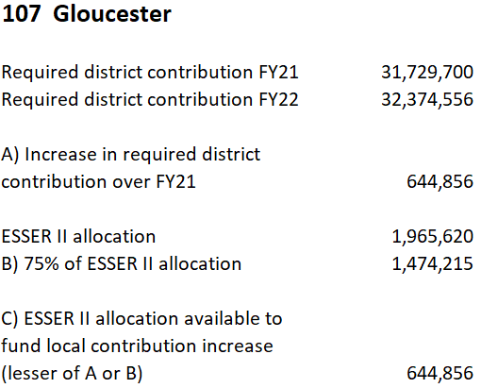
House 1 allows districts to use a portion of ESSER II funds to satisfy increases in local contribution requirements
A municipality may deem up to 75% of their ESSER II grant awards toward meeting local contribution requirements, but not more than the increase in required contribution from FY21 to FY22

Slide 10
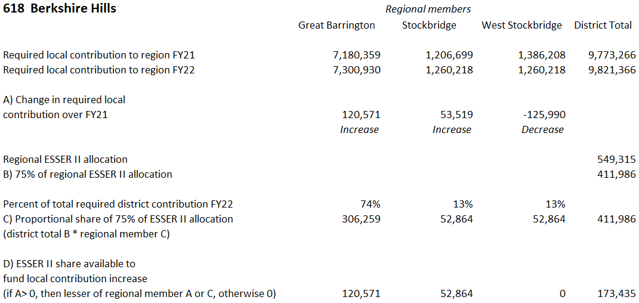
House 1 allows districts to use a portion of ESSER II funds to satisfy increases in local contribution requirements (continued)
Regional districts: Members may deem a proportional share of 75% of the regional district’s ESSER II grant award toward increases in required contribution, equal to the municipality’s share of the district’s total required contribution
Notes:
Updated 2/3/2021

Slide 11
Charter school tuition and reimbursements
Charter school tuition and reimbursements
02

Slide 12
Tuition rates for Commonwealth charter schools are based on the same foundation budget rates used in Chapter 70
Foundation budget rate increases being implemented in FY22 have been incorporated into our projected FY22 tuition rates
In addition, charter school low income enrollment for FY22 has been estimated in a manner consistent with the methodology used for districts (see slide 4)
Notes:
Updated 1/25/2021

Slide 13
House 1 implements the 3-year (100%/60%/40%) schedule for transition aid tied to year over year tuition growth
Funding for first year reimbursements is prioritized over funding for second year reimbursements
The Act requires the 75% of the total state obligation to be funded in FY22, 90% in FY23, and 100% in FY24 and subsequent years
House 1 allocates $143.5 million appropriation for these reimbursements
  This appropriation level is expected to meet or exceed the 75% requirement when tuition assessments are updated to reflect actual enrollments and district spending levels
The facilities component of the tuition rate is held constant at FY21 levels at $938 per pupil, with this cost fully reimbursed by the state as in prior years
House 1 excludes the per pupil amount of required local contribution that may be supported by each sending school district's ESSER II award, resulting in a reduction in tuition payments to charter schools of $7.5 million
Notes:
Updated 1/25/2021

Slide 14
Calculating Chapter 70 local contribution requirements and state aid
Calculating Chapter 70 local contribution requirements and state aid
03

Slide 15
Goal of the Chapter 70 formula
To ensure that every district has sufficient resources to meet its foundation budget spending level, through an equitable combination of local property taxes and state aid.

Slide 16
The updated formula includes three parameters to be specified in each year’s general appropriations act
In House 1, these are specified as:
  Total state target local contribution = 59%
  Effort reduction = 100%
  Minimum aid = $30 per pupil
Notes:
Updated 1/21/2021

Slide 17
There are 6 factors that work together to determine a district’s Chapter 70 aid
Foundation Budget
Enrollment
Wage Adjustment Factor
Inflation
Local Contribution
Property value
Income
Municipal Revenue Growth Factor

Slide 18
There are three primary steps in determining each district’s Chapter 70 aid
Determine an equitable local contribution requirement, how much of the foundation budget that should be paid for by each city and town’s property tax, based upon the relative wealth of the municipality
Define and calculate a foundation budget for each district, given the specific grades, programs, and demographic characteristics of its students
Calculate state aid, providing necessary funds to reach foundation or mandated minimum aid increases
Local Contribution + State Aid = a district’s net school spending (NSS) requirement
This is the minimum amount that a district must spend to comply with state law

Slide 19
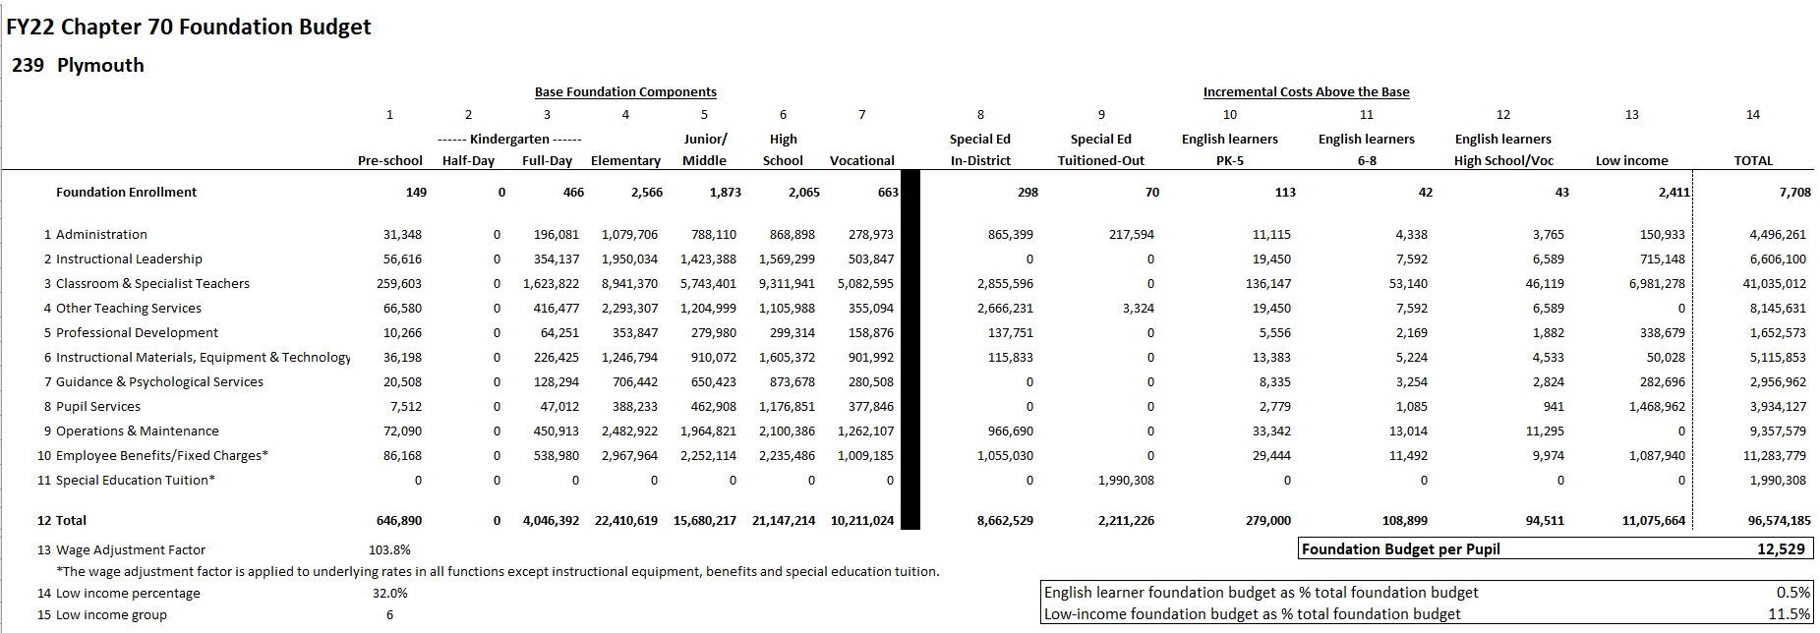
Each district's foundation budget is calculated by multiplying the number of pupils in 13 enrollment categories by cost rates in 11 functional areas
All of your students are counted in categories 1−7; special education, English learner, and low income costs are treated as costs above the base and are captured in 10−13

Slide 20
Foundation budgets vary based on student needs
Note: Chart excludes vocational and agricultural districts.
Notes:
Updated 1/21/2021

Slide 21
Determining each municipality’s target local share starts with the local share of statewide foundation
Calculate statewide foundation budget
Determine target local share
of statewide foundation
Statewide, determine percentages that yield ½ from property and ½ from income
Statewide foundation budget
$11.884B
41% State aid
$4.872B
59% Local contribution
$7.011B
Income effort
1.4135%
$3.506B
Property effort
0.3311%
$3.506B
Property and income percentages are applied uniformly across all cities and towns to determine the combined effort yield from property and income.
Notes:
Updated 1/22/2021

Slide 22
An individual municipality’s target local share is based on its local property value, income, and foundation budget
The sum of a municipality’s local property and income effort equals its Combined Effort Yield (CEY)
Target Local Share = CEY/Foundation budget (calculated at the city/town level)
  Capped at 82.5% of foundation (161 municipalities or 46% are capped)
2018 aggregate income X Statewide Income % 1.4135%
2020 EQV X Statewide Property % 0.3311%
CEY

Slide 23
Next the formula calculates each municipality’s preliminary local contribution (PLC) and makes adjustments relative to target to determine the required local contribution (RLC)
Preliminary contribution Required contribution
Increase last year’s required local contribution by the MRGF
If the PLC as a % of foundation< target
If the difference is < than 2.5%, the PLC is the new requirement
If the difference is > 7.5%, add 2% to PLC
If the PLC as a % of foundation > target
Reduce PLC by 100% of the gap
If the difference is between 2.5% and 7.5%, add 1% to PLC
Municipal Revenue Growth Factors (MRGF) are calculated annually by the Department of Revenue. MRGFs quantify the most recent annual % change in each municipality’s local revenues, such as the annual increase in the Proposition 2½ levy limit, that should be available for schools

Slide 24
Once a city or town’s required local contribution is calculated, it is allocated among the districts to which it belongs
Town of Dartmouth
Notes:
Updated 1/21/2021

Slide 25
Foundation aid provides additional funding for districts to spend at their foundation budgets
Foundation budget – Required local contribution = Foundation aid
Start with prior year’s aid
Add together the prior year’s aid and the required local contribution
If this year’s foundation aid exceeds last year’s total Chapter 70 aid, the district receives the amount needed to ensure it meets its foundation budget
(2) This year’s required local contribution
Prior year’s aid
(3) Foundation aid increase
(1) Foundation budget

Slide 26
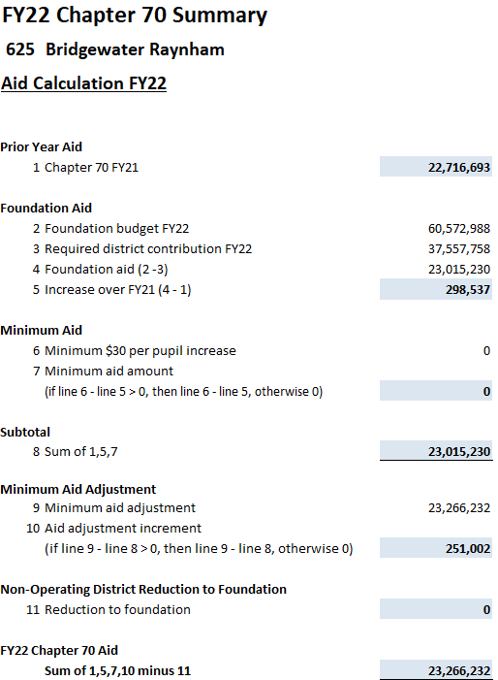
Calculating Chapter 70 aid: Districts are held harmless to previous aid levels and guaranteed at least a $30 per pupil increase
Districts are held harmless to the previous year’s level of aid
242 districts receive minimum aid increases of $30 per pupil over FY21
Notes:
Updated 1/25/2021

Slide 27
Districts receive different levels of Chapter 70 aid because their municipality’s ability to pay differs
Notes:
Updated 1/22/2021

Slide 28
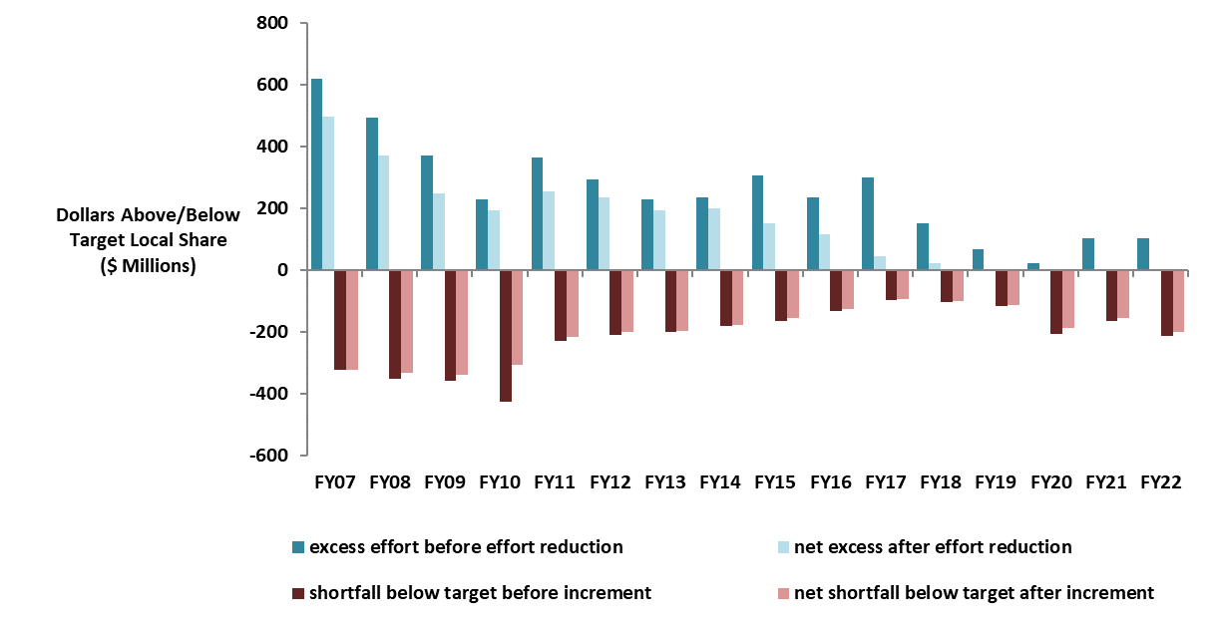
Changes to local contribution calculations started in FY07 have eliminated required excess effort and reduced effort shortfalls
Notes:
Updated 1/22/2021

Slide 29
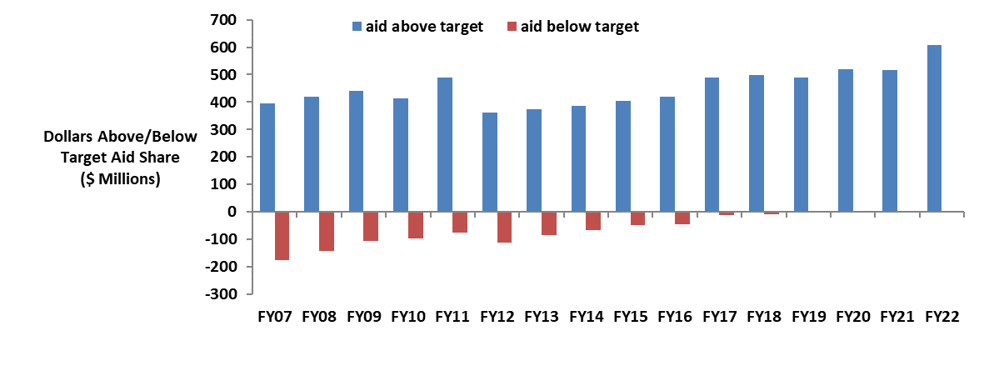
There are no longer any districts funded below target, while above target aid has increased

Slide 30



Questions?
QUESTIONS?
Rob O’Donnell, Director of School Finance
Rob Hanna, State Aid Programs Manager
Robert.F.O’Donnell@mass.gov
781.338.6512
Robert.Hanna@mass.gov
781.338.6525

