Slide 1
FY25 Chapter 70 aid and Charter reimbursements
July 2024

Slide 2
FY25 Chapter 70 funding

Slide 3
FY25 Chapter 70 continues implementation of the Student Opportunity Act (the SOA)
FY25 Chapter 70 is $6,901,918,685, a $309 million increase (4.7%) over FY24
The SOA establishes new, higher foundation budget rates in 5 areas:
  Benefits and fixed charges
  Guidance and psychological services
  Special education out-of-district tuition
  English learners
  Low-income students
FY25 Chapter 70 includes rate changes above inflation toward the goal rates in these 5 areas and closes an additional 1/6th of the gap
FY25 will be the fourth year of implementation of the SOA

Slide 4
The low-income threshold is 185% of the federal poverty level in accordance with the SOA
The SOA restores the definition of low-income enrollment used prior to FY17, based on 185% of the federal poverty level, up from the 133% threshold used for the economically disadvantaged match from FY17 to FY22
  Statewide low-income enrollment for FY25 is 415,821, compared to 421,305 for FY24
Starting in FY23, the Department has designated a student enrolled on October 1st as low income if the student is:
  Identified as participating in state public assistance programs, including the Supplemental Nutrition Assistance Program, Transitional Aid to Families with Dependent Children, MassHealth, and foster care; or
  Verified as low income through a supplemental data collection process; or
  Reported as homeless through the McKinney-Vento Homeless Education Assistance program application

Slide 5
The SOA also increases the assumed in-district special education enrollment percentages
The SOA increases the rate for vocational students from 4.75% to 5% and from 3.75% to 4% for non-vocational students
Proposed rate increases for FY25 close an additional 1/6th of the gaps, so the factors used for FY25 are 4.93% and 3.93%, respectively

Slide 6
On top of the targeted rate increases, all foundation budget categories have been adjusted upward for inflation
An employee benefits inflation rate is applied to the employee benefits and fixed charges category
  Based on the enrollment-weighted, three-year average premium increase for all GIC plans
  For FY25 the increase is 5.03%
An inflation increase of 1.35% has been applied to all other foundation budget rates, based on the U.S. Department of Commerce’s state and local government price deflator

Slide 7
The SOA also adds a new minimum aid adjustment to the formula
This provision provides hold harmless aid to operating districts that otherwise would have lost aid due to the foundation budget factors
  Determines the aid that these districts would have received if foundation budget rates were only increased by inflation
  If this amount is higher than the revised formula amount, districts get the higher amount

Slide 8
The SOA codified the aggregate wealth model for determining local contribution requirements
For municipalities with required contributions above targets, the requirement is reduced by 100% of the gap
Cities and towns with combined effort yields greater than 175% of foundation have required local contributions set at not less than 82.5% of foundation
Due to rapid increases to foundation, many communities are below target and fewer are eligible for excess effort reductions
  236 communities are subject to below effort increments to bring their contributions closer to target compared to 48 in FY21 (year prior to implementation of the SOA)
  65 communities are eligible for excess effort reduction compared to 201 in FY21

Slide 9
Charter school tuition and reimbursements

Slide 10
Tuition rates for Commonwealth charter schools are based on the same foundation budget rates used in Chapter 70
Foundation budget rate increases being implemented in FY25 have been incorporated into our projected FY25 tuition rates
In addition, charter school low-income enrollment for FY25 has been identified using the same eligibility criteria used for districts (see slide 4)

Slide 11
FY25 implements the 3-year (100%/60%/40%) schedule for transition aid tied to year over year tuition growth
Funding for first year reimbursements is prioritized over funding for second year reimbursements
The reimbursement formula for transitional aid to districts reflects the change enacted by Section 38 of the FY20 budget, with an entitlement of 100% of any tuition increase in the first year, 60% in the second year, and 40% in the third year
The SOA requires that 100% of the total state obligation to be funded in FY25
FY25 budget allocates $199.0 million for these reimbursements
  This appropriation level is expected to meet the 100% requirement when tuition assessments are updated to reflect actual enrollments and district spending levels
The facilities component of the tuition rate is $1,188 per pupil, with this cost fully reimbursed by the state as in prior years

Slide 12
Calculating Chapter 70 local contribution requirements and state aid

Slide 13
Goal of the Chapter 70 formula
To ensure that every district has sufficient resources to meet its foundation budget spending level, through an equitable combination of local property taxes and state aid.

Slide 14
The updated formula includes three parameters to be specified in each year’s general appropriations act
For FY25, these are specified as:
  Total state target local contribution = 59%
  Effort reduction = 100%
  Minimum aid = $104 per pupil

Slide 15
There are 6 factors that work together to determine a district’s Chapter 70 aid
Foundation Budget
Enrollment
Wage Adjustment Factor
Inflation
Local Contribution
Property value
Income
Municipal Revenue Growth Factor

Slide 16
There are three primary steps in determining each district’s Chapter 70 aid
Determine an equitable local contribution requirement, how much of the foundation budget that should be paid for by each city and town’s property tax, based upon the relative wealth of the municipality
Define and calculate a foundation budget for each district, given the specific grades, programs, and demographic characteristics of its students
Calculate state aid, providing necessary funds to reach foundation or mandated minimum aid increases
Required Local Contribution + State Aid = a district’s net school spending (NSS) requirement
This is the minimum amount that a district must spend to comply with state law

Slide 17
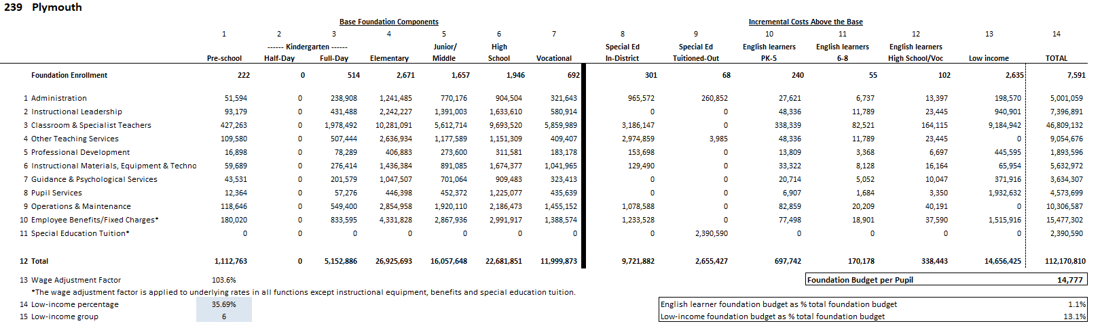
Each district's foundation budget is calculated by multiplying the number of pupils in 13 enrollment categories by cost rates in 11 functional areas
All students are counted in categories 1−7; special education, English learner,
and low-income costs are treated as costs above the base and are captured in 8−13

Slide 18
Foundation budgets vary based on student needs, including concentrations of low-income students
Note: Chart excludes vocational and agricultural districts.

Slide 19
Determining each municipality’s target local share starts with the local share of statewide foundation
Calculate statewide foundation budget
Determine target local share
of statewide foundation
Statewide, determine percentages that yield ½ from property and ½ from income
Statewide foundation budget
$14.535 B
41% State aid
$5.959 B
59% Local contribution
$8.576 B
Income effort
1.4312%
$4.288 B
Property effort
0.3906%
$4.288 B
Property and income percentages are applied uniformly across all cities and towns to determine the combined effort yield from property and income.

Slide 20
An individual municipality’s target local share is based on its local property value, income, and foundation budget
The sum of a municipality’s local property and income effort equals its Combined Effort Yield (CEY)
Target Local Share = CEY/Foundation budget (calculated at the city/town level)
  Capped at 82.5% of foundation (182 municipalities or 52% are capped)
2021 aggregate income
X
Statewide Income %
1.4312%
2022 EQV
X
Statewide Property
0.3906%
CEY

Slide 21
Next the formula calculates each municipality’s preliminary local contribution (PLC) and makes adjustments relative to target to determine the required local contribution (RLC)
Preliminary contribution Required contribution
Increase last year’s required local contribution by the MRGF
If the PLC as a % of foundation is less than target
If the difference is < than 2.5%, the PLC is the new requirement
If the difference is > 7.5%, add 2% to PLC
If the PLC as a % of foundation is more than target
Reduce PLC by 100% of the gap
If the difference is between 2.5% and 7.5%, add 1% to PLC
Municipal Revenue Growth Factors (MRGF) are calculated annually by the Department of Revenue. MRGFs quantify the most recent annual % change in each municipality’s local revenues, such as the annual increase in the Proposition 2½ levy limit, that should be available for schools

Slide 22
Once a city or town’s required local contribution is calculated, it is allocated among the districts to which it belongs
Town of Orleans

Slide 23
Foundation aid provides additional funding for districts to spend at their foundation budgets
Foundation budget – Required local contribution = Foundation aid
Start with prior year’s aid
Add together the prior year’s aid and the required local contribution
If this year’s foundation aid exceeds last year’s total Chapter 70 aid, the district receives the amount needed to ensure it meets its foundation budget
(2) This year’s required local contribution
Prior year’s aid
(3) Foundation aid increase
(1) Foundation budget

Slide 24
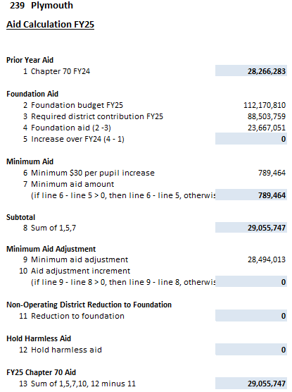
Calculating Chapter 70 aid: Districts are held harmless to previous aid levels and guaranteed at least a $30 per pupil increase
Districts are held harmless to the previous year’s level of aid
229 districts receive minimum aid increases of $104 per pupil in FY25

Slide 25
Districts receive different levels of Chapter 70 aid because their municipality’s ability to pay differs
Required Local Contribution + State Aid = a district’s net school spending (NSS) requirement

Slide 26
The aggregate wealth model has eliminated required excess effort, but in recent years effort shortfalls have increased
For communities that are below target, recent expansions in foundation budgets have resulted in required local contributions not keeping pace with the foundation budget increases

Slide 27
There are no longer any districts funded below target, while above target aid has increased

Slide 28


QUESTIONS?
Rob O’Donnell, Director of School Finance
Meghan Ryan, State Aid Programs Manager
Robert.F.O’Donnell@mass.gov
781.338.6512
Meghan.Ryan2@mass.gov
781.338.6507

