Slide 1
Extraordinary Relief and Reserve Relief
FY2024 Special Education Circuit Breaker
Office of District & School Finance
January 10, 2024

Slide 2
Agenda
Circuit Breaker Program Overview
Eligibility Criteria for Reimbursements
Relief Calculation Examples
Timeline & Further Information

Slide 3
Circuit Breaker Program
Commonwealth’s Special Education Reimbursement Program (“Circuit Breaker”)
Provides annual financial assistance to public school districts
Supports delivery of “high cost” special education services to students age 3 through 21
Annual Claim Cycle:
Relief claims: reimburse for current year instruction/tuition expenses (Net Claim in FY24 claim file)
(districts file in March 2024, reimbursed in May 2024)
Year-End claims: reimburse for prior year instruction/tuition and transportation expenses
(districts file in July 2024, reimbursed quarterly during FY25)
Legal References:
School Finance Regulations 603 CMR 10.07
Mass General Law Chapter 71B section 5A
RESERVE RELIEF: Session Law, Acts of 2023 item 1599-0012

Slide 4
Reserve Relief Language
1599-0012 For a reserve to support reimbursements for extraordinary relief to school districts pursuant to section 5A of chapter 71B of the General Laws and item 7061-0012; provided, that funds shall be made available for reimbursements in fiscal year 2024 to school districts that experience increases to instructional costs reimbursable under said section 5A of said chapter 71B and incurred such instructional costs during fiscal year 2024 that exceed 25 per cent of such instructional costs incurred during fiscal year 2023; provided further, that funds shall also be made available to reimburse districts in fiscal year 2024 for 100 per cent of any such instructional cost increases exceeding 7.5 per cent where the total of such increase also exceeds 0.5 per cent of total actual net school spending in fiscal year 2023; …provided further, that funds paid from this provision in fiscal year 2024 shall not be reimbursable in fiscal year 2025;…

Slide 5
Relief Program: Eligibility Overview
1. District must qualify for Extraordinary Relief and/or Reserve Relief:
Key metric (both Extraordinary Relief and Reserve Relief) is the change in net eligible special education instruction/tuition expenses between FY23 and FY24
Reserve Relief also compares that instruction/tuition change to the district’s FY23 Net School Spending (NSS)
Transportation expenses are not considered for Relief (year-end claims only)
2. Per-student expenses must reach “high cost” claim threshold for reimbursement:
FY24 per-student costs must exceed $51,721
District is reimbursed a percentage of costs over this claim threshold:
Target is 75% reimbursement for Extraordinary Relief and 100% for Reserve Relief

Slide 6
Circuit Breaker Claiming Eligibility
For services provided during FY24 (July 1, 2023 to June 30, 2024)
Circuit Breaker Program | Claims Filed by Districts | Eligibility | Reimbursement Categories and Amounts
Extraordinary Relief | Filed March 2024 for services provided and anticipated through June 30, 2024 | districts with net eligible FY24 tuition & instructional expenditures that are: tuition/instructional 25%+ higher than in FY23 | Tuition & instruction only 75% reimbursement target (subject to appropriation) for expenses over eligibility threshold
Reserve Relief | Filed March 2024 for services provided through FY24 | districts with net eligible FY24 tuition & instructional expenditures that are: 7.5%+ higher than in prior year and Increase = an amount > 0.5% of FY23 NSS | Tuition & instruction only 100% reimbursement target (subject to appropriation) for expenses over eligibility threshold
Final Year End Reimbursements | Filed July 2024 for services provided through June 30, 2024 | All districts with financial responsibility for student(s) with services that meet or exceed the “high cost” threshold | Tuition & instruction and out-of-district transportation 75% reimbursement target (subject to appropriation) for expenses over eligibility threshold

Slide 7
Circuit Breaker Reimbursements
For services provided during FY24 (July 1, 2023 to June 30, 2024)
CB Program | Reimbursement Paid | Expenditure Deadlines
Extraordinary Relief | May 2024 | Must be spent in current FY (spend by June 30, 2024)
Reserve Relief | May 2024 | May carry forward one FY (spend by June 30, 2025)
Final Year End Reimbursements | Quarterly during FY25 | May carry forward one FY (spend by June 30, 2026)

Slide 8
Calculation Example: Scenario 1
A. Key District Metrics
D. Calculating Extraordinary Relief Reimbursement
District FY23 net eligible special education instruction/tuition costs | $1,000,000
District FY24 net eligible special education instruction/tuition costs | $1,090,000
FY23 Net School Spending | $20,000,000
N/A
District was not eligible
B. Calculate District Eligibility Thresholds
Change in net eligible instruction/ tuition costs from FY23 to FY24 | $1,090,000 minus $1,000,000 = $90,000, which is a 9% increase
0.5% of FY23 Net School Spending | $20,000,000 times 0.005 = $100,000
E. Calculating Reserve Relief Reimbursement
N/A
District was not eligible
C. Determine District Eligibility
Does district qualify for Extraordinary Relief? | No. Change in expenses are 9%, which is lower than the 25% required
Does district qualify for Reserve Relief? | No. Change in expenses are $90,000, which is more than the $100,000 NSS increase required (even though change in expenses are 9%, which is higher than the 7.5% required)

Slide 9
Calculation Example: Scenario 2
A. Key District Metrics
D. Calculating Extraordinary Relief Reimbursement
District FY23 net eligible special education instruction/tuition costs | $1,000,000
District FY24 net eligible special education instruction/tuition costs | $1,300,000
FY23 Net School Spending | $64,000,000
District FY23 net eligible special education instruction/tuition costs plus expected escalation (assumed at 10%) | $1,000,000 times 1.10 = $1,100,000
District FY24 net eligible special education instruction/tuition costs | $1,300,000
Target 75% reimbursement of unanticipated increase (subject to appropriation) | $1,300,000 minus $1,100,000 = $200,000, then times 0.75 = $150,000 Extraordinary Relief
B. Calculate District Eligibility Thresholds
Change in net eligible instruction/ tuition costs from FY23 to FY24 | $1,300,000 minus $1,000,000 = $300,000, which is a 30% increase
0.5% of FY23 Net School Spending | $64,000,000 times 0.005 = $320,000
E. Calculating Reserve Relief Reimbursement
N/A
District was not eligible
C. Determine District Eligibility
Does district qualify for Extraordinary Relief? | Yes. Change in expenses are 30%, which is higher than the 25% required
Does district qualify for Reserve Relief? | No. Change in expenses are $300,000, which is less than the $320,000 NSS increase required (even though change in expenses are 30%, which is higher than the 7.5% required)

Slide 10
Calculation Example: Scenario 3
A. Key District Metrics
D. Calculating Extraordinary Relief Reimbursement
District FY23 net eligible special education instruction/tuition costs | $1,000,000
District FY24 net eligible special education instruction/tuition costs | $1,200,000
FY23 Net School Spending | $30,000,000
N/A
District was not eligible
B. Calculate District Eligibility Thresholds
Change in net eligible instruction/ tuition costs from FY23 to FY24 | $1,200,000 minus $1,000,000 = $200,000, which is a 20% increase
0.5% of FY23 Net School Spending | $30,000,000 times 0.005 = $150,000
E. Calculating Reserve Relief Reimbursement
Adjusted FY23 net eligible special education instruction/tuition costs (specified by legislature at 7.5%) | $1,000,000 times 1.075 = $1,075,000
District FY24 net eligible special education instruction/tuition costs | $1,200,000
Target 100% reimbursement above adjusted increase minus Extraordinary Relief reimbursement (subject to appropriation) | $1,200,000 minus $1,075,000 = $125,000, then minus $0 Extraor. Relief = $125,000 Reserve Relief
C. Determine District Eligibility
Does district qualify for Extraordinary Relief? | No. Change in expenses are 20%, which is lower than the 25% required
Does district qualify for Reserve Relief? | Yes. Change in expenses are $200,000, which is more than the $150,000 NSS increase required AND change in expenses are 20%, which is higher than the 7.5% required

Slide 11
Calculation Example: Scenario 4
A. Key District Metrics
D. Calculating Extraordinary Relief Reimbursement
District FY23 net eligible special education instruction/tuition costs | $1,000,000
District FY24 net eligible special education instruction/tuition costs | $1,400,000
FY23 Net School Spending | $60,000,000
District FY23 net eligible special education instruction/tuition costs plus expected escalation (assumed at 10%) | $1,000,000 times 1.10 = $1,100,000
District FY24 net eligible special education instruction/tuition costs | $1,400,000
Target 75% reimbursement of unanticipated increase (subject to appropriation) | $1,400,000 minus $1,100,000 = $300,000, then times 0.75 = $225,000 Extraordinary Relief
B. Calculate District Eligibility Thresholds
Change in net eligible instruction/ tuition costs from FY23 to FY24 | $1,400,000 minus $1,000,000 = $400,000, which is a 40% increase
0.5% of FY23 Net School Spending | $60,000,000 times 0.005 = $300,000
E. Calculating Reserve Relief Reimbursement
Adjusted FY23 net eligible special education instruction/tuition costs (specified by legislature at 7.5%) | $1,000,000 times 1.075 = $1,075,000
District FY24 net eligible special education instruction/tuition costs | $1,400,000
Target 100% reimbursement above adjusted increase minus Extraordinary Relief reimbursement (subject to appropriation) | $1,400,000 minus $1,075,000 = $325,000, then minus $225,000 Extr. Relief = $100,000 Reserve Relief
C. Determine District Eligibility
Does district qualify for Extraordinary Relief? | Yes. Change in expenses are 40%, which is higher than the 25% required
Does district qualify for Reserve Relief? | Yes. Change in expenses are $400,000, which is more than the $300,000 NSS increase required AND change in expenses are 40%, which is higher than the 7.5% required

Slide 12
Scenarios 1 - 4
 | FY23 Net Claim | FY24 Net Claim | Change in Net Claim | % Increase | Extra Relief required increase | Eligible for Ext Relief |  | FY23 Net School Spending | .5% of FY23 Net School Spending | Change in Net Claim | Eligible for Reserve Relief
Example 1 | 1,000,000 | 1,090,000 | 90,000 | 9.00% | 25% | N |  | 20,000,000 | 100,000 | 90,000 | N
Example 2 | 1,000,000 | 1,300,000 | 300,000 | 30.00% | 25% | Y |  | 64,000,000 | 320,000 | 300,000 | N
Example 3 | 1,000,000 | 1,200,000 | 200,000 | 20.00% | 25% | N |  | 30,000,000 | 150,000 | 200,000 | Y
Example 4 | 1,000,000 | 1,400,000 | 400,000 | 40.00% | 25% | Y |  | 60,000,000 | 300,000 | 400,000 | Y

Slide 13
Scenarios 1 – 4 Continued
 | FY23 Net Claim | Expected increase in Net Claim | Adjusted FY23 Net Claim (ANC) | FY24 Net Claim | Increase in FY24 - ANC | Basis for Ext Relief | Estimated Ext Relief |  | Adjusted FY23 Net Claim (ANC) | FY24 Net Claim | Increase | Estimated Reserve Relief
Example 1
Example 2 | 1,000,000 | 100,000 | 1,100,000 | 1,300,000 | 200,000 | 200,000 | 150,000
Example 3 |  |  |  |  |  |  |  |  | 1,075,000 | 1,200,000 | 125,000 | 125,000
Example 4 | 1,000,000 | 100,000 | 1,100,000 | 1,400,000 | 300,000 | 300,000 | 225,000 |  | 1,075,000 | 1,400,000 | 325,000 | 100,000

Slide 14
Finding Key Metrics (net eligible instruction & tuition)
FY23 Net Eligible Instruction/Tuition found in FY24 Reimbursement Listing:
https://www.doe.mass.edu/finance/circuitbreaker/payments/
FY24 Net Eligible Instruction/Tuition determined in FY24 relief claim excel file (due March 2024):

Slide 15
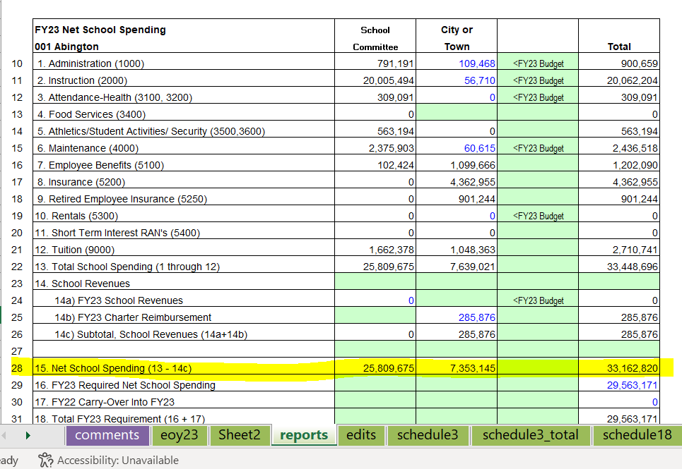
Finding Key Metrics (net school spending)
FY23 Net School Spending found in District’s FY23 End-of-Year Report (see reports sheet within workbook)

Slide 16
Relief Claiming Timeline
FY24 Relief Claims supporting both Extraordinary Relief and Reserve Relief:
Beginning Today until January 26 – Districts should notify DESE of intent to file for Relief by emailing circuitbreaker@mass.gov
February 2 – Relief claim files are available for download in the security portal
Relief Training – Stay tuned
March 8 – District Relief Claims Due
March & April – Relief claims are reviewed
May – Extraordinary Relief and Reserve Relief reimbursements determined and paid

Slide 17
Upcoming Trainings
Course Number | Topic | Date
CB-201 | Expense Claiming Overview | Wednesday 01/31/2024 at noon
CB-202 | Claiming In-District Services | Monday 02/05/2024 at noon
CB-203 | Claiming Out-Of-District Private, Approved | Monday 02/12/2024 at noon
CB-204 | Claiming Out-Of-District Public/Collaboratives and Unapproved Programs | Wednesday 02/14/2024 at noon
Q&A 1 | Questions & Answers | Thursday 02/29/2024 at noon
Q&A 2 | Questions & Answers | Tuesday 03/05/2024 at noon
Registration Links will be sent to the COA and Circuit Breaker listservs

Slide 18
Further Information
For assistance filling out claims, including what costs are eligible and how to navigate the claim file:
Contact the circuit breaker liaison assigned to your district: https://www.doe.mass.edu/finance/circuitbreaker/liaison.html
Be sure your district has applied for and received any necessary approvals from the Operational Services Division (OSD):
Includes Individual Price Authorizations (IPAs) and Individual Student Programs (ISPs)
Links to applications can be found on this circuit breaker page:
https://www.doe.mass.edu/finance/circuitbreaker/service-costs/default.html

Slide 19
Questions?
Please type questions into the Q&A portion of Zoom (not chat)

Slide 20
Thank You

Slide 21
Additional Resource Materials

Slide 22
Reserve Relief Language
1599-0012 For a reserve to support reimbursements for extraordinary relief to school districts pursuant to section 5A of chapter 71B of the General Laws and item 7061-0012; provided, that funds shall be made available for reimbursements in fiscal year 2024 to school districts that experience increases to instructional costs reimbursable under said section 5A of said chapter 71B and incurred such instructional costs during fiscal year 2024 that exceed 25 per cent of such instructional costs incurred during fiscal year 2023; provided further, that funds shall also be made available to reimburse districts in fiscal year 2024 for 100 per cent of any such instructional cost increases exceeding 7.5 per cent where the total of such increase also exceeds 0.5 per cent of total actual net school spending in fiscal year 2023; …provided further, that funds paid from this provision in fiscal year 2024 shall not be reimbursable in fiscal year 2025;…

Slide 23
Circuit Breaker Cost Eligibility
Examples of Eligible Expenses | Examples of Ineligible Expenses
Instruction (based on IEP) Tuition Out-of-district transportation | Evaluations Building Adaptation Administrative & overhead costs In-district transportation
Instruction & tuition costs are further defined in School Finance Regulations 603 CMR 10.07
Questions related to expense eligibility can be directed your district’s Circuit Breaker Liaison

Slide 24
Eligible Out-of-District Costs (1 of 2)
Instruction and Tuition
Approved Private Programs | Unapproved Private Programs | Public Programs
Programs are approved and rates are set by Operational Services Division (OSD) DESE/OSD Approved Summer Programs DESE/OSD Approved 10/12 Month Programs DESE/OSD Approved One-to-One Services (1:1) | Requires both DESE approval and OSD authorization per individual student Seek approval for Individual Student Program (ISP) and Request for Pricing Authorization online: mass.gov PQA portal (service-now) | Out-of-district public program at a public school or collaborative where tuition is paid by the student’s sending district

Slide 25
Eligible Out-of-District Costs (2 of 2)
Transportation
out-of-district programs only
OOD Transportation
Beginning with the Student Opportunity Act (SOA), districts can claim transportation costs for students attending out-of-district programs only Transportation services provided by 3rd party (bus company) In-house transportation (a district uses its own buses to transport students) Parents reimbursement - based on state approved rate per mile Can include cost of monitor

Slide 26
Eligible In-District Costs (1 of 2)
Reimbursable costs are instructional services associated with implementing Individualized Education Plans (IEPs)
All services being claimed must be documented in an IEP
All services claimed must have been provided
Reimbursement rates for in-district services:
Set by the State
Not based on actual district expense
Adjusted annually

Slide 27
Eligible In-District Costs (2 of 2)
Interpreting the IEP Service Delivery Grid:
What service provider is listed?
Who provided the service?
How was the service provided (group, small group, individual)?
Frequency/duration (number of hours)?
Days in cycle?
Dates of service?
In many cases, services provided in extended year programs are outlined separately

