Slide 1
Lesson 2: Words for Wood
Connecting Essential Vocabulary

Slide 2
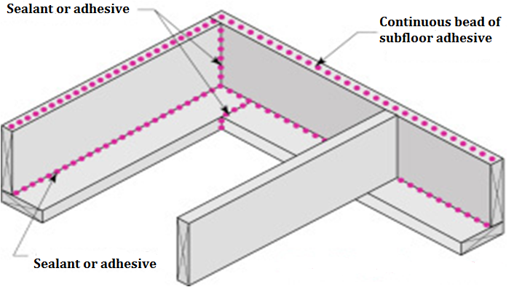
Band Joist

Slide 3
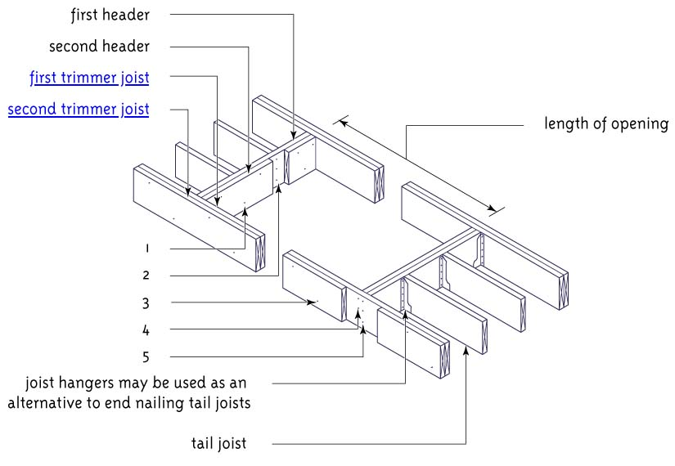
Double Header

Slide 4
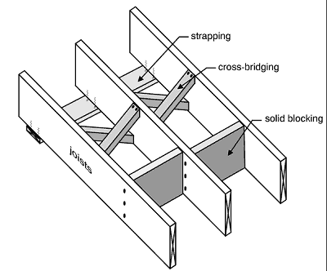
Cross-Bridging

Slide 5
Solid Bridging

Slide 6
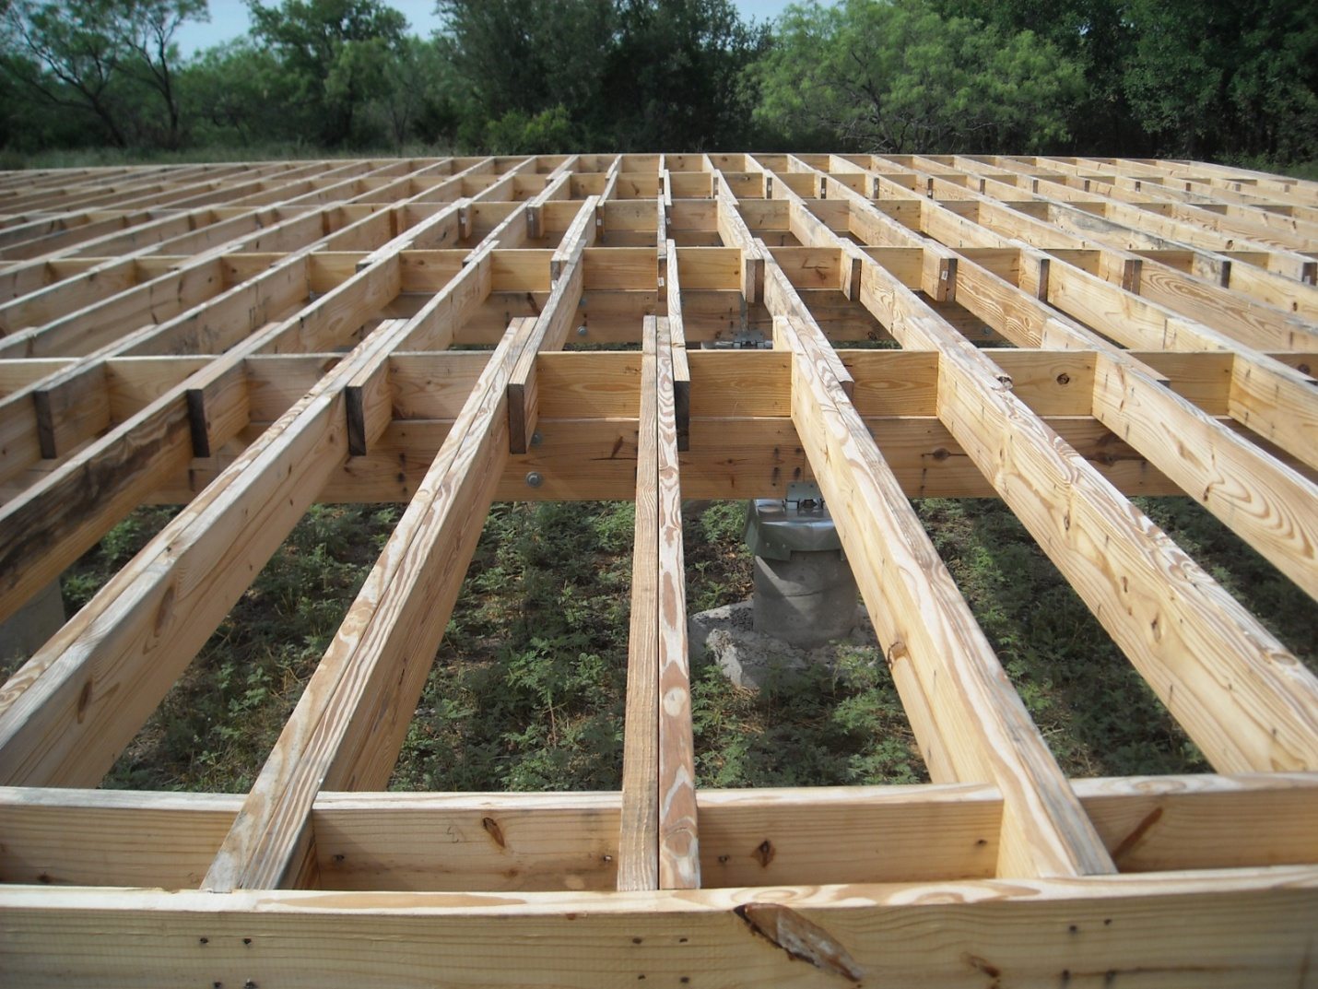
Floor Joist

Slide 7
Trimmer

Slide 8
Fire Blocking

Slide 9
Sill

Slide 10
Sill Sealer

Slide 11
Anchor Bolt

Slide 12
Joist Hanger

Slide 13
Lally Column

Slide 14
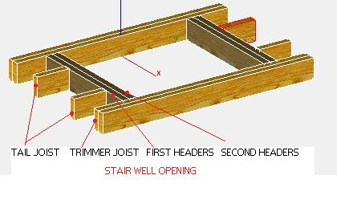
Tail Joist

Slide 15
Built Up Girder

Slide 16
Framing Square

