Slide 1
Selecting Title I schools and allocating funds
June 2020

Slide 2
Overview
Introduction
Obtain the district’s Title I allocation
Determine district-level reservations
Determine if rank ordering by poverty percentage is needed for school-level funding
For districts/charter schools with only one school per grade span
For districts/charter schools with enrollment less than 1,000 students
Select the basis for determining poverty
Choose the method for qualifying schools
Rank all schools in descending order by the percentage of greatest poverty
Identify schools having the greatest need for additional services
Allocate funds to schools
Determine the actual per-pupil amount for each Title I school

Slide 3
Introduction
Federal Title I, Part A funds are allocated to districts with high percentages or high numbers of children from low-income families. In turn, districts must identify Title I schools and assign funds to those schools based on poverty percentage. Districts may also consider school performance when funding school- and district-level supports and interventions with Title I.
The primary purpose of this guide is to provide to Title I Directors and other district staff a brief overview of the process used in selecting and allocating funds to schools for the purposes of implementing Title I programs.

Slide 4
Obtain the district’s total Title I allocation and accountability and assistance categories
District Title I, Part A allocations: http://www.doe.mass.edu/grants/awards.html
District and school accountability and assistance categories: http://profiles.doe.mass.edu/statereport/accountability.aspx

Slide 5
Determine district-level reservations
Step 1 District Reservations
Equitable participation for private school students
Family engagement
Neglected & Delinquent programs
Administrative costs
Preschool programs
Homeless students
Foster Care transportation
Indirect costs
MTRS
Other Costs

Slide 6
Determine if rank ordering by poverty percentage is needed for school-level funding
For districts/charter schools with only one school per grade span:

Slide 7
Determine if rank ordering by poverty percentage is needed for school-level funding
For districts/charter schools with enrollment less than 1,000 students:

Slide 8
Select the basis for determining poverty
Economically Disadvantaged Data
Economically Disadvantaged Data x 1.6 multiplier
Other
Note:
Poverty data may be used by itself or in combination with two or more other sources.
ESE preloads Economically Disadvantaged data into the Title I, Part A grant application as the default source of poverty data. Districts may opt to use other sources if there is compelling reason to do so.

Slide 9
Choose the method for qualifying Title I schools
District-wide low-income percentage
Grade span grouping & district-wide percentage
One school per grade span
Total enrollment less than 1,000
35% Rule
Grade span grouping & 35% rule
Grade span grouping & group-wide percentage
Note:
When possible, consider allocating funds in accordance with academic need.

Slide 10
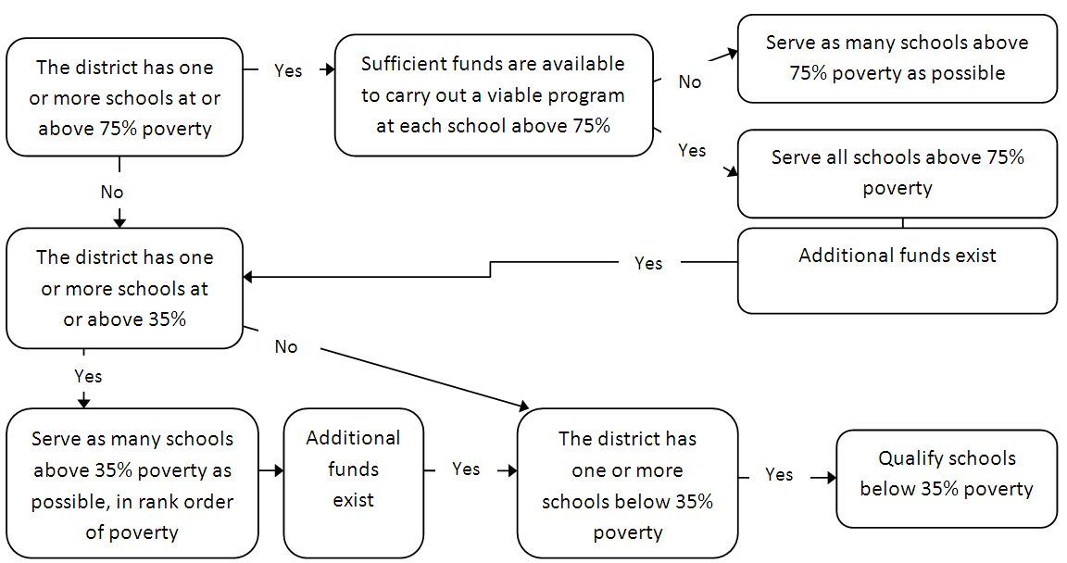
Rank all schools in descending order by the percentage of greatest poverty

Slide 11
Identify schools having the greatest need for additional services
For each school, consider:
Accountability and assistance Level
Low-performing subgroup(s)
Presence of additional funding (beyond Title I)

Slide 12
Allocate funds to schools
Base school allocations on the per-pupil amounts and low-income enrollment for each school
Include required accountability-related district-level reservations for targeted supports and interventions
Note:
Minimum per-pupil amounts are set for districts serving schools under 35% poverty. Districts serving only schools at or above 35% poverty can set the per-pupil amount.

Slide 13
Determine the actual per-pupil amount for each Title I school
Based on each school’s total allocation divided by the number of low-income students enrolled in the school
Per-pupil allocations must either be equal across all served schools in the district or descend in the order of poverty percentage for each served school
School allocations must meet minimum funding requirements based on minimum per-pupil allocations and low-income enrollment

Slide 14
Questions?
Resource Allocation Strategy and Planning
(781) 338-6230
federalgrantprograms@doe.mass.edu
www.mass.mass.edu/federalgrants

