Slide 1
GEM$ Final Expenditure Report (FER)
July, 2024
Webinars from the Grants Management Team

Slide 2
When & Who
FERs are available to start the day after the grant end date
Refer to the Grant Award Notification (GAN) to confirm end date
FERs are available prior to grant end date if all grant funds have been requested and there is a $0 balance remaining (for every fund code connected to the application)
LEA Fiscal Representative completes the FER
Notes:
Validations – bullet 2 and 3. decrease – reimb request will not allow you to draw more than the new amount;

Slide 3
Due Dates
FERs are due to DESE 90 days after the grant end date
If FER is being used to claim final reimbursement on a grant they must be filed by 8/15

Slide 4
FER Scenarios
All grant funds have been claimed and reported as expended in full
Some grant funds have been claimed and what has been claimed is reported as expended in full
Applicant claimed more grant funds than what was expended – applicant owes DESE refund
DESE expects this scenario to mitigate since reimbursements are based on true reported expenditures
Applicant reports grant funds as expended in full but has an unclaimed balance – DESE owes applicant reimbursement (time sensitive – file by 8/15)
Notes:
Bullet 1: your allocation was X amount, that is what you wrote for, received & all funds expended
Bullet 2: your allocation was X amount but you only requested x amount (received & expended)
Bullet 3: same as above but you only spent 5000 – will be returning 2000

Slide 5
FER scenarios: examples
All funds have been claimed and reported as expended in full

Slide 6
FER scenarios: examples
Some grant funds have been claimed and what has been claimed is reported as expended in full

Slide 7
FER scenarios: examples
Applicant claimed more funds than was expended
Return of grant funds owed to DESE (negative amount in Pending Transaction Amount)

Slide 8
FER scenarios: examples
Applicant reports grant funds as expended in full but has an unclaimed balance (positive amount in Pending Transaction Amount)
If filed by 8/15 – DESE owes applicant reimbursement
DESE cannot guarantee payment will be released if filed after 8/15.

Slide 9
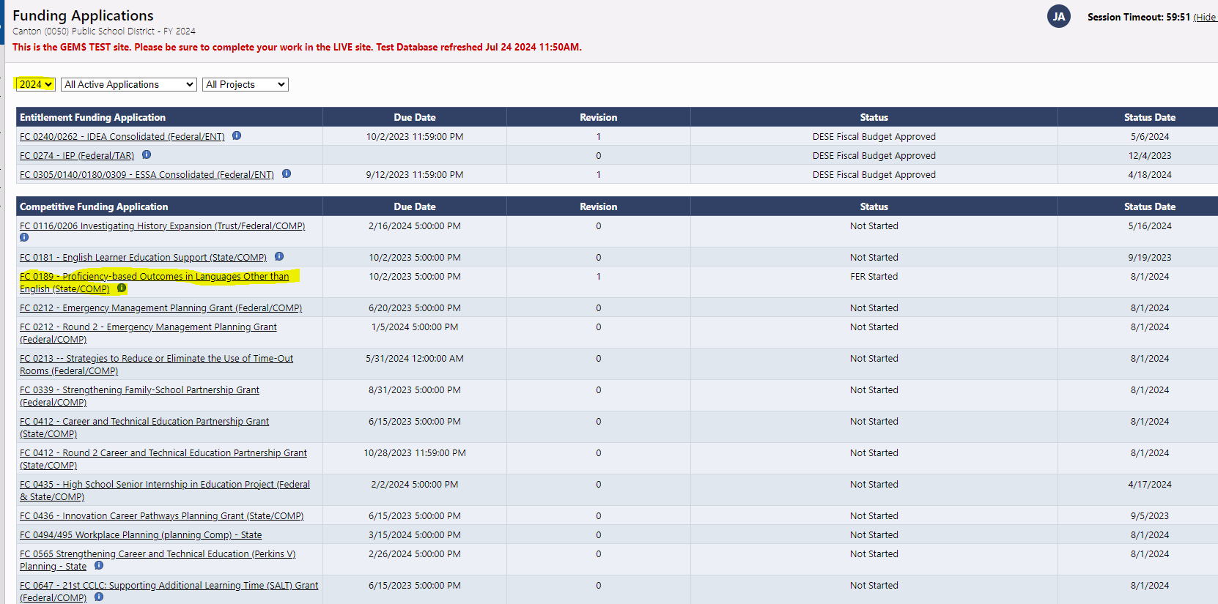
How to begin FER
Click on Funding (left hand column) and navigate to Funding Applications
Choose the grant fund code you want to file FER for. This brings user to the Sections area of the grant

Slide 10
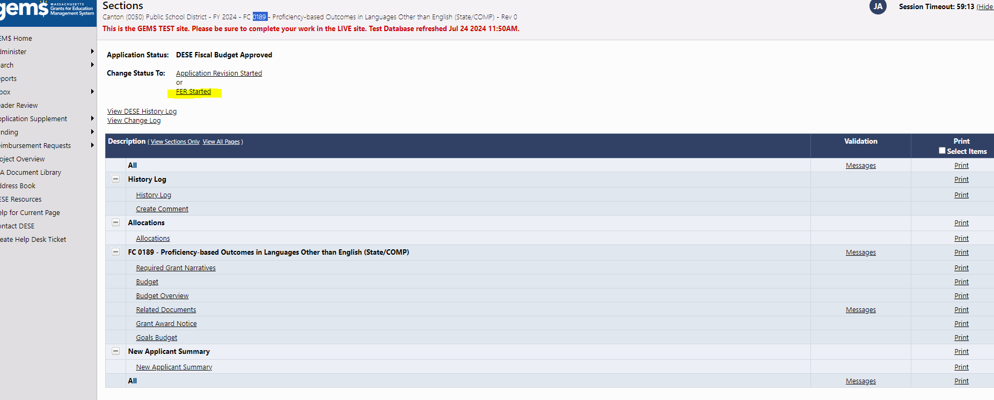
How to begin FER
LEA Fiscal Rep moves Application to FER Started status (Sections)

Slide 11
Cannot change status to FER Started
If there is no option to change the status to FER started, it means the grant is under revision.
Revisions need to be fully processed through the workflow before you can start the FER.
This is why DESE asks for all final revisions to be completed 30 days prior to grant end date.

Slide 12
FER Summary
Once FER Started check FER Summary (in Sections)
Allocation: Grant Allocation/Award Amount
Expenditures: The sum of all expenditures reported by applicant on completed Reimbursement Requests
Cash Received: Funds paid to applicant from the grant
Amount Remaining: Unclaimed grant balance OR amount left unexpended as reported by applicant
Amount Eligible for Carryover: NA DESE does not use this feature on the FER

Slide 13
FER Summary
Pending Transaction Amount:
Displays whether applicant owes DESE a refund (negative dollar amount) or
If DESE owes applicant additional funds according to expenditures reported (positive amount)
FERs must be filed by 8/15 if additional funds are owed to applicant by DESE

Slide 14
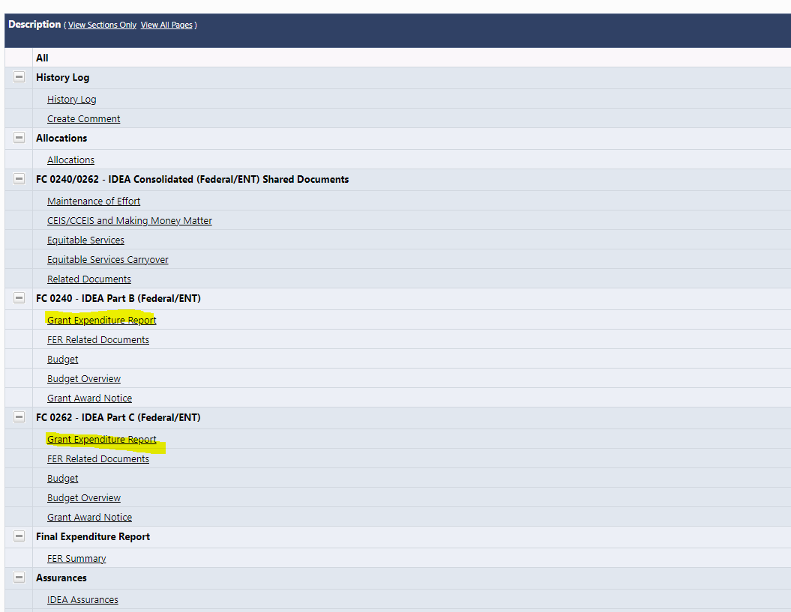
Grant Expenditure Report
After verifying FER Summary, go to Grant Expenditure Report
Consolidated grant applications will have a Grant Expenditure Report for each Fund Code and must be completed at the same time.

Slide 15
Grant Expenditure Report
Grant Expenditure Report will pull in expenditures as reported on reimbursement requests for each Object/Function of the budget.

Slide 16
Grant Expenditure Report
If there are no changes to previously reported expenditures, move to FER Submitted. FER is now complete!
If needed, you can modify reported expenditures to true up actuals before moving to FER Submitted
Re-review the FER Summary before moving to complete to ensure no funds are owed to you or from you

Slide 17
Grant Expenditure Report
The Grant Expenditure Report will not allow reported expenditures over 10% or $10,000 in any Function/Object Code category. An error message will appear. A revision should have been completed 30 days prior to grant end date.
If a revision is required, contact grants management so we can cancel the FER.
If the FER is being used to claim final balances and a revision needs to be done DESE cannot guarantee the payment will process in time for Fiscal Year close since the revision must complete the entire workflow before changes are reflected on the FER.

Slide 18
Error message when moving to FER started
An error message will appear if the end date of the grant has not passed and there is still a grant balance unclaimed.
An error message will appear if previously a Reimbursement Request was started but never completed.

Slide 19
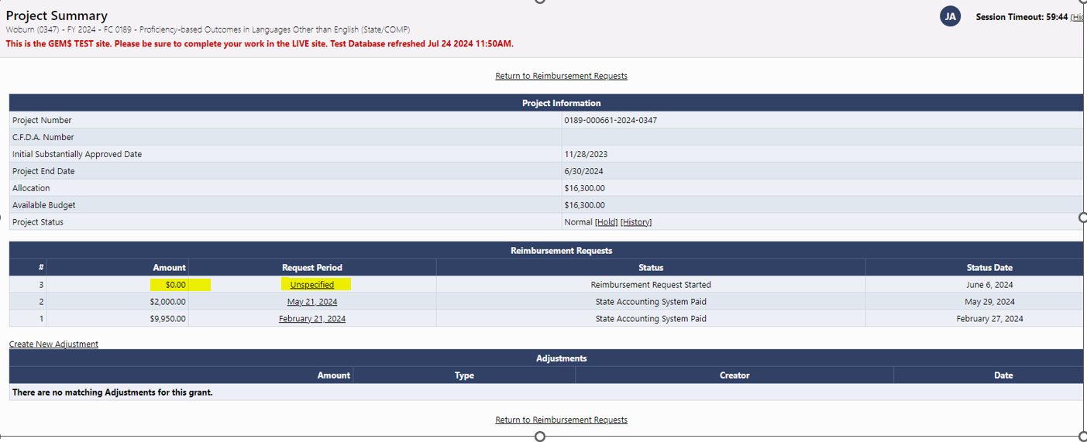
Clearing Error message
Go to reimbursement requests and delete the Reimbursement request that was started but not completed
Click Unspecified under request period

Slide 20
Clearing Error Message
Click “Delete Reimbursement Request”

Slide 21
FER is submitted – now what?
Grants Management will review and process FERs
Any FERs filed on or before 8/15 will be prioritized so that if final balances are being claimed via FER filing those can process before Accounts payable closes
DESE cannot guarantee payment for balances owed on any FERs if filed after 8/15

Slide 22
FER submitted – Applicant owes return
If applicant reports expenditures less than what was claimed
A message signaling return owed will appear as you move to FER submitted
Acknowledge/confirm and change status to FER Submitted

Slide 23
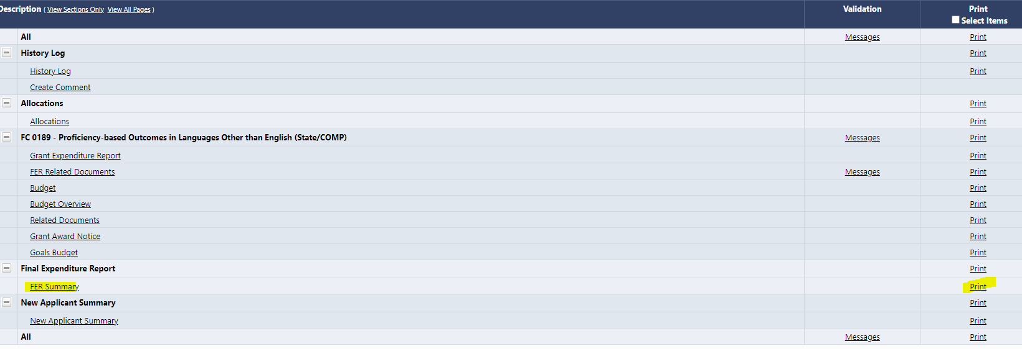
FER submitted – Applicant owes return
FER Summary screen should be printed out
Check for pop-up blockers!

Slide 24
FER submitted – Applicant owes return
Clicking print will generate a document (this could take a few minutes); Save the document and print and mail with a return check for the grant
Each grant return should be a separate check with a separate FER Summary print so that DESE can attach return to the proper award
Mail returns to:
DESE
Grants Management
135 Santilli Highway
Everett, MA 02149

Slide 25
In Closing
Always submit revisions 30 days prior to grant end date to ensure smooth final reimbursement and FER filing
Applicants that continuously claim funds and then return them will be subject to DESE audit
New grant awards may be held due to delinquent funds owed

Slide 26
Questions

