Slide 1
Overview of State Reporting
Melissa Marino – Data Collection Supervisor

Slide 2
Table of Contents
01
General Reminders
02
SIF
CONTENTS
03
Data Reporting Process
04
Tips and Support

Slide 3
General Reminders
General Reminders
01

Slide 4
Reminders
For October, remember to refer to the updated data handbooks and error lists to help with your data submissions.
User must have ‘SIMS Contact’, ‘EPIMS Contact’, and/or ‘SSDR Contact’ functions associated with username in Directory Administration to be included in data collection related communication from DESE on these topics.
If you are a Directory Administrator: remember to do a clean up of DA for your district to reflect any necessary changes for the new school year.

Slide 5
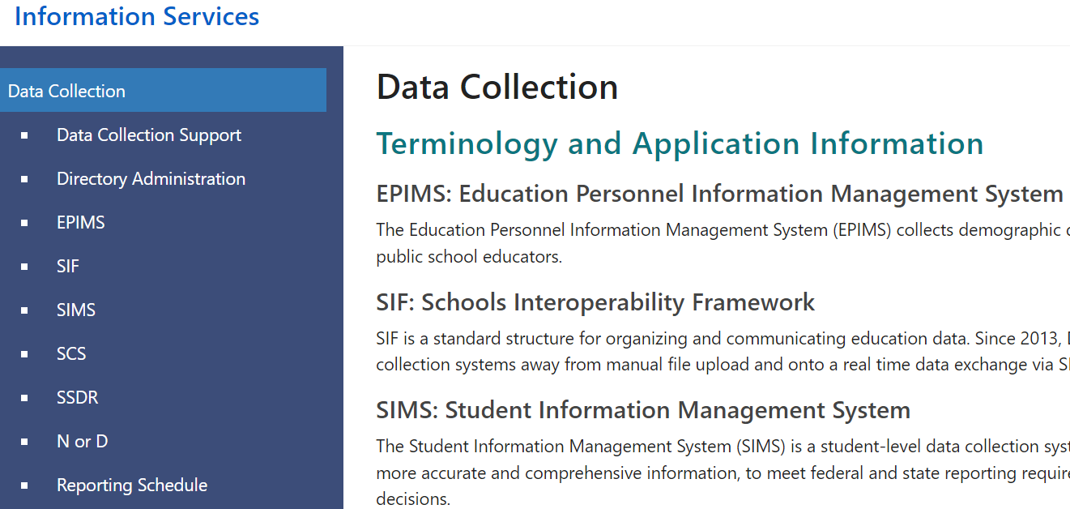
Reminders
Documentation about our collections is posted to our public site: Data Collection - Information Services (mass.edu)

Slide 6
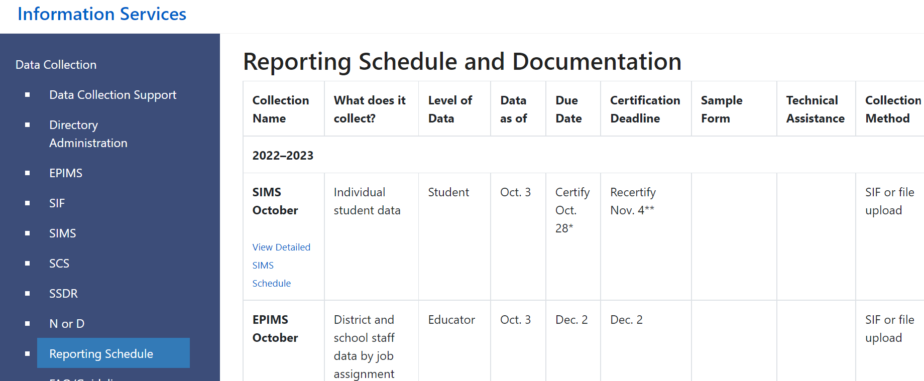
Reporting Schedule
Reporting Schedule and Documentation - Data Collection/Information Services (mass.edu)

Slide 7
SIF
SIF
02

Slide 8
Evolution of State Reporting
SIMS collection established & file uploads introduced
SCS collection established
SSDR collection established
2000
2010
2011
October 1 enrollment reports submitted on paper
2006
2010
2013
EPIMS collection established
SIF first piloted with small group of districts
SIF established as primary data collection method

Slide 9
What is SIF?
SIF = School Interoperability Framework
It is a universal standard for organizing and communicating education data. MA uses SIF as the standard structure for collecting state reporting data electronically via XML messaging.
structure for collecting state reporting data XML messaging.
Real time data transmission from local SIS to DESE applications
Relies on and encourages data quality at the source (local SIS)
Allows for integration across different applications
Makes state reporting more efficient over time

Slide 10
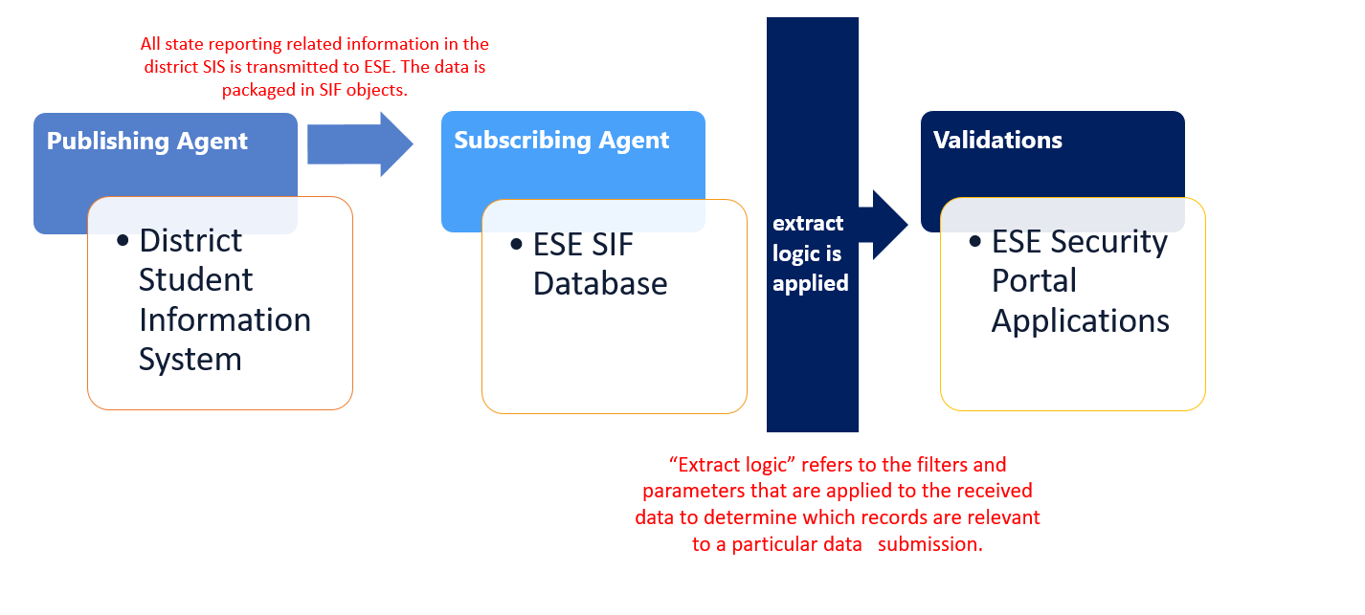
Mechanics of SIF

Slide 11
What is collected via SIF?
SIMS - Student Information Management System
SCS - Student Course Schedule
EPIMS - Education Personnel Information Management System
SSDR - School Safety and Discipline
Other collections and activities are facilitated by SIF:
Homeless/Foster Care, Student Claiming, SASID Requests, Charter School sibling preference

Slide 12
Data reporting process
Data reporting process
03

Slide 13
Reporting windows and Report dates
  There are three reporting windows each school year that surround the three report dates: October 1, March 1 and EOY (last day of school)
  Report date = data as-of date
  This can be found in the header of your SIF Error Reports
Reporting windows open several weeks prior to report date, so districts can begin reviewing errors and correcting them earlier if able
Certification deadlines are typically a month after report date

Slide 14
High level steps of the data reporting process
  These steps apply to our main data collections (SIMS, SCS, EPIMS and SSDR):
  1. Check SIF Error Reports and clear errors in source system
  2. Freeze data
  3. Request and review Summary Reports
  4. Cross Validate (where applicable*)
  5. Certify
  *Cross Validation is applicable to SIMS/SCS/EPIMS in October and EOY

Slide 15
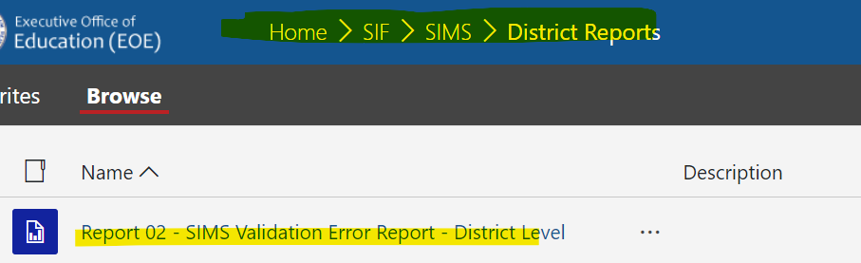
Check SIF Error Reports
To check your errors, go to “SIF Reports” on your application list. Then click on the folder for the collection you’re working on, then “district reports”. Report 2 is the main error report.
This report shows your current errors. SIF validations are running against your data 7 days per week from 6am to 7pm. The validation date at the top indicates the last time validations ran against your data. Your district is included in a validation sweep whenever new or updated data is received on our end.

Slide 16
Freeze Data
After your data is error free, next step is to freeze
To “freeze” the data is to take a snapshot and stop the flow of SIF data from introducing changes to your data submission
Freeze is a button in the data applications (SIMS Data Transmission, SCS, EPIMS or SSDR)
The freeze button is enabled after report date, not before

Slide 17

Request and Review Summary Reports
After data is frozen, the next step is to request summary reports. Each collection has a series of reports that summarize the data in different ways for your review.
If possible, have administrator and/or department heads review the summary reports for accuracy prior to certifying

Slide 18
Cross Validate
Cross Validate is applicable to SIMS, SCS and EPIMS in the October and EOY reporting windows.
This is the process where SIMS and EPIMS are both validated against SCS. Each enrolled student should have a course schedule, and vice versa. Each course section should have a teacher, and vice versa. A cross validation error report will show the errors here.
If just a few CV errors, they could be fixed via single edits
If many errors, unfreezing could be best course of action

Slide 19
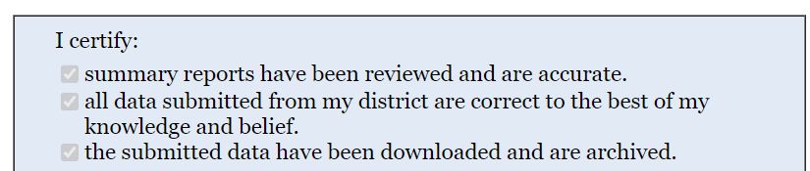
Certify
The last step in each data collection is certification. This is the district signing off on and finalizing the data submission to DESE.

Slide 20
Tips and Support
Tips and Support
04

Slide 21
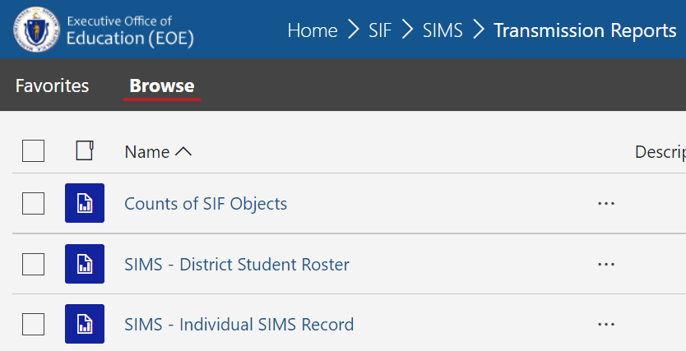
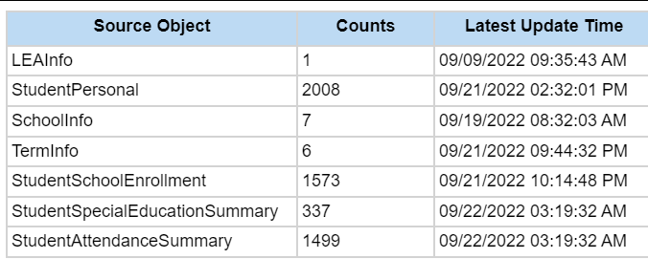
Transmission Reports
The SIF Transmission reports in the security portal are a great tool to check on the status of your data transmission. They show you the raw data that has been received on the state end. Each collection folder has a “Transmission Reports” subfolder.
The SIF Object Count report shows at a glance the counts of each object received and the latest update date

Slide 22
Who to call for support
Identify the issue you need help with:
Is data not transmitting when it should?
Check to make sure your SIF agent is on
Check SIF Object Count report to make sure data has been received recently
If not, start with your SIS vendor. If so, start with DESE support specialist
Need help understanding why something is producing an error, or how to correct a particular data error? Or need assistance with a security portal application or function?
Start with your DESE support specialist
If they are not available, submit a ticket to data collection support:
EOE Request Form - EOE Internal Portal (service-now.com)

Slide 23
Exceptions
Exceptions are an override of a particular validation in cases where there is a legitimate reason the data would not comply with the validation logic.
To request an exception, reach out to your support specialist with the validation ID and the reason you need an exception.
Exceptions are primarily for scenarios where the data represents reality and is accurate, but it falls outside of our business rules.
Exceptions must be run toward the end of your error clean up. If applied too early in the process, the waiving of a particular validation could allow bad data to come through without error.

Slide 24
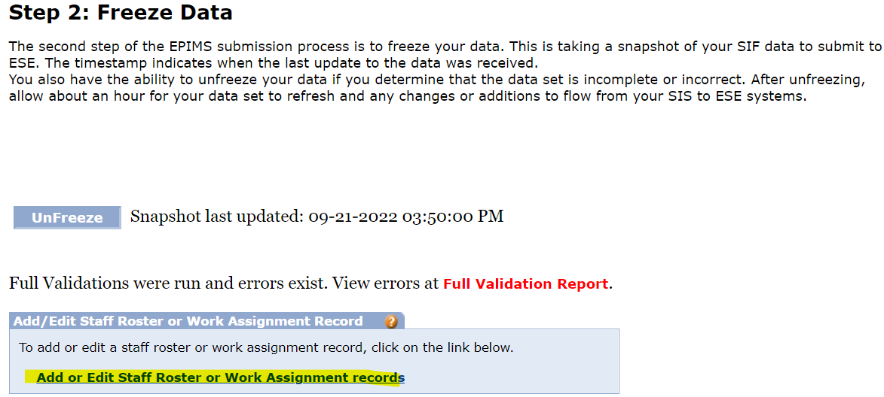
Single Edit
“Single edit” is a feature that is available in the SIMS, SCS, and EPIMS applications. This feature allows you to look up individual records and make manual updates to a record directly in the application
Data has to be in frozen status to edit
This feature is useful to correct a few last errors, or to make small updates to the data before certifying if needed.
Single edit link from EPIMS application Step 2 screen

Slide 25
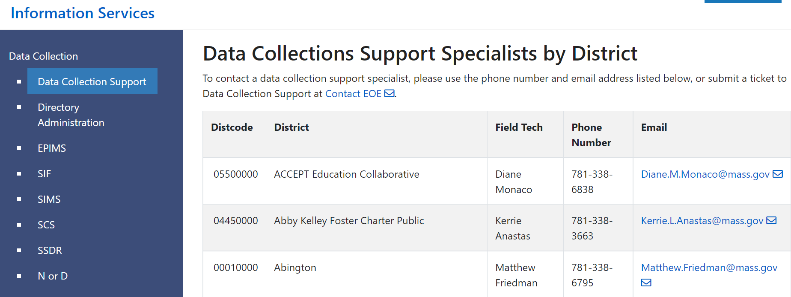
Data Collection Support Specialists
Data Collections Support Specialists by District - Information Services (mass.edu)

Slide 26


Thank you
THANK YOU
Please reach out to DESE Data Collection with questions
781.338.6797
Melissa.r.marino@mass.gov
Data Collections Support Specialists by District

