Slide 1
Grant Opportunity:
Supporting Arts & Cultural Vitality Teams
Information Session
September 18, 2025

Slide 2
Agenda
Part 1: The Resource
Part 2: The Grant

Slide 3
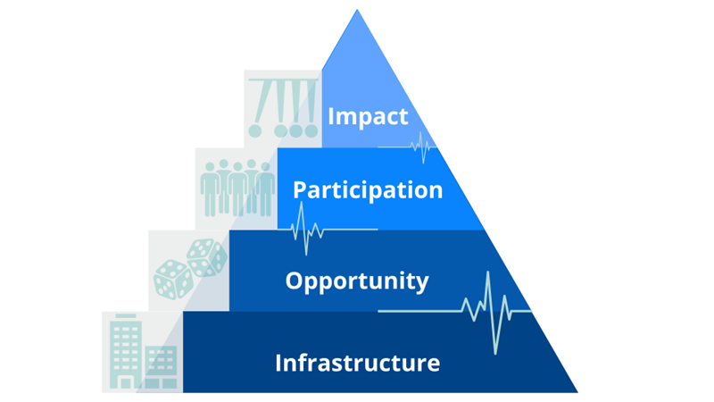
The Resource
Arts & Cultural Vitality (ACV) Index

Slide 4
About the Resource
Arts & Cultural Vitality (ACV) Index
EQUITY
Purpose: To support the development and sustaining of inclusive arts and culture in MA schools
Background:
MA students, especially those who have been and continue to be historically marginalized, are shown to have inequitable access to and in the arts.
"Vitality" refers to the "healthiness" of a school's arts and culture when it comes to inclusivity (access, equity, and cultural responsiveness)

Slide 5
About the Resource
The Arts & Cultural Vitality (ACV) Index
A voluntary self-evaluation
Conducted by a Review Team of diverse stakeholders
A consensus rating is formed on each indicator based on evidence from collected artifacts/established practices.

Slide 6
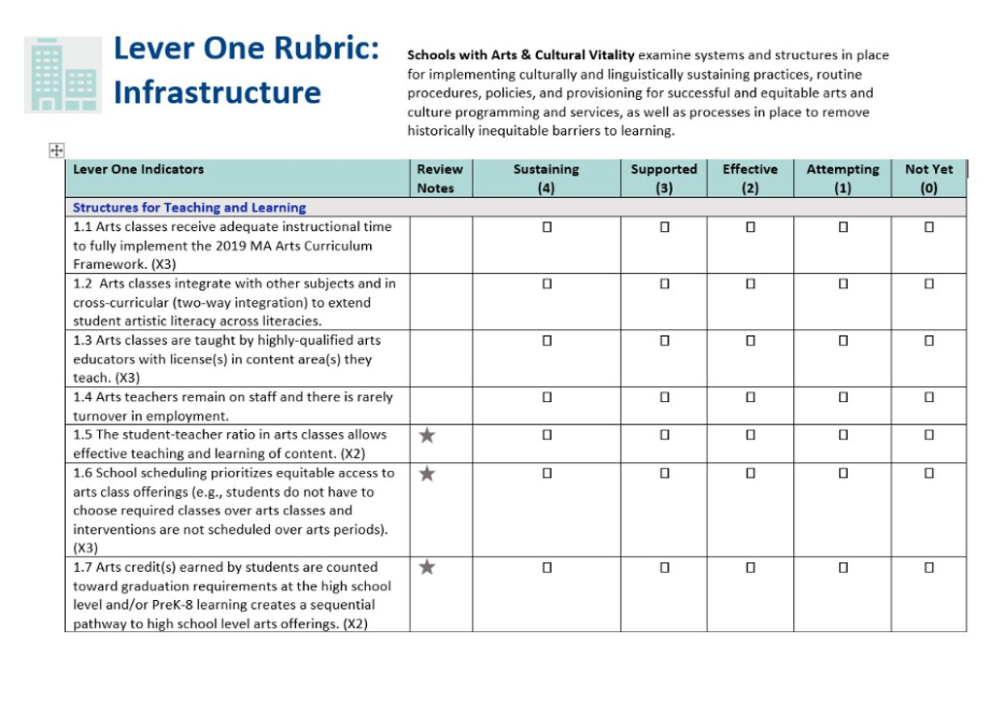
ACV Index Structure- Four Levers
  Infrastructure, Opportunity, Participation, Impact
  Each lever represents a separate metric that is unique and changing within a school community
  Rubrics with a rating system of indicators help to pinpoint areas of strength or needed support

Slide 7
Benefit to You
Formative:
Enriching conversations about learning in the arts
Shared visioning across stakeholder groups
Summative:
A "roadmap" to the exact areas that need support
Data-informed decision-making in the arts
Equity is centered to support students
TESTIMONIAL
Our review with the Arts & Cultural Vitality Index gave us a direction for the conversation we’ve been trying to have for many years around equity. A great crossroad between frameworks and equity around the district for conversations that are difficult to have.

Slide 8
Phases of the ACV Process
Preparation Phase:
  1) Plant the seed through engaging others who may be great resources for the review process
  2) Make a commitment to what you hope to specifically gain from the review (such as through a SMART goal)
  3) Structure the experience by developing a plan for how to conduct the review

Slide 9
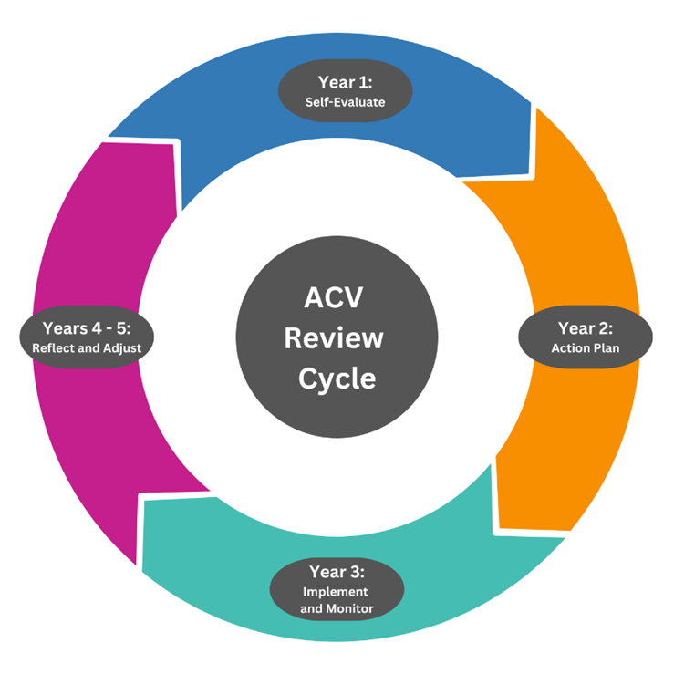
Phases of the ACV Process, Continued
Steps:
  1) Self-Evaluate the Artifacts for evidence of ingrained practices and indicator metrics
  2) Plan for Continuous Improvement by structuring an action plan for addressing areas in need of support
  3) Implement and Monitor Progress changes in arts programming that will benefit all students
  4) Reflect and Adjust on the effectiveness of changes and make adjustments as needed

Slide 10
The Grant
Supporting Arts & Cultural Vitality (ACV) Teams

Slide 11
About the Grant Program
Three Tracks
New grant recipients to implement an arts program review. (Track 1)
Returning grant recipients to engage in action planning around their FY24 ACV review. (Track 2)
Returning grant recipients to engage in implementation and monitoring of their ACV action planning in FY24. (Track 3)
Purpose
To provide funding for stipends of school staff members participating as review team members of the Arts & Cultural Vitality Index

Slide 12
ACV Grant Eligibility and Funding
Eligibility:
All Massachusetts public school districts, charter schools, and collaboratives are eligible to apply. LEAs can have a single school or group of schools participate.
Funding:
This RFP is the governing document for these grant funds. Funding is contingent upon availability. All dollar amounts listed are estimated/approximate and are subject to change.

Slide 13
ACV Grant Fund Use
Fund Use:
Recipients can use funds to support the cost of stipends for team members and administrative costs for conducting the review, action planning, or implementation/monitoring.
Grant recipients may select a range of team members made up of staff members to receive up to a $1,000 stipend each
Approximately 8–10 hours of work outside regular school hours on ACV Index Team (districts may award PDPs for in-service hours used, but that is not part of grant funding)
If stipend positions in district policy call for an amount smaller than $1,000 for 8–10 hours of work, the remaining grant stipend fund can be applied to compensate additional team members

Slide 14
ACV Grant Parameters (From RFP)
If schools are conducting individual, separate reviews:
A minimum of 3 team members must participate
Up to 5 team members for any school with <800 students; Up to 10 team members for any school with >800 students; Up to 10 schools in the district may participate
If conducting a review at the district level:
A minimum of 8 team members must participate
Up to 20 team members for any district with >6,000 students; Up to 15 team members for any district with 2500–5999 students; Up to 10 team members for any district with <2500 students
Applicants may additionally request up to $225 for administrative costs such as materials. Funds may not be used to purchase technology or instructional resources

Slide 15
Support Provided to Grantees
Grant Launch Session (November 2025)
Informal Email Check-ins
In-Person Visit
(Individually arranged)
REQUIRED Professional Learning Community (at least one delegate)
  Session 1: Tuesday, December 09, 2025
  Session 2: Wednesday, January 28, 2026
  Session 3: Tuesday, March 10, 2026
  Session 4: Wednesday, April 29, 2026
Exit Interviews with Grant Facilitators (individually arranged)
Exit Surveys (June 1 - Summer, 2025)
(All review team members provide
feedback on experience)

Slide 16
GEM$ Application Support
Submission Instructions (Read and Follow RFP Closely):
The FY26 FC0718 Supporting Arts & Cultural Vitality Teams Grant will be submitted in our new GEM$ system. GEM$ is a cloud-based fiscal and program management grant system that will eventually phase out the use of EdGrants.
Do not wait until last minute to check the submission instructions and begin application on the GEM$ platform. Note: in GEM$, ensure you can move the grant from “Grant Writer” to the approvers!
DESE support may not happen immediately, so we may not be able to help you if it is very close to the application deadline of:
Tuesday, October 07, 2025 at 5:00 p.m.

