Slide 1



When an artist creates a work, they make purposeful decisions to express, evoke, or communicate. Artistic intent drives the creation of both students and master artists.
How do I know if my curriculum is driven by artistic intent?
When creating art, students are employing technique in service of what they intend to express, evoke, or communicate. When experiencing art created by others, students are investigating why the artists did what they did. Structures that encourage students to reflect and defend their choices support artistic intent.
What to L k For
What are the students doing?
When artistic intent drives an arts class, students…
can specify what they are thinking about when they are making decisions, and why they are making them.
express the desire for others to have a specific reaction when they engage with the piece.
are selective about which artistic concepts and skills they employ to effectively communicate their artistic idea.
are committed to an artistic idea and create multiple iterations of the same idea in order to refine it.
can identify other works of art that express, evoke, or communicate ideas like their own.
can cite evidence of artistic intent when examining works of art.
1

Slide 2
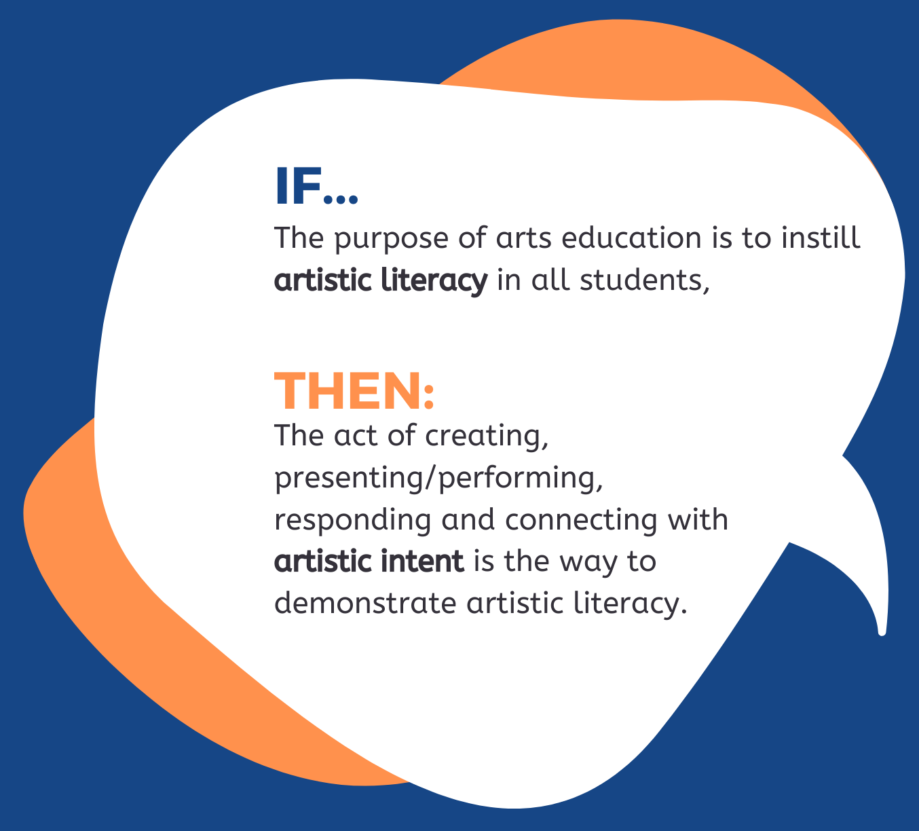
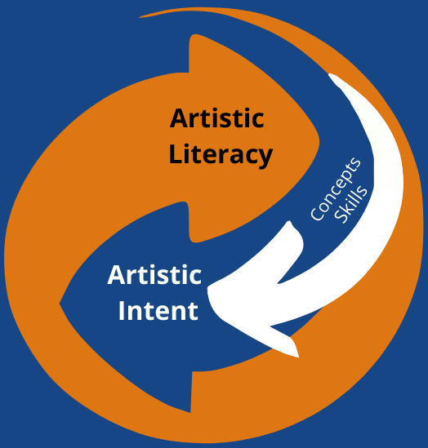
The Big Picture
Artistic literacy is the knowledge and understanding required to participate authentically in and through the arts. Students demonstrate artistic literacy when executing artistic intent because they are required to select and use the specific concepts and skills within their repertoire to successfully execute their ideas.
The Relationship Between Artistic Intent, Concepts, and Skills
Individual skills and concepts are critical parts of developing a student’s artistic literacy, but they should always be in service of supporting the student’s artistic intent. Students who understand how skills and concepts amplify their artistic voice will be more engaged and motivated to integrate these skills into their work and sense of self.
From the Framework
2
Guiding Principle 2: An effective arts education develops students’ understanding of the concept of artistic intent.
Arts programs should focus on helping students create or perform work guided by thoughtful and intentional decision-making. Likewise, students should understand that an analysis or critique of a work of art considers artistic intent. A high-quality arts education program keeps artistic intent central by ensuring student analytical and aesthetic thinking, opportunities to share work, and conversations.

