Slide 1
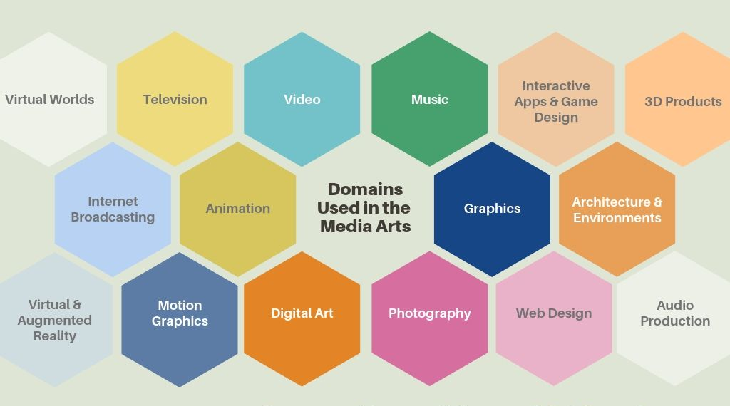
In the Framework
About
The National Core Arts Standards (NCAS) define Media Arts as “a unique medium of artistic expression that can also amplify and integrate the four traditional art forms [dance, music, theatre, visual art] by incorporating the technological advances of the contemporary world” (Olsen et al., 2012, p. 4).
The 2019 MA Arts Curriculum Framework communicates the NCAS description of this discipline through an education lens: Media Arts education encompasses interconnectivity across all disciplines and domains, artistic and academic elements, aesthetics and forms for the purpose of learning and creating in the arts. Media artworks are intrinsically interdisciplinary, integrative, and expressive, inclusive of imaging, sound, moving images, virtual and interactive components (Ibid.).
To serve the student’s artistic intent, the Media Arts can encompass the combination of any of sixteen domains. Since the field of Media Arts is still evolving as technological advances continue to be forged, these potential domains may increase to ones not yet invented.
1
The 2019 Massachusetts Arts Curriculum Framework shows a shift from the 1999 version by adding a set of standards for this emerging arts discipline. The Media Arts is now formally recognized as the fifth arts discipline, joining the previously established art forms of Dance, Music, Theatre, and Visual Arts.

Slide 2
“While media arts forms depend on technological tools, the tools are a vehicle for communication and creative processes; not an end to themselves …media arts education provides learners the essential skills of creativity, visual/media literacy, digital citizenship and the ability to learn effectively via a variety of processes” (NAEA, n.d., paras. 2-3).
What possibilities exist for learning in the
Media Arts?
Media Arts products can include any output generated by the sixteen established domains. With the use of this “broad range of tools, design processes and production forms” one can liken a media arts studio to a “virtual makerspace” that enables learners to “produce any communication or expression or design they can imagine…students can produce entire interactive [virtual] worlds” (Olsen, n.d., para. 4).
Aren’t the Media Arts already included in the visual and performing arts?
In the previous Arts Framework, the Media Arts were integrated throughout the other four arts forms. However:
Media Arts' recent and rapid expansion in forms, complexity and central role in 21st Century culture has necessitated its separation, as is reflected in industry, higher-education and arts organizations (National Endowment for the Arts, National Coalition for Core Arts Standards, Every Student Succeeds Act). It now has very unique characteristics, forms, tools, and processes, as well as great potentials for learning and creating. (Media Arts Education Coalition, n.d., para. 4.)
How can the Media Arts standards be implemented in Massachusetts schools?
Many visual arts educators receive training in Media Arts content during their undergraduate and/or educator preparation programs and therefore can be well-suited to implement Media Arts standards in the curriculum. Teachers in non-arts settings may also incorporate the Media Arts, such as library or technology. The new standards require redefining these roles, and the Framework serves as a foundational structure to focus resources and opportunities for growth
References
Media Arts Education Coalition (n.d.). FAQs. Retrieved December 28, 2020, from
https://sites.google.com/site/maartsedcoalition/faq
National Art Education Association (n.d.). NAEA position statement on the media arts. Retrieved December 28, 2020, from https://www.arteducators.org/advocacy-policy/articles/523-naea-position-statement-on-media-arts
Olsen, D. (n.d.). Media arts education: An introduction. National Coalition for Core Arts Standards. Retrieved December 28, 2020, from https://www.medialit.org/sites/default/files/announcements/Media%20Arts%20Education%20Intro.pdf
Olsen, D., Burrows, R., Jensen, A., McCaffrey, M., Paulson, P., Rubino, N., Wilkerson, C., & Hill, E. (2012, July 28). The inclusion of media arts in next generation arts standards. National Coalition of Core Arts Standards. Retrieved December 28, 2020, from https://nationalartsstandards.org/sites/default/files/Media%20arts_resources/NCCAS_%26_Media_Arts_ 7- 28-12%20FINAL.pdf
2

