Slide 1
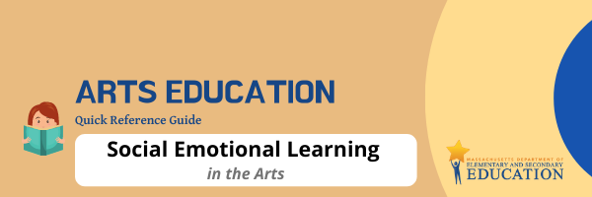
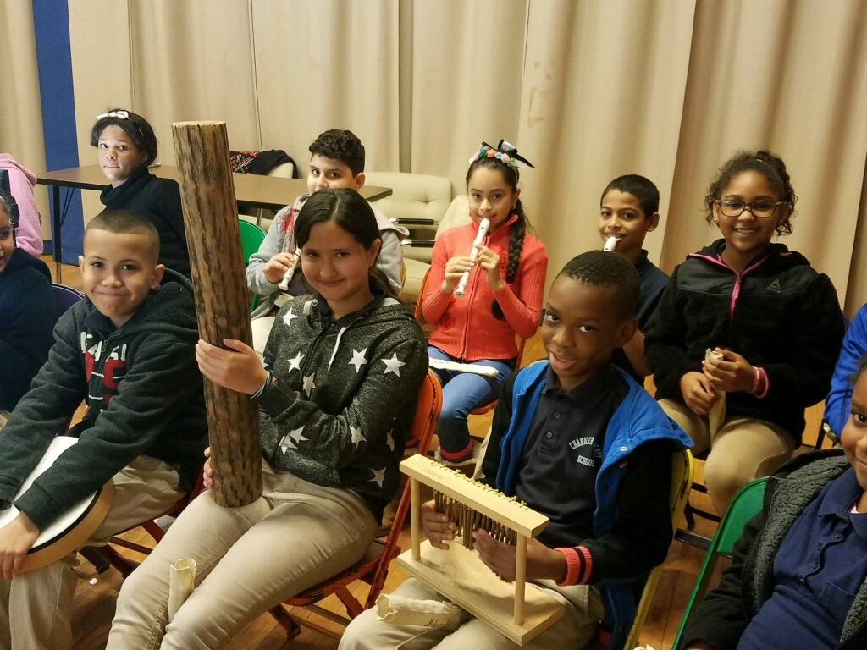

Page 1
What is Social Emotional Learning (SEL)?
The Department commonly uses the Collaborative for Academic, Social, and Emotional Learning (CASEL's), definition of Social and Emotional Learning (SEL):
Social and emotional learning (SEL) is the process through which children and adults understand and manage emotions, set and achieve positive goals, feel and show empathy for others, establish and maintain positive relationships, and make responsible decisions.(CASEL, n.d., para. 1). SEL consists of five core competencies:
Self-awareness
The ability to accurately recognize one's emotions and thoughts and their influence on behavior.
Self-management
The ability to regulate one's emotions, thoughts, and behaviors effectively in many different situations.
Social awareness
The ability to take the perspective of and empathize with others from diverse backgrounds and cultures, to understand social and ethical norms for behavior, and to recognize family, school, and community resources and supports.
Relationship skills
The ability to establish and maintain healthy and rewarding relationships with diverse individuals and groups.
Responsible decision-making
The ability to make constructive and respectful choices about personal behavior and social interactions based on consideration of ethical standards, safety concerns, social norms, the realistic evaluation of consequences of various actions, and the wellbeing of self and others.
How do the Arts support SEL?
“Just as art practices are developed into arts competencies through guidance and intentionality, the social-emotional components of these practices can be intentionally developed into social-emotional competencies” (Farrington & Shewfelt, 2020, p. 31). Former Secretary of Education Arne Duncan observed that diverse artistic experiences foster flexibility: “The arts can help students become tenacious, team-oriented problem solvers who are confident and able to think creatively.”
The arts also:
offer limitless opportunities for students to lead others and to practice collaboration.
help students develop their own self-awareness, confidence, and persistence through studying an arts discipline.
deepen student respect for others’ ideas, cultures, and perspectives represented through various art forms.
assist students in recognizing their personal traits, strengths, and challenges through the process of self-expression.
enable students to explain and self-advocate for their artistic intent and creative choices in constructive ways.
1
Worcester Public Schools’ music students break
for a photo opportunity.

Slide 2

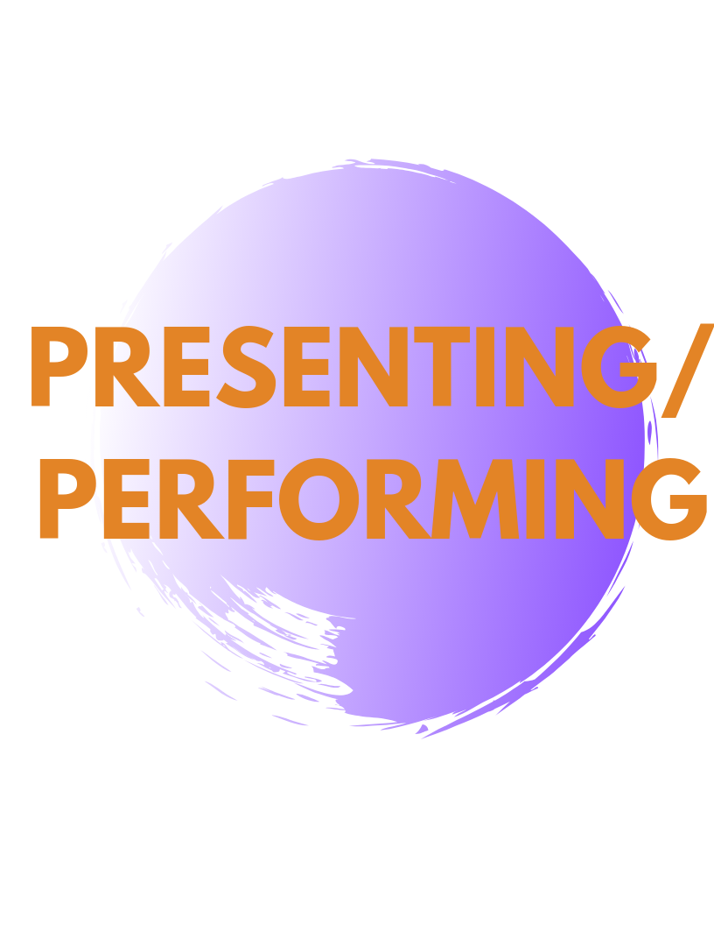
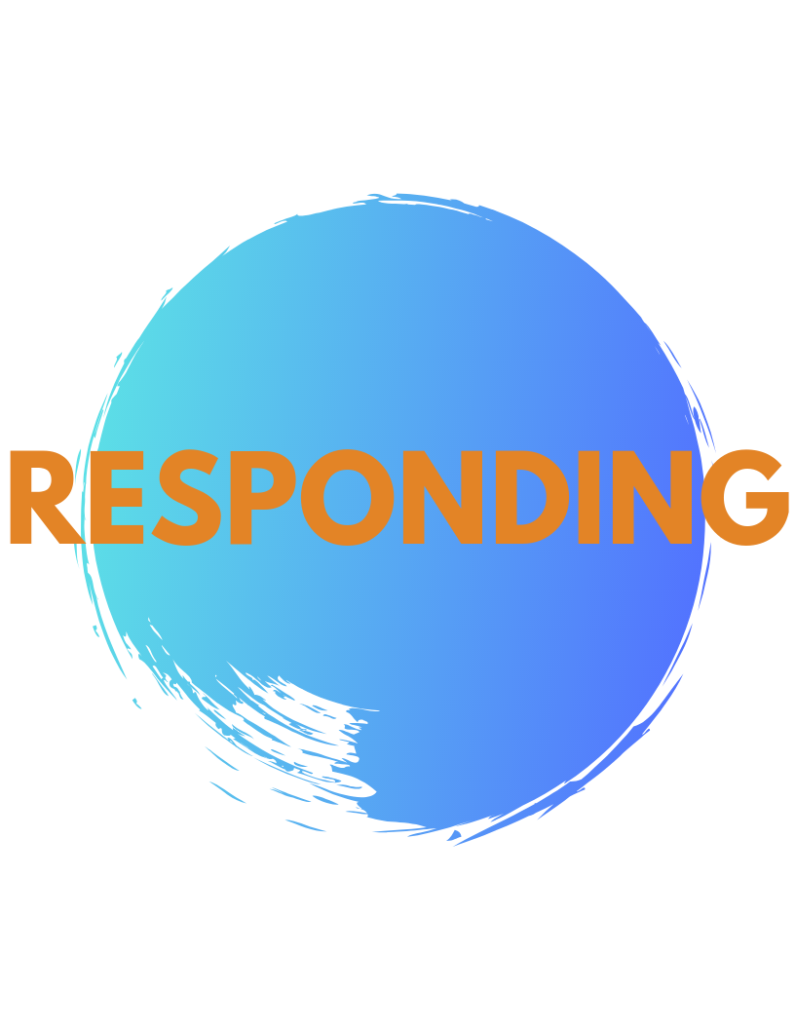
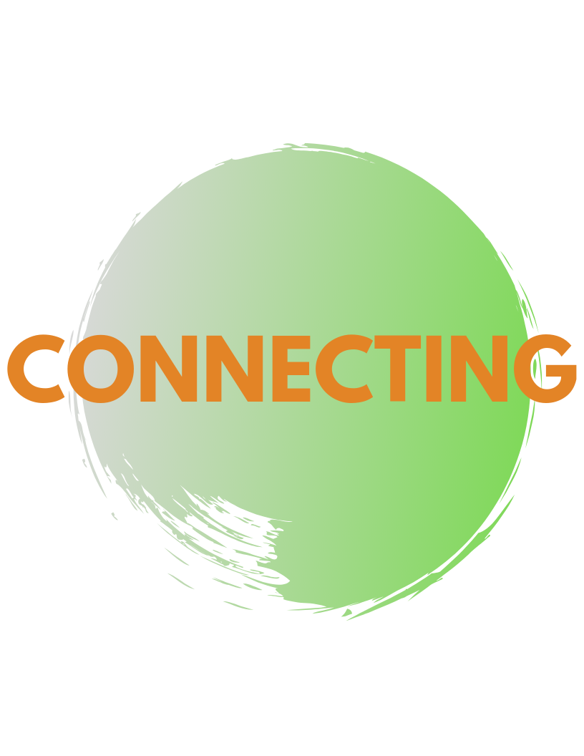
SEL-centered arts learning?
SEL & Arts Essential Questions
What content should you focus on when facilitating
SEL-aligned arts discussions with students?
The SEL competencies are embedded within arts education during everyday practice. Well-designed discussions using arts-specific Essential Questions (EQs) can help arts practitioners make explicit connections for students between artistic practices, the content being learned, and social-emotional learning. The SEL & Arts essential questions below are excerpted from a crosswalk framework created by the SEL and Arts Education Taskforce and align SEL competencies to the four clusters of the arts standards. Find the complete framework and supporting resources in the link* below.
How does overcoming obstacles during the creative process impact the refinement and completion of an artistic work? How do artists balance their own creative ideas with the input of others? | How do strategies for self-management contribute to the process of preparing for presentation/ performance? How can an artist’s relationship with others impact the performance/ presentation of artistic works? | How do artists communicate intent through artistic works to engage audience and provoke conversations? How does responding to an artistic work develop the capacity to evaluate and think critically? | How does engagement in the arts deepen recognition of one’s personal traits, strengths and challenges? How does engaging in the arts provide opportunity to demonstrate awareness of the expectations for social interactions in a variety of settings?
Learn More:
Linked Resources for SEL
DESE’s SEL webpage
MA SEL Standards for Preschool & Kindergarten
Culturally Responsive Social-Emotional Competency Development
Arts-Specific SEL Resources
SEL and Arts Framework*
SEL and Arts Podcasts by SEADAE
NAfME Article: SEL and Visual and Performing Arts
NAEA SEL Town Hall Conversations
What are some examples of
SEL is synergistic with and central to arts learning. Actors develop empathy when they assume roles of characters whose personalities and situations are markedly different from their own. Group performances require cooperation, concentration, listening to colleagues. The thrill of an excellent performance boosts self-confidence. These are broad descriptions but can become far more granular. As stated by Farrington and Shewfelt (2020), “We argue that each of these daily art practices also have social-emotional components to them… For example, violin practice could include learning strategies to deal with performance anxiety, a theatre rehearsal could help a young actor learn to work with peers in practicing a scene and deciding on the subject of a mural could prompt youth to reflect on their feelings about important events in their lives” (p. 31).
References
2
Collaborative for Academic, Social, and Emotional Learning. (n.d.). What is SEL? Retrieved January 22, 2021, from: https://casel.org/what-is-sel-4/
Farrington, C. & Shewfelt, S. (2020). How arts education supports social-emotional development: A theory of action.The State Education Standard, 20 (1), 31-35.
National Association of State Boards of Education. Retrieved January 21, 2021, from: https://nasbe.nyc3.digitaloceanspaces.com/2020/05/January-2020-Standard.pdf
SELVPA. (n.d.). Arts education & social emotional learning framework: A synergistic pairing. SEL/ARTS. Retrieved January 22, 2021, from: https://selarts.org/

