Slide 1
Curriculum Data Collection
Technical Directions

Slide 2
This Power Point
Will provide specific directions on how to enter your districts data into the application called Curriculum Data Collection.
Will provide a brief rationale for this data collection.

Slide 3
What is Curriculum?
Curricular materials are resources teachers use to facilitate sequences of learning experiences (e.g., lesson and unit plans, texts); also called adopted or written curriculum, or instructional materials.
A curriculum is a sequence of student learning experiences teachers facilitate using curricular materials as a foundation (not a script!); also called enacted or taught curriculum.

Slide 4
Why Does Curriculum Matter?
Curricular materials can make a real difference. Providing teachers with access to higher-quality, better-aligned curricular materials can prompt improvement in student outcomes:
Comparable to over half a year of additional learning (Kane et al., 2016)
About 1.5 times the difference between an average teacher and one at the 75th percentile (Chingos & Whitehurst, 2012)
Greater than the difference between a new teacher and one with three years of experience (Kane, 2016)
Notes:
This is about providing educators with the best tools to do their job effectively.

Slide 5
Why are we collecting this data?
With this data, districts can
learn from each other, especially from those further along in implementation.
collaborate with others using the same materials, and
inform districts’ selection of new materials.

Slide 6
Data Entry Steps

Slide 7
Curriculum Data Collection User
Prior to entering the data, you need to be assigned the role of Curriculum Data Collection User
For access, ask your local District Administrator

Slide 8
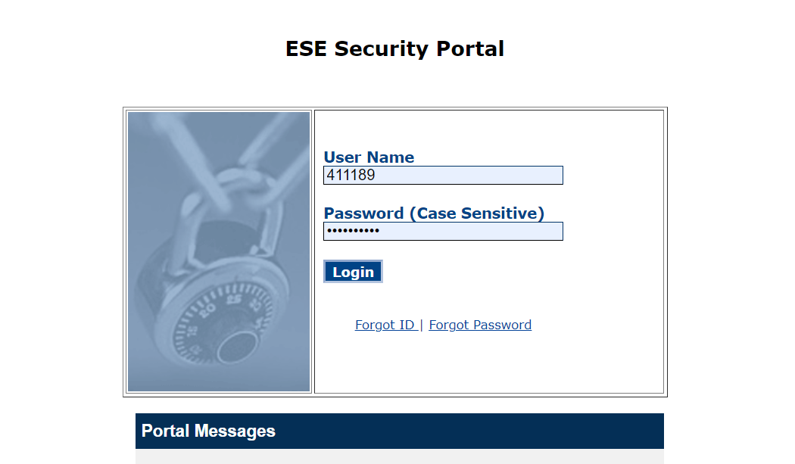
Where to find the Application: Security Portal
Link

Slide 9
First Page: Select your Organization
Select your organization from the drop-down list
You probably will only have one choice.
Then select next.

Slide 10
Second page: Add Curriculum

Slide 11
Second page: Add Curriculum
This collection pertains only to curricular materials used for K–8 ELA/literacy, K–12 math, and 6–8 science for the majority of instruction across all classrooms in a school or district.

Slide 12
Second page: Add Curriculum – Select School
If all schools in the district that teach the covered grades, use the materials, then select “all schools”.
Otherwise, you will need to enter the curricular materials used for each school separately.

Slide 13
Second page: Add Curriculum – Select Subject
Select if you are reporting materials for English Language Arts, Mathematics, or Science.

Slide 14
Second page: Add Curriculum – Begin Grade
Enter the first grade the materials are used. If this is different for schools, you will need to enter the data at a school level.

Slide 15
Second page: Add Curriculum – End Grade
Next, enter the ending grade. For example, if you are using a set of materials for grades 1-4, you will enter 1st in the beginning and 4th in the end. If you are using materials in only one year, you will enter the same grade for both the beginning and ending grade.

Slide 16
Second page: Add Curriculum – Foundational Skills
If you selected ELA with grade ranges K-5, you will be asked if the curricular materials are for teaching foundational skills or not. You can learn more about foundational skills here.

Slide 17
Second page: Add Curriculum – Foundational Skills
Because some districts use different materials for teaching foundational skills, we are collecting information about curriculum use for foundational skills separately. If you are using the same materials for both foundational skills and core curriculum, please enter the curricular materials twice, once selecting foundational skills and once without selecting foundational skills.

Slide 18
Second page: Add Curriculum – Foundational Skills
For curricular materials used for Engaging with Complex Texts and Writing, select the option “No” for Foundational Skills, even if you use those materials for Foundational Skills as well.

Slide 19
Second page: Add Curriculum – Select Publisher
Based on your previously entered data, you will be provided a list of publishers. If you do not see the name of the you can select other and add the name.
You may also select teacher-developed, if individual teachers are responsible for generating their materials, or district-developed if the district developed a curriculum used across all classrooms in the given grade and subject.

Slide 20
Second page: Add Curriculum – Select Product
Based on the publisher, you will be provided a drop-down list of the products that publisher offers.
If you selected teacher developed or district developed, you will select the product of the same name.

Slide 21
Second page: Add Curriculum – Core Instruction
For Core Instruction, you will be given three choices.
Core Instruction: These are materials that are being used for the majority of instruction across the school or district.
Supplemental: These are materials that are being used to supplement other materials but are not being used to support the majority of instruction.
Pilot: These are new materials being used, in part or comprehensively in the district.

Slide 22
Second page: Add Curriculum – Required
Select Required if the expectation is that educators are using these materials for the majority of instruction.
If these materials are being provided to educators as a resource, but there are no requirements about how teachers use these resources, select “No”

Slide 23
Second page: Add Curriculum – Notes
The district can add any additional notes about the materials that you want to add, but this is not required. These notes will not be shared publicly.

Slide 24
Second page: Curriculum Table
The beginning or ending grade will also reflect if the material was reported for foundational skills or not.
Once a curriculum is added, it will be added to a searchable table at the bottom of the page. You can edit or delete these entries.

Slide 25
Second page: Completing Page Two
After you have completed entering your curricular materials, select PREVIEW to see what will be publicly available in profiles.

Slide 26
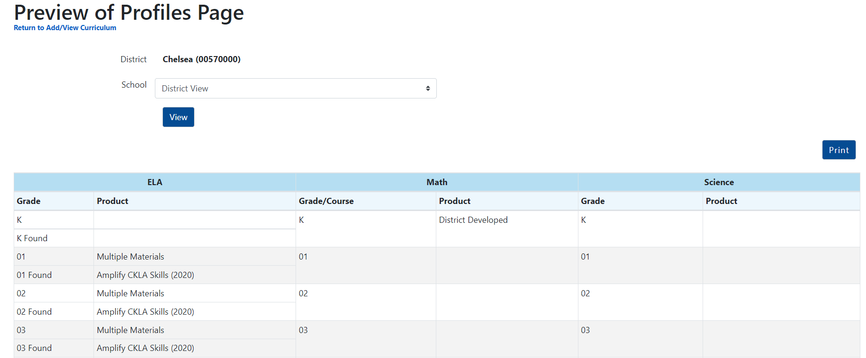
Third page: Preview of Profiles Page: What is included?
Only material that are reported as core materials that are required to be used by educators will be publicly available in Profiles. This data will not be on Profiles until after July 15th.

Slide 27
Third page: Preview of Profiles Page: District or School View
You can select to preview what the table will look like for the school or district.

Slide 28
Third page: Preview of Profiles Page: Multiple Materials
If more than one materials is reported for the same grade and subject, it will be publicly reported as multiple materials. For example, if two different elementary schools in a district use two different curriculum, the district page will show multiple materials, but you will be able to see the individual materials at the school pages.

Slide 29
Third page: Preview of Profiles Page: Return to Page 2
If you want to make edits to your data, you can return to page 2.

Slide 30
Select Publish
PUBLISH
Once you have verified that the data has been entered correctly, select PUBLISH. You can update your data at any time and that change will be reflected in profiles after July 15th

Slide 31
Thank you!
If you have any questions or concerns, please contact Craig Waterman at craig.a.waterman@mass.gov

