Slide 1
General Overview of
Physical Restraint Requirements for Public Education Programs
Including Revisions that Take Effect January 1, 2016
Prepared by the Massachusetts Department of Elementary and Secondary Education for use by Public Education Programs in Annual Staff Training.

Slide 2
Caution
This presentation provides an overview of the regulatory requirements for the use of physical restraint, but does not iterate all of the detail in the regulations.
Throughout the presentation there are references to the revised regulations which take effect on January 1, 2016.
Cites to the revised regulations are noted in red.
All school staff should read and be familiar with the regulations.

Slide 3
Find the Regulations
Previous and amended regulations on Physical Restraint at:
http://www.doe.mass.edu/lawsregs/603cmr46.pdf
New regulations in effect January 1, 2016, Prevention of Physical Restraint and Requirements If Used at: http://www.doe.mass.edu/lawsregs/ under Recently Approved Regulations

Slide 4
Training is IMPORTANT Because
A safe school environment is better able to promote effective teaching and learning.
Preparing appropriate responses to potentially dangerous circumstances helps to eliminate or minimize negative consequences.

Slide 5
Read the Regulations
603 CMR 46.00 -- these regulations apply to all public education programs including day schools, school events and school sponsored activities.
Viewing this presentation does not substitute for a careful reading of the full regulatory requirements.

Slide 6
Key Aspect: Training and Awareness
Regulation 46.03(1 & 2) & 46.04(2)
Annually, For ALL staff - Review:
  School restraint policy.
  The school’s prevention and behavior support policy and procedures including individual crisis planning.
  Methods of prevention of need for physical restraint and alternatives to restraint.
  Types of restraint and related safety considerations.
  Administering restraint in accordance with student’s needs/limitations including known or suspected trauma history.
  Required reporting & documentation.
  Identification of selected staff to serve as information resource to school.

Slide 7
For Selected Staff: In-Depth Training - Contents
Regulation 46.03(4) & 46.04(4)
Prevention techniques.
Identifying specific dangerous behaviors.
Experience in restraining and being restrained.
Demonstration of learned skills.
Recommended 16 hours.
Instruction on the impact physical restraint has on the student and family.

Slide 8
Knowing the terminology:
Physical restraint "The use of bodily force to limit a student’s freedom of movement."
Physical restraint
“Direct physical contact that prevents or significantly restricts a student’s freedom of movement.”
Regulation 46.02(3) & Regulation Section 46.02

Slide 9
Terminology
Regulation 46.02(3) & Regulation Section 46.02
NOT physical restraint:
“Touching or holding a student without the use of force --- includes physical escort, touching to provide instructional assistance, and other forms of contact that do not include the use of force.”
NOT physical restraint:
“Brief physical contact to promote student safety, providing physical guidance or prompting when teaching a skill, redirecting attention, providing comfort, or a physical escort.”

Slide 10
Other Terminology:
Regulation 46.02(5) & Regulation Section 46.02
Chemical restraint/Medication Restraint - is prohibited. Medication that is prescribed by a physician and authorized by the parent is not medication restraint.
Mechanical restraint - do not use without physician’s order and parental consent – as of 1/1/16 prohibited in all instances.
Seclusion - “physically confining a student alone in a room or limited space without access to school staff.” “The involuntary confinement of a student alone in a room or area from which the student is physically prevented from leaving.”
Don’t do it.

Slide 11
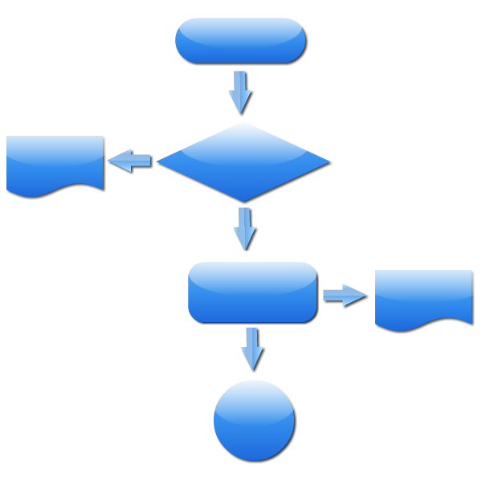
Time-Out
Time-out definition - staff remains accessible. Staff is present, continuously observing the student.
Procedure for obtaining principal approval to extend time out longer than 30 minutes.
See Advisory at: http://www.doe.mass.edu/sped/advisories/2016-1ta.html
For a flow chart distinguishing between exclusionary time-out and seclusion.

Slide 12

Prone Restraint until 1/2016
46.05(3) Safest method. …Floor or prone restraints shall be prohibited unless the staff member administering the restraint has received in-depth training …and, in the judgment of the trained staff member, such method is required to provide safety for the student or others present.

Slide 13
New: Prone Restraint
Regulations 46.03(1)(b) and 46.05(3) Safest method
Prone restraint is prohibited except if ALL of the below is true and documented:
  The student has a documented history of repeated dangerous behavior to self or others.
  All other forms of restraint have been unsuccessful
  There are no medical contraindications.
  There is psychological/behavioral justification with no contraindications.
  The program has obtained consent to use prone restraint.
  The program has documented all of the above in advance of the use of prone restraint
Then, prone restraint only by people with in-depth training.

Slide 14
Extended Restraint
Regulation 46.02(1) and Regulation 46.05(5)(c)
Longer than 20 minutes.
Increases the risk of injury.
Requires approval of the principal prior to the restraint exceeding 20 minutes.
Requires additional written documentation and report to the Department of Education. After 1/16 Reported to DESE at the same time as any restraint is reported.

Slide 15
The use of restraint.
Regulation Section 46.04
Regulation 46.03(1)(c) retains this same language.
Restraint is not a form of treatment or punishment.
Restraint is an emergency procedure.
Restraint is to be used only as a last resort when a student’s behavior poses a threat of assault, or imminent, serious, physical harm to self of others.

Slide 16
Do not use physical restraint
When the student cannot be safely restrained including medical contraindications.
As a standard response for any student.
When non-physical interventions could be used.
As a means of discipline or punishment.
As a response to property destruction, school disruption, refusal to comply, or verbal threats.
The use of restraint may not be included in behavior plans or IEPs. Begin to remove them now so they are not in plans as of 1/16.
Regulation 46.04(3) & Regulation 46.03(2)

Slide 17
Proper Administration of Physical Restraint
Regulation Section 46.05 (current) and 46.05 (new)
Remember training considerations.
Have an adult witness if possible.
Use only the amount of force necessary to protect the student or others.
Use the safest method. Do not use floor or prone restraints unless you have received in-depth training –for prone, all required steps must be completed beforehand.
Discontinue restraint ASAP or if the student indicates that s/he cannot breathe.

Slide 18
Safety requirements
Regulation 46.05(5) & Regulation Section 46.05
Know students’ medical and psychological limitations, including known or suspected trauma history.
Make sure student is able to breathe and speak. If the student indicates that s/he cannot breathe the restraint must be stopped.
Monitor physical well-being, respiration, skin temperature, and color.
If student experiences physical distress -- release restraint and seek medical assistance immediately.

Slide 19
Regulations do not prohibit or limit:
The right to report a crime.
Law enforcement, judicial authorities, or school security personnel from completing their responsibilities.
Mandated reporting of neglect or abuse.
The use of reasonable force to protect oneself, a student, or others.
Regulation 46.04(4)
Regulations 46.03(4) & 46.01(4)

Slide 20
Follow-Up Procedure: Prevention/Learning from the Experience
Regulation 46.05(5)(d)
Following every restraint action taken, the circumstances should be discussed with the student, and with others, as appropriate.
Ask: “How can we avoid this happening again?”
Regulation 46.05(5)(e)

Slide 21

Key Reporting Requirements
When to Report: Currently report only restraints over 5 minutes or in any case of an injury (to student or staff). As of 1/1/16 report the use of any restraint.
Notify School Administration: Notify school administration as soon as possible, & provide written report by the next school working day.
Notify Parents: The principal or director of the program notifies the parent, verbally as soon as possible (verbally within 24 hours), and by written report within 3 school working days.
Student and parents must be allowed to comment
Regulation Section 46.06 (current) & 46.06 (new)

Slide 22
Content of Written Report
Regulation
46.06(4) (current) and new
Who was restrained? Who participated in the restraint? Observers? Who was informed and when?
If longer than 20 minutes the name of the principal or designee who approved the continuation.
When did the restraint occur? (date/time)
What was happening before, during, and after the restraint? Describe alternative efforts attempted. What behavior prompted the restraint? Describe the restraint –holds used and reasons for their use.
Documentation of any injury to students or staff.
Has the school taken, or will it take, any further actions, including disciplinary consequences?

Slide 23
Key Data Keeping Aspect: Ongoing Log
Regulation 46.06(2) (current) and new
School district maintains a log of all reported instances of physical restraint in the school.
Use the log for review of incidences and consideration of school safety policies and procedures.
The following two slides detail additional restraint data review requirements.

Slide 24
New: Individual Student Review (weekly)
Regulation 46.06(5)
Principal is to identify individual students restrained multiple times within the previous week and convene a review team to consider:
  Reports about the use of restraint, and comments provided by parents and the student.
  Analyze circumstances and factors leading up to the perception of need for the use of restraint.
  Consider strategies to reduce or eliminate the use of restraint for this student in the future.
  Review team agreement on a written plan of action.

Slide 25
New: Administrative Review (monthly)
The principal shall conduct a monthly review of school-wide restraint data.
Consider patterns of use, looking for commonalities.
Principal will consider modification(s) to the restraint policy.
Determine need for additional training.
Determine other necessary actions to reduce the need for the use of restraint.
Regulation 46.06(6)

Slide 26

Reporting to the Department
Collect and annually report all physical restraints to the Department.
Report all restraint related injuries to the Department within 3 school working days.
Extended restraints (restraints over 20 minutes).
Any time there is a serious injury.
Send report within 5 school working days of restraint. Include log for 30 day period prior to restraint.
Department may determine additional required action.
Regulation 46.06(5) & 46.06(7&8)

Slide 27
Find the Regulations: http://www.doe.mass.edu/lawsregs/603cmr46.pdf
See 603 CMR 46.00
The revised regulations can be found under:
Recently Approved Regulations and Regulations Amendments
Any questions?
Contact: Restraint@doe.mass.edu

