Slide 1
Renewing a Professional Teacher License

Slide 2
Agenda
Introduction to Licensure Renewal
Renewal Requirements
PDP Distribution and Providers
Inactive/Invalid licenses
Renewal Process
Sheltered English Immersion (SEI) and other PDPs
Professional License Renewal Audit
Endorsements
Questions

Slide 3
Who Needs to Renew a Professional license?
All educators who hold a PROFESSIONAL (not Provisional or Initial) license must renew their license on or before the renewal/expiration date to keep the license active, as an educator in Massachusetts.
Professional level licenses are due to be renewed every 5 calendar years

Slide 4
What is Required to Renew a Primary Area Professional License?
150 Professional Development Points( PDPs) are required.
An Individual Professional Development Plan (IPDP) OR if relevant, the Educator Plan (Plan that is part of the Educator Evaluation System), signed by the educator’s supervisor.

Slide 5
The Individual Professional Development Plan (IPDP) and the Educator Plan
The Individual Professional Development Plan (IPDP)
The Educator Plan- part of Educator Evaluation
If employed in the role of the Professional license in a Massachusetts public school, the IPDP (and/or Educator Plan if being used for this purpose), must:
Align with School/School District PD Plans & Goals; and
Receive initial approval and final endorsement of the Professional Development Plan from the educator’s Supervisor.
If using the Educator Plan, this Plan must include:
Educator Goals (Professional Practice and Student Learning)
Plan for implementation of goals
Signature of the educator’s supervisor

Slide 6
PDP Distribution –Primary area
The following requirements apply to the renewal of a Primary area license (even if the license is renewed early—up to one year from renewal/expiration date):
A minimum of 150 PDPs:
At least 15 PDPs must be in content (subject matter knowledge)
At least 15 PDPs must be in pedagogy (professional skills and knowledge)
At least 15 PDPs must be in English as a Second Language (ESL), Sheltered English Immersion (SEI) or Bilingual
At least 15 PDPs must be in strategies for effective schooling for students with disabilities and instruction of students with diverse learning styles
The remaining required 90 PDPs may be earned through any combination of elective activities that address other educational issues and topics that improve student learning, or more on the above areas. The Primary area is the Professional license designated by an educator, upon renewal. It may be, but does not have to be, the license under which the educator is employed.

Slide 7
PDP Distribution -Additional Area
The following requirements apply to the renewal of an ADDITIONAL area license (even if the license is renewed early—up to one year from renewal/expiration date):
A minimum of 30 PDPs:
At least 15 PDPs must be in content (subject matter knowledge).
The remaining 15 PDPs may be earned through any combination of elective activities that address other educational issues and topics that improve student learning, or more on any of the areas, i.e.,: content, pedagogy, ESL/SEI, etc.
NOTE: To renew one or more Additional area licenses alone, you must have already renewed a Primary area previously that has not yet expired, and the renewal of the Primary area must be greater than 12 months from the day of renewal.

Slide 8
Non-renewal of a Primary and/or Additional area license
A Primary area or an Additional area license that is not renewed is deemed INACTIVE.
If an Inactive license is not renewed within 5 years, it becomes INVALID
The following requirements apply to the renewal of a Primary area license that has been deemed Inactive or Invalid:
A minimum of 150 PDPs:
At least 15 PDPs must be in content (subject matter knowledge)
At least 15 PDPs must be in pedagogy (professional skills and knowledge)
At least 15 PDPs must be in English as a Second Language (ESL), Sheltered English Immersion (SEI) or Bilingual
At least 15 PDPs must be in strategies for effective schooling for students with disabilities and instruction of students with diverse learning styles
The remaining required 90 PDPs may be earned through any combination of elective activities that address other educational issues and topics that improve student learning, or more on any of the areas, i.e.,: content, pedagogy, ESL/SEI, etc.

Slide 9
Renewing an INACTIVE Additional Area License
The following requirements apply to the renewal of an Additional area license that has been deemed Inactive:
A minimum of 30 PDPs:
At least 15 PDPs out of 30 must be in content (subject matter knowledge). The remaining 15 PDPs may be earned through any combination of elective activities that address other educational issues and topics that improve student learning, or more on the above areas.

Slide 10
Renewing an INVALID Additional Area License
The following requirements apply to the renewal of an Additional area license that has become Invalid:
A minimum of 150 PDPs:
At least 15 PDPs out of 150 must be in content (subject matter knowledge). The remaining 135 PDPs may be earned through any combination of elective activities that address other educational issues and topics that improve student learning, or more on the above areas.

Slide 11
Inactive License
Inactive License
A Professional license that is not renewed within the validity period of 5 years is deemed inactive for a period of 5 calendar years.
If the educator is newly hired in a position requiring the license that has become inactive, he/she has two years from the start of new employment to complete the professional development requirements for the license.
If the educator was employed under a Professional license that has become inactive, the educator is no longer employable in that role and in that district with an inactive license, as the license has become invalid for legal employment under the license.

Slide 12
Invalid License
A Professional license not renewed within the inactive period of 5 years, becomes invalid
A person that becomes employed under an inactive license that does not satisfy the renewal requirements within two years from the date of hire, is now deemed employed under an invalid license.
An educator with an invalid license may not be employed under the license, unless the school district requests a Hardship Waiver for Employment from the Department, pursuant to 603 CMR 7.00. For more information on Renewal Hardship Waivers, please contact the Licensure Call Center at 781-338-6600.

Slide 13
Can I Renew a Professional License Before its Expiration Date?
Yes, any license that is up to 12 months from expiring may be renewed
However:
PDPs towards the next renewal cycle will count from the date of the new renewal cycle (Not from the date of early renewal)

Slide 14
Example
Example- John’s Primary area license expires May 17, 2021. John earned a minimum of 150 PDPs, therefore, he decides to renew his license early on December 17, 2020. He now has a new renewal/expiration date of May 17, 2026. John is not required to accrue any additional PDPs until May 17, 2021. PDPs accrued before then, will not apply towards the next renewal cycle.

Slide 15
Professional Development Providers
Professional Development Points (PDPs) may be awarded by the Department, school districts, educational collaborative and registered PD Providers.
School districts and educational collaboratives are not required to register with the Department as approved providers. All other Providers who wish to award PDPs, must register during the Department’s application window. A database that allows the public to search the list of registered PD providers for professional development can be found at: www.doe.mass.edu/pd (search registered PD Providers).
DESE offers two free online courses: Foundations for Inclusive Practice-for Educators and Administrators. These courses are self-paced and are one way to earn the 15 professional development points. For more information, go to www.doe.mass.edu/pd.

Slide 16
University and college PD programs/courses
University and college PD programs (both onsite and online) that only issue credits or CEUs are not required to register with the Department as a PD Provider. However, as noted below, any university/college with a PD program/course that wishes to offer Professional Development Points (PDPs) must register with the Department as a PD Provider. Universities and colleges issuing credits must be accredited.
NOTE: If you are unsure whether your college/university is accredited, please, see the DESE recognized organizations.

Slide 17
All other PD Providers
All other PD Providers, including but not limited to the following, who wish to award PDPs must apply to the Department to become a registered PD Provider:
Non-public schools
Not-for-profit organizations
Private and for-profit organizations
Individuals
Educational partnerships and corporations
Educational agencies and associations

Slide 18
Professional Development Activities and Point Equivalence
PD Activities:
School-Based Activity: One Clock Hour = 1 PDP
Approved PD Providers’ Activity: One Clock Hour = 1 PDP
Seminars/Institutes: One Clock Hour = 1 PDP
Undergraduate Coursework: One Credit = 15 PDPs
Graduate Coursework: One Credit = 22.5 PDPs
Audit Course (Undergraduate/Graduate): One Credit = 7.5 PDPs
Registered CEU-Granting Organizations: 1 CEU = 10 PDPs
Registered Providers Directory: www.doe.mass.edu/pd/

Slide 19
How do I “bundle” PDPs?
PDPs submitted for renewal of license must equal at least 10 hours per activity.
Educators may bundle (combining related topics) activities that are less than 10 PDPs to reach/exceed the 10 PDP threshold.
Activities awarding less than 10 PDPs may be bundled if they are related to a similar topic.

Slide 20
Example of Bundling PDPs
Ms. Lyons received 2 PDPs for a workshop on MCAS, 6 PDPs for a workshop on Online Testing, and 4 PDPs for a workshop on Formative Assessment. Since all three activities are related to the topic of Assessment, she may bundle them as 12 PDPs under the topic Assessment.
Exception to the minimum 10 PDP/topic requirement are PDPs accrued that are related to the Educator Evaluation System.

Slide 21
Meeting the ESL/SEI/Bilingual Requirement for Renewal of Licenses
These can be obtained in a variety of ways, including but not limited to:
Obtaining 15 PDPs on the topic in a workshop
Successful completion of the SEI MTEL, if passed for the first time during this the renewal cycle
Completion of the Department Approved SEI Endorsement course (this course awarded 22.5 PDPs for the short bridge course, 45 for the long bridge course and 67.5 for the full teacher course)
NOTE: Not all educators are required to have the SEI endorsement but ALL educators, regardless of the type of Primary license for renewal, are required to accrue 15 PDPs in ESL/SEI/Bilingual.

Slide 22
SEI Course PDP Carryover
Educators that have already earned the needed 150 PDPs, and have no need to use these SEI course PDPs to their current renewal, may “carry over” these PDPs from one renewal cycle to the next (one time only)
Please note that educators choosing to carry over PDPs will need to retain their documentation for both renewal cycles in the event they are audited

Slide 23
Grouping/Synchronizing Professional licenses
Educators have the option to group/synchronize the renewal dates of two or more Professional licenses by self selecting a new renewal date, as long as the Professional licenses are within one year from its renewal/expiration date. The date selected must be less than 5 years.
Pre 12/2016 | Field, Level | Application Type | Status | Expiration Date | New Expiration Date
 | English, 5-8 English, 8-12 | Academic Academic | Licensed Licensed | 6/16/2019 6/16/2020 | 6/16/2024 6/16/2025
New | Field, Level | Application Type | Status | Expiration Date | New Expiration Date (with Synchronization)
 | English, 5-8 English, 8-12 | Academic Academic | Licensed Licensed | 6/16/2019 6/16/2020 | 6/16/2024 6/16/2024

Slide 24
Renewal Process
Over 95% of the applicants renew online through ELAR since renewal is immediate upon completion of the application.
The cost of renewing a Primary area license is $100.00. The cost of renewing each Additional area license is $25.00
Payment for online renewal of licenses is through credit card or electronic check. Information on how to apply and pay online: www.doe.mass.edu/licensure
A paper renewal application is still acceptable, but will take considerably more time to process. Credit cards or checks are acceptable when renewing by paper.

Slide 25
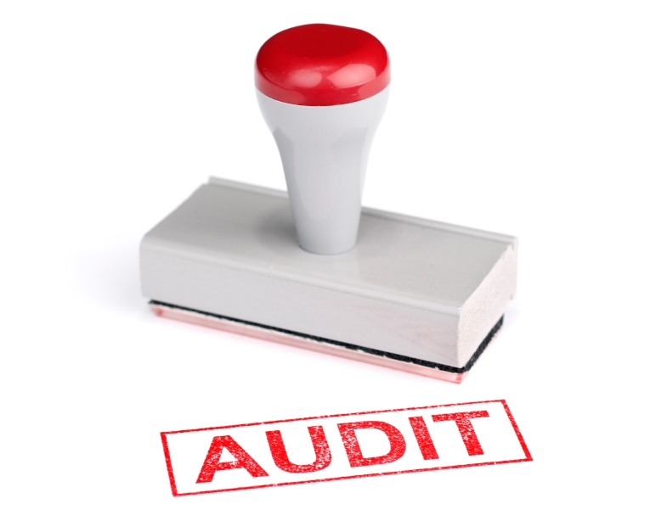
Professional License Renewal Audit
To ensure the integrity of the license renewal process, a sampling of applicants are selected by ELAR for auditing.
Applicants may be selected for auditing whether or not they are employed in the role of their license or are retired.
Educators are responsible for maintaining original documentation of their PD activities for the next 5 years from date of renewal as well as a signed Plan (if employed in the role of the license).

Slide 26
Endorsements
When renewing an Endorsement, such as the Autism or Transition Specialist Endorsement, unlike licenses, these endorsements are not deemed as a Primary or Additional area. Both Endorsements may be renewed with the accrual of 30 PDPs and an active prerequisite license.
The SEI Endorsement does not require PDPs or renewal.

Slide 27
Online Resources

Slide 28
Office of Educator Licensure - www.doe.mass.edu/licensure
Licensure News
How to use ELAR Portal
Massachusetts Tests for Educator Licensure (MTEL)
Licenses offered and Requirements to Obtain a License
Renewal of a Professional license
Information pertaining to Endorsements
FAQ and Glossary of Terms
Licensure Video Series
Contact Information

Slide 29
Office of Educator Licensure - www.doe.mass.edu/licensure
Click Here!
ELAR (Educator Licensure and Renewal) - online licensure system that allows you to:
Apply to obtain/advance a license, or renew a Professional license
Check the status of a license or application
View correspondence from the Office of Educator Licensure
Make a payment, upload documents, and view description of documents in file
Update personal profile
Request a hard copy license
Print an unofficial copy of your license

Slide 30
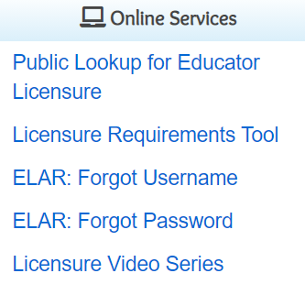
Office of Educator Licensure - www.doe.mass.edu/licensure
Licensure Requirements Tool – allows you to view the
requirements for a specific license.
Massachusetts Educator Licensure Series (MELS) is a sequence of
informational videos for current and aspiring educators. MELS consists
of videos that provide an overview of paths to academic teacher,
vocational teacher, and academic school administrator licenses..

Slide 31
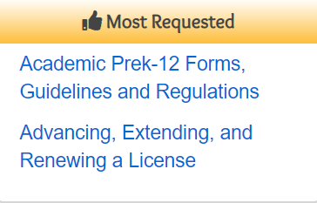
Office of Educator Licensure - www.doe.mass.edu/licensure
Looking for a licensure form?
Click the link under “Most Requested”
to find:
Licensure Forms
“How to” Guides/Advisories
Professional License Renewal Information
Information about Regulations

Slide 32
Online DESE Resources to Assist with Licensure Renewal
License Renewal Guidelines
License Renewal-Frequently Asked Questions
Professional Development (Guidelines for PD Providers, PD Provider Registry Search, Satisfying the requirements for PDPs in ESL/SEI and special education, and more)
Extending the Learning (Course offerings)
MELS- (NEW) Massachusetts Educator Licensure Series:
YouTube videos on topics related to all aspects of Educator Licensure and Renewing Your Professional Academic License

Slide 33
Thank You!
A special thanks for being an educator in Massachusetts.
We greatly appreciate all that you do!
Please contact us:
Licensure Call Center: 781-338-6600
Hours: Monday-Friday 9am-1pm & 2pm-5pm.

Slide 34
Thank you!

