Slide 1
2021 MCAS Reporting Call for Superintendents, Principals and Test Coordinators
September 17, 2021
Embargoed until 9:30 a.m, September 21

Slide 2
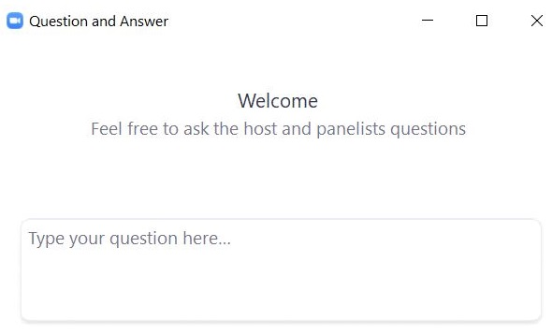
Logistics for This Session
Questions may be asked at any time using the Q&A feature on the Zoom Webinar screen.
Questions about a specific student should be sent by email to mcas@doe.mass.edu.
Some questions may be covered during the course of the presentation.
We will answer some questions at the end of this session.
After the session, we will email questions and answers to participants.
This session is being recorded and will be available online in about one week at the MCAS Resource Center.

Slide 3
Presenters
Rob Curtin, Chief Officer for Data, Assessment and Accountability
Michol Stapel, Associate Commissioner for Student Assessment
Scott Kelley, Data and Reporting Specialist

Slide 4
Today’s Call
What’s New for Spring 2021 MCAS
FAQ
Review MCAS release schedule
Statewide results for all grades and subjects
Review revised Parent/Guardian report for grades 3–8
Additional resources

Slide 5
Important Dates
Category | Date(s) | Item
Reporting | September 17 | Official embargoed spring 2021 MCAS results available in Edwin Analytics and Dropbox Central at gateway.edu.state.ma.us
 | September 21 | Public release of official spring 2021 MCAS results available on School and District Profiles
 | September 30 | Districts receive Parent/Guardian Reports; electronic versions of Parent/Guardian Reports are available in PearsonAccess Next, at the school level, in Published Reports

Slide 6
What’s New in 2021
Extended administration timeline
Students in grades 3–8 were randomly assigned one session of a regular two-session test in ELA, Math, and STE
Students in grades 3–8 learning remotely could take computer-based tests at home (one of six states)
Approximately 20% of students took the test remotely
Test administrators monitored administration using an audio/video-based platform (Zoom, etc.)
Grade10 remained a two-session, in-school test
SGP calculated using a 2-3 prior-year baseline (gr. 5–8 and 10)
Redesigned parent/guardian report for grades 3–8

Slide 7
What’s New in 2021 (continued)
Grade 11 students took next generation or legacy tests for scholarship purposes.
Depending on subject, approximately 6,900–7,500 participated
Student rosters now available only in Edwin (IT621–IT626)
View or save as.PDF; .XLSX; .CSV
No longer posted to DropBox Central

Slide 8
Frequently Asked Questions
Why is DESE making these data public?
Are the grades 3-8 data “reliable” to be used?
Is something different with the SGPs this year?
How will these data be used in the accountability system?
Will there be explanatory documents to assist us?

Slide 9
Edwin Analytics Updated
Edwin Analytics Updated User Interface; Report Redesign
Home page looks different; reports remain organized by content area.
Report prompts/filters integrated into the report (top)
Some reports have been modified and combined
Separate school/district reports integrated into a single report with a school/district filter
Most reports replicate legacy reports or introduce requested enhancements
View or save as.PDF; .XLSX; .CSV

Slide 10
Redesigned Parent/Guardian Report for Grades 3–8
Grades 3-8 Parent/Guardian Report Redesign for 2021
Added more parent-friendly elements
Graphic icons & short messages highlight differences in 2021 tests, encourage parental engagement.
Changes to subject (ELA, Mathematics, STE) reporting pages:
No reporting category or item results (one-session tests)
Question boxes introduce achievement and growth charts
Grade and subject-specific question and discussion prompts support parent engagement in student’s current grade.
See Curriculum & Instruction Family Guides at www.doe.mass.edu/highstandards

Slide 11
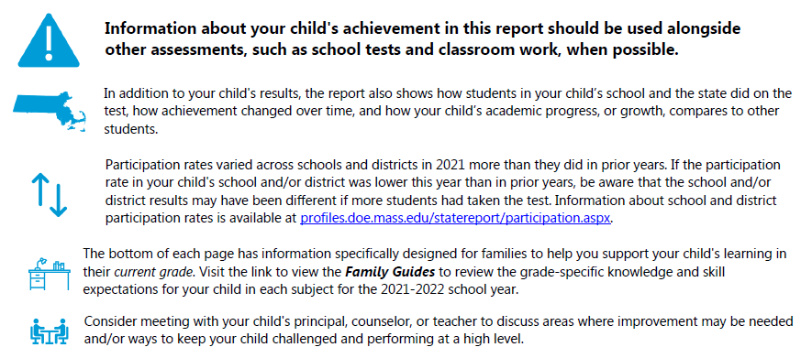
Grade 5 Parent/Guardian Report—Page 1 Redacted

Slide 12
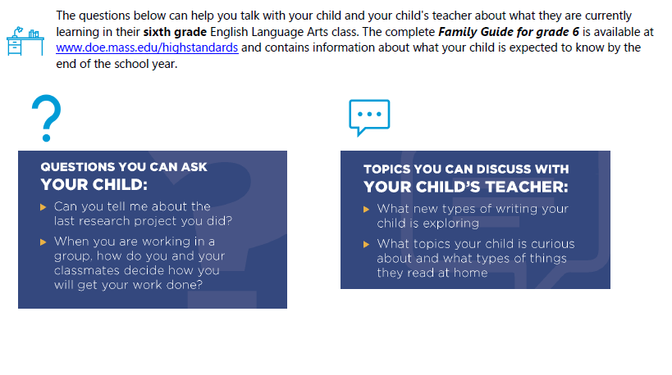
Grade 5 Parent/Guardian Report—Page 2 Redacted (continued)

Slide 13
2021 MCAS Participation
Grade | ELA # | ELA % | Math # | Math % | Sci # | Sci %
3 | 63,935 | 97 | 63,910 | 97
4 | 65,381 | 97 | 65,357 | 97
5 | 65,735 | 97 | 65,659 | 97 | 65,448 | 96
6 | 66,799 | 96 | 66,678 | 95
7 | 67,893 | 94 | 67,804 | 94
8 | 67,818 | 93 | 67,806 | 93 | 53,046 | 91
10 | 64,578 | 90 | 64,233 | 89

Slide 14
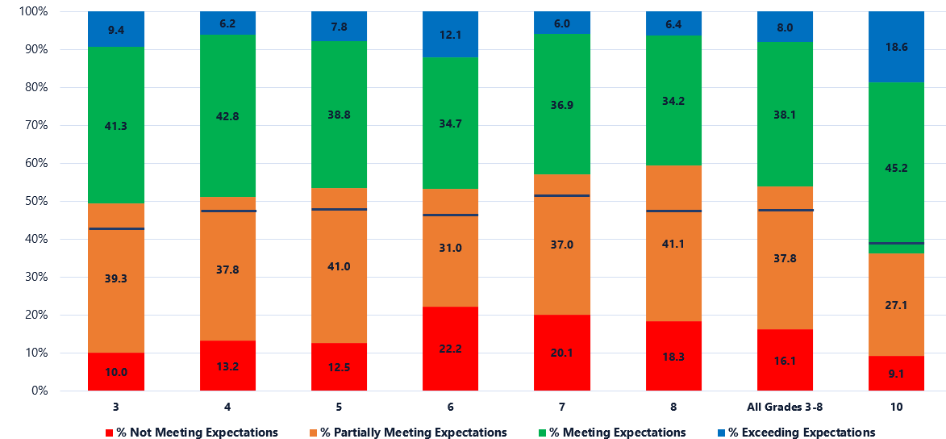
2021 ELA MCAS Achievement Levels by Grade
**Blue line in stacked bar indicates the 2019 Meeting and Exceeding Expectations level

Slide 15
ELA Change in Achievement Levels, 2019 to 2021
Grade | Not Meeting | Partially Meeting | M&E Trend | Meeting | Exceeding
3 | +2% | +3% | -6% | -5% | -1%
4 | +4% | -1% | -3% | 0% | -3%
5 | +4% | +2% | -5% | -6% | +1%
6 | +9% | -2% | -7% | -6% | -1%
7 | +7% | -1% | -5% | -3% | -2%
8 | +4% | +6% | -11% | -7% | -4%
3-8 Total | +5% | +1% | -6% | -4% | -2%
10 | +1% | -4% | +3% | -3% | +6%

Slide 16
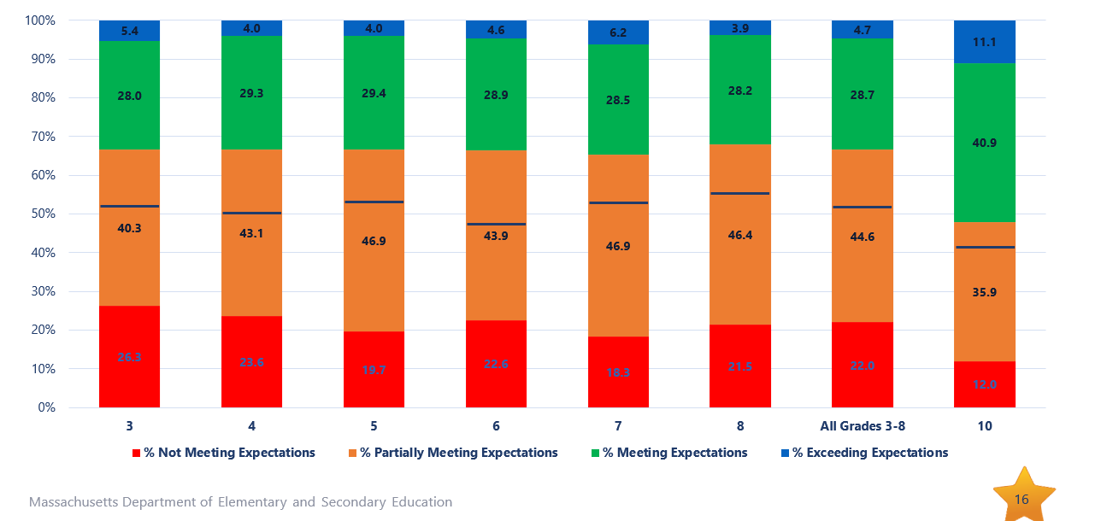
2021 Mathematics MCAS Achievement Levels by Grade

Slide 17
Mathematics Change in Achievement Levels, 2019 to 2021
Grade | Not Meeting | Partially Meeting | M&E Trend | Meeting | Exceeding
3 | +13% | +3% | -16% | -12% | -4%
4 | +12% | +4% | -16% | -12% | -4%
5 | +10% | +5% | -16% | -14% | -2%
6 | +13% | +5% | -17% | -12% | -5%
7 | +5% | +8% | -13% | -8% | -5%
8 | +10% | +5% | -15% | -9% | -6%
3-8 Total | +10% | +6% | -15% | -11% | -4%
10 | +3% | +3% | -7% | -5% | -2%

Slide 18
Change in Average Scaled Score 2019 to 2021
ELA 2019–2021 Change
Math 2019–2021 Change
Grade | Average Scaled Scores |  | Scaled Score Change
 | 2019 | 2021 | 2019 to 2021
Grade 3 | 504.1 | 499.5 | -4.6
Grade 4 | 501.8 | 498.0 | -3.8
Grade 5 | 501.2 | 496.7 | -4.5
Grade 6 | 501.3 | 496.6 | -4.7
Grade 7 | 499.0 | 494.2 | -4.8
Grade 8 | 499.8 | 494.6 | -5.2
Grades 3-8 | 501.2 | 496.5 | -4.7
Grade 10 | 506.2 | 507.3 | 1.1
Grade | Average Scaled Scores |  | Scaled Score Change
 | 2019 | 2021 | 2019 to 2021
Grade 3 | 499.4 | 488.1 | -11.3
Grade 4 | 499.2 | 488.1 | -11.1
Grade 5 | 498.5 | 490.2 | -8.3
Grade 6 | 500.8 | 490.1 | -10.7
Grade 7 | 498.2 | 492.1 | -6.1
Grade 8 | 499.0 | 489.4 | -9.6
Grades 3-8 | 499.2 | 489.7 | -9.5
Grade 10 | 505.1 | 500.6 | -4.5

Slide 19
2021 Growth Calculated Using Baseline SGP
In prior years, growth was calculated by comparing students’ current-year score to that of students with similar scores in their cohort. Each year, the cohort group changed (depending on the performance of the current year population), which resulted in state average SGP of about 50.
In 2021, growth was calculated using a historical academic peer group. This historical peer group represents a “baseline” from which current progress can be measured over time.
The baseline method provides a more sensitive and realistic measure of student growth when a systemic event, such as the Covid-19 pandemic, has a statewide impact on student performance.
The Department worked with stakeholder groups in researching, developing, and testing the baseline growth model:
Massachusetts Technical Advisory Committee
Center for Assessment (www.nciea.org)

Slide 20
Growth Illustration: 2019 Cohort vs. 2021 Baseline SGP
The chart on the left illustrates cohort model SGP; the chart on the right illustrates baseline model SGP.
SGP charts from the grade 6 & 8 Mathematics tests for the same student, same school, 2019-2021

Slide 21
Interim CD Standard for the Classes of 2022 and 2023 (unchanged)
 | Legacy PASSING but requires an Educational Proficiency Plan (EPP) in ELA/math only | Legacy PASSING and met the MCAS graduation requirement | Next Gen PASSING but requires an EPP | Next Gen PASSING and met the MCAS graduation requirement
ELA | 220–238 | 240+ | 455–471 | 472+
Mathematics | 220–238 | 240+ | 469–485 | 486+
STE | 220 | 220+ | TBD

Slide 22
Available Resources
Student Work Samples | Samples of student work for each score point for ELA, math and STE; ELA essays include annotations for each score point. | MCAS Sample Student Work & Scoring www.doe.mass.edu/mcas/student/2021
Student Essay Responses | One essay at each grade in grades 3–8; both next generation essays released at grade 10; legacy essays no longer released | PearsonAccess Next mcas.pearsonaccessnext.com
Released Items | Approximately 50% of items released at grades 3–8; 100% released at grade 10 next generation ELA and math; legacy items no longer released. | MCAS Resource Center mcas.pearsonsupport.com/released-items/
Edwin Analytics | Official embargoed MCAS interactive reports available on Sept. 19; student Competency Determination status available in PE618 Student CD Roster | DESE Security Portal gateway.edu.state.ma.us
District Analysis and Report Tools (DART) Success after high school report | Analysis of school and district postsecondary outcomes. See what proportion of the students from your school attended college, required remediation and graduated. | DESE Data Tools http://www.doe.mass.edu/dart/dart-success-after-high-school.xlsx

Slide 23
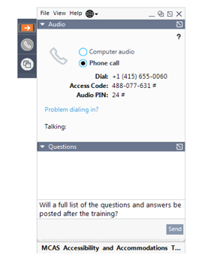
Questions and Answers
Questions & Answers
(Use the “Questions” feature to ask questions.)

Slide 24
Thank You
The Office of Student Assessment Services
781-338-3625
mcas@doe.mass.edu
www.doe.mass.edu/mcas
75 Pleasant Street, Malden, MA 02148

