Slide 1
MCAS-Alt Participation Criteria Required by the Every Student Succeeds Act (ESSA)

Slide 2
Topics in this Training Session
ESSA requirements and alternate assessments
Which students should take the MCAS-Alt?
Clarify the criteria for participation.
Other available assessment options.
Next steps for Districts and IEP teams.

Slide 3
Statewide Assessment Participation Requirements
All students must participate in MCAS testing for their grade level. It is not a question of whether students with disabilities participate, but how they will participate. All students who are educated with Massachusetts public funds, including students with disabilities, English learners, and English learners with disabilities, are required by state and federal laws to participate in statewide assessments.

Slide 4
Participation Cap for Alternate Assessments Based on Alternate Achievement Standards
The total number of students assessed in a subject using an alternate assessment aligned with alternate academic achievement standards…may not exceed 1 percent of the total number of students in the state who are assessed in that subject.”
Defines “1%” based on total number of students assessed in a subject.
Districts may exceed 1% of all assessed students if justification is provided.
Districts must address any disproportional representation of students from all subgroups taking the MCAS-Alt.
States may exceed 1%, if a one-year waiver was granted based on assessing 95% of students and other factors.

Slide 5
ESSA Requires Parental Notification of Participation in an Alternate Assessment
Parents must be informed as part of the IEP process that:
their child’s academic achievement will be measured based on “alternate achievement standards” that reflect lower expectations than for other students; and
participation in an alternate assessment may eventually delay or otherwise affect the completion of the requirements for a diploma.
A Sample Parent Notification Letter, translated in five languages, may be copied onto school/district stationery and must either be sent or provided at the IEP meeting.

Slide 6
Revised Participation Criteria
The Office of Special Education stated that, States that adopt Alternate Assessment based on Alternate Achievement Standards must create a “definition for students with the most significant cognitive disabilities.
Further in 34 CFR § 200.6 - Inclusion of all students ….
“consistent with section 612(a)(16)(C) of the IDEA, [States must]… monitor implementation of clear and appropriate guidelines for IEP teams to apply in determining, on a case-by-case basis, which students with the most significant cognitive disabilities will be assessed based on alternate academic achievement standards. Such guidelines must include a State definition of “students with the most significant cognitive disabilities” that addresses factors related to cognitive functioning and adaptive behavior…”
References for additional information
NCEO Reports: Alternate Assessments for Students with Significant Cognitive Disabilities: Participation Guidelines and Definitions (#406)
NCEO Reports: 2018-19 Participation Guidelines and Definitions for Alternate Assessments based on Alternate Academic Achievement Standards (#415)

Slide 7
Criteria for Students with the Most Significant Cognitive Disabilities
Massachusetts defines “students with the most significant cognitive disabilities” as students who:
have cognitive disabilities evidenced by significant delays in attaining age-level academic achievement standards, even with systematic, extensive individually designed instruction, related services, and modifications; and
have cognitive disabilities that significantly impact their educational performance and ability to apply learning from one setting to another; and
require extensive, direct individualized instruction and substantial support to achieve measurable gains on the challenging State academic content standards for the grade in which the student is enrolled; and
perform significantly below average in general cognitive functioning and adaptive behavior. This is defined as a student functioning two or more standard deviations below the mean on commonly accepted norm-referenced assessments in both cognitive functioning and adaptive behavior (e.g., two or more adaptive skill areas such as daily living skills, communication, self-care, social skills, and academic skills).

Slide 8
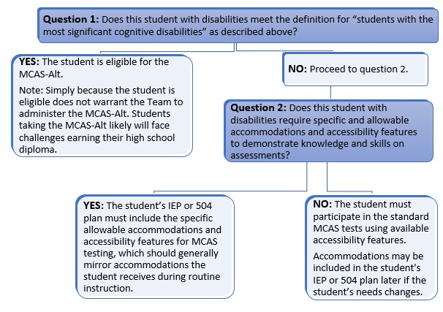
Decision Making Tool and Participation Tool
Notes:
All are recorded within 10 days and posted to the DESE website Introduction to the Alternate assessment on website

Slide 9
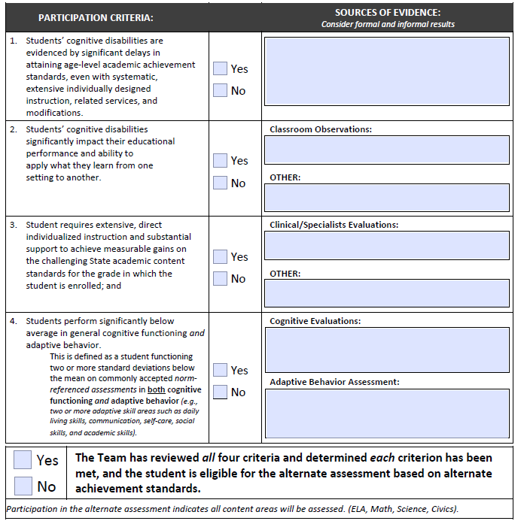
Alternate Assessment Participation Tool is a required document to be maintained by schools (SE 5).

Slide 10
A student should not take the MCAS-Alt based solely on…
a particular disability or placement
lack of standards-based instruction
participation in MCAS-Alt the previous year (since this is an annual decision)
English learner (EL) status
low income, child in foster care, or interrupted formal education
potential impact on a school’s accountability rating
previous low achievement on MCAS

Slide 11
Attempt standard MCAS tests, with Accommodations for Students with Disabilities
Standard test should be the default
Students should be given opportunities to take MCAS practice tests.
Even if a student is not performing at grade level, there may be test questions that the student can answer.

Slide 12
Next Steps for Districts
Districts should:
Review data on the rate of MCAS-Alt participation.
Provide assurances that, if disproportionality is found for students taking MCAS-Alt in any subgroup, steps will be taken to address it.
District data is available here and in School and District Profiles.
Complete Statement of Assurances, if likely to exceed one percent in the current school year. Notice will be sent from DESE if over the 1%.
Retrain teams annually on criteria to be used (and not used) for selecting students for MCAS-Alt.
This training presentation

Slide 13
How to Calculate Disproportionality for the MCAS-ALT

Slide 14
Disproportionality Defined
Disproportionality for the MCAS-Alt occurs when one of the student subgroups is designated at a significantly different rate than the proportion that participated in the general assessment.
Defined as an overrepresentation and under-representation of a particular population of demographic subgroup in the overall student population.

Slide 15
Disproportionality Guidance
Risk ratio* is a term often used to describe the relationship of observed versus expected proportions.
Calculated by dividing the proportion of MCAS-Alt participants in a particular subgroup by the proportion of students in the same subgroup who take the standard MCAS.
A risk ratio of 1.0 indicates that the proportion of students in a subgroup who are MCAS-Alt participants is the same as the proportion of students in that subgroup who take the standard MCAS. Therefore, there would be no evidence of disproportionality when the risk ratio is at or very near 1.
Significantly disproportionality occurs when the risk ratio is $≥3$ times the percent of students that participate in the MCAS-Alt compared to the general assessment.
*A risk ratio is one method to analyze for disproportionality. Districts may develop their own reasonable strategy (e.g., use percentages).

Slide 16
Risk Ratio Formula
 | MCAS-Alt Participants | Standard MCAS test participants
Subgroup | 148 | 15,000
Non subgroup | 302 | 35,000
Total | 450 | 50,000
Subgroup Proportions (%) | 32.9% | 30.0%
Risk ratio: This is simply calculated by dividing the proportion of Subgroup MCAS-Alt participants by the proportion of subgroup students who are non-participants. Drawing from the previous example, the calculation is as follows:
$$\frac{Proportion of subgroup Participants}{Proportion of subgroup Non−Participants}= \frac{32.9}{30.0}=1.10$$
In the example above, a risk ratio of 1.10 does not represent significant disproportionality.

Slide 17
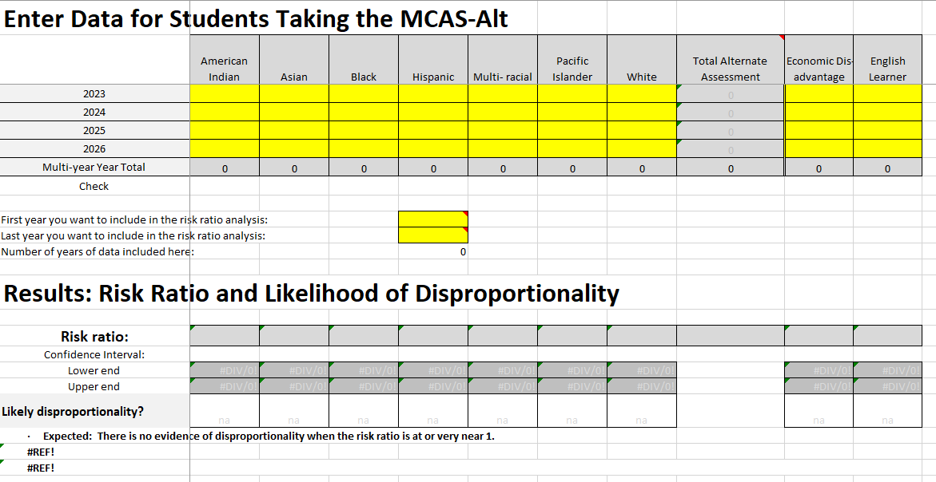
Worksheet to Calculate Risk Ratio
Districts can use the risk ratio template worksheet to help determine if disproportionality exists.
District staff members will enter their MCAS-Alt and MCAS participation data in the highlighted yellow cells.
Sample Formula Worksheet to Calculate Disproportionality Risk Ratio

Slide 18
Evaluating Disproportionality Data for MCAS-ALT and Developing a Local Action Plan

Slide 19
Questions to Guide MCAS-Alt Disproportionality Discussion
Is the number of students in the identified group large enough to have a valid result?
For example, in very small districts, the number of students in some subgroups may be so small that even one or two students in a subgroup may have a substantial effect on the results.
Is there a plausible reason to have the disproportionality?
For example, if the number of students in a subgroup in the district is small but there is one family in the district in that subgroup that has three students taking the MCAS-Alt, there may appear to be disproportionality, but it could be justified.
Is the disproportionality significant and is there a need to address it?
For example, if the risk ratio is 1.5%, it may not be significant, but a risk ratio of 3.0% may warrant further investigation.

Slide 20
Causes and Action Plan
What root cause may be contributing to this disproportionality?
Identify factors contributing to significant disproportionality, such as:
Are IEP Teams considering using special access accommodations for students before assigning the MCAS-Alt?
Do students in your school qualify to participate in the alternate assessment based on the new eligibility criteria?
Are IEP Teams considering how economic, cultural, or linguistic barriers may affect their process?

Slide 21
Recommended Timeline
Conduct a review of Policies, Practices, and Procedures (PPP)
Based on responses to the root cause questions, how can staff review the PPPs?
What timeline makes sense for the school?
Two school years to achieve a desired goal to reduce disproportionality overtime.
Year 1 – revise procedures and policies and train staff
Year 2 – continue to implement procedures and evaluate if disproportionality has reduced
Continue to train staff and revise procedures, if necessary.

Slide 22
Next Steps for IEP Teams
Team Chairperson and team members must:
Discuss your district data provided by DESE.
Be familiar with guidelines, criteria, and decision-making guidelines for participation in the alternate assessment.
Meet regularly to discuss transitions from elementary to middle and/or high school.
Review the IEPs of students currently who currently participate in the MCAS-Alt during annual IEP meetings.
Review all assessment options.

