Slide 1

Family Portal Help Guide
View your student’s MCAS test results on the MCAS Family Portal. Use this data to track your student’s performance from year to year.
Go to https://mcasfamilyportal.emetric.net to view the MCAS Family Portal on a desktop or mobile device.
Select a section below or scroll through this guide to learn more.
Getting Started
  Viewing in Spanish
  Resetting your Password
  Adding Students
  Removing Students
  Selecting a Student
Viewing MCAS Results
  Viewing Test History
  Viewing Test Results
  Viewing Detailed Results
Viewing MCAS-Alt Results
  Viewing Test History
  Viewing Test Results
Additional Resources

Slide 2
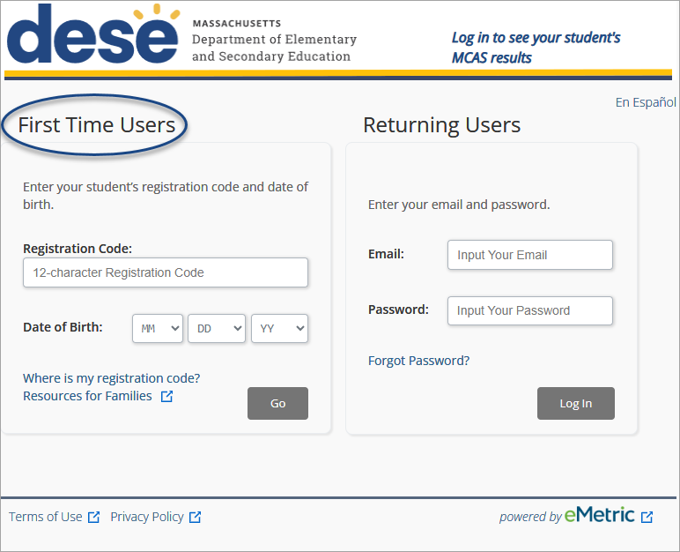
Getting Started: First-Time Users
Enter your student’s registration code (found in the letter from your district) and date of birth. Then click Go.
If you don’t know your student’s registration code, click Where is my registration code? for help.

Slide 3
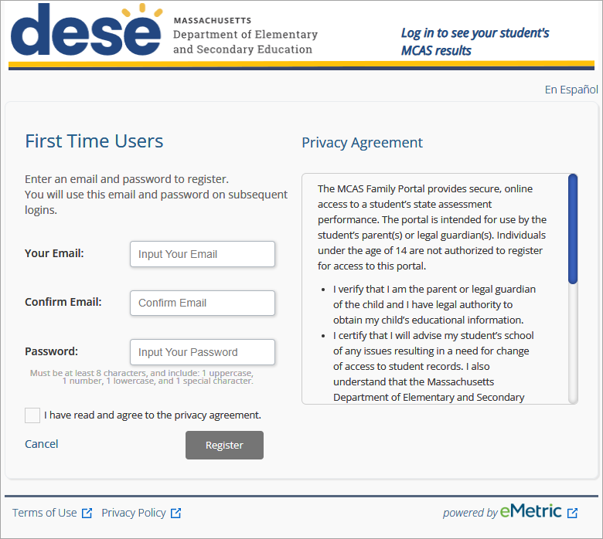
Getting Started: First-Time Users (continued)
Create an account using your email address and password.
Read the privacy agreement. Check the box and click Register.

Slide 4
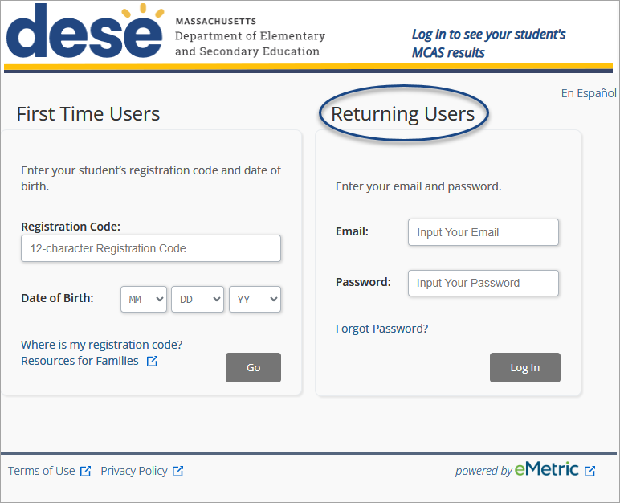
Getting Started: Returning Users
Returning Users: Enter the email address and the password you registered with, and then click Log In.

Slide 5

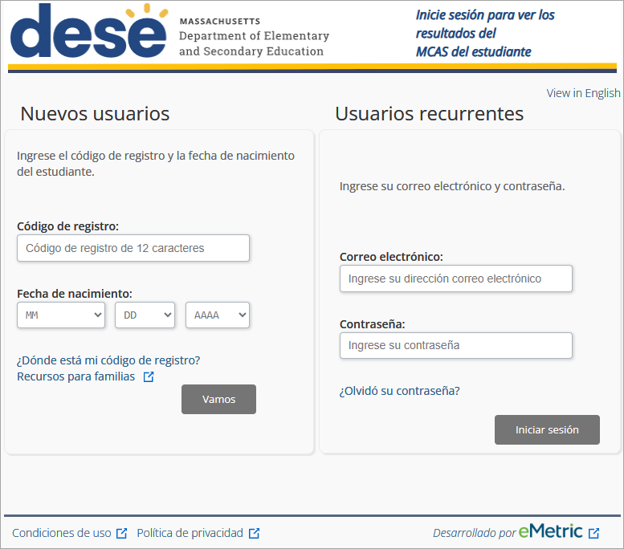
Getting Started: Viewing in Spanish
Select the En Español link to view the MCAS Family Portal in Spanish.

Slide 6
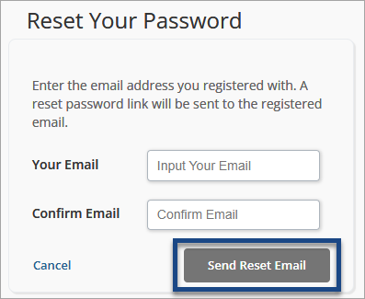
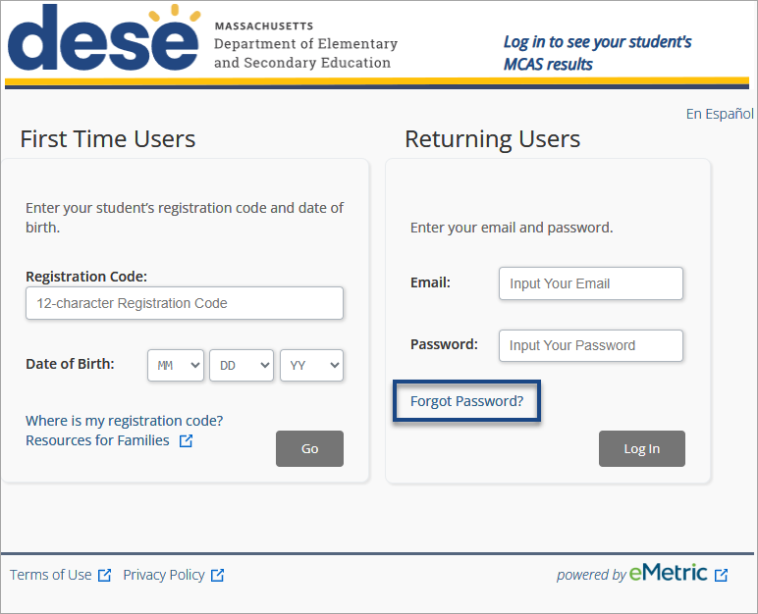
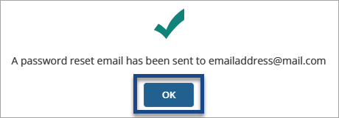
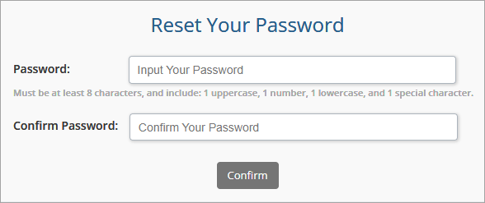
Resetting your Password
1
Returning users can click the Forgot Password? link to reset their password.
2
Enter the email address registered to the account and then enter it again to confirm.
Click Send Reset Email.
2
1
3
3
Click OK.
4
4
Check your email and follow the link provided. You will be prompted to reset your password in the portal.

Slide 7
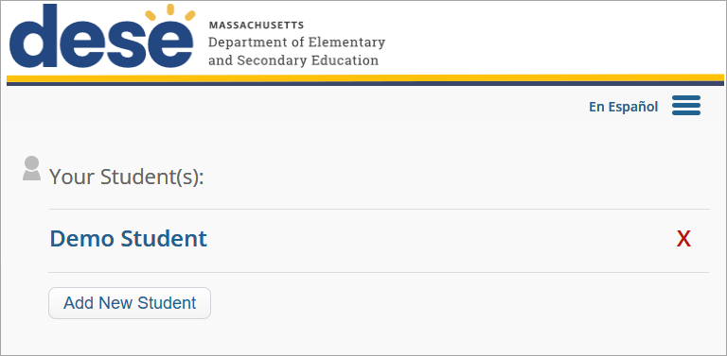
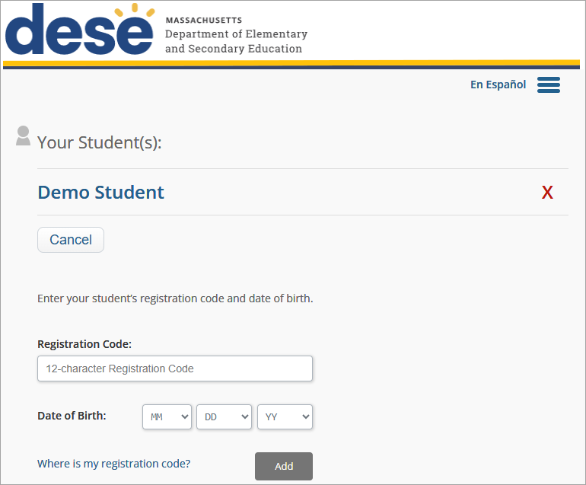
Adding Students
Each parent/guardian can create their own account and add up to 10 students. Three accounts can share the same student. You must be 14+ to create an account.
To add additional students to your account, click Add New Student, enter the student’s registration code and date of birth, and then click Add.

Slide 8
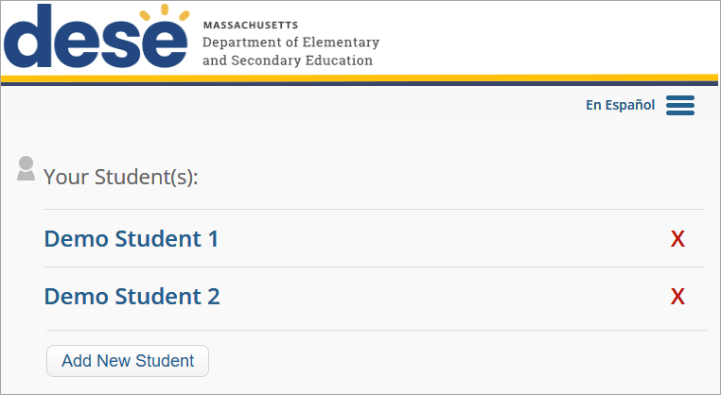
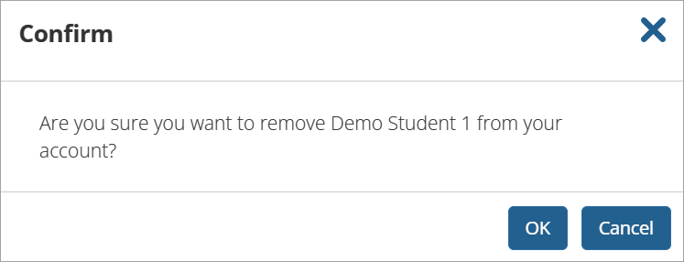
Removing Students
To remove a student, click on the red X near the student’s name. A pop-up message will appear to confirm the removal.

Slide 9
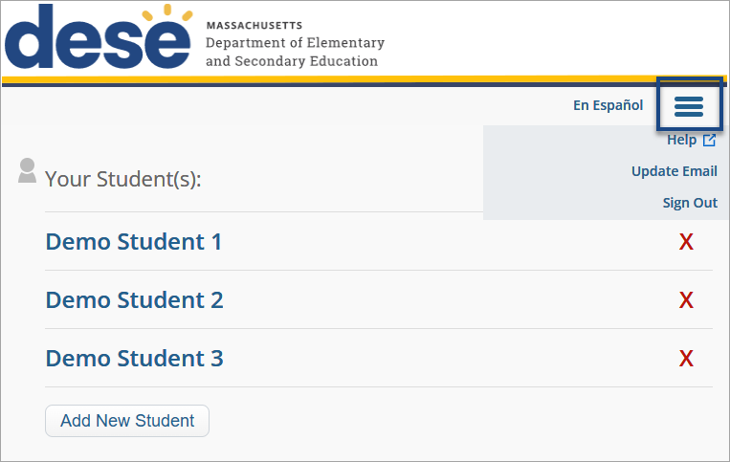
Selecting a Student
To view a student’s test history, select the student's name.
Click the menu icon to update your email address or sign out of the MCAS Family Portal.

Slide 10
Viewing MCAS Results

Slide 11
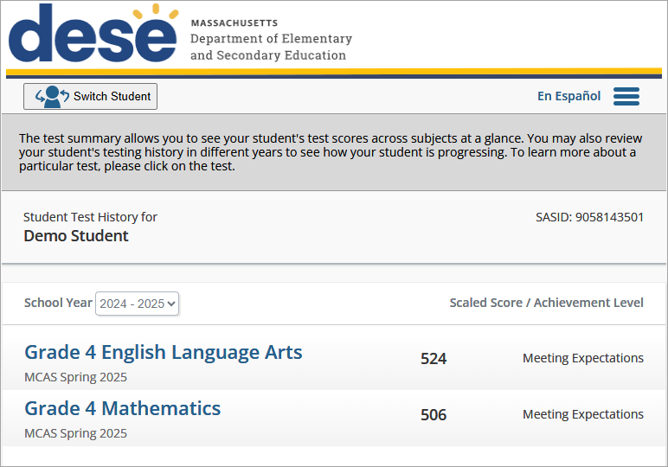
Viewing Test History: MCAS
The Test History page gives an overview of a student’s results for that school year.
To navigate between students, select the Switch Student Button.
For more detailed information, select a test.
Use the School Year drop-down menu to see data from previous years, if available.

Slide 12
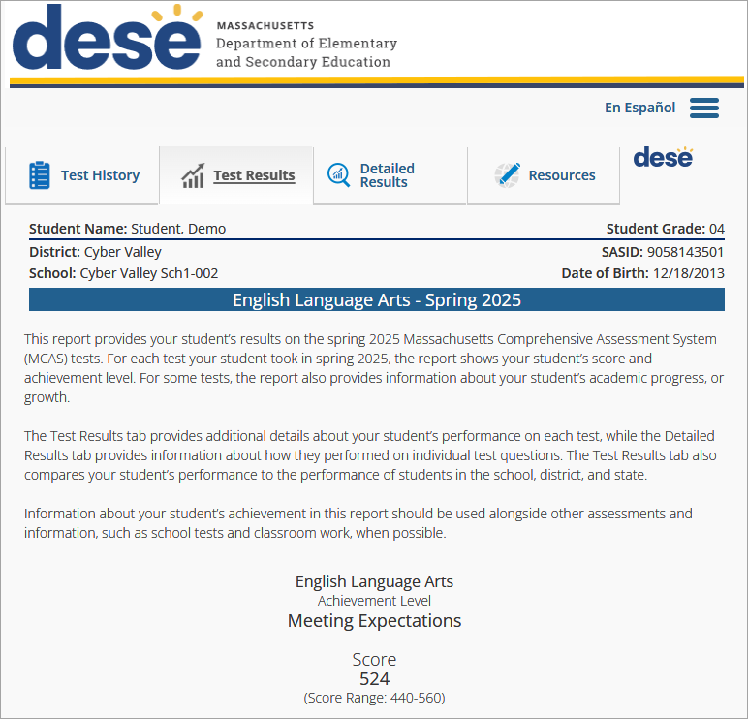
Viewing Test Results: MCAS
The Test Results tab shows your student’s achievement level and score. Scroll through the report for more information about your student’s performance.

Slide 13
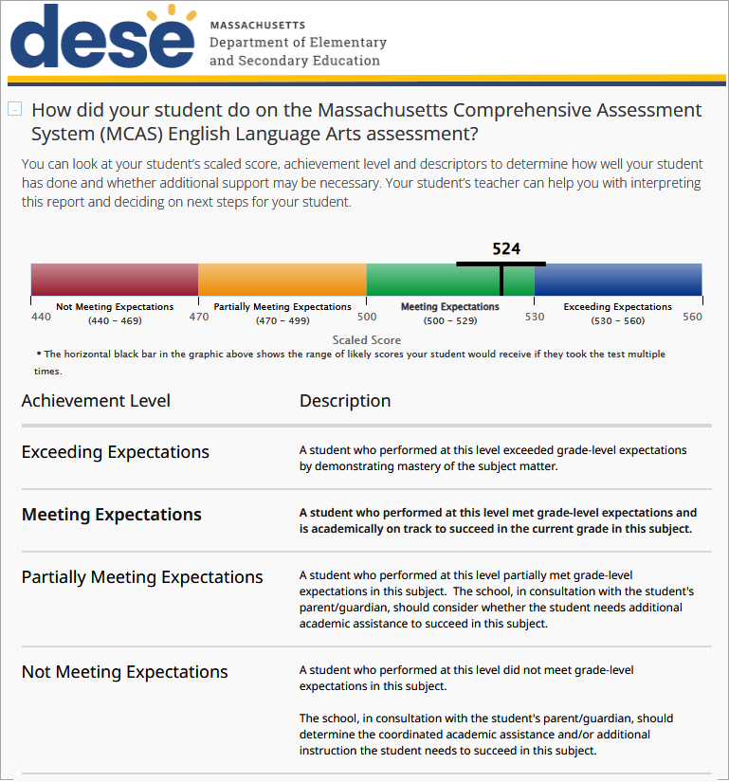
Viewing Test Results: Achievement Level
Here you can see your student’s score and achievement level, which show you how well they did on the test. In this example, the student’s score was 524, which is in the Meeting Expectations level.
Print pages from the MCAS Family Portal directly from your browser.

Slide 14
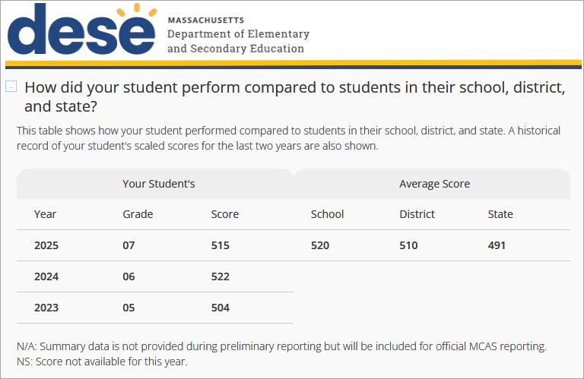
Viewing Test Results: Data Comparison
Scroll down to see how your student scored compared to students in their school, district, and state.
View your student’s scores on the test for the previous two years (if available).

Slide 15
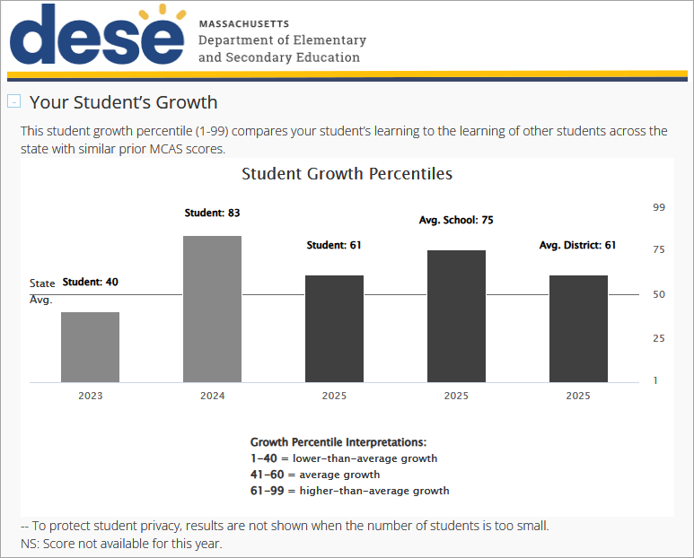
Viewing Test Results: Student Growth
View your student’s growth compared to the growth of other students in the school, district, and state.

Slide 16
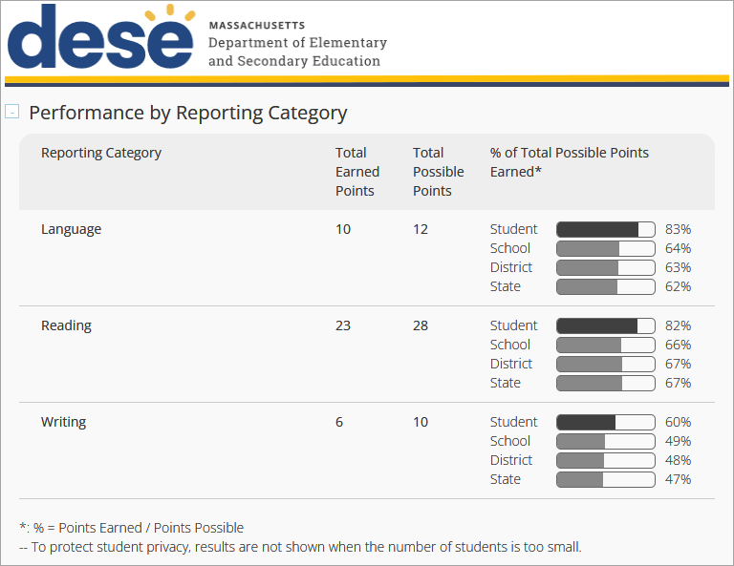
Viewing Test Results: Reporting Category
See how your student performed on specific reporting categories, or areas of learning within a subject.
Compare the percentage of points your student earned with the percentage of points other students in their school, district, and state earned.

Slide 17
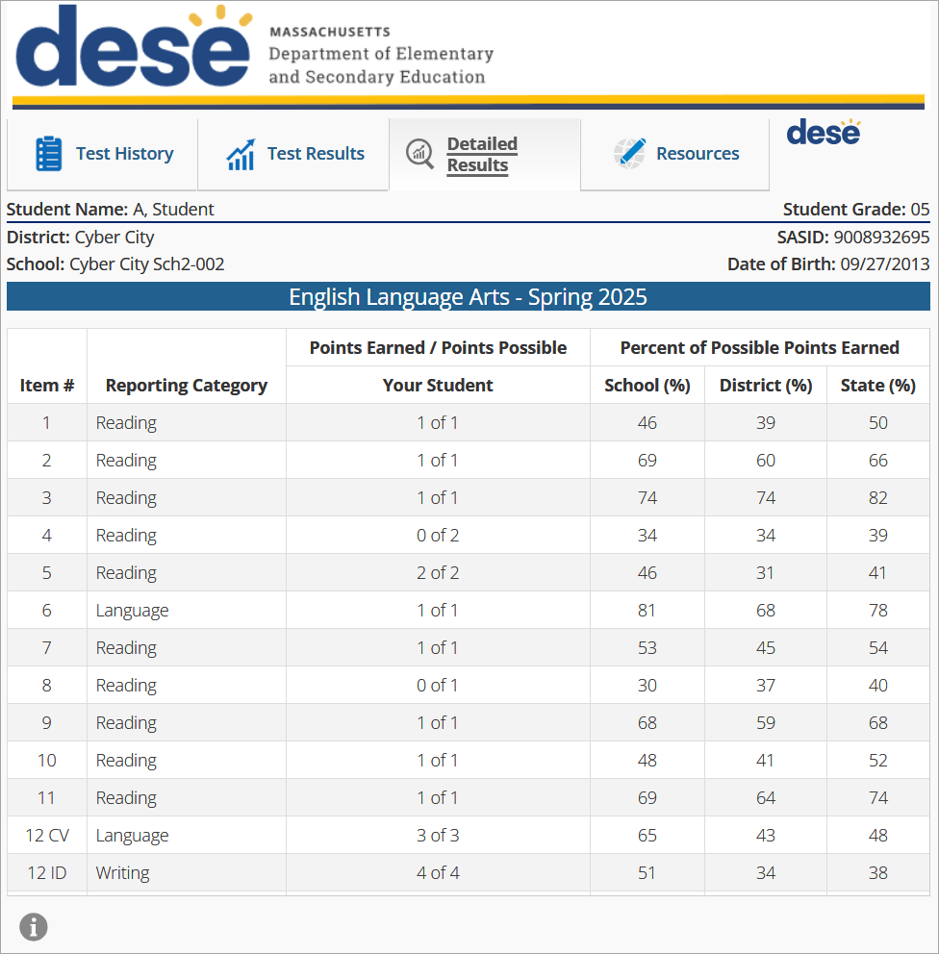
Viewing Detailed Results
The Detailed Results tab gives you more information about your student’s performance.
It shows how your student did on each question in the test. It lists the reporting category (or area of learning), the points your student earned, and the total points possible.

Slide 18
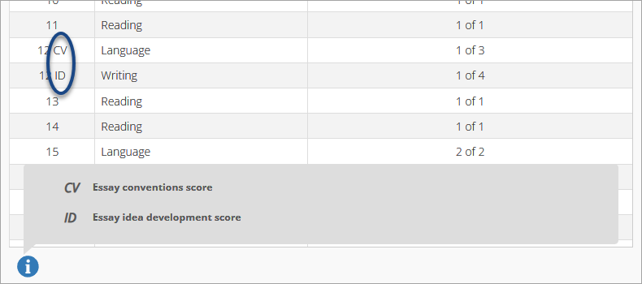
Viewing Detailed Results (continued)
Hover over the circle at the bottom of the Detailed Results tab to understand the abbreviations that you may see on your student’s report.

Slide 19
Viewing MCAS-Alt Results

Slide 20
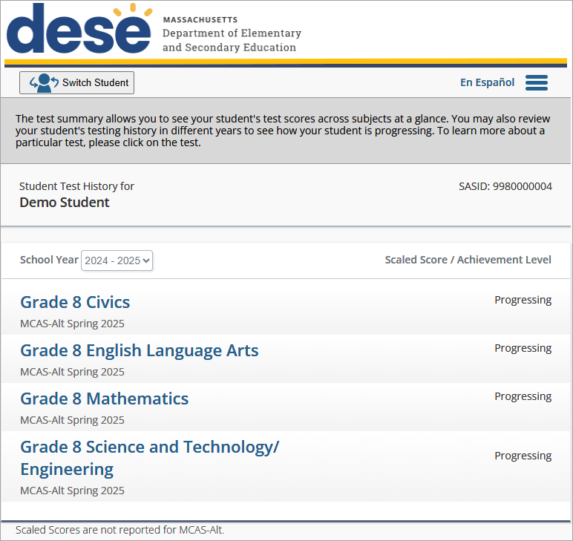
Viewing Test History: MCAS-Alt
The Test History page gives an overview of a student’s results for that school year.
To navigate between students, select the Switch Student Button.
For more detailed information, select a test.
Use the School Year drop-down menu to see data from previous years, if available.

Slide 21
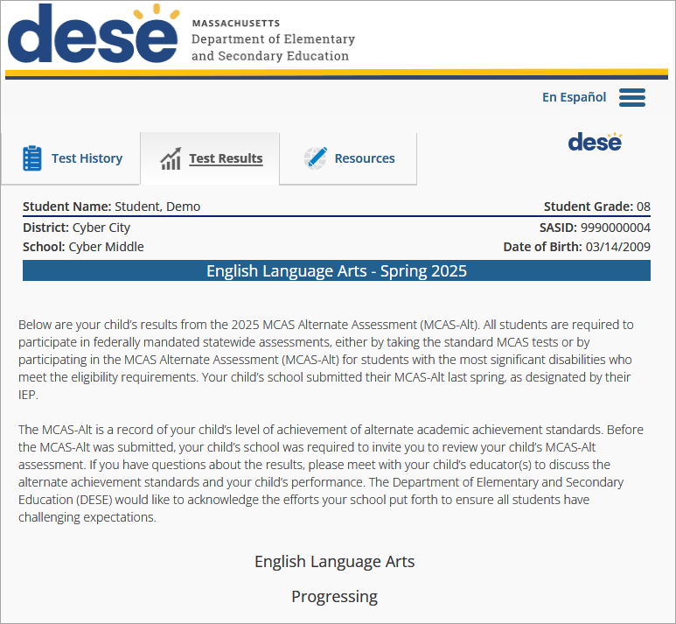
Viewing Test Results: MCAS-Alt
The Test Results tab shows your student’s achievement level. Scroll through the report for more information about your student’s performance.

Slide 22
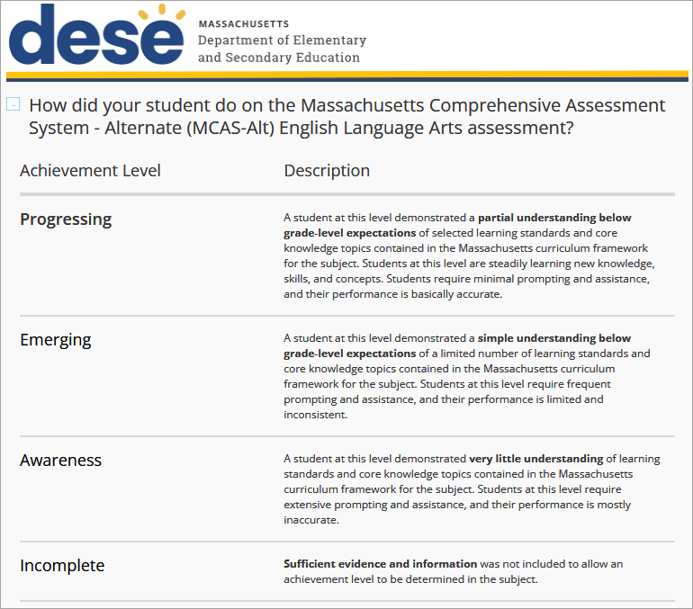
Viewing MCAS-Alt Test Results: Achievement Level
Here you can see your student’s achievement level, which shows you how well they did on the test. In this example, the student’s achievement level is Progressing.
Print pages from the MCAS Family Portal directly from your browser.

Slide 23
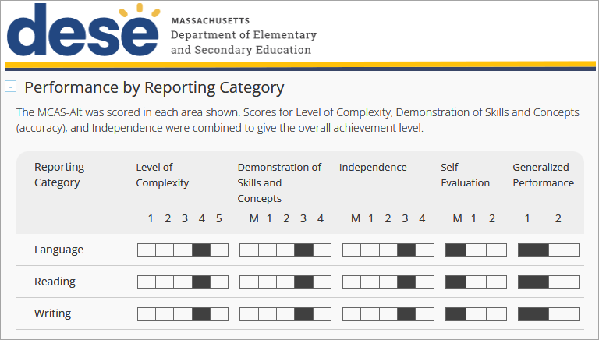
Viewing MCAS-Alt Test Results: Reporting Category
See how your student performed on specific reporting categories, or areas of learning within a subject.

Slide 24
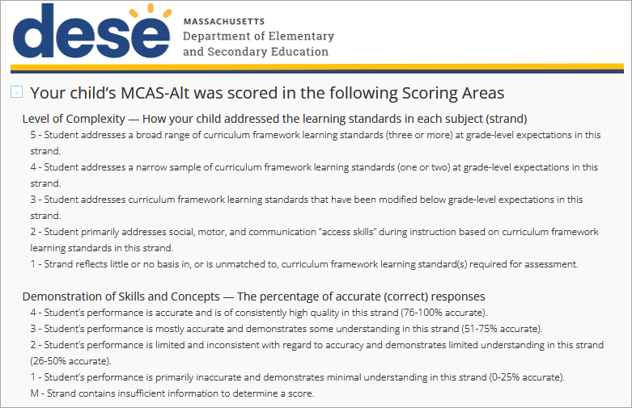
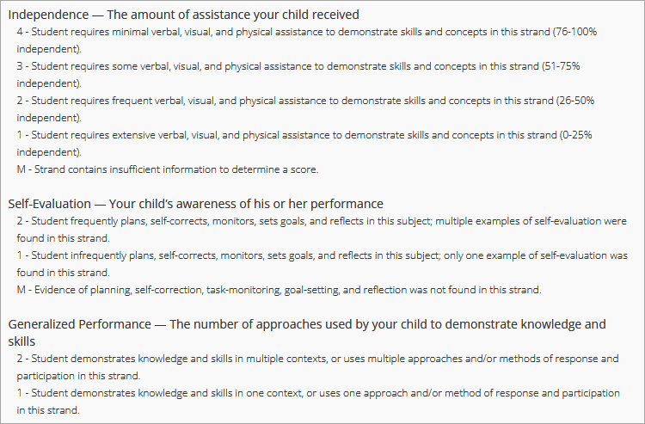
Viewing MCAS-Alt Test Results: Scoring Areas
View detailed information of the Scoring Areas for the MCAS-Alt assessment.

Slide 25
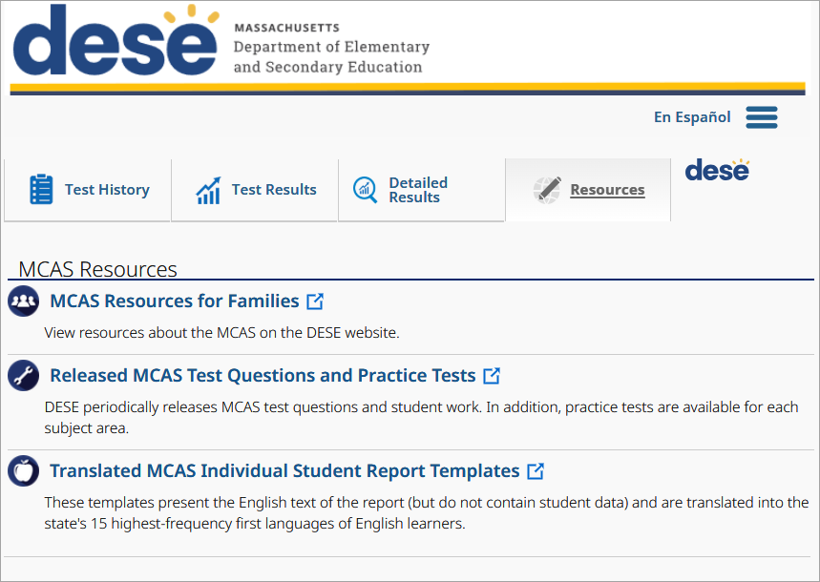
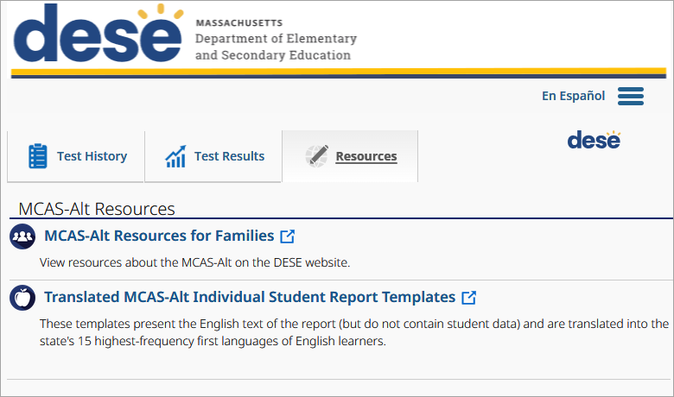
Additional Resources
Click the Resources tab to find helpful information about the MCAS tests, including student report templates in different languages.
MCAS Resources
MCAS-Alt Resources

