Slide 1
Spring 2024 MCAS Grades 3–8 Parent/Guardian Report Walk-Through

Slide 2
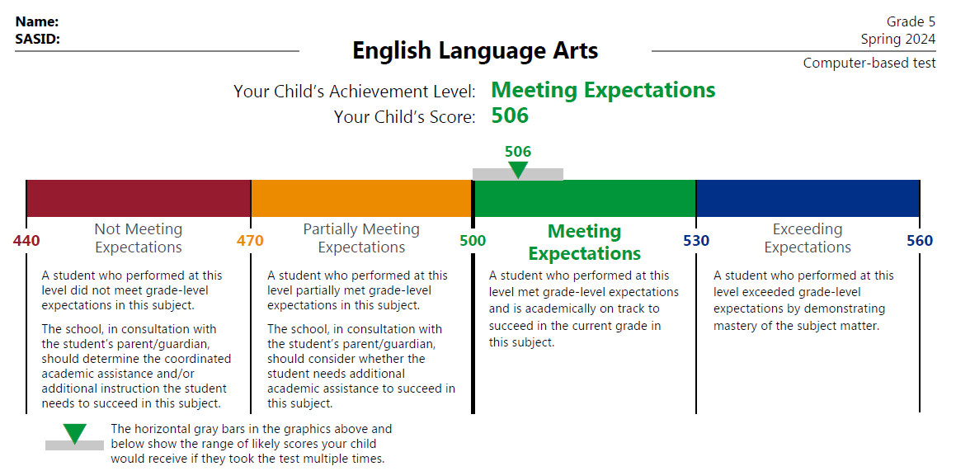
Results for Each Subject Test: Pages 2–4 of Report
This section shows your child’s score and achievement level in each subject and explains what each achievement level means.
The colored bar shows the score range for each achievement level and where your child’s score falls, which indicates how close your child is to the next level.
The gray bar shows the range your child would likely score if they took the test many times.

Slide 3
Achievement and Growth Percentiles: Pages 2 and 3 of Report
Achievement
Your child’s score this year
Your child’s score from previous years in the same subject
School, district, and state averages for comparison
Growth
Your child’s Student Growth Percentile (1-99)
An SGP of 89 means your child scored higher than 89% of the students with similar prior MCAS scores.
Scores from at least two consecutive-year tests are used to calculate SGPs.
School, district, and state averages for comparison

Slide 4
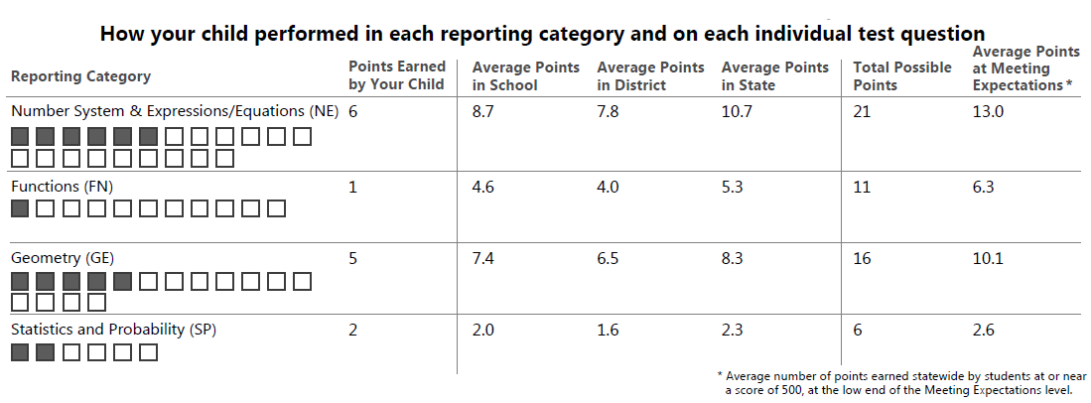
ELA and Mathematics Reporting Categories and Item Results: Pages 2 and 3
A table for each subject area shows the following information:
the reporting categories for that subject
the number of points your child earned out of the total possible points
the average points earned by students in your child’s school and district
the average points earned statewide by students who performed at or near a score of 500 (the low end of the Meeting Expectations achievement level)

Slide 5
ELA and Mathematics Reporting Categories and Item Results: Pages 2 and 3 (cont’d)
The reporting category (middle row) can be used to identify areas where your child is succeeding and areas where they may need additional support.
The points earned (bottom row) shows how many points your child earned on each question of the test.

Slide 6
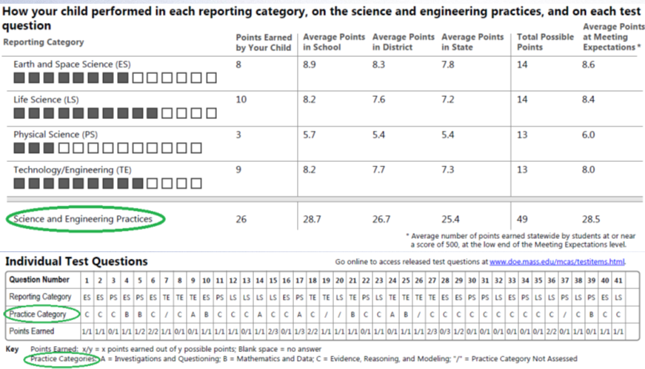
Science and Technology/Engineering Reporting Categories, Item Results, and Practice Categories: Page 4
Reports for students in grades 5 and 8 who took the Science and Technology/Engineering test include Science and Engineering Practices.
The Practice categories include (A) Investigations and Questioning; (B) Mathematics and Data; and (C) Evidence, Reasoning, and Modeling.
More information about the Practice categories is available at www.doe.mass.edu/mcas/tdd/practice-categories.html.

Slide 7
THANK YOU
The Office of Student Assessment Services
781-338-3625
mcas@mass.gov
www.doe.mass.edu/mcas
135 Santilli Highway, Everett, MA 02149

