Slide 1
Topic 2 Development of the U.S. Government
8th Grade Civics

Slide 2
Overview
You will be completing two activities about the events that led to the development of the U.S. government.
You will first explain how an event led to the American Revolution. and answer the question on Handout 1.
Next, you will break into small groups and read and analyze several sources on Handout 2 about how the U.S. government took shape. You will work in your groups to answer the questions on Handout 2.
Finally, the whole class will have a discussion.

Slide 3
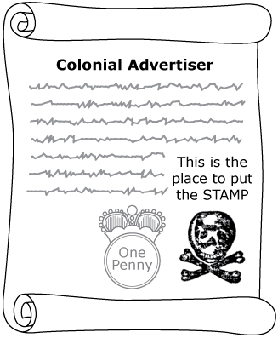
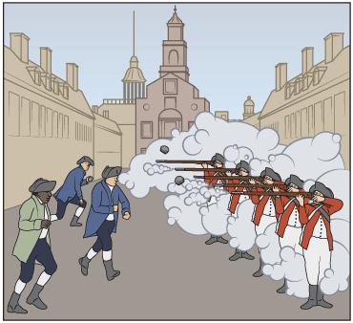
Activator
The Stamp Act of 1765
The Boston Massacre, 1770

Slide 4
Handout 1
Two of the events that led to the American Revolution are shown.
Select one event and explain how it helped lead to the American Revolution.
Use the information provided in the illustration to support your explanation.

Slide 5
Suggestions for Working in a Small Group
You may work in a pair or in a group of 3 students on the next handout.
You may assign the following roles to each person in your group or pair (each person may need to do more than 1 role):
Reading the questions aloud to the group
Providing an initial answer to a question on the Handout
Keeping track of time
Sharing out the group’s answers with the whole class
Note to educator: Remove or replace this slide if your class will use a different procedure for Handout 2

Slide 6
Handout 2
Work with your group to read the information provided and answer the questions.
Your group should read and discuss the information together, but each student should complete their own handout.

Slide 7
Whole-class discussion
How did the new U.S. Constitution resolve some concerns the Founders of the U.S. government had based on their experiences under British rule or under the Articles of Confederation?
Which issues remained unresolved with the creation of the U.S. Constitution?

