Slide 1
Topic 3 Institutions of U.S. Government Local Task
8th Grade Civics

Slide 2
Overview
You will be completing an activity about the three branches of the federal government.
You will be given handouts to explore some ways that the federal government has responded to an important issue that affects the lives of people living in the United States.
You will work in groups to examine sources related to this issue, discuss the federal government’s constitutional powers used to address this issue, and answer the questions on the handouts.
We will then discuss the powers of the federal government as a class.

Slide 3
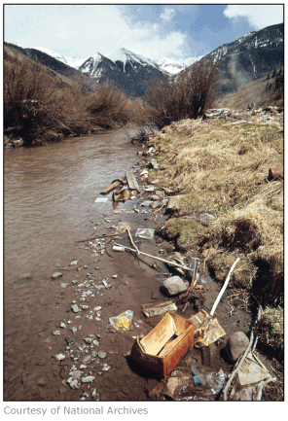
Handout 1
Work with your small-group to complete Handout 1.
Read and discuss the questions together, but each student should complete their own handout.

Slide 4
Whole-Class Discussion
What constitutional powers did the three branches of government exercise in their efforts to address water pollution?

Slide 5
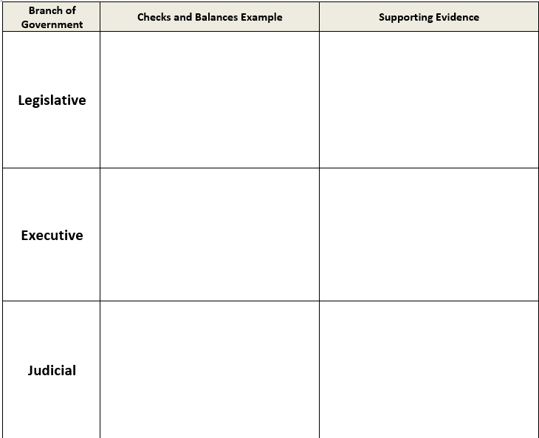
Handout 2a
Work with your small-group to complete Handout 2a.
Read and discuss the chart together, but each student should complete their own handout.

Slide 6
Handout 2b (optional)
Explain how the actions taken by the legislative, executive, and judicial branches, in relation to the Clean Water Act of 1972, show how the checks and balance system of the federal government works.
Describe three examples of the checks and balances system, one for each branch of government.
You may use Handouts 1 and 2a to support your explanation.

