Slide 1
Topic 4 Local Task
8th Grade Civics

Slide 2
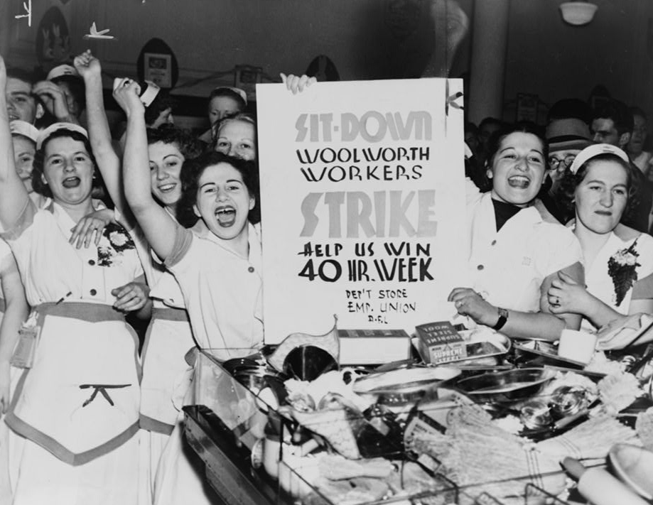
Handout 1 Activator Image
Courtesy of the Library of Congress
Notes:
Image URL: https://www.loc.gov/pictures/item/00649864/

Slide 3
Handout 1
Explain what the individuals in the photograph want to achieve. Use details from the image to support your reasoning.
Explain how an activity like the one shown in the photograph supports a healthy democracy.

Slide 4
Handouts 2 and 3
Examine the sources on Handout 2.
Then work with your group to complete Handout 3.
For some questions, you will first respond individually (without talking to each other); write your response in the box labeled “Individual Response.”
Then you will each share your answers with the group and write a combined answer in the box labelled “Group Response.”
The answers that you write in the “Group Response” box will be scored.

Slide 5
Whole-Class Discussion
Sometimes it takes courage and leadership to change society. What examples of leadership and courage did you notice in the sources you looked at today?
How does civic engagement help ensure an effective democratic society?

