Slide 1
Topic 7 Freedom of the Press Local Task
8th Grade Civics

Slide 2
Overview
You will be completing three activities about the freedom of the press.
We will first analyze a political cartoon about a local town issue and answer the question on Handout 1.
Next, you will break into small groups and read and analyze several sources in Handout 3 about a public policy issue in the fictional town of Cloverville. You will work in your groups to answer the questions on Handout 2.
Finally, each group will share their answers with the whole class.

Slide 3
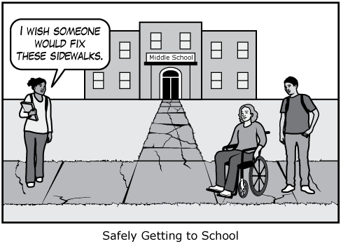
Political Cartoon Activator (Handout 1)
Examine the cartoon and answer the questions that follow.

Slide 4
Questions about Cloverville’s Sidewalk Proposals (Handouts 2 and 3)
Now you will work in small groups to read, analyze, and discuss sources about a public policy issue in the fictional town of Cloverville.
As a group, read, analyze, and discuss each source in Handout 3.
On Handout 2, complete the chart and answer questions 1–5. Each student should fill out their own handout.

Slide 5
Whole-Class Discussion
Did your group vote in favor of or against the proposal to improve sidewalks? Why did your group vote the way that it did?
Why is freedom of the press important for a democratic society?

