Slide 1
Instructions for Using These Slides
These slides are intended to assist principals in preparing their school training for test administrators and others involved in MCAS administration.
There is no requirement to use these slides; however, the information they contain must be conveyed during the training.
Principals may add slides, delete slides, and adjust slides as needed.
Although some slides can be used as is, many are meant to serve as a template to be filled in with school-specific procedures.
  Areas where information is meant to be filled in by the school are generally presented in red text.

Slide 2
MCAS Test Administration Training Session
For Test Administrators, Technology Staff, and Other School Personnel
March 2025 Retests

Slide 3
Today’s Agenda
MCAS Updates
Test security requirements – Part I of the Test Administrator’s Manuals (TAMs)
Test administration protocols – Part II of the TAMs
Tasks for test administrators
Local procedures and logistics for MCAS administration
Accessibility and accommodations
Procedures for paper-based testing, if the school is doing PBT
Questions and answers

Slide 4
Goals for This Training
Understanding procedures to follow before, during, and after testing
Understanding test security requirements and test administration protocols
Knowing which resources to review prior to testing, and how to find answers to questions

Slide 5
MCAS Program Updates
The MCAS Portal (mcas.cognia.org) is the new test administration management platform beginning in 2025.
  Refer to the Crosswalk of Terminology for MCAS Tests Beginning in 2025 (www.doe.mass.edu/mcas/testadmin/crosswalk-of-terminology.pdf).
Many tasks that were part of administering tests through PearsonAccess Next are not necessary in the MCAS Portal. Among these are
  Preparing sessions
  Starting and stopping sessions
  Locking and unlocking sessions
  Resuming students
  Marking tests complete
New tasks (performed by the test coordinator) include
  Creating classes
  “Scheduling” classes

Slide 6
New Testing Systems and Terms
MCAS Portal – The test administration and management website for district test coordinators, technology coordinators, principals/school test coordinators, test administrators, and other staff as needed (replacement for PearsonAccess Next/PAN)
  There is also an MCAS Training Site that can be used to set up practice tests and to practice with tasks that schools will complete in the MCAS Portal.
MCAS Student Kiosk – The student testing platform in which students will take their MCAS tests (replacement for TestNav)
Student logins – Contain the usernames and passwords for students to sign in to the MCAS Student Kiosk for testing (replacement for student testing tickets)
Test administrator logins – Allow a test administrator to access a test in the MCAS Student Kiosk to read aloud or sign the test to students (replacement for proctor testing tickets)
Classes – Groups of students testing together in the same place at the same time (replacement for PAN Sessions)

Slide 7
New Testing Procedures
After entering their usernames and passwords, students will enter a session access code (that test administrators will write on the board) in order to access their tests.
Students will have the ability to pause their tests (e.g., during a break or during lunch). If a test is paused for less than 60 minutes, students will only need to enter their passwords to resume testing.
In some circumstances, students or test administrators will need to enter a special password (the “proctor password”) in order for students to sign back in to the test. The proctor password can be found in the MCAS Portal (see pages 107–108 in the CBT TAM).
Notes entered in the notepad and any highlights made by a student with the highlighter tool will be lost if a student pauses a test for more than 60 minutes, signs out of a test, submits a test, or if there is a circumstance that abruptly closes the kiosk (e.g., the device shutting down due to low battery).

Slide 8
Training and Documentation Requirement
All school personnel involved in MCAS test administration must participate in a school training session before test administration.
Today the following must be documented:
  You are being trained.
  You received your Test Administrator’s Manual (TAM)/test security requirements.
  How will you document staff participation in training? Will the sample DESE forms be used? Electronic forms?
Before today’s session, you received the following:
  For test administrators: the TAM for the test(s) you will administer
  For hallway monitors and others: test security requirements
  For technology staff: test security requirements and relevant technology troubleshooting steps
If you did not receive your documents, let us know.

Slide 9
Test Administration Dates
Insert dates for student tutorial
Insert dates for practice tests
Test Administration Dates
  ELA Session 1 – March 6
  ELA Session 2 – March 7
  Math Session 1 – March 11
  Math Session 2 – March 12
Make-up testing dates (last day for make-up testing: March 14)

Slide 10
Local Procedures related to Testing Times
Insert the school’s length of time for each test session.
  See DESE recommended times on the following slide.
Describe the procedure for any students who arrive late.
  Will the test administrator read the script quietly to these students in the room, read it to them outside the room, or will the students instead be scheduled for make-up testing?
Describe the procedure for students who finish testing early.
  Will they be allowed to leave the room early, or will they stay in the room until the end of the session?
Describe the procedure for students who need extended time.
  Will students who need more time stay in the same room to finish, or will they move to a different room?

Slide 11
DESE Recommended Testing Times:
MCAS Subject Area | Number of Sessions | Recommended Testing Time
ELA retest | 2 | Session 1: 2½ hours Session 2: 1½ to 2 hours
Mathematics retest | 2 | 1½ to 2 hours per session

Slide 12
Breaks during a Session
At the test administrator’s discretion, a break of 3–5 minutes is allowed approximately halfway through the session.
Students should not have conversations during the break.
The TAM scripts contain instructions that test administrators can read to students to explain how to pause their tests (see, e.g., page 33 in the CBT TAM). When student tests are paused, no content is visible on the screen.
Discuss school procedures and what will be allowed/not allowed during breaks
How will security be maintained during a break?

Slide 13
Secure Content and Materials
Secure content
  MCAS questions not publicly released by the Department
  student responses to test questions
  passages, diagrams, graphics, writing prompts, and other test content
Secure materials
  student logins
  summary pages from the student login PDFs
  test administrator logins (for test administrators who are administering the Human read-aloud or Human signer accommodation)
  used scratch paper (i.e., after students have written on it)
  test & answer booklets (for PBT)

Slide 14
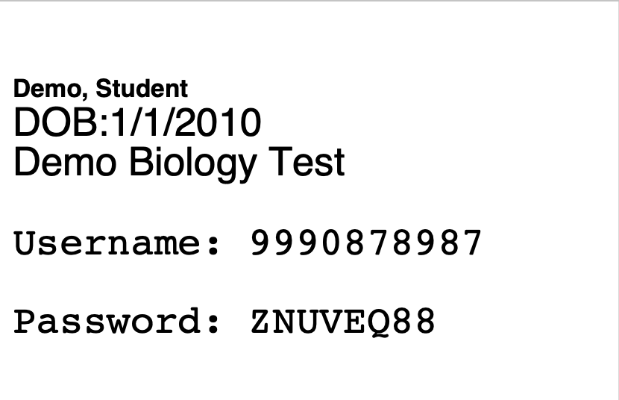
Sample Student Login

Slide 15
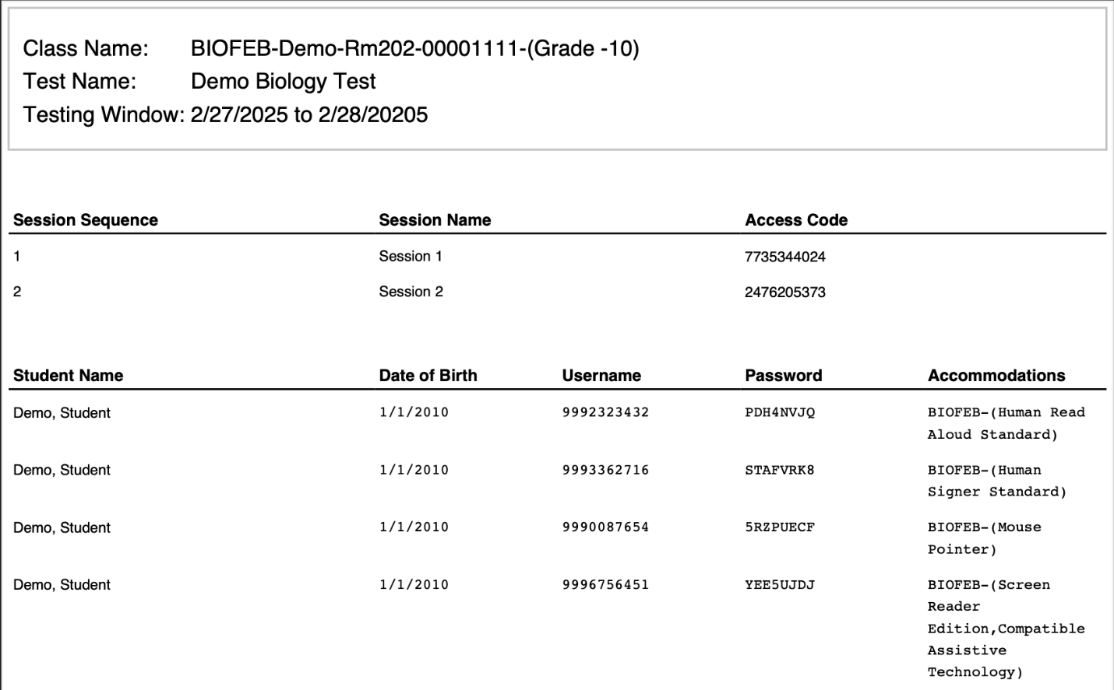
Sample Summary Page
Test administrators will write the session access code on the board.
Check that accommodations are correct before testing.

Slide 16
Test content is confidential. The following things are prohibited:
Viewing test content (on screens or in booklets)
Duplicating or reproducing test content
  School personnel may not copy questions by hand or photograph them.
    Technology staff may not photograph computer screens even when troubleshooting a problem.
Discussing test content with anyone before, during, or after testing
  School personnel may not discuss test content with each other.
  Teachers may not review unreleased MCAS questions with students.
    (e.g., “Were there any questions that you had on Session 1 that you want me to go over?”)
  Exception: students reporting a concern about a test question

Slide 17
If a Student Reports a Concern About a Test Question
If any students report that they have a concern with a test question (i.e., the student thinks there is a problem with the question, or the student is uncomfortable with the content of the question for a non-academic reason)
  Note the form number and question number and inform the principal, who will contact DESE for guidance.
  Do not reproduce the question itself or the answer choices.
  Refrain from discussing the question except as needed to report the issue.
  See also page 23 of the CBT TAM.

Slide 18
Exceptions to Prohibition of Test Administrators Viewing MCAS Content
Administering certain accommodations (Nondisclosure Acknowledgment form required)
  Accommodations A2, A3.1, A3.2, A3.3, A5, A6.1, A8, A10.1, A10.2, A11, A12, A13, A14, A15
  Special access accommodations SA1.2, SA2, SA3.1, SA3.2, SA6
  English learner accommodations EL3.2, EL4.1, EL4.2
Reading a word or phrase aloud on the Mathematics retest – Universal Accessibility Feature 11 (UF11)
  See page 83 of the PAM for the description of UF11.
  UF11 cannot be used on the ELA retest.
Assisting a student with the computer interface during testing

Slide 19
Storage of Secure Materials
Secure materials (student logins, used scratch paper, PBT booklets, etc.) must be stored in a secure central location when tests are not being administered.
  Secure materials cannot be stored in classrooms, even if classrooms are locked.
  Access to the storage area must be restricted.
After each test session is completed, secure materials must be returned to the test coordinator.
Secure materials may not be left unattended when not in the central secure storage location.

Slide 20
Tracking Secure Materials
The chain of custody of secure materials during test administration must be maintained.
Internal tracking forms must be used whenever secure materials are removed from, or returned to, secure storage.
  Test administrators and the test coordinator must independently count student logins (or booklets for PBT) and record the separate counts on the tracking form before signing it.
    Sheets of scratch paper do not need to be counted; however, the return of used scratch paper must be indicated on tracking forms.
  The appropriate box on tracking forms must be checked when student logins and used scratch paper are destroyed after testing.
  Inform test administrators if your school plans to use the sample DESE forms or your own forms (as discussed on pages 16–17 of the PAM).

Slide 21
Monitoring Students Outside the Testing Room
Students must be supervised at all times when they are out of the testing room (e.g., going to the restroom, going to the nurse, going to a lunch break, moving to a test completion room).
Describe the school’s plan for monitoring students out of the testing room
  Hallway monitors?
  Restroom monitors with a view of testing rooms?
  Call main office for escort?
  Second test administrator escorts student (if two test administrators are used)?

Slide 22
A Secure Environment in the Testing Room
Cover or remove prohibited classroom displays.
  Describe how and when this will be done in the school.
  See page 24 in the CBT TAM for examples of what must be covered or removed.
Unauthorized persons may not enter testing rooms, including
  parents
  non-testing students
  teachers not assigned to the room as test administrators
Testing rooms may be entered by
  school administrators (including the test coordinator, even if they do not have a formal administrative role at the school)
  district staff
  DESE observers
  technology staff (to troubleshoot technology problems)

Slide 23
A Secure Environment in the Testing Room (continued)
Students must not be able to view any screen (or booklet) but their own.
Describe how rooms will be set up to ensure a secure testing environment, or whether test administrators will set up their own rooms
  Set up rooms in advance, if needed, to test out different seating arrangements.
  If test administrators will set up their own rooms, who will walk around at the start of testing and check all the rooms?
  Will students be separated by enough space to support secure testing?
  Will physical barriers (e.g., partitions, privacy screens, carrels) be used?

Slide 24
Prohibited Materials
Make sure students understand that they are not allowed to have
  cell phones and other electronic devices (e.g., smartwatches, ear buds)
  calculators on the noncalculator session (Mathematics)
  notes or reference material such as additional reference sheets other than what they have been given (except for certain accommodations)
  dictionaries
  other instructional materials
A more comprehensive list can be found on pages 15–16 of the CBT TAM.
A poster showing examples of prohibited materials is available at www.doe.mass.edu/mcas/testadmin/retest/forms
  Inform staff whether the school will be using this poster during testing (recommended).

Slide 25
Cell Phones
Cell phones give students the ability to communicate with other students, to access the internet, and to access tools such as a calculator, camera, or dictionary.
Inform test administrators how phones will be collected before testing and whether they will read the optional scripts in the TAMs.
  Will students put phones in backpacks and backpacks at the side of the room (included in the optional TAM script)?
  Will phones be collected and kept by the test administrator at the front of the room?
  Will phones be put away in lockers?
Convey to students that they may not have cell phones during testing and that they may not access phones, even to check the time, since their results may be invalidated.
Be aware that some students turn in a spare phone and retain their own.

Slide 26
Allowable Materials
Scratch paper (blank, ruled, or graph)
  Students receive one sheet of scratch paper at the start of testing. They may have up to three pieces at one time. If students need more than three pages, they will have to turn in sheets.
  See page 13 of the CBT TAM for more information about scratch paper.
Pens, pencils, highlighters, colored pencils (for use on scratch paper)
Handheld calculators for Session 2 of the Mathematics retest
  The MCAS Student Kiosk provides calculators, but students may use a handheld calculator if they want. (See pages 14–15 of the CBT TAM for more information.)
Copies of bilingual word-to-word dictionaries (for students who are currently or were ever reported as ELs)

Slide 27
Allowable Materials (Continued)
Printed reference sheets for Mathematics
  Although the reference sheet is available by clicking the References icon in the MCAS Student Kiosk, the Department recommends that students also be given printed copies (available at www.doe.mass.edu/mcas/tdd/math.html?section=reference)
  Students are not permitted to use additional reference sheets from class.
  Students should not write on their reference sheets; they should use their scratch paper for any figuring they need to do.
Printed copies of equation editor guides and symbol keys (for Mathematics)
  Reference sheets, equation editor guides, and symbol keys are available to print from mcas.onlinehelp.cognia.org/practice.
Inform test administrators whether your school is going to give printed reference sheets, equation editor guides, or symbol keys to students.

Slide 28
Allowable Materials (Continued)
Students with accommodation A9 listed in their IEPs or 504 plans—and only these students—may use printed copies of the supplemental Mathematics reference sheet.
  See www.doe.mass.edu/mcas/accessibility/organizers/ for the supplemental Mathematics reference sheet for accommodation A9.
  Supplemental reference sheets may not be filled in before testing. Test administrators should check that students receive “clean” copies of the reference sheets and do not use sheets that have previously been filled in.

Slide 29
Additional information about Reference Sheets
Make sure students understand that they can only use reference sheets they are given on test day. Reference sheets that they used in class (even for MCAS preparation) are not allowed.
Make sure that students understand that no other reference materials (e.g., multiplication tables, conversion charts) are allowed during testing.
Students should not write on their reference sheets, but rather should use their scratch paper for any figuring they need to do.

Slide 30
Test Administrator Day-of-Testing Responsibilities Before Testing Begins
Include the following instructions for these steps from the CBT TAM (e.g., page 28–29) or give a demonstration on the training site. Schools may choose to instead have the test coordinator complete these steps.
  On the test administrator device, sign in to the MCAS Portal and click Administration. Go to Test Scheduling and select the scheduled test session from the drop-down menu. Click View Details/Student Logins and review the students scheduled to take the test. Make sure the students listed here match those on the summary page you were given with your student logins.
  Verify that the correct accommodated forms such as Screen Reader, Human Read-Aloud, and Human Signer are assigned to students, if applicable. This can be confirmed on the View Details/Student Logins page in the MCAS Portal.
  Also verify that students’ other accommodations such as Text-to-Speech are listed, if applicable. This can be confirmed on the Edit Student page in the MCAS Portal or the summary page you were given with your student logins.

Slide 31
Test Administrator Day-of-Testing Responsibilities Before Testing Begins, continued
Ensure that all students have the proper materials.
  Verify that students have their correct student login.
Write the session access code on the board.
  This can be found in the MCAS Portal and on the printed student summary page.
Collect cell phones and any other prohibited devices. Describe the procedures the school plans to use to prevent students from accessing phones.

Slide 32
Avoiding Common Issues during Testing
At the start of testing, check that students do not have
  smartwatches
  wireless ear buds
Be especially aware of these issues while monitoring the room:
  cell phone use
    Observe whether students are looking in their laps or have their hands under their desks, even if they turned in a phone (they may have another one with them).
  extra reference sheets/notes
    Check that only students with accommodation A9 have a supplemental reference sheet, that these are the approved supplemental reference sheets, and that these supplemental reference sheets are blank when the test begins.
  calculators on noncalculator sessions
  human read-aloud or text-to-speech on the ELA retest
    only available to a very small number of students who have special access accommodation SA1.1 or SA1.2 in their IEPs.
    The standard human read-aloud and text-to-speech accommodations (A4 and A5) are only available for the Mathematics retest, NOT ELA.

Slide 33
Test Administrator Responsibilities During Testing
Read the scripts in the TAMs verbatim to students.
Focus full attention on the testing room for the full test session.
Circulate throughout the room periodically to prevent cheating and the use of prohibited materials.
Refrain from coaching students or influencing their responses in any way.
Complete tasks in the MCAS Portal
  If needed, provide the proctor password (in the CBT TAM, see sections 4 and 6 on page 18, and see pages 107–108 in Appendix B).
  Monitor student testing status (Not Started, In Progress, Finished)
    Note that test administrators cannot see students’ progress through the test in the MCAS Portal – only their status.

Slide 34
Coaching is not permitted on MCAS tests.
What is coaching?
Providing hints or clues that might affect a student’s response
  “Think about what we studied in class last week.” “What’s the acronym for order of operations?” “Consider it from the main character’s perspective.” “Be sure to use specific examples in your constructed response.” “Try to picture the photosynthesis chart in your mind.”
Indicating in any way that a student has answered a question incorrectly
  “You might want to look at that one again.”
  “You should review number 11.”
  “Check your work.”
    Note: This may be said aloud to the class but may not be said to an individual student working on a particular question (with the exception of reading the script instruction for a student to check their work before turning in their test)
Defining or spelling words
Explaining, simplifying, or paraphrasing any part of the test
Suggesting that a student write more
Influencing a student’s response through gestures, facial expressions, nods, body language, or changes in voice inflection

Slide 35
What is permitted?
Reading a word or short phrase aloud – Universal Accessibility Feature 11 (UF11) for Mathematics (not ELA). See page 83 of the PAM.
Assisting students with technology-related problems (see page 19 of the CBT TAM)
Re-reading part of the TAM script to students
  The TAM scripts all contain instructions to students to check their work if they finish early, so it is allowable to remind the whole class to check their work before submitting their tests.
Encouraging students if they ask questions about test content
  “Just do your best.” “Give your best effort.” “Do the best you can.” “You can do this.” “You’ve got this.” “Just answer it as well as you can.”

Slide 36
Providing Technology-Related Help to Students
Students should be familiar with computer-based testing through practice tests, but test administrators may assist students during testing with technology-related problems.
Examples of allowable assistance:
  Helping students sign in to the MCAS Student Kiosk (The test administrator may type in students’ usernames and passwords.)
  pointing to a tool button that a student cannot find (e.g., the calculator)
  explaining how to move through the test using the arrow keys
  pointing to the fraction bar in the equation editor if a student does not know how to enter his or her answer as a fraction
  Explaining how to navigate to a test question directly from the review screen
Examples of prohibited assistance
  telling a student to use the calculator or a specific tool on a question
  telling a student which ruler to use
  typing any answers into the test or clicking any answer choices (Students should enter or choose all answers themselves.)

Slide 37
Steps to Take in Case of Technology Problems
Who will be the designated technology support staff?
How will the test administrators contact the designated technology support staff?
  One technology staff member in each wing of the school building?
  Call a technology staff member who is located centrally?
If a student experiences a technology error, resume testing on the same device, if possible.
  If the original testing device cannot be used or if the original error is still occurring, then another device should be attempted.
Do not turn off the device.
Make note of which testing device the student was using.
If there is a situation in which a student is waiting for more than 15–20 minutes, then consult with the principal/test coordinator on scheduling the student to complete the session at a later time.
Note that staff may not take photographs of the MCAS Student Kiosk screen when troubleshooting technology issues.

Slide 38
Testing Irregularities
Testing irregularities are incidents that represent a deviation from prescribed testing procedures. Testing irregularities may include student impropriety, errors in providing accommodations, educator misconduct, or the mishandling of secure test materials.
Testing irregularities must be reported to the principal and then to DESE.
Test results may be invalidated if students do any of the following:
  duplicating any portion of secure test content
  accessing prohibited materials such as cell phones or other electronic devices
  communicating with other students (e.g., talking, whispering, writing notes)
  looking at any other student’s computer screen or test & answer booklet
  asking for or receiving help from anyone
  providing help to another student
  consulting notes, books, or instructional materials during testing
  accessing the internet
Results may also be invalidated if students receive any impermissible assistance from test administrators (coaching), or receive accommodations they are not entitled to, especially special access accommodations such as
  read-aloud or text-to-speech on the ELA test (SA1.1, SA1.2)
  calculator on noncalculator tests and sessions (SA4)

Slide 39
Responsibilities After the Session is Over
Make sure you have all student logins and used scratch paper.
Make a list of any students assigned to you that were absent. These students will need to be scheduled for make-up testing.
Describe the procedures for how students who need more time will continue testing.
  Continue testing in the same room after other students leave?
  Move into a test completion room?
Return student logins and used scratch paper to the test coordinator and sign the tracking form after independent counts are completed.
There are no steps that need to be performed in the MCAS Portal at the conclusion of testing.

Slide 40
Other School Procedures
The TAMs contain optional scripts as described below. Inform test administrators at the training session if they will read the scripts or if the school will develop an alternative version.
  whether test administrators will read the recommended script instructing students to put away cell phones and other electronic devices in their backpacks at the side of the room or if a locally developed script will be used instead
  whether test administrators will read the scripts for students going to a supervised lunch, students moving to a test completion room, and students going to the restroom
Inform staff whether student logins will be collected from students after they sign in to the MCAS Student Kiosk, or students will retain their logins until the end of the session.

Slide 41
Other School Procedures (Continued)
Inform staff how to contact the school administration if there is a problem during testing.
  How will they contact technology staff if there is a technology problem?
Inform staff whether they should come to the central secure storage area to pick up materials, or if materials will be delivered to them.
Inform staff whether students who finish early may be dismissed or must wait until the end of the scheduled session.
  If students will wait until the end of the session to be dismissed, inform staff of what they may do and what they are allowed to have with them until then.
Inform staff how lunch will be handled for students whose testing extends into the lunch period.
  lunch brought to the room?
  supervised lunch in the cafeteria?

Slide 42
Training Resources for Computer-Based Testing
Training modules and recordings of training webinars are available at https://mcas.onlinehelp.cognia.org/training/

Slide 43
Universal and Designated Accessibility Features for All Students
Accessibility Features for All Students
  Universal Accessibility Features (UFs) are tools and supports available to all students that are either built into the computer testing platform or provided by a test administrator.
  Designated Accessibility Features (DFs) are changes in scheduling, setting, group size, or other conditions of test administration that can be provided to any student at the principal’s discretion.

Slide 44
Universal Accessibility Features (UFs) – Available to All Students
UF1 – Highlighter tool
UF2 – Color contrast
UF3 – Screen Zoom tool
UF4 – Enlarged cursor/Mouse pointer tool
UF5 – Line reader tool
UF6 – Answer masking
UF7 – Answer eliminator
UF8 – Item flag/bookmark
UF9 – Audio aid
UF10 – Notepad
UF11 – Test administrator reads aloud selected words on the Mathematics or STE Tests
UF12 – Test administrator redirects student’s attention to the test
UF13 – Test administrator reads aloud, repeats, or clarifies general test administration directions from the Test Administrator’s Manual scripts to student, as needed.
UF14 – General masking
UF15 – Reverse contrast
Descriptions of these features can be found in Appendix C of the PAM on pages 82–83.

Slide 45
Designated Accessibility Features (DFs) –
Available to All Students, at the Principal’s Discretion
DF1 – Small group test administration
DF2 – Individual (one-to-one) test administration
DF3 – Frequent brief supervised breaks
DF4 – Separate or alternate test location
DF5 – Seating in a specific area of the testing room
DF6 – Adaptive or specialized furniture
DF7 – Noise buffer, such as noise-canceling earmuffs/headphones or white noise
DF8 – Familiar test administrator
DF9 – Student reads test aloud to self
DF 10 – Specific time of day
DF 11 – “Stop Testing” policy
Descriptions of these features can be found in Appendix C of the PAM on pages 83–84.

Slide 46
Preparing to Administer Accommodations
Test administrators who administer certain accommodations (listed on page 85 of the PAM and on slide 17) must
  sign a Nondisclosure Acknowledgment Form
  receive additional training on what is and is not permitted
Who will provide additional training on accommodations and when?
How will descriptions of students’ accommodations be provided – e.g., will test administrators be given copies of Appendix C of the PAM (available as a separate PDF at www.doe.mass.edu/mcas/testadmin/retest/manual)?
Who should test administrators contact if they discover an accommodation is not given correctly? (There may be some additional steps for CBT.)
How will accommodation refusals be handled? Will the sample DESE form be used? (Refusals by students should be documented in writing and kept on file.)
  www.doe.mass.edu/mcas/testadmin/retest/forms

Slide 47
Accommodations for Students with Disabilities
Full descriptions of accommodations can be found in Appendix C of the PAM. Categories are as follows:
  Test presentation accommodations
    e.g., Braille edition, text-to-speech
  Response accommodations
    e.g., graphic organizers, scribe
  Special access accommodations
    e.g., text-to-speech or human read-aloud for the ELA tests
Only provide accommodations listed in a student’s approved IEP or 504 plan.

Slide 48
List of Accommodations for Students with Disabilities
A1 – Paper-based edition of the test
A2 – Large-print edition (only applicable to PBT)
A3.1 – Screen reader; A3.2 – Braille edition; A3.3 – Assistive technology
A4 – Text-to-speech (for Math)
A5 – Human read-aloud (for Math)
A6.1 – Human signer (for Math)
A7 – Human signer for test directions only
A8 – Track student progress
A9 – Graphic organizer, checklist, or supplemental reference sheet
A10.1 – Human scribe; A10.2 – Speech-to-text (for Math)
A11 – Responses recorded by student on special paper (only applicable to PBT)
A12 – Typed responses (only applicable to PBT)
A13 – Student records responses on an external recording device
A14 – Responses signed onto video
A15 – Monitor placement of responses
A16 – Refreshable Braille display/Braille note-taker
A17 – Braille writer
A18 – Word prediction for Math
Descriptions of these accommodations can be found in Appendix C of the PAM on pages 86–92.

Slide 49
Special Access Accommodations
Special access accommodations are intended for use by a very small number of students with significant delays in word decoding/reading, writing, or performing basic numerical calculations who would not otherwise be able to access the test because a disability severely limits or prevents them from performing the skill in question.
  SA1.1 – Text-to-speech for ELA; SA1.2 Human read-aloud for ELA
  SA2 – Human signer for ELA (passages, not questions)
  SA3.1 – Human scribe for ELA; Speech-to-text for ELA
  SA4 – Calculation device on a noncalculator session of the Mathematics test
  SA5 – Spell-checker for ELA
  SA6 – Word prediction for ELA
Descriptions of these accommodations can be found in Appendix C of the PAM on pages 93–96.

Slide 50
Accommodations for English Learners
Accommodations for EL students
  Documentation of EL accommodations must be kept at the school.
  Bilingual word-to-word dictionaries available for any student who was identified as an English learner
    Be sure that students have an opportunity to practice with the bilingual word-to-word dictionary prior to taking MCAS tests.
  Spanish/English edition of the Mathematics retest available in CBT and PBT editions
Who will provide additional training on accommodations and when?
How will test administrators know which accommodations to provide to which students?

Slide 51
List of EL Accommodations
EL1 – Paper-based test
EL2 – Approved bilingual word-to-word dictionary or glossary
EL3.1 – Text-to-speech for Mathematics; EL3.2 – Human read-aloud for Mathematics
EL4.1 – Scribe for Mathematics; EL4.2 – Speech-to-text for Mathematics
EL5 – Test administrator reads aloud/repeats/clarifies general administration directions in English (from TAM)
EL6 – Test administrator reads aloud/repeats/clarifies general administration directions in student’s native language
EL7 – Spanish/English edition of the Mathematics retest
EL8 – Word prediction for Mathematics
Descriptions of these accommodations can be found in Appendix C of the PAM on pages 104–105.

Slide 52
Special Instructions for Human Read-Aloud and Human Signer Accommodations
Special instructions are found in Appendix C of the CBT TAM.
Test administrators who provide these accommodations may either read over the student’s shoulder or use their own computer and print their own test administrator login to access a “test administrator” edition of the test.
  A separate class for “Human Read-Aloud” or “Human Signer” must be created.
  Students will use their own student login to sign in to their test.
  Do not confuse the student login with test administrator login.

Slide 53
If a Student Refuses an Accommodation
Document the student’s refusal in writing; keep in student’s file.
  Sample refusal form — available at www.doe.mass.edu/mcas/testadmin/retest/forms
  Do not ask student to sign any forms.
Continue to make accommodation available for remainder of test administration.
Update information in Student Registration, if an accommodation was entered incorrectly or was not used.
Notify parent/guardian of student’s refusal.
Amend IEP/504 plan for future testing.
  If appropriate, list the accommodation in the IEP/504 plan “as requested by student,” or remove it.

Slide 54
Additional Resources for Accommodations
Resource | Link
List of accessibility features and accommodations in Appendix C of the Principal’s Administration Manual | www.doe.mass.edu/mcas/testadmin/retest/manual
Recordings of previously offered accessibility and accommodations training sessions | mcas.onlinehelp.cognia.org/training
Accessibility and accommodations | www.doe.mass.edu/mcas/accessibility

Slide 55
Paper-Based Testing
Discuss the following:
  whether Student ID Labels will be applied before test sessions or applied by students after test & answer booklets are distributed
  who to contact in the event that test materials become contaminated
MCAS booklets are secure and must be tracked on internal tracking forms.
Yellow highlighters and colored pencils may be used in booklets; however, all answers must be written with a #2 pencil only.
Test administrators must monitor students during testing to ensure that they do not view one another’s booklets.
Test administrators must write their names as well as the school and district name on the board for students to copy onto their booklets at the start of testing.
Most UFs and DFs have paper-based equivalents listed in Appendix C of the PAM.

Slide 56
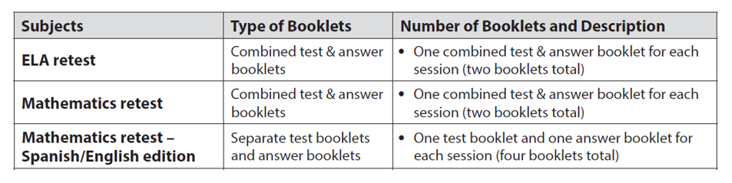
Paper-Based Testing
List of paper-based booklets
Note: Large-print booklets are also available for students using accommodation A2.

Slide 57
Questions and Answers
Opportunity for questions on material covered
Additional topics as needed

