Slide 1
MCAS Administration Training
Submitted by The Learning Center for Deaf Students
Contact Jessica Greenfield at
Jessica_Greenfield@tlcdeaf.org with questions.

Slide 2
Make-Up Testing
Students who are absent on the date scheduled for testing for any reason (including illness or other medical condition) must be scheduled for make-up testing as soon as they return to school. Make-up tests may be administered at any time after the scheduled testing date and before the end of the test administration window.
If a student is absent for a session of a test, he or she should take the remaining session(s) of the test according to the prescribed administration schedule and take the missed session during the make-up period.
The only exception to the make-up testing policy above is for the ELA Composition retests. If a student is absent for any reason other than a documented medical absence, a school must receive prior written approval from the Department to administer the ELA Composition as a make-up.

Slide 3
Security Requirements
Keep MCAS test materials in locked storage when not in use (cabinet outside principal’s office)
Document the location of secure materials (fill out tracking form when you take and return materials)
Ensure the security of the testing environment and testing materials
Don’t leave materials unattended
Don’t discuss the contents of the test, outside of American Sign Language (ASL) translation meetings [ESE note: There are special procedures related to signing the test for students who are deaf or hard of hearing, and all students at this school have the test signed to them. Except for test administrators administering the tests to students with disabilities using certain accommodations, test administrators do not review test materials.]

Slide 4
Security Requirements, continued
Attend administrator training (now!)
Read Test Administrator’s Manual before testing
Review accommodations for students in your group before testing and follow procedures for accommodations during testing
Administer tests according to policies and procedures in Test Administrator’s Manual

Slide 5
Testing Irregularities
A testing irregularity is any deviation from prescribed testing procedures.
Report any irregularities to the MCAS Coordinator immediately
MCAS Coordinator will contact ESE

Slide 6
Supervising Test Administration
It is the test administrator’s responsibility to oversee his or her assigned test sessions. This includes:
Understand and enforce the test security requirements
Cover/remove classroom displays related to the content of the test
Prevent use of unapproved materials (no cell phones/pagers). The use of cell phones during testing for any purpose is prohibited and must be reported to the Department. Results will be invalidated for students who use cell phones during testing.
Monitor testing process
Supervise students at all times to prevent cheating
Administer accommodations to students according to their IEPs

Slide 7
Supervising Test Administration, continued
Read the scripts contained in the Test Administrators Manual verbatim to students (translate into ASL)
Follow all other instructions contained in the Test Administrator’s Manual
Do not coach students or alter responses.
Monitor students to make sure they are working in the correct session, but do not check students’ answer booklets to make sure they are answering in the right place or have answered all questions (unless the student has Accommodation #14 or #22)

Slide 8
Approved Resource Materials
The following are approved for student use:
#2 pencils (must be used in answer booklets)
Pens and highlighters in test booklets only
Printed copies of English dictionaries for ELA Composition only
Calculators for Mathematics Session 2 only (unless the student has Accommodation #30)
Approved ELA graphic organizers and Mathematics Reference Sheet (for students who have Accommodation #20)

Slide 9
Before Day of Testing for MCAS Coordinator
Provide training for test administrators and organize ASL translation meetings
Inform principal of staff coverage needs
Collect testing materials (accommodations pages, graphic organizers, pencils, do not disturb signs, etc.) and leave in locked storage *except dictionaries and calculators*
Reserve and request setup for testing location
Pre-label student answer booklets

Slide 10
Before Day of Testing for test administrators
Attend training and sign to acknowledge that you attended the training, received the Test Administrator’s Manual, and will follow security procedures
Read Test Administrator’s Manual and contact MCAS Coordinator with any questions
Review accommodations for students in your group and procedures for providing accommodations, and contact MCAS Coordinator with any questions
Sign Non-Disclosure Agreement and return to MCAS Coordinator before viewing the test at ASL translation meetings
Attend ASL translation meetings and sign in on Tracking Form

Slide 11
Morning of Testing for test administrators
Leave classroom set up for sub
Pick up testing materials from locked storage
Bring calculators or dictionaries (if appropriate)
Fill out Materials Tracking Form
Gather students and bring them to testing location
Make sure testing location is set up correctly and fix setup if needed (including posting Do Not Disturb signs)

Slide 12
Timing of Testing
Aim to begin testing at 8:30am
If students in your group have not arrived by 8:20am, please contact MCAS Coordinator and Secondary secretary to determine whether the student is absent or will arrive late.
If students have not arrived by 8:30, begin testing anyway unless you know that the missing student(s) will be arriving shortly. Let MCAS Coordinator know either way!

Slide 13
Breaks During Testing
From the Principal’s Administration Manual:
Breaks may not be scheduled in the middle of a session. It is recommended that students be provided snacks, drinks, and the opportunity to use the restroom before the beginning of the test session. During the session, students must be supervised at all times. However, they may be permitted to use the restroom one student at a time.

Slide 14
After Testing for test administrators
Complete Accommodations Tracking form
Bubble in accommodations in student answer booklets (on last day of that subject)
Return materials to locked storage
Fill out Materials Tracking Form
Contact MCAS Coordinator if any follow-up is needed

Slide 15
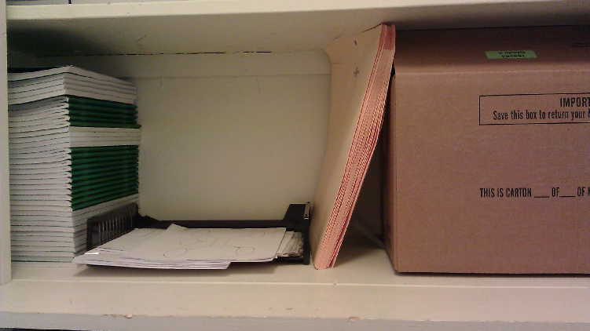
The MCAS Closet (a sample of what it might look like)
Empty box - please do not take
Approved Math
Graphic Organizer
(same for MS and HS)
Folders to put your
testing materials in

Slide 16
Questions?

