Slide 1
A District’s Perspective: Nessacus Regional Middle School
January 2020

Slide 2
Presenters
Deborah White, Principal
Nessacus Regional Middle School, Central Berkshire Regional School District
Located in Dalton, MA

Slide 3
Preparing for Computer Based Testing
Rely on Tech department to ensure computers are set up and the bandwidth is sufficient.
Have all students take practice tests (MCAS Resource Center).
Plan for staff to be available for glitches.
Students may need their test restarted or have other minor problems.
Have staff in hallways with access to restart the tests and troubleshoot other issues.
Over prepare!
Reduce stress for yourself and staff.
Ensure all staff are clear on the procedures:
Picking up materials
Locations for small groups and test administrators

Slide 4
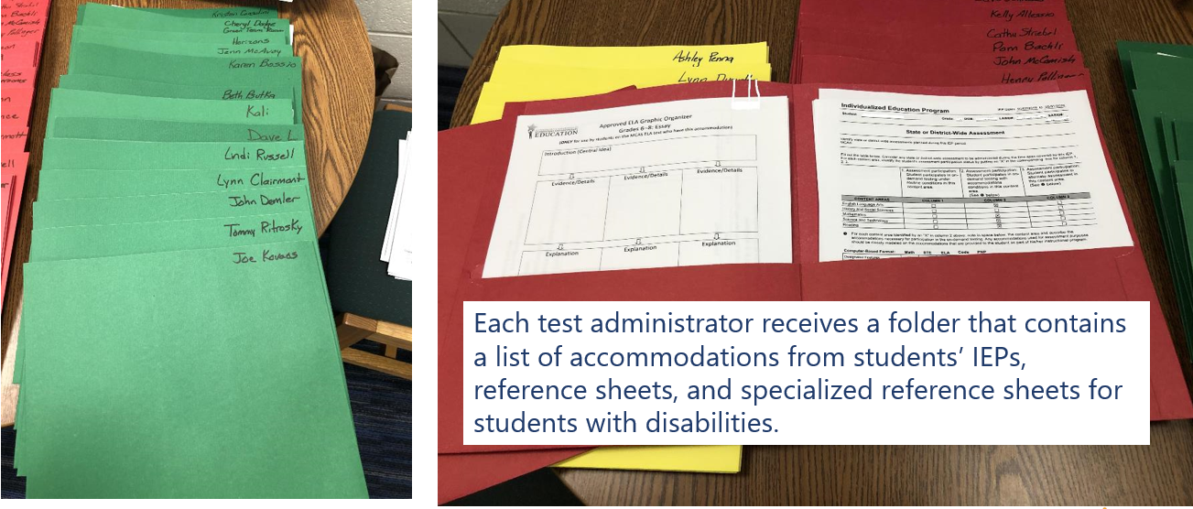
Prepare Test Administrators’ Folders

Slide 5
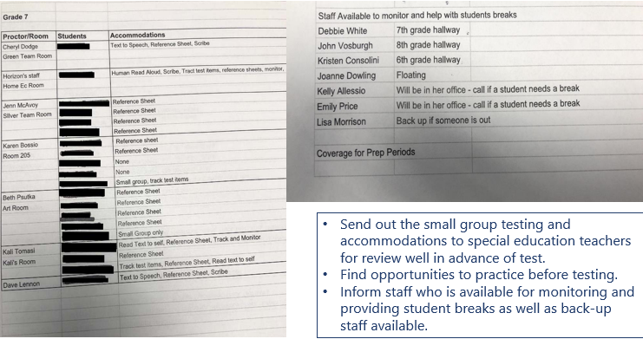
Assign Test Administrators and Staff Available to Troubleshoot

Slide 6
Lessons Learned – Steps to Take Prior to Testing
Tech preparation is key. Make sure you do an Infrastructure Trial to minimize issues.
Ensure staff are aware of who to contact for testing issues and make sure there is more than 1 person available to troubleshoot.
Put the time into preparing folders and communicating accommodations and testing groups.
Train all staff, even those you don’t think you will be using.
Having additional trained staff helps when you are short-staffed due to illness.

Slide 7
Lessons Learned – Steps to Take During Testing
Active presence of administration and/or tech staff helps staff feel supported, minimize disruptions in the hallways, and support supervision of student bathroom breaks.
Have at least 1 person actively looking at PearsonAccess Next for student progress and to minimize time to restart a test.
If staffing allows, assign a staff person as a “floater” to give teachers breaks.
Primary role of administration during the test is to keep people calm and create a secure testing environment.
It is helpful to have a space that some students can go to when they complete the test.

Slide 8
Contact Information for Nessacus Reg. Middle School
Deborah White, Principal
dwhite@cbrsd.org

