Slide 1
MCAS Test Administration
General Information and
Student Responsibilities & Expectations
Submitted by Sharon High School
Contact Principal Jose Libano at libano@sharon.k12.ma.us with questions.

Slide 2
ELA Schedule
ELA Composition (B Day)
In classrooms, 8:05 – 11:43
Library closed: 11:20 – end of day
ELA Reading Comprehension Sess. 1 and 2 (C Day)
In classrooms, 8:05 – 10:43 & 11:47 – 2:40
Library closed: 10:20 – 11:43
Sophomores & Juniors switch lunches
ELA Reading Comprehension Sess. 3 (E Day)
In classrooms, 8:05 – 10:43
Library closed: 10:20 – 11:43

Slide 3
Math Schedule
Math Session 1 (F Day)
In classrooms, 8:05 – 11:43
Library closed: 11:20 – 12:45
Math Session 2 (A Day)
In classrooms, 8:05 – 11:43
Library closed: 11:20 – 12:45

Slide 4
The Testing Space
Room assignments will be posted on the windows by the cafeteria, in the auditorium foyer, as well as next to each classroom in the 100’s. Desks will be arranged in standard rows all facing the same direction and separated.
TV’s (or projectors) will be on, as well as tuned to the correct channel, for the instructions.
The date, the appropriate question numbers for the testing session, and the name of the 1st proctor of the day will be written on the board.
All student belongings (i.e., book-bags, electronics) must be placed against a wall prior to the distribution of test and answer booklets. Desks must be clear of all items, except for pencils, calculators (when allowed), and any bottled water.

Slide 5
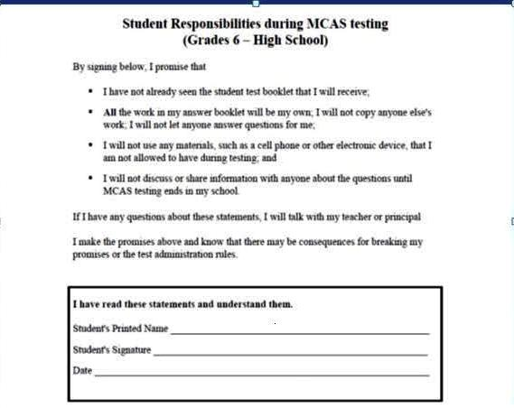
MCAS Pledge Form

Slide 6
Important Issues
Tardiness: If you are late to school and miss the start of the directions, you may not be permitted to take the test that day and may be required to complete the make-up test on another day.
Electronics: Phones, iPods, etc. should be placed in your book-bags with your other belongings and switched off. You may not use them, even if you finish early, as doing so is a violation of MCAS rules and will disqualify your test.
Finishing early: If you finish before the end of the session, you are encouraged to review your work. You may not return to a previously finished test or look ahead to an upcoming test. When ready, you may turn in your test materials in exchange for a reading book that you bring and leave on the teacher desk prior to the start of the test.

Slide 7
Important Issues (continued)
Restroom breaks: When necessary, you may use the restroom. This must be done one person at a time.
Nurse: If you need the nurse for any reason, notify your proctor. He/she will call for the nurse and she will come and see you.
Building emergencies: If there is an evacuation, give all of your testing materials to the proctor so that he/she can secure them.
Discussing the test: During the testing sessions, if you are in the hall using the restroom, getting a drink of water, or headed to the library, you may not discuss the test. Doing so would be a violation of MCAS rules and will disqualify your test.

Slide 8
Important Issues (continued)
Dictionaries: During the ELA Composition session, a dictionary may be used. There are not enough to distribute to everyone. Several will be available in each testing room, and you may use them one at a time. They will be in a designated spot in the classroom and should be returned to that designated spot as soon as reasonably possible so that others may also use them.
Calculators: These may be used during certain testing sessions. You will be reminded in advance and should bring one if you own one. If you don’t own one, we will provide you with one. You are not allowed to share calculators.
Bottled water/snacks: You may bring/drink bottled water to the test. Snacking should be done before the test, as it is disruptive to others.

Slide 9
Moving to/working in the Library
Extra time to complete the test, beyond that provided in the classrooms, is allowed until the end of the school day.
You will be brought to the library at the appropriate time. Before moving, testing materials must be turned into your proctor. MCAS rules prohibit you from transporting your testing materials, so you will be escorted to the library by a guidance counselor or administrator who will carry your testing materials.
Once you arrive in the library, find a seat quickly so that your testing materials can be distributed and you can begin working again. It should be understood that all previously communicated expectations apply.
Guidance counselors and administrators will proctor and monitor the library as you complete your tests. When comfortable that you have finished, turn in your test materials, get a pass, and return to regular classes.

Slide 10
Final notes!
It’s always important to get a good night sleep and to have a healthy dinner and breakfast. Sometimes we forget to do these things. Remembering to do so on important days can help you.
If you miss a test for any reason, there are make-up days. These occur in the days immediately following the scheduled testing days.
Each day, your cooperation and help in getting to the room and getting yourself settled/ready for the instructions and test is appreciated.
If you work into lunch, don’t worry. You may eat lunch while finishing the test. If you buy lunch, a guidance counselor or test administrator will escort you to the cafeteria to get lunch so that it can be brought back to the library.
Your teachers have prepared you well for these tests, so be confident that you’ll do awesome!
Do your best! Make yourself, your teachers, your family, and your school proud!

Slide 11
Questions? See me, a teacher, or your guidance counselor. Thanks for listening!!

