Slide 1
A District’s Perspective: Springfield Public Schools

Slide 2
Communication Plan - District Support for Schools
Lean district team – 2 people
Planning and organization are keys to success.
One collaboration platform
Communicate extensively using MS Teams all year long
Culture is to use and extensively promote one collaboration tool for all stakeholders
“One-stop shopping” for school faculty for testing schedules, timelines, resources, and DESE instructional guides
Laptop preparations
DESE/district-hosted training and drop-in sessions
PearsonAccess Next (PAN)

Slide 3
Key Points in the Communication Process
Planning and organization are key!
Plan, prepare, and communicate well in advance of deliverable due dates.
Communicate early and often using a collaboration platform (MS Teams or other).
Deliverables and timelines
Share Student Assessment Updates and summarize important points.
Importance of a documented school communication plan
Laptop preparations
School testing schedules
Accommodations – where to obtain student information (IEPs, 504s)
PAN functionality

Slide 4
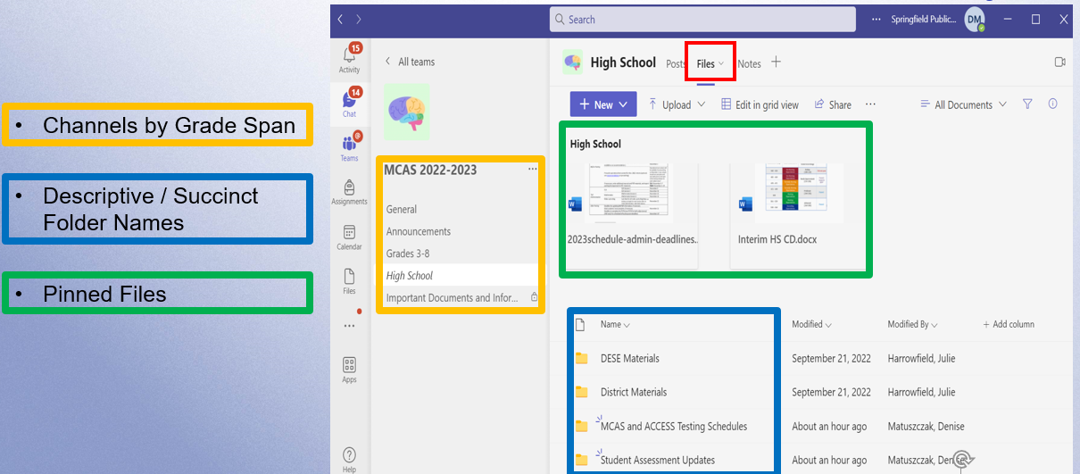
One Collaboration Platform - Teams “Files” Layout

Slide 5
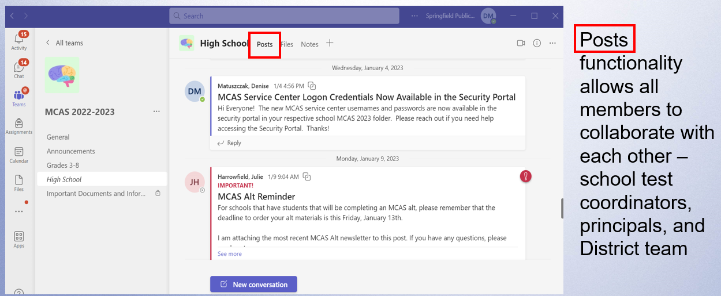
Teams “Posts” – District-Wide Collaboration

Slide 6
Laptop Preparations
District Teams
Technology Operations/Digital Learning and Assessment
Confirm that schools are using the TestNav app from the Microsoft Store.
Engage a few school test coordinators to test out functionality as a double-check.
Communicate the process for laptop preparedness to schools
Have enough devices?
Is TestNav properly installed on the student devices?
Process for maintaining loaner laptops
Laptop charging considerations

Slide 7
DESE/District-Hosted Trainings
Share information about DESE-sponsored trainings, resources, and sign-up links
District-hosted trainings/resources:
Principals’ meetings
CSOs zone meetings
Test administration and test security trainings for principals
Mandatory (for new staff) and optional drop-in sessions
District-prepared trainings and slide decks for schools
Test administration and security
SR/PNP
Accommodations
Infrastructure Trial process

Slide 8
PearsonAccess Next (PAN)
Schools:
Test coordinators set up test administrators
Upload SR/PNP and manage updates to student /staff information
Participate in district-hosted platform navigation trainings
District team:
Provides trainings for school teams
Monitors schools’ upload of SR/PNP according to established deadlines and ensures completion of tasks
Monitors sessions setup, progress during testing, and closing after testing according to established deadlines
Live “demos” during district-hosted trainings

Slide 9
Springfield Public Schools Contact Information
For any questions or more information
Denise Matuszczak – Senior Administrator of Digital Learning and Assessment matuszczakd@springfieldpublicschools.com

