Slide 1
The future of education
The opportunity for all students to fulfill their potential
Michael B. Horn | Twitter: @michaelbhorn

Slide 2
Schools were not built for learning

Slide 3
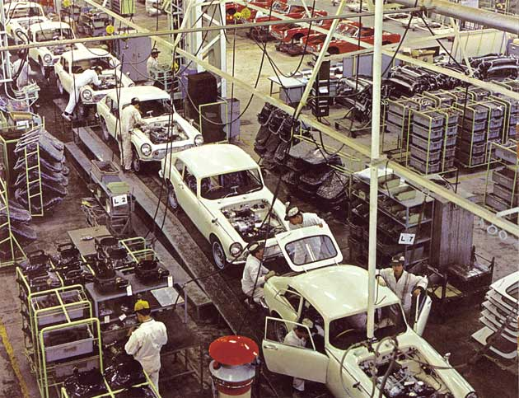
Learning environments modeled upon factories
Current system was built to standardize

Slide 4
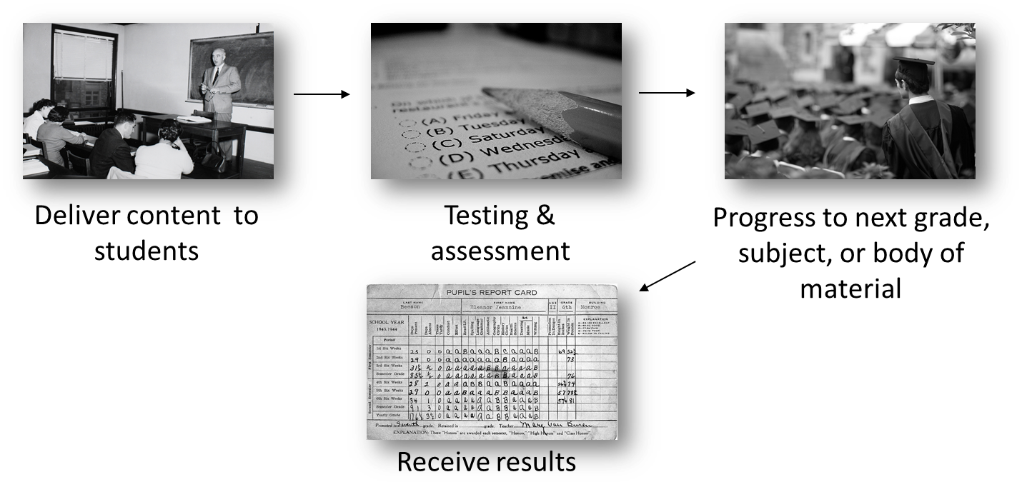
Fixed-time, variable learning

Slide 5
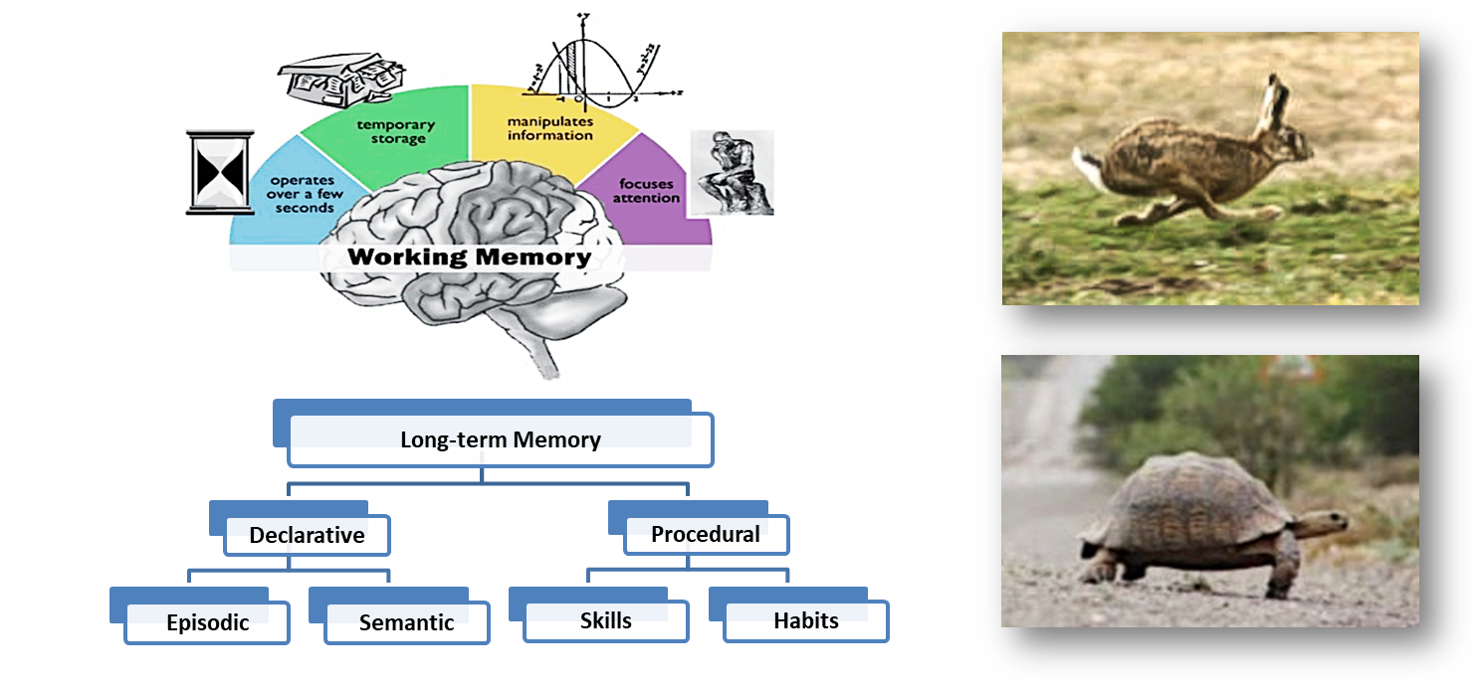
Different learning needs at different times

Slide 6

The power of a tutor
Prohibitively expensive for every student

Slide 7

The “Swiss-cheese problem” in education
Students develop holes in their learning

Slide 8

Despite all this, the system was successful…
But that’s now changing as we move from….

Slide 9
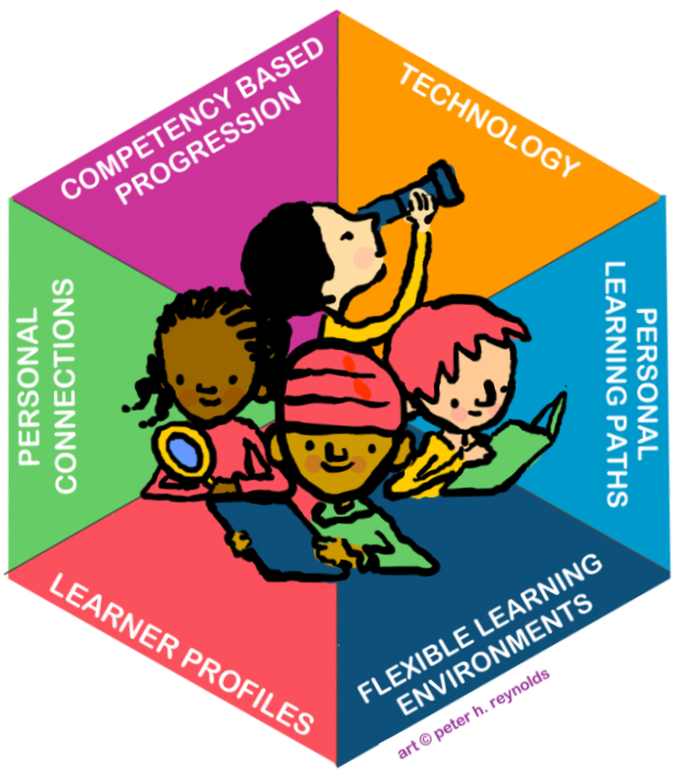
Personalized learning in Massachusetts
Personalized learning seeks to accelerate student learning by tailoring the instructional environment – what, when, how and where students learn – to address the individual needs, skills and interests of each student.
Within a framework of established curriculum standards and high expectations, personalized learning motivates students to reach their goals. Students take ownership of their own learning and develop deep, personal connections with each other, their teachers and other adults.
Technology is necessary to implement personalized learning effectively, affordably, and at significant scale. Teachers leverage technology to gain detailed and timely knowledge of their students that guides instruction. Effective use of technology allows teachers and students to focus more on creativity, critical thinking, and collaboration.

Slide 10
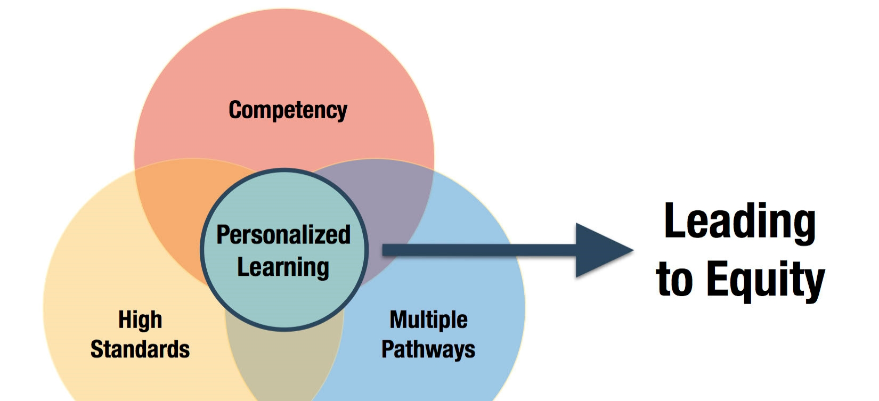
The Massachusetts opportunity
Rigorous standards, personalization, mastery equals better learning for all students

Slide 11
An historic opportunity to innovate

Slide 12
Disruptive innovation

Slide 13
Personalized learning in Massachusetts
Personalized learning seeks to accelerate student learning by tailoring the instructional environment – what, when, how and where students learn – to address the individual needs, skills and interests of each student.
Within a framework of established curriculum standards and high expectations, personalized learning motivates students to reach their goals. Students take ownership of their own learning and develop deep, personal connections with each other, their teachers and other adults.
Technology is necessary to implement personalized learning effectively, affordably, and at significant scale. Teachers leverage technology to gain detailed and timely knowledge of their students that guides instruction. Effective use of technology allows teachers and students to focus more on creativity, critical thinking, and collaboration.

Slide 14
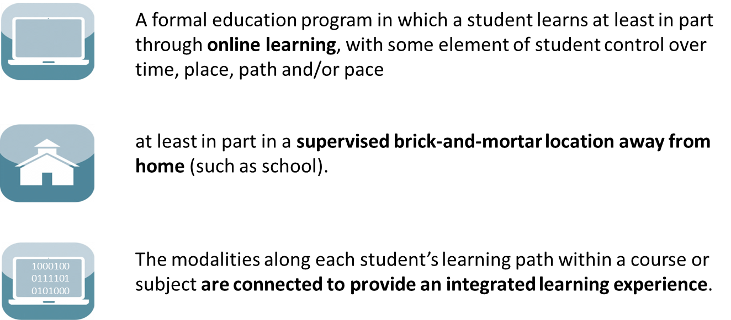
The rise of K–12 blended learning
Definition of blended learning

Slide 15
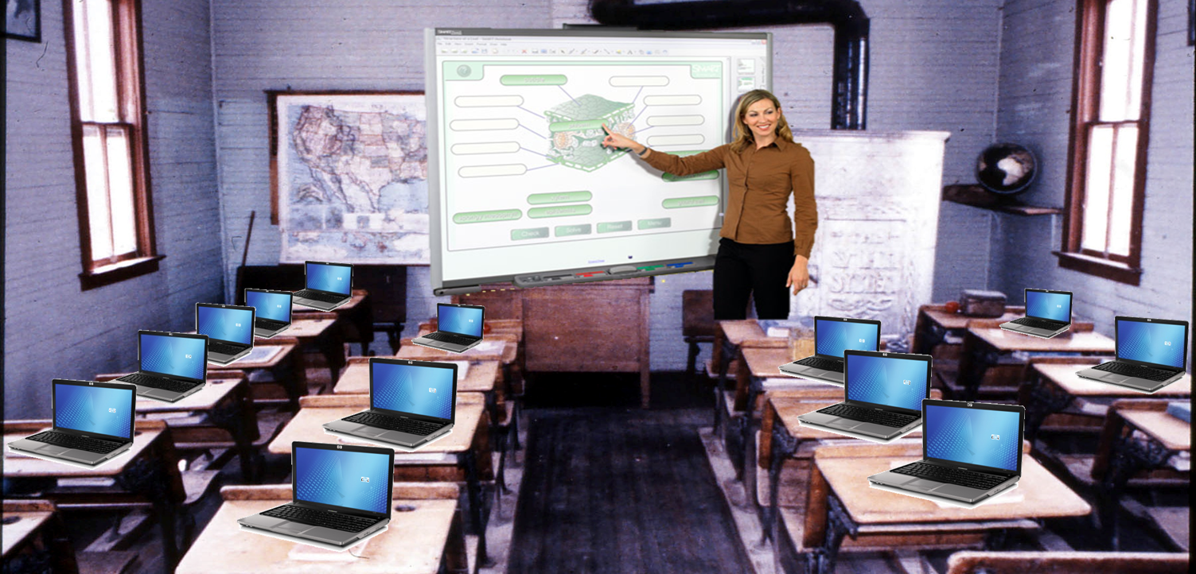
Blended learning is not…

Slide 16
Why blend?
To personalize at scale

Slide 17
Personalized learning isn’t a “thing” or the goal

Slide 18
Different learning needs at different times

Slide 19
We can personalize along many dimensions
We need to observe, document, measure to create “standards”
Time, place, path, pace
Student choice over how to learn, choice over what to learn
Student voice
Learner connected, learner focused, learner demonstrated, learner led
Social-emotional learning, cognitive domain, executive function, student background

Slide 20
Personalized learning in Massachusetts
Personalized learning seeks to accelerate student learning by tailoring the instructional environment – what, when, how and where students learn – to address the individual needs, skills and interests of each student.
Within a framework of established curriculum standards and high expectations, personalized learning motivates students to reach their goals. Students take ownership of their own learning and develop deep, personal connections with each other, their teachers and other adults.
Technology is necessary to implement personalized learning effectively, affordably, and at significant scale. Teachers leverage technology to gain detailed and timely knowledge of their students that guides instruction. Effective use of technology allows teachers and students to focus more on creativity, critical thinking, and collaboration.

Slide 21
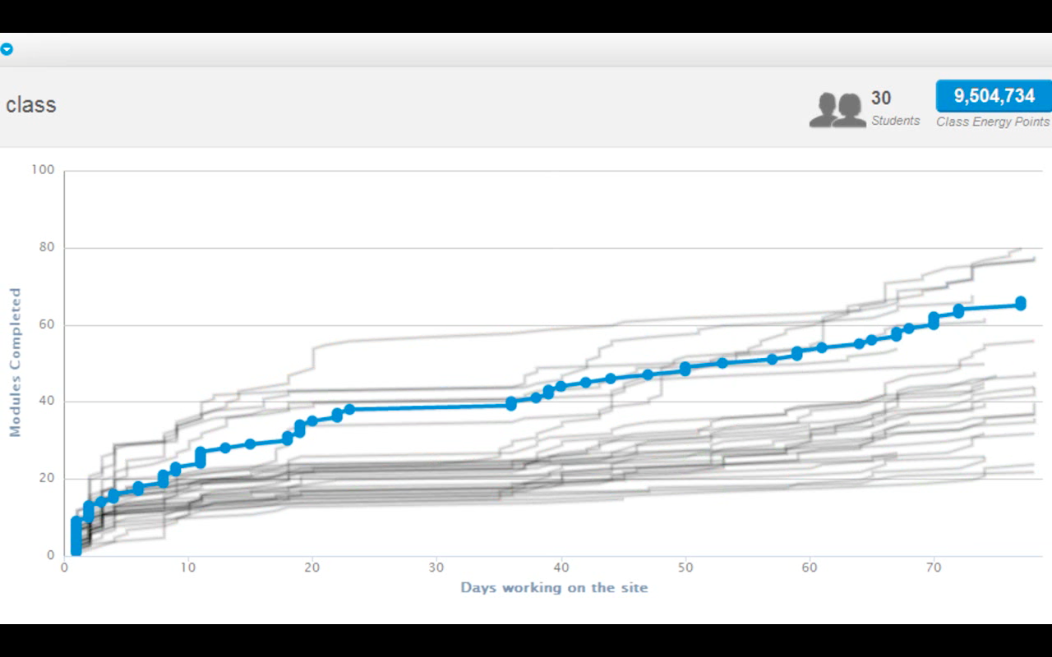
Benefits of online and blended learning
Personalization through modularity

Slide 22
Research base for personalization
Individualized instruction shows effect sizes ranging from 0.65 to 2.0 standard deviation units (SDUs)
  Bloom, B. S. (1984). The 2 sigma problem: The search for methods of group instruction as effective as one-to-one tutoring. Educational Researcher, 13(6), 4–16
  Hattie, J. (2003, October). Teachers make a difference: what is the research evidence? Paper presented at the annual meeting of Australian Council for Educational Research, Melbourne, Australia
  More recent meta-analysis suggests average effect size is around 0.79
Machine-based tutoring shows effect sizes of 0.35 to 0.75 SDUs
  VanLehn, K (2011, October). The relative effectiveness of human tutoring, intelligent tutoring systems, and other tutoring systems. Educational Psychologist (197-221)

Slide 23
Why blend?
Competency-based learning
at scale

Slide 24
Fixed-time, variable learning

Slide 25
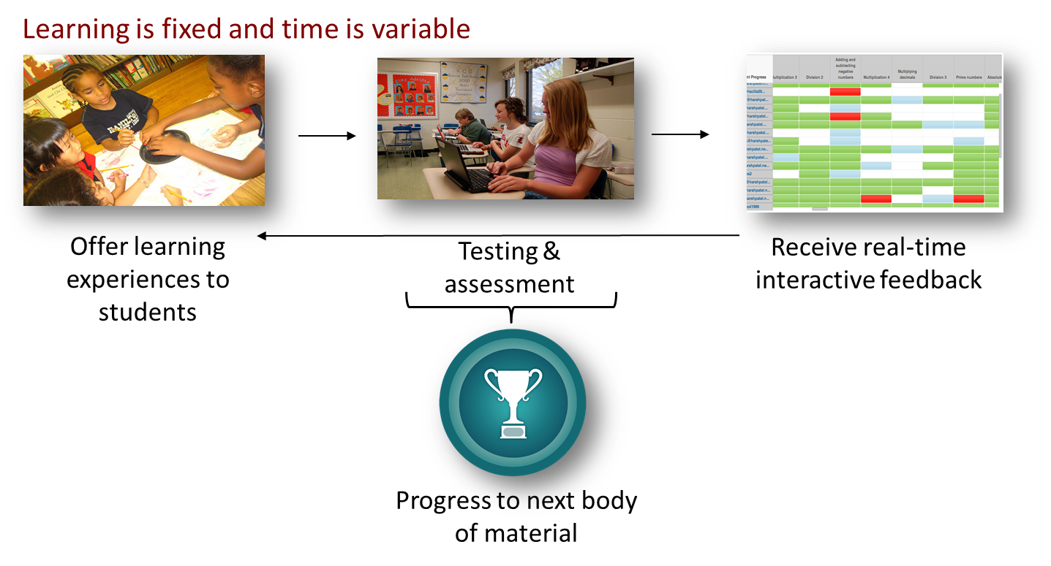
Competency-based learning

Slide 26
The future of assessments
Systems of assessments
Smaller
Frequent
Both FOR and OF learning

Slide 27

A case study

Slide 28
Outcomes
Grit
Perseverance
Student agency
In short, lifelong learners fit for today’s society…
and tomorrow’s

Slide 29
Personalized learning in Massachusetts
Personalized learning seeks to accelerate student learning by tailoring the instructional environment – what, when, how and where students learn – to address the individual needs, skills and interests of each student.
Within a framework of established curriculum standards and high expectations, personalized learning motivates students to reach their goals. Students take ownership of their own learning and develop deep, personal connections with each other, their teachers and other adults.
Technology is necessary to implement personalized learning effectively, affordably, and at significant scale. Teachers leverage technology to gain detailed and timely knowledge of their students that guides instruction. Effective use of technology allows teachers and students to focus more on creativity, critical thinking, and collaboration.

Slide 30
Research base for mastery learning
Frequent assessment and feedback shows effect sizes ranging from 0.41 to 1.13 SDUs
  Hattie, J. (2003, October). Teachers make a difference: what is the research evidence? Paper presented at the annual meeting of Australian Council for Educational Research, Melbourne, Australia
  Marzano, R. J., Pickering, D., & Pollock, J. E. (2001). Classroom instruction that works: Research-based strategies for increasing student achievement. Alexandria, VA: Association for Supervision and Curriculum Development
Active learning and mastery learning shows effect sizes of 0.5 to 0.61 SDUs
  Hattie, J. (2003, October). Teachers make a difference: what is the research evidence? Paper presented at the annual meeting of Australian Council for Educational Research, Melbourne, Australia
  Marzano, R. J., Pickering, D., & Pollock, J. E. (2001). Classroom instruction that works: Researchbased strategies for increasing student achievement. Alexandria, VA: Association for Supervision and Curriculum Development

Slide 31
The Massachusetts opportunity
Rigorous standards, personalization, mastery equals better learning for all students

Slide 32
The future of education

