Slide 1
E-rate 2.0 Funding to Support High Speed Internet & Wi-Fi
date 2015
Presented by: Name
Last revised 11/11/2015
Notes:
This presentation is designed to explain changes in E-rate funding. It also encourages superintendents to implement a robust broadband and Wi-Fi infrastructure significantly paid for by E-rate funds to support digital learning and college and career readiness.
During this presentation, we are going to show you how to quickly determine much funding your district will be eligible for category 2 funding.
Presenter – ask the audience to:
think about their experiences with E-rate in the past.
Write down two things: 1) do you think your district can get any funding and 2) how much funding do you think you can get.

Slide 2
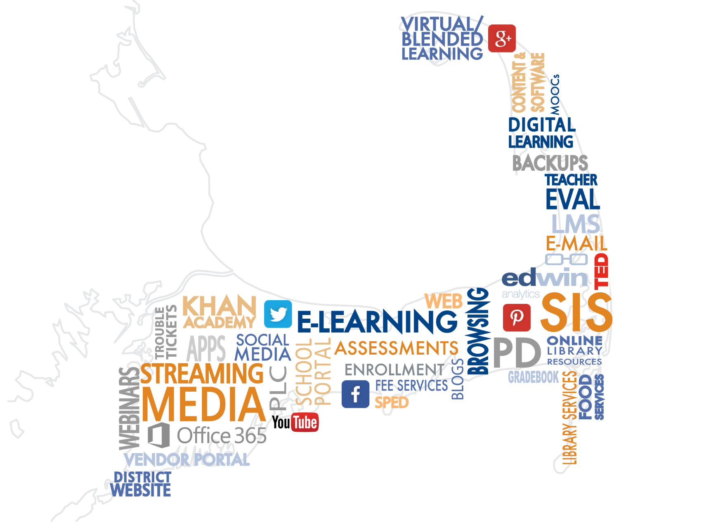
Desirable Destinations
More and more educational resources in the cloud.
Pedagogical shifts in teaching, learning, & PD.
How well is your district reaching the cloud?
What’s driving your technology purchasing decisions?
Notes:
We can all relate to driving to the Cape in the summer. The destinations, the traffic…..Just getting there! You think about the Cape as a destination with all its interesting sites. (Beaches, hotels, restaurants, golf courses, water sports, sailing, fishing, museums, funky towns……) In fact, many of you were there in July at M.A.S.S.
Let’s imagine the Cape as the cloud and all the destinations as content and resources in that cloud that education stakeholders need to reach. Here are just a few examples of resources that are or soon will be in the cloud, rather than residing on a server.
Many of these “destinations” are bandwidth-hungry media like streaming video.
Cloud-based resources save teachers and tech specialists enormous amounts of time because they are continually updated and require no maintenance.
And many of these programs are now filling essential functions in the classroom. In fact, technological advances are driving how instruction is delivered. For example, the Horizon report cites adoption of an increased use of Hybrid/blended learning designs and Makerspaces within one year or less and 3D Printing and Adaptive Learning Technologies 2 to 3 years away.

Slide 3
More Devices
Students may have devices, but how many of them will be able to reach their destinations on time?
Notes:
Some of the reasons driving purchasing decisions is that today schools need more than just 4 desktops in the back of the classroom. Each student needs a device participate in class, at least part of the day.
Between devices purchased by districts and devices brought from home, many believe each student will have at least one device in the coming years, if not now. According to the 2015 K-12 Horizon Report, time-to-adoption for BYOD is one year or less.
The number of devices with high speed access to the internet from all devices in a school (classrooms, library media center, offices, cafeteria, nurse, gym, auditorium, etc.) is rapidly becoming a necessity in order to meet educational goals.
If the number of devices will be increasing, will your Internet and Wi-Fi networks be able to keep up?

Slide 4
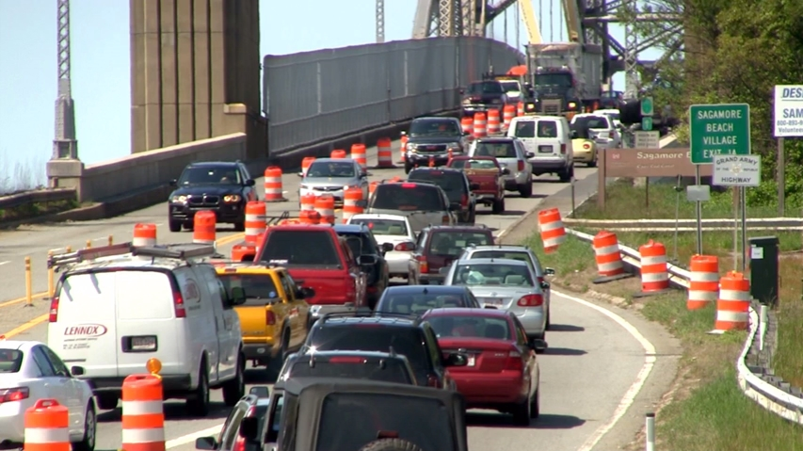
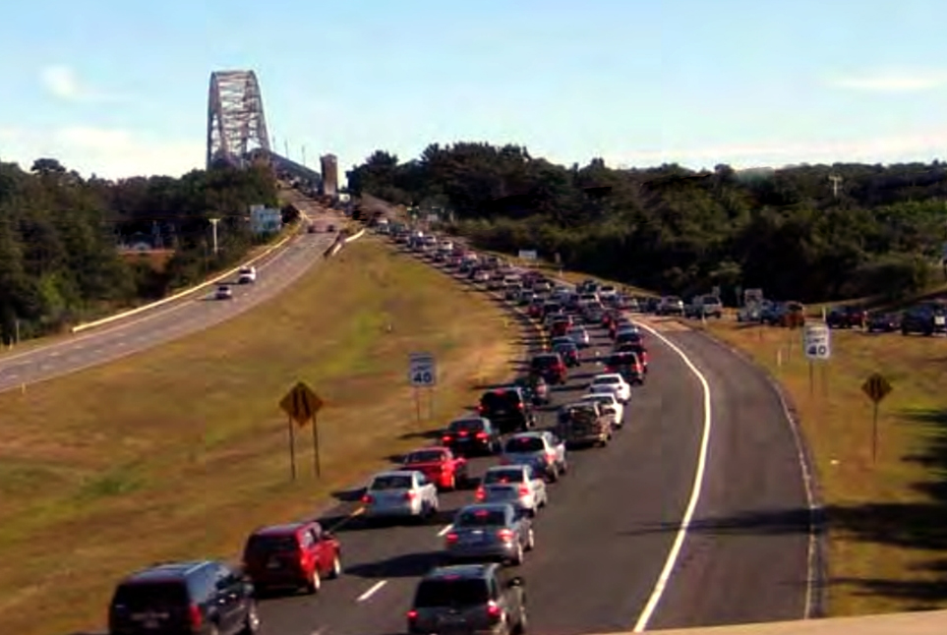
Are we there yet?
Notes:
Or will your education stakeholders get stuck in traffic trying to reach their destinations

Slide 5
Resources and tools are only as good as the network they run on
More devices and content requires more bandwidth & Wi-Fi.
Is your district ready?
Where will you get the money?
Notes:
So when you add more devices and more content, you end up with a need for more bandwidth and more Wi-Fi.
Without high speed internet, the hardware is useless and essential resources that reside in the cloud can’t be accessed.
Slow internet speeds in the classroom can lead to a cycle of frustration, making it less likely for teachers to try to use technology as their efforts don’t work and students turn off because the technology they use outside of school may be faster and more up-to-date.
So what’s your district doing to get ready? Where will you get the money meet the bandwidth and Wi-Fi needs in the classrooms?

Slide 6
Notes:
Speaking of funding, how about a bake sale? Maybe not!
Or maybe there’s another way…..

Slide 7
E-Rate 2.0
2014 FCC Modernization Order: new game, new rules, more funding for all schools.
Focused on Wi-Fi and broadband services for ALL school districts.
60% increase in funding to $3.9 billion annually.
All schools receive a budget of $150 per student for next 4 years.
Funding depends on the district discount. But you must apply to receive funds!
Notes:
Introducing E-rate 2.0. In 2014, based on strong advocacy from Senators Markey and Rockefeller (both were instrumental in creating the program in 1996) and organizations such as SETDA, CoSN, ISTE, ALA, the FCC issued its first two modernization orders since the legislation was passed in 1996. “FCC issued the first E-rate Modernization Order on July 11, 2014 & the Second E-rate Modernization Order on December 11, 2014 .”
E-Rate is a federal program administered by Federal Communications Commission to provide funding for Internet and some internal infrastructure services for all eligible schools and public libraries. E-Rate is NOT an entitlement program. You receive discounts on actual expenditures based on a funding formula that includes Free and Reduced Lunch discounts and urban or rural status-- but only if you apply.
In the past, only the poorest schools received funding for internal infrastructure such as Wi-Fi; for the last 2 years, no schools in MA received funding. The FCC is now committed to make sure all schools can have broadband and Wi-Fi.
E-Rate 2.0 provides massive funding to give all schools a budget of $150 per student over a 5 year period (there are now 4 years remaining), to improve Internet access and Wi-Fi.
NOTE: If you already have Wi-Fi, this funding is available at any time during the five years to upgrade or to add more stations, for example beyond the library and cafeteria to every classroom.
The Federal Communications Commission (FCC) adopted the E-rate Modernization Order on July 11, 2014 (https://www.fcc.gov/document/fcc-releases-e-rate-modernization-order) and the Second E-rate Modernization Order on December 11, 2014 (https://www.fcc.gov/document/fcc-continues-e-rate-reboot-meet-nations-digital-learning-needs). This is a summary of the Order adopted in July, which has been updated to account for changes made in the Second Order.
For a summary of the Second E-rate Modernization Order, please go to https://www.fcc.gov/page/summary-second-e-rate-modernization-order

Slide 8
How Much Category 2 Funding Can a District Get?
If a School has 500 students, its budget would be $75K ($150x500).
A district with a 40% discount would receive $30K for Category 2 WiFi.
Blackstone Millville Regional School District, a rural district with 1,775 students and 50% discount, has applied for ALL of its funding – $133,135.
Fitchburg Public Schools, an urban district with 5,041 students and 85% discount, has applied for almost all of its Category 2 funding.
Wayland Public Schools, a suburban district with 2,659 students and 40% discount has begun to apply for its funding.
Districts in MA are eligible to receive 40-85% in funding.
Notes:
Formula: $150 per student over 5 years (4 remaining) As example, in a school with 500 students at $150 each, a total budget would be $75,000. With the district’s 40% discount, they would receive $30,000 towards WiFi.
We are going to highlight a few examples of the 110 out of 404 districts in Massachusetts that have already applied for Category 2 funding.
The first district is Blackstone-Millville Regional School District, a rural district of 1,775 students with a 50% discount. The district has 3 elementary schools, one Middle School and one High School.
Superintendent Allen Himmelberger has made technology one of his highest priorities.
Last December, he hired a new network administrator who was very knowledgeable about the E-rate program, especially the new rules for Category 2 funding.
This person immediately assessed the district’s need for increased WiFi to each classroom and increased bandwidth to the district.
In just 2.5 months, he started a new job and performed all of the time consuming activities of preparing an E-rate application and applied for ALL of the district’s funding in year 1 to upgrade WiFi throughout all the schools and increase bandwidth to 400 Mbps, well above the minimum recommended Internet speed for a district of its size!
Urban placeholder
40% district example – perhaps a district represented by someone at the meeting
So is it worth it for your district to apply? Only one school district in Massachusetts is at the 20% level. All the other districts are eligible to receive at least 40% in funding for Category 2, with many above that number.
At the end of this slide ask the audience if they are ready to see how to quickly determine much funding your district will be eligible for category 2 funding.

Slide 9
The New Category 2 Funding Estimator!
This Category 2 Funding Estimator tool was developed by TECedge in partnership with the MA Department of Elementary and Secondary Education for Massachusetts districts.
Category 2 Funding Estimator
Notes:
Walk through the calculator.
E-rate can provide significant funding, but a lot of this federal money is left on the table because the application process can be complicated. To help you decide to pursue funding, you can will soon be able to use calculator.
You can select your district and can automatically determine your Category 2 budget.
I urge you all to work with your school committee and municipal officials to identify funds that will enable you to take advantage of the dramatic changes in E-rate.
School/municipal budget discussions should begin no later than the fall in order to complete the process of filing an application for funding in March.
Reimbursements for WiFi and Broadband expenses should be reserved to pay for educational technology initiatives: devices, professional development, and assistive technology (for students with disabilities).
Ensuring that reimbursed funds for WiFi and Broadband go to schools may require discussions with municipal officials.
NOTE: These tools will not run on mobile devices.

Slide 10
“For most MA districts, this will be the first time they can get E-rate funds for Wi-Fi network infrastructure. It’s like a sale on Wi-Fi ranging from 40% to 85% off.”
-Stephen Kelley, TECedge
Notes:
Almost all districts will receive 40% or more.
For almost every district in the state, the E-rate application process will yield significant funding.

Slide 11
Getting Local Funding
Work with your school committee and municipal officials to identify local share of funds.
Start in the fall in order to complete the process of filing an application for funding in March.
Negotiate with town/city to use reimbursements for school technology.
Notes:
Work with your school committee and town hall to identify matching funds that will enable you to take advantage of the dramatic changes in E-rate.
School/municipal budget discussions should begin no later than the fall in order to complete the process of filing an application for funding in March.
Reimbursements for Wi-Fi and Broadband expenses should be reserved to pay for educational technology initiatives: devices, professional development, and assistive technology (for students with disabilities).

Slide 12
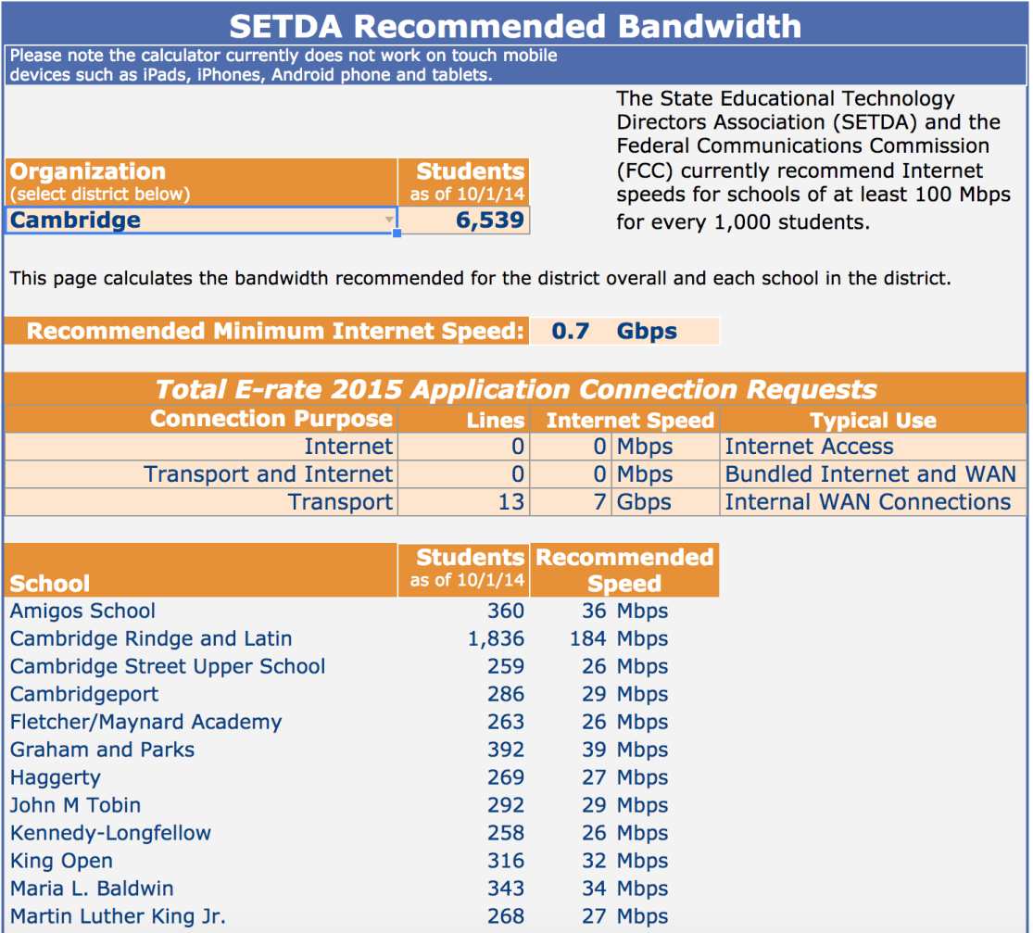
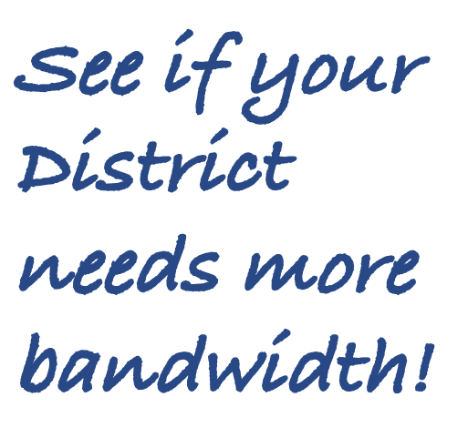
The New Recommended Bandwidth Tool!
This Recommended Bandwidth Tool was developed by TECedge in partnership with the MA Department of Elementary and Secondary Education for Massachusetts districts.
Recommended Bandwidth Tool
Notes:
How fast does your internet connection have to be to provide good response to all users?
This tool provides a guide to determining your needed speed. It recommends bandwidth based on the number of students in a building.
The recommendations come from the State Education Technology Directors Association (SETDA) and have been adopted by the Federal Communications Commission in E-rate 2.0.
Walk through the calculator.
NOTE: These tools will not run on mobile devices.

Slide 13
Benefits of E-rate 2.0 Funding
Faster Wi-Fi and Internet for ALL classrooms.
Opportunity to rethink delivery of teaching, learning, and professional development.
Leverage technology for communication and collaboration.
Makes cloud applications and websites faster.
Strengthens 1 to 1 and/or bring-your-own-device (BYOD) initiatives.
Notes:
Let’s look at the specifics of what E-rate funding can help you provide for your district.
High speed internet and Wi-Fi lay the foundation upon that so many instructional initiatives depend, and E-rate can help you pay for them.
Work with your school committee and town hall to identify matching funds that will enable you to take advantage of the dramatic changes in E-rate.

Slide 14
Changes in Subsidies
E-Rate 2.0 funding supports a major focus on FCC priorities: increasing Broadband and Wi-Fi to increase internet speed.
To fund these efforts, the FCC is eliminating subsidies for phones, cell phones, web hosting, email, and voicemail.
Biggest fiscal impact is phase out of phone/cell phone subsidies.
Potentially a large impact on budgets.
Notes:
With E-Rate 2.0, the FCC set increasing bandwidth to schools and placing Wi-Fi in all schools as a major priority.
The FCC is eliminating or phasing out E-rate funding for services that do not support their new priorities (e.g., phone, cell phone, web hosting, email, voicemail, etc.), thus freeing up funding for their priorities. Many Massachusetts districts had relied on these funds and will now have to find ways to make up the shortfall.
Changes:
Phone / Centrex / VoIP and cell phone subsidy phased out 20% a year.
For 2016-2017, 40% discount districts will receive no voice discounts.
Challenges:
Many districts’ voice costs exceed data costs.
Potentially Large Budget Impact.

Slide 15
Mitigating Loss of Phone Subsidies
Explore alternative technologies such as Voice over IP (VoIP), which is often less expensive than traditional phone service.
Proactively examine phone and cell phone contracts, reducing quantities if possible.
Conduct “mini bid” for land line and cell phones under state contract ITT46, using price as the primary award factor.
Notes:
There are ways to mitigate some of what E-rate no longer covers.
Note that E-rate does NOT fund VoIP
Since none of these services are covered by E-rate, all the more reason to apply for E-Rate

Slide 16
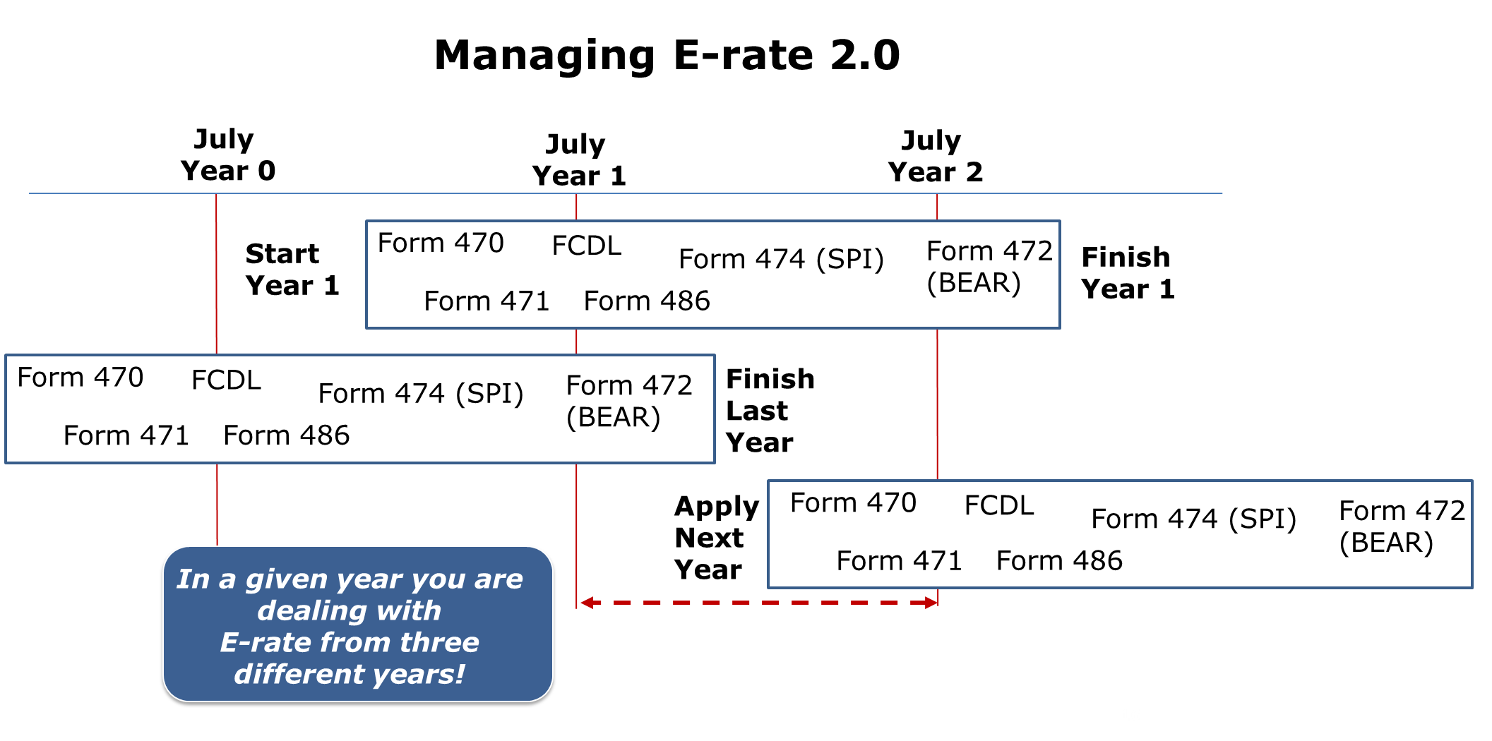
Notes:
This graphic illustrates the timeline for major E-rate events.
Since one E-rate year takes almost 2 years to prepare and complete, districts are dealing with three applications during any one fiscal year. Make this a build
I’m going to walk you through a typical scenario that the person filing for E-rate will have to do for this school year.

Slide 17
Don’t Miss Out!
So far, 110 out of 404 MA districts applied for Category 2 funding!
Identify E-rate support:
Use internal staff.
Hire a consultant.
Determine how best to reap the rewards of this critical program.
Notes:
E-rate preparation is analogous to tax preparation, time-consuming and extremely detail-oriented.
Typical activities in preparing E-rate application and
E-rate funding strategy
Wi-Fi & broadband design
Procurement
RFP Specs & evaluation
Forms preparation
Deadline compliance
Funds tracking
Work with SLD
Preparing reimbursement claims or working with vendors to receive reimbursements on bills
Appeal, if needed
Audit support

Slide 18
Further Information
Filing Deadline: March 2016 tbd by FCC (for 2016-2017 projects)
USAC Website (USAC Search Tools)
ESE E-rate Site
ESE E-rate Video
For more information: odl@doe.mass.edu

