Slide 1
Using Data to Plan
High Quality Professional Development
Findings From Interviews With Massachusetts Educators
May 2015
Notes:
Massachusetts Department of Elementary and Secondary Education
1

Slide 2
Background
The purpose of this set of three presentations to is to convey key findings from a study conducted by the American Institutes for Research and the Concord Evaluation Group on behalf of the Massachusetts Department of Elementary and Secondary Education.
These presentations are one component of a larger project to help Massachusetts educators envision what it takes to ensure that all educators have access to high quality professional development (HQPD).
The focus of this presentation is on how educators in four nominated sites in Massachusetts use data to plan HQPD.

Slide 3
About This Project
What is it?
Case profiles of four sites engaged in building systems to support HQPD. The case profiles are based on interviews and collected documents.
What are the goals of the project?
To highlight for professional learning leaders across the Commonwealth how some Massachusetts educators are working to establish HQPD in their schools and districts.
Please see ESE’s Resources for PD Leaders and Educators page for relevant PD resources, including the full case studies.
Which sites participated?
Cambridge Public Schools
Easthampton High School of Easthampton Public Schools
Lexington Public Schools
Melrose Public Schools

Slide 4
About the Project
How were sites selected?
Teacher and Principal Advisory Cabinet members nominated districts or schools that were making consistent use of the Massachusetts Standards for Professional Development to inform professional learning by doing things such as:
Building internal staff capacity to facilitate high quality, results-oriented professional development in creative ways
Doing an exceptional job coordinating/managing professional development and creating the conditions for educators to engage in deep learning, and/or
Thoughtfully using educator evaluation data to inform planning and delivery of professional development
ESE, in collaboration with AIR, selected four sites from among the many nominated based on the comprehensiveness of their approach.
What were the key themes observed across the sites?
Seven key themes were identified as important levers in ensuring HQPD;
they are listed on the next slide.

Slide 5
Seven Key Levers the Profiled Sites Used for Establishing HQPD
Instilling a “growth mindset” among educators
Collaborating for change using data
Making time for learning
Embedding professional learning in educators’ daily work
Empowering teachers to choose their own path toward growth
Using data (including goals, evidence, and standards) to plan HQPD
Using data to assess HQPD

Slide 6
About This Presentation
Some useful definitions (slides 7–14)
How the profiled sites used data to plan HQPD (Lever 6) (Slides 15–26)
Please see ESE’s Resources for PD Leaders and Educators page for relevant PD resources, including the full case studies.

Slide 7
What Is HQPD?
High Quality Professional Development (HQPD) is a set of coherent learning experiences that is systematic, purposeful, and structured over a sustained period of time with the goal of improving educator practice and student outcomes.
Source: http://www.doe.mass.edu/pd/standards.html

Slide 8
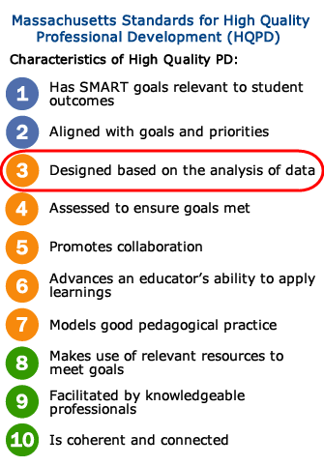
What Are the Massachusetts HQPD Standards?
Released in 2013, the Massachusetts Standards for Professional Development describe the research-based features of HQPD.
For more information visit: http://www.doe.mass.edu/pd/standards.html

Slide 9
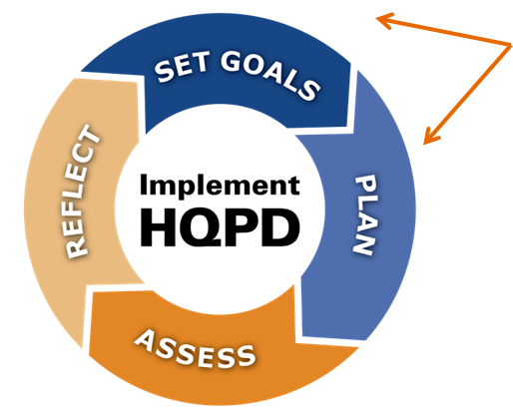
What Is HQPD Planning?
This slide deck focuses on two aspects of building an HQPD system:
Set goals:
Identifying areas of strength and challenge
Setting goals for student & educator learning
Plan:
Designing and selecting offerings and formats
Differentiating HQPD according to goals
The HQPD Planning & Assessment Process

Slide 10
What HQPD Formats Are Used in the Profiled Sites?
Courses
Internally and externally led workshops and summer institutes
Multi-year induction programs
Professional Learning Communities
Action research
Lesson study
Coaching
* Some sites use some formats more than others depending on HQPD goals.

Slide 11
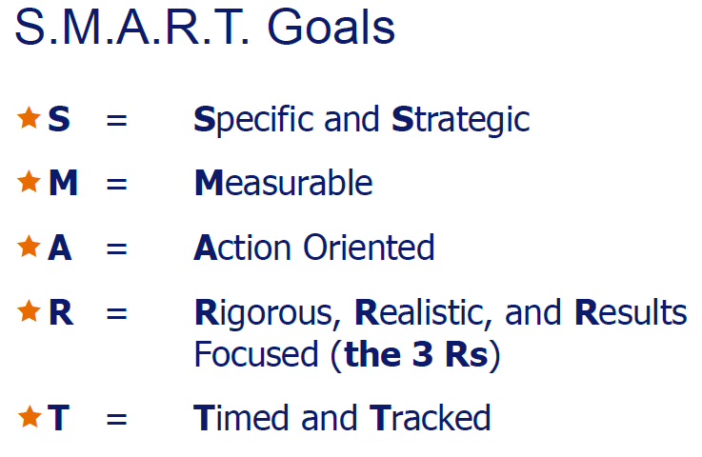
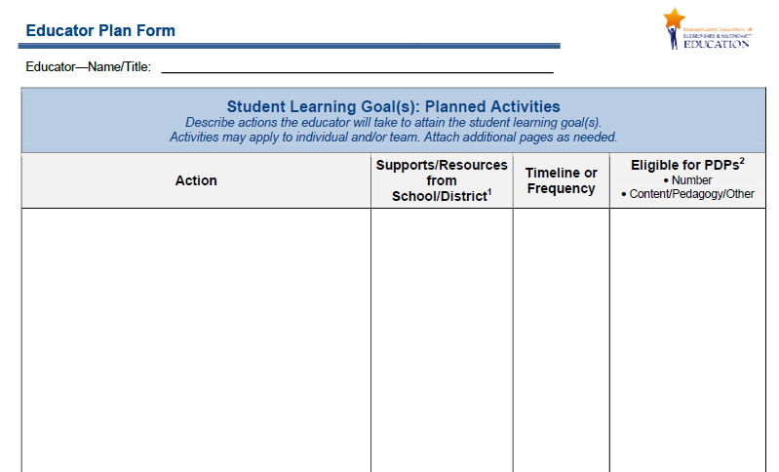
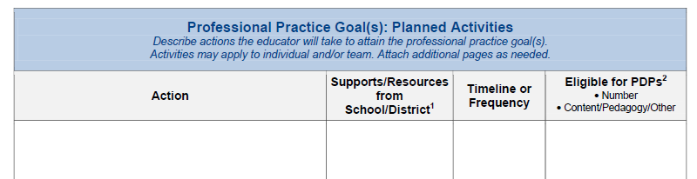
What Are Educator Plans?
Part of the 5-Step Cycle of evaluation, each educator develops an Educator Plan, which is differentiated based on experience and past performance, and includes individual or team S.M.A.R.T. goals for professional practice and student learning as well as key action steps for achieving the goals.

Slide 12
What Are Summative Performance Ratings?
The Summative Performance Rating is the final step of the 5-Step Cycle of educator evaluation.
Upon consideration of an educator’s evidence of practice and progress toward goals, evaluators apply professional judgment and assign one of four possible overall ratings to each educator:
  Exemplary
  Proficient
  Needs Improvement
  Unsatisfactory
Educators also are assigned a rating for each of the four standards of effective practice for teaching or administrative leadership.
For more information see the Quick Reference Guide on Performance Ratings.

Slide 13
What Are Learning Walkthroughs (or Learning Walks)?
Learning Walkthroughs are a systematic and coordinated method of gathering data on student learning and instructional practice to inform district and school-level decisions.
During the walkthroughs, a team of teachers and administrators visits a sample of classrooms for periods of 20 minutes each.
Observations are recorded on a protocol designed to capture a variety of teacher and student behaviors related to specific learning goals.
At the end of the walkthrough day, the team meets to debrief about their observations and discuss what they learned.
The Learning Walkthroughs enable the leadership team to gather critical data about classroom practice to identify HQPD needs at the school.

Slide 14
What Are Two Other Sources of Data Used in Planning HQPD?
TELL MASS Survey: A statewide survey of school-based educators to determine if they have the supports necessary for effective teaching. The online survey was a source of information used in HQPD planning in several sites.
Conditions for School Effectiveness Self-Assessment: This tool is designed to be used at the school level by leaders, those responsible for day-to-day instruction, and key stakeholders. It is a tool for conducting a scan of current practice, identifying areas of strength, and highlighting areas requiring greater focus. the tool delineates the level of development of each condition along a continuum: 1 (Little Evidence), 2 (Developing), 3 (Providing), and 4 (Sustaining)

Slide 15
How Do the Profiled Sites Use Data to Plan HQPD (Lever 6)?
Key Cross-Site Observations

Slide 16
Using Data for Planning HQPD: Key Observations
Site leaders use multiple and varied sources of data, evidence, and standards to set goals and plan HQPD.
Site leaders work to align HQPD goals with Educator Plan goals (i.e., professional practice and student learning S.M.A.R.T. goals), which often map to school goals, which map to district goals.
District, school, educator, and HQPD goals are informed by the careful review of student learning data from multiple sources.
Once goals are articulated, PD leaders and PD Committees work to design or select HQPD.

Slide 17
Using Data for Planning HQPD: Key Observations
Educator feedback (from formal surveys as well as anecdotal input) informs HQPD planning decisions.
Evaluators bring the patterns they see in teachers’ performance ratings from educator evaluation to site leaders to inform HQPD goal setting and planning.
Site leaders see the HQPD Standards as a tool for HQPD planning & assessment.
Each of these key observations are described more fully in the slides that follow.

Slide 18
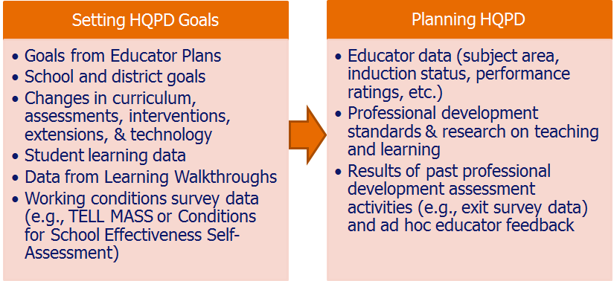
1. Site leaders use multiple and various sources of data, evidence, and standards to set goals and plan HQPD
The lists below contain the sources of information that have been used to inform each planning activity:

Slide 19
2. Site leaders work to align HQPD goals with educator goals, which often map to school goals, which map to district goals
District leaders collaborate with school leaders, teachers, the School Committee, and other stakeholders to set or refine district strategic goals.
HQPD goals for individuals and teams.
Principals, in collaboration with other administrators and teachers, set schoolwide goals, which map to the district goals.
Individual educators set their own Educator Plan goals, which often map to the district and school goals for student learning.

Slide 20
3. District, school, educator, and HQPD goals are informed by the careful review of student learning data from multiple sources:
Statewide and national assessments
  Massachusetts Comprehensive Assessment System (MCAS) data
  Preliminary SAT/National Merit Scholarship Qualifying Test (PSAT/NMSQT) data
  SAT data
  Advanced Placement (AP) data (participation rates and scores)
District benchmark assessments
Reviews of student work (e.g., end-of-unit assessments, writing samples, problem sets, lesson quizzes)
Data from Learning Walkthroughs

Slide 21
4. Once goals are articulated, PD leaders and PD Committees work to design or select HQPD
In the selected districts, assistant superintendents tended to have chief responsibility for planning HQPD, often working with a district-level HQPD coordinator.
These HPQD leaders worked closely with or were members themselves of the Professional Development Committees, which:
  Review and approve educators’ proposals for HQPD
  Plan district-wide HQPD and other initiatives to meet HQPD goals
  Relay anecdotal feedback on HQPD to district leadership
In Easthampton High School, the principal and a teacher leader plan HQPD in collaboration with a learning walk team and the data Team.

Slide 22
4. PD Committees’ and leaders’ work, continued
In the selected district sites, there is a formal proposal and review process for district-sponsored HQPD courses.
Teachers and administrators are encouraged to propose courses or workshops for the district to provide or support.
Course proposal forms typically require:
  Proposed course title and instructor(s) and target audience
  Number of sessions/hours and course timeline
  Course objectives and rationale
  Description of the relevance to school or district goals
  Description of the documentation or artifact produced as a result of the course
  Number of Professional Development Points offered
New in 2015 in Cambridge Public Schools is an electronic proposal form that requires proposers to indicate which standard(s) of effective practice for teaching or administrative leadership the course addresses.

Slide 23
4. PD Committees’ and leaders’ work, continued
PD Committees and leaders reference district and school goals and student learning data when collaboratively reviewing proposals. They also discuss whether the proposed course relates to a sufficient number of educators’ HQPD goals.
In some cases, PD leaders work with proposers to revise their offerings.

Slide 24
5. Educator feedback (from formal surveys as well as anecdotal input) informs HQPD planning decisions
PD Committee members in the sites are often participants in HQPD themselves, and can provide crucial anecdotal information to planners.
Feedback surveys on previous courses are also reviewed to help decide which formats are most helpful, which instructors to engage again, and which courses to offer again.
Cambridge Public Schools sets HQPD goals in part based on findings from the MASS TELL Survey. In fact, findings on that survey sparked a major overhaul of their HQPD system.

Slide 25
6. Evaluators bring the patterns they see in teachers’ performance ratings from educator evaluation to site leaders to inform HQPD goal setting and planning
Through the 5-Step Cycle of evaluation, principals and other evaluators get to know the strengths of educators as they observe their performance and review the artifacts they submit.
Patterns in performance ratings are shared with PD leaders and PD Committees to inform HQPD. (This is aggregated data, not individual educator-level data.)
  For example, in Melrose Public Schools, leaders noticed that a significant proportion of new teachers across the district were receiving low ratings on the teacher practice rubric element of effective teaching 1-A-4: Well-Structured Lessons. The district responded by adding a component to the induction program that provides additional guidance on lesson planning,
  and added a performance-assessment task consisting of planning and implementing a lesson to a group of colleagues.

Slide 26
7. Site leaders see the HQPD standards as a tool for HQPD planning & assessment
At the time of the interviews, none of the sites were using the HQPD standards to plan their professional development.
Some had designed their HQPD using Learning Forward’s Standards for Professional Learning as a guide.
All four sites used the HQPD standards as a check to make sure they were on the right track.

Slide 27
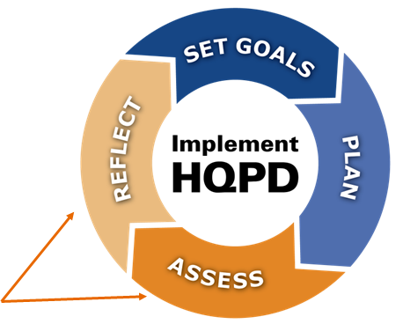
Looking Ahead
The third slide presentation in this series explores how the profiled sites used data for HQPD assessment.
Assess:
Examining the quality and impact of HQPD for the purposes of improvement and future planning.
Reflect:
Reflecting on the results of the assessment process to inform continuous improvement.
The HQPD Planning & Assessment Process

Slide 28
For more information about this project and to read the site profiles:
Please see ESE’s Resources for PD Leaders and Educators page for relevant PD resources, including the full case studies.
Email: profdev@doe.mass.edu

