Slide 1

Reimagining and Recalibrating the Massachusetts State Complaint System: The Problem Resolution System (PRS)
February 10, 2026

Slide 2
Agenda
Introductions and Goals
Remembering our roots
Reimagining PRS
Recalibrating PRS
Reflecting on the changes to PRS
Questions

Slide 3
Introductions and Goals
Kelsey LoDuca-Towne, Esq., Director
Julie Garell, Ed.D., Assistant Director

Slide 4

Let’s remember. How do our roots inform our next chapter?

Slide 5
PRS Mission Statement
The Problem Resolution System (PRS) Office provides students, families, school districts, and other community members with access to information regarding students' rights and educational options and access to a forum for the resolution of disputes that is prompt, accurate, and fair.

Slide 6
Key Governing Authority for Special Education Complaints
Special Education Complaints: Federal regulation requires each state education agency to maintain a state complaint process to investigate complaints filed alleging a violation of the Individuals with Disabilities Education Act, Part B. (34 C.F.R. §§ 300.151 - 300.153)
State special education laws
State special education regulations

Slide 7
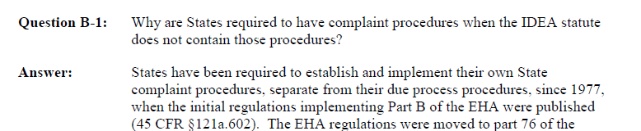
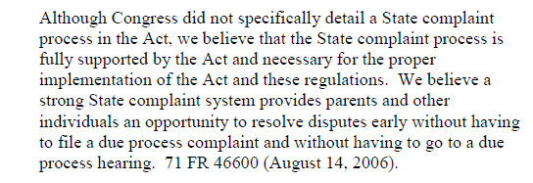
Why States Required to Have Procedures

Slide 8
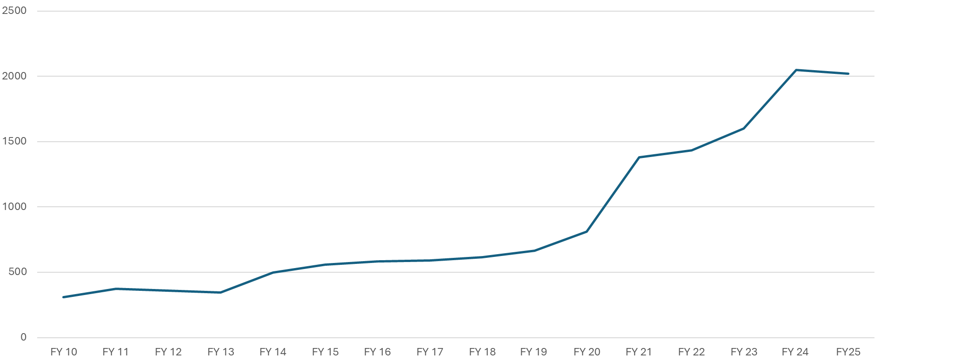
Complaint Intakes Received FY10-FY25

Slide 9

Let’s reimagine. How do we refocus on the IDEA?

Slide 10

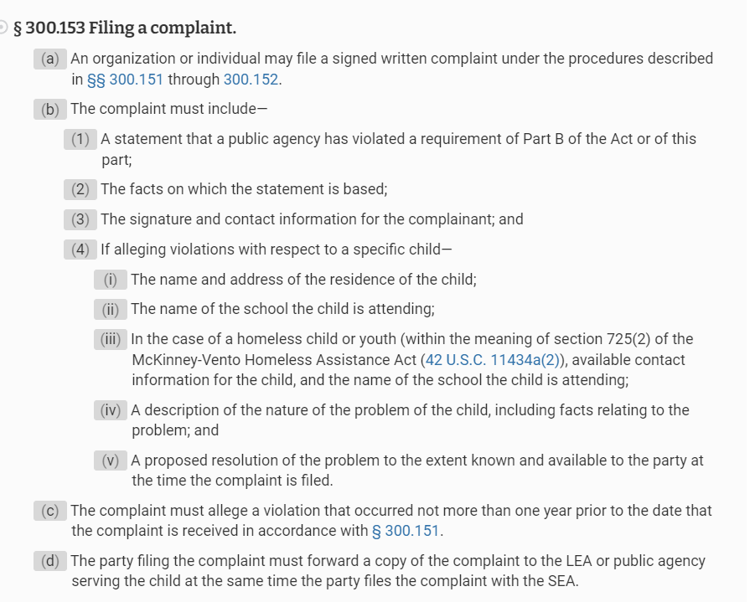
What are the requirements for filing a complaint?
Alleges violation of Part B of the IDEA w/in one year
No limits to filing outside of regulatory filing requirements

Slide 11
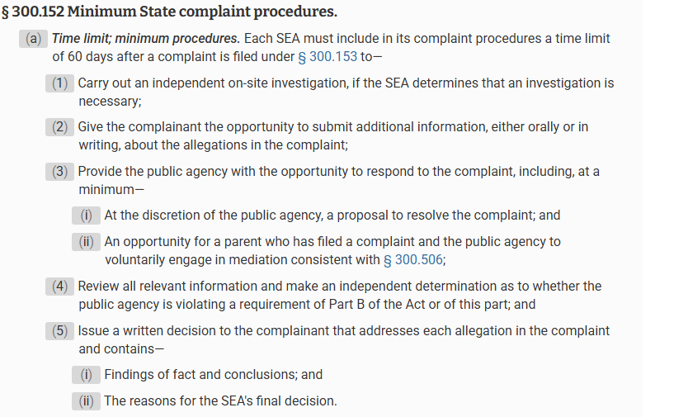
What are the requirements for an investigation?
Investigation has two minimum requirements

Slide 12
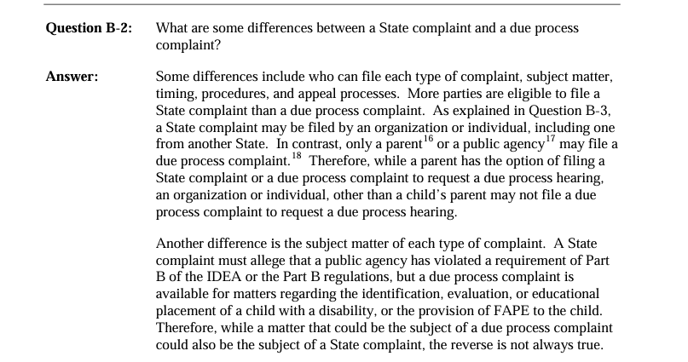
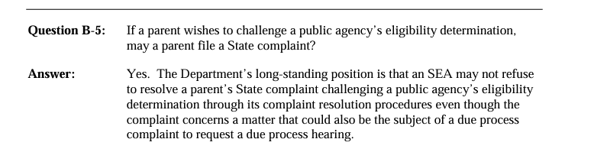
What is the scope of our authority according to the guidance?
More can be filed as a complaint than due process
OSEP Memo and Q&A on Dispute Resolution (July 23, 2013)

Slide 13
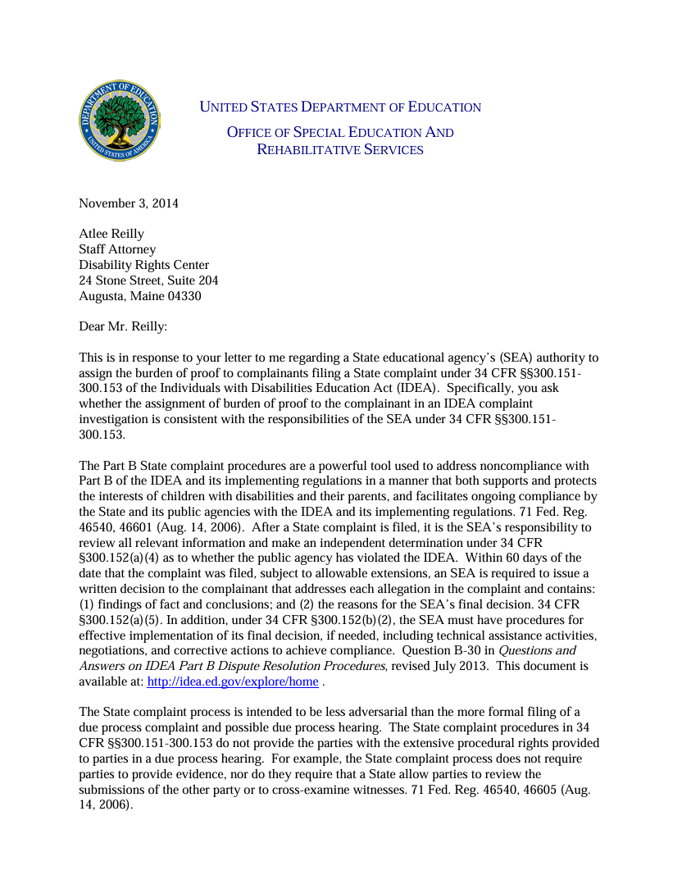
What is this process supposed to look like?
SEA’s Obligation
Intended to be less adversarial
71 Fed. Reg. 46540, 46605 (Aug. 14, 2006) Letter to Reilly (OSEP 2014).

Slide 14
14
SEA’s Obligation
Intended to be less adversarial
Alleges violation of Part B of the IDEA w/in one year
State Complaints
More can be filed as a complaint than due process
Investigation has two minimum requirements
No limits to filing outside of regulatory filing requirements

Slide 15

Let’s recalibrate. How do we meet these requirements?

Slide 16
PRS Team
2
Managers
4
Investigation Teams
1
Corrective Action Team
1
Technical Assistance Team
1
Support Staff Team

Slide 17
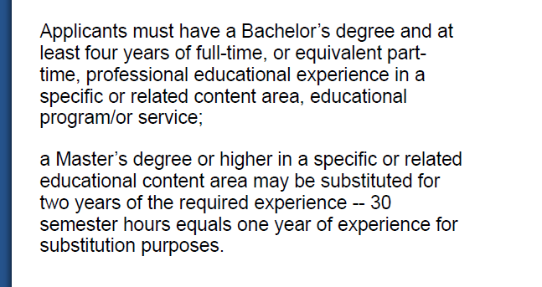
PRS Specialist: Minimum Entrance Requirements

Slide 18
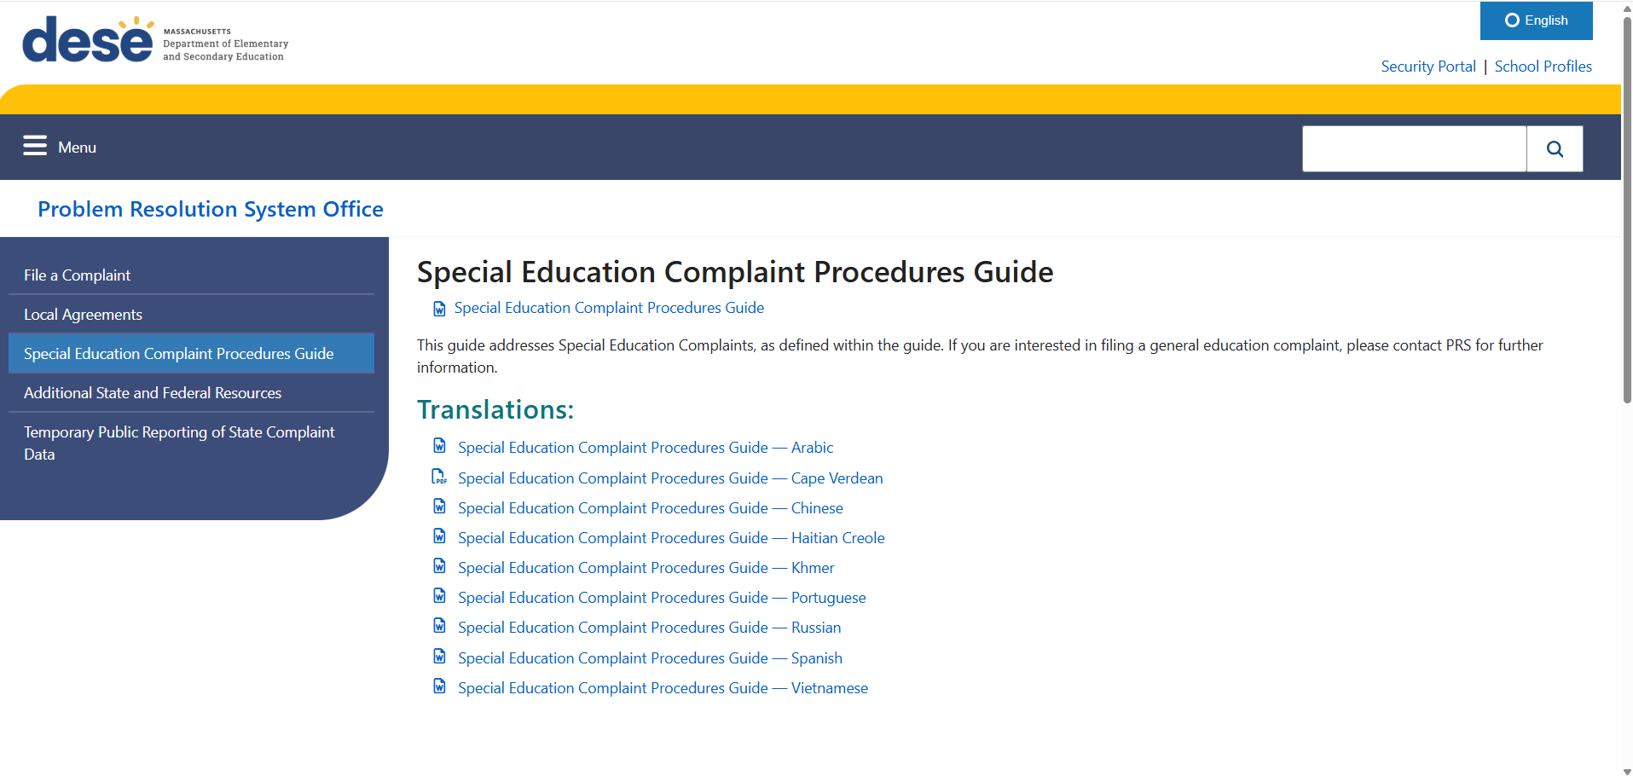
Launch Clear and Comprehensive Procedures

Slide 19
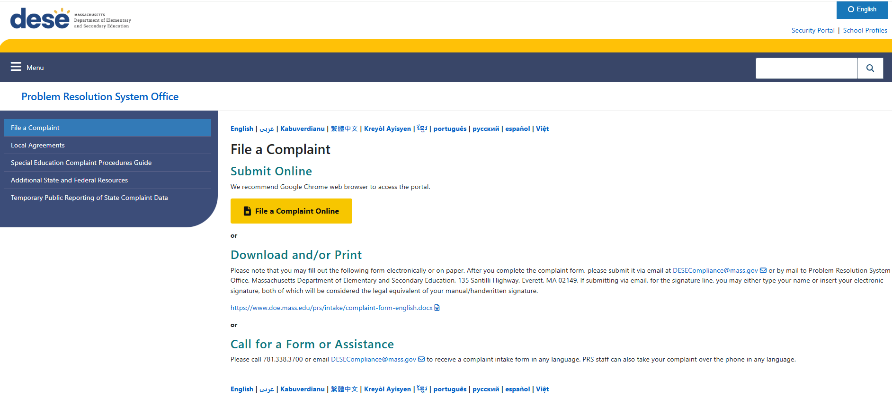
19

Slide 20
Overview of the SE Complaint Process: The Intake
Intake Received
Assigned to an Investigator
Reviewed for Minimum Requirements
If missing the minimum requirements:
PRS will issue a No Further Action Letter (NFA)
If the complaint contains the minimum requirements:
The matter is open for investigation.

Slide 21
Overview of SE Complaint Process: The Investigation
PRS Investigates
PRS will review all relevant information and make an independent determination whether the school district or school violated the applicable special education laws or regulations.
PRS must:
1. Provide the complainant the opportunity to submit additional information, either orally or in writing, about the allegations in the complaint.
2. Provide the public agency with the opportunity to respond to the complaint.
PRS may:
Issue a Request for Local Response (RLR)
Conduct interviews and/or an on-site investigation.
Other investigatory steps, as needed.

Slide 22
Overview of Complaint Process: The Determination
PRS reviews all information
Drafts a determination that includes:
1. findings of fact
2. conclusions, and
3. reasons for the final decision.
Determination is reviewed internally for accuracy, consistency, and clarity.
The determination is issued to both parties

Slide 23
PRS Determinations
Finding of compliance: PRS determines that a school district, school, or other entity complied with the applicable legal requirements.
Finding of noncompliance: PRS determines that a school district, school, or other entity did not comply with the applicable legal requirements.
Corrective Action Plan (“CAP”): PRS directs the district, school, or other entity as to what actions are necessary to remedy the identified non-compliance.

Slide 24
Orders of Corrective Action in Special Education Matters
PRS has broad authority to determine the corrective action(s) necessary to resolve the non-compliance identified in a specific complaint. Corrective action is developed to address a noncompliant procedure, policy, or process, provide student-level remedies, or both, and must address:
the failure to provide appropriate services, including corrective action(s) appropriate to address the needs of the child (such as compensatory services or monetary reimbursement); and
appropriate future provision of services for all students with disabilities.

Slide 25
Overview of SE Complaint Process: Timelines
PRS will issue a written decision within sixty (60) calendar days of receiving the special education complaint, unless subject to an allowable extension or set aside for due process proceedings on the same issue.
Reasons for extension are:
1. State-sponsored mediation and by agreement; or
2. Exceptional circumstances as determined by PRS on a case-by-case basis.
Except for the sixty (60) day timeline, any due dates related to the complaint investigation are at the discretion of PRS.

Slide 26
Request for Factual Correction
If a party believes that any findings of fact in PRS’s written final decision contradict the documentation provided to PRS during its investigation and would impact the outcome and conclusion, they may notify PRS in writing within ten (10) calendar days of the date of the written decision.
A factual correction is not to:
Revisit or challenge the legal standard(s) applied in the decision;
Disagree with PRS’s analysis, conclusion(s), or overall finding(s);
Request reconsideration of the outcome or corrective actions;
Introduce new information not already part of the original record.
Notice must:
Identify the finding of fact, including the page number and section of the written final decision where it appears, and reference where in the documentation submitted during the investigation the contradiction exists;
explain why the party believes the finding of fact is a contradiction; and
Indicate how the contradicted finding of fact impacts the outcome and conclusion(s).
PRS may elect to correct any findings of fact that contradict the record and impact the outcome and conclusion(s) in the written final decision.

Slide 27
Finality of Decision
PRS decisions are final and may not be appealed. However, either or both of the parties may seek mediation or a due process hearing through the Bureau of Special Education Appeals (BSEA) on the same issues addressed by PRS. A due process hearing would be a new proceeding and not for the purpose of reviewing PRS’s decision. The BSEA’s due process hearing decision would be binding on the parties and may be appealed.

Slide 28
Compliance with Ordered Corrective Action
The PRS CAP Team reviews and determines whether the district, school, or public agency complied with Corrective Action Plans to ensure compliance. The assigned specialist may:
provide technical assistance,
issue order(s),
issue additional corrective action(s), and/or
take other actions necessary to achieve compliance.
Noncompliance identified by PRS must be corrected as soon as possible, and in no case later than one year after PRS identifies the noncompliance (34 C.F.R. §300.600(e))
Once PRS has determined that the district, school, or public agency has reached full compliance with the required corrective action(s), PRS will issue a Letter of Closure.

Slide 29
Tips for Navigating PRS Complaints
Work together to resolve disputes before, during, and after a complaint has been filed.
A complainant can withdraw some or all their concerns at any time before a determination. Local Agreement Form or email the Specialist.
Communicate with the specialist assigned to the complaint.
Frame your exchanges with PRS as if the investigator has no prior knowledge of what happened.

Slide 30
Technical Assistance Team (TA Team)
What We Do
Responds to parents, guardians, public school district personnel, advocates, attorneys, outside agencies, and other members of the public who are seeking information about educational requirements or may have concerns related to educational compliance. The TA Team provides timely, professional, and impartial technical assistance in response to requests received by PRS. Technical Assistance is typically provided on the phone and/or via email.
How We Do It
Examples of information and resources frequently shared as technical assistance:
District resources, policies, and contact information
Federal and state education laws, regulations, and guidance
Guidance issued by the Department
State-level dispute resolution options
Clarification of PRS’s role and the complaint process
Referrals to other state or federal agencies
Information regarding advocacy resources

Slide 31
2025 PRS Customer Service Update
When callers contact PRS at (781) 338-3700, they will hear the following message during business hours:
Thank you for calling the Problem Resolution System office. To continue in:
English, press 1
Spanish, press 2
Portuguese, press 3
Haitian Creole, press 4
Cantonese, press 5
Mandarin, press 6
Cape Verdean Creole, press 7
Vietnamese, press 8
Callers then hear the following message in the language selected:
Thank you for contacting the Problem Resolution System Office with the Department of Elementary and Secondary Education. Please leave a message with your name, phone number, email, and the subject of your call, and an education specialist will contact you within two business days.

Slide 32

Let’s reflect. What does the data show?

Slide 33
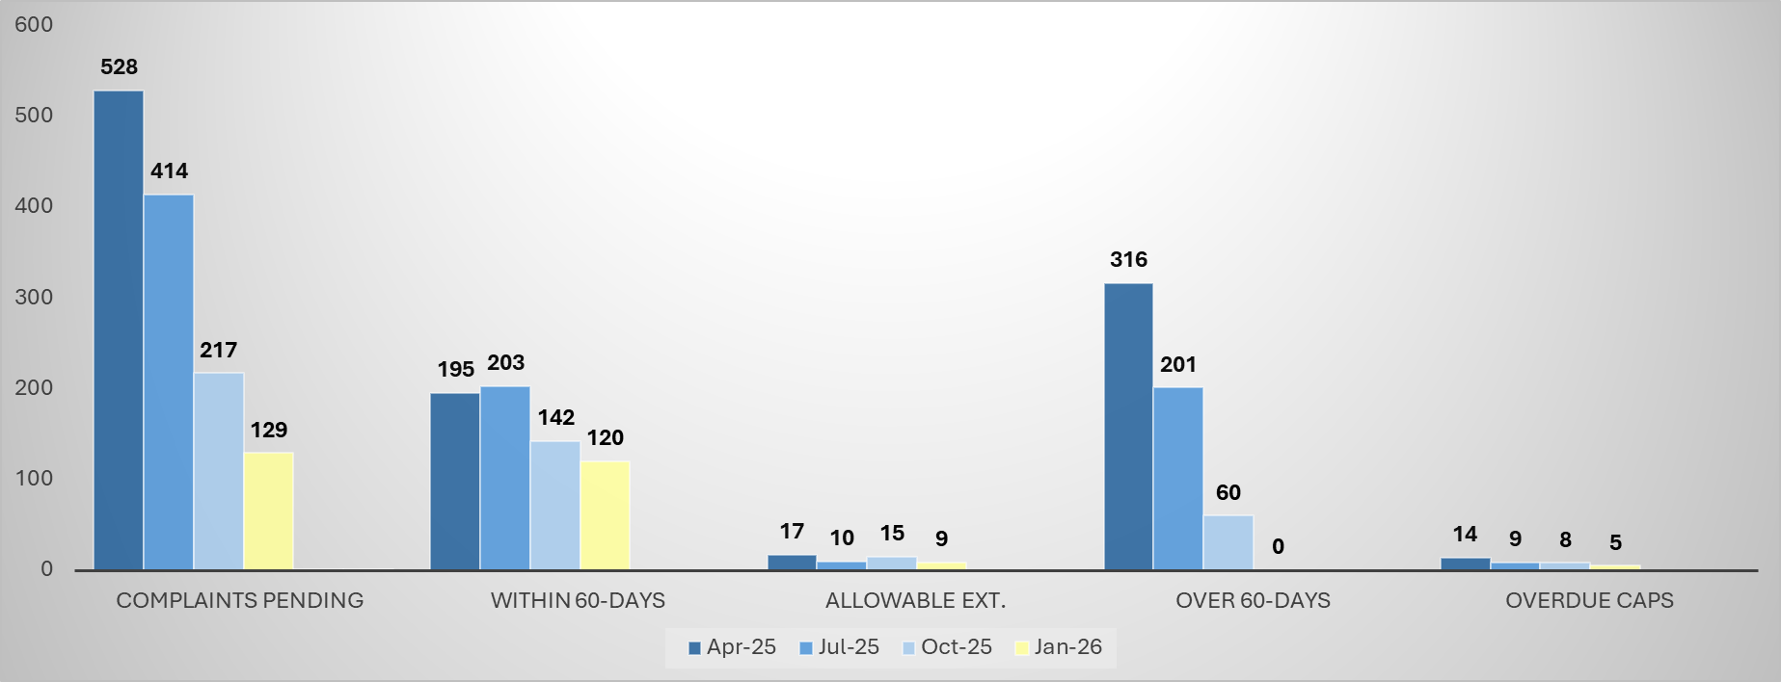
April 2025 to January 2026 Comparisons

Slide 34

Questions

Slide 35
35
Problem Resolution System Office
Massachusetts Department of Elementary and Secondary Education
135 Santilli Highway, Everett, MA 02149
Main Telephone: 781-338-3700
TTY: N.E.T. Relay: 1-800-439-2370
Email: DESECompliance@mass.gov
PRS Website
Kelsey LoDuca-Towne, Esq., Director
Email: Kelsey.LoDuca-Towne@mass.gov
Julie Garell, Ed.D., Assistant Director
Email: Julie.L.Garell@mass.gov

