Slide 1
Tiered Focused Monitoring
OFFICE OF PUBLIC SCHOOL MONITORING

Slide 2

Tiered Focused Monitoring
Topics we will cover:
Role of Public School Monitoring (PSM)
Tiered Focused Monitoring (TFM) overview
Monitoring timeline
Department of Elementary & Secondary Education (DESE) offices working together
https://www.nature.com/articles/d41586-018-06619-3
No copyright infringement is intended
2

Slide 3
Tiered Focused Monitoring: Role of PSM
Public School Monitoring, a unit of the Department of Elementary & Secondary Education, is charged with:
Monitoring school districts for compliance with special education and civil rights laws and regulations that impact student outcomes
Providing technical assistance to help districts:
  Understand and comply with regulations
  Develop supports and resources for students

Slide 4

Tiered Focused Monitoring: Universal Standard Group A
Special Education Identification Process
Parent Involvement
IEP Development
Programming & Support Services
Equal Opportunity
https://www.doe.mass.edu/resources/credits.html
Notes:
Was slide # 5

Slide 5
Tiered Focused Monitoring-TFM
Tiered Focused
Monitoring
Parent Survey
Analysis & Results
District Self-Assessment
PSM
Onsite Visit
District Support
Method for determining compliance with regulations
Districts undergo a TFM review every 3 years
Five major review components help identify opportunities for
improved practices
Notes:
Was slide # 4

Slide 6
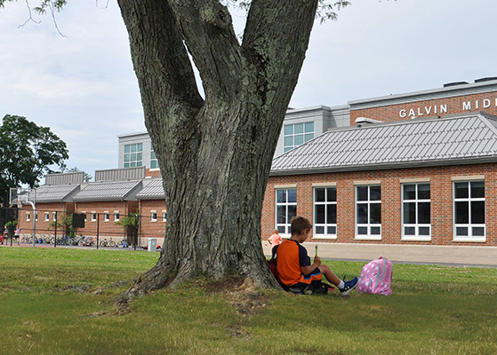
Tiered Focused Monitoring: District Self-Assessment
Review of special education student records
Review of special education and civil rights policies and procedures
Focused questions relating to special education and civil rights laws and regulations under review
Galvin Middle School, Wakefield, MA
https://www.doe.mass.edu/resources/credits.html
Notes:
Was slide # 6

Slide 7

Tiered Focused Monitoring: PSM Onsite Visit
Chair reviews district
self-assessment &
parent survey results
Chair reviews statewide reports
& data
Chair develops
an onsite plan
Onsite monitoring may
include:
Review of student records
Focused interviews

Slide 8

Tiered Focused Monitoring: Parent Survey
Public School Monitoring uses survey responses to enhance onsite monitoring
Surveys are sent by email and are available in several languages
Focused questions about the special education process
Opportunity to add comments
https://www.dreamstime.com/stock-photo-smiling-young-african-american-couple-having-online-conversation-together-via-touch-tablet-morning-living-room-blurred-image96756040

Slide 9

Tiered Focused Monitoring: Analysis and Results
  Compliance Ratings
Commendable
Implemented
Partially Implemented
Not Implemented
The report includes actions for the district to implement in response to the ratings.
Reports are available on the DESE website: http://www.doe.mass.edu/psm/tfm/default.html
  Final Report
https://goo.gl/images/FwwH5J

Slide 10

Tiered Focused Monitoring: Supporting School Districts
PSM works closely with districts to do the following:
Correct non-compliance and build systems to support students
Identify opportunities for improved practices
Develop resources for teachers and administrators
https//www.integration.samhsa.gov/workforce/teamwork.jpg

Slide 11
Tiered Focused Monitoring: Timelines Group A & Group B
Year 1 Prep:
Self- Assessment
Group A or B
Year 2 Onsite:
Supports, Action Plans, Monitoring &
Progress Reporting
Year 3
Follow-up:
Internal Monitoring

Slide 12
Next Tiered Focus Monitoring Review: Group B
Licensure & Professional Development
Parent, Student & Community Engagement
Facilities & Classrooms
Oversight
Student Learning Time
Equal Access
Building Tours & Observations
GROUP B
Focus on Civil Rights
Review includes:
Data Review
Policy and Procedure Review
Interviews
Parent Surveys

Slide 13
DESE Systems Work Together
Problem Resolution Services (PRS):
  Helps you address specific problems or complaints regarding your child, services, the school, or district
Public School Monitoring (PSM):
  Uses general information about your school or district that you have shared to inform the TFM review process

Slide 14
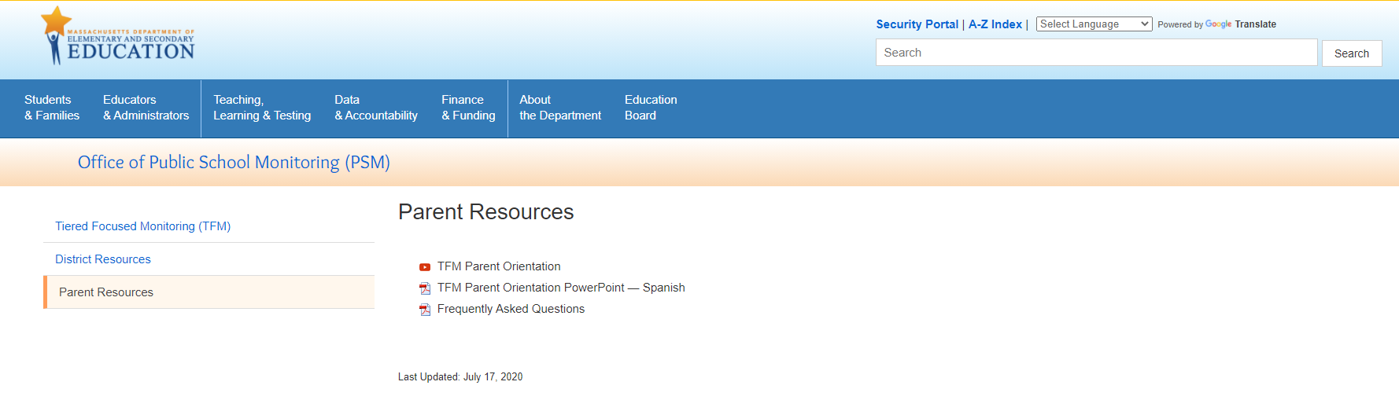
Parent Resource Page
If you want to access this presentation or other resources, please visit the Office of Public School Monitoring Parent Resource Page.

Slide 15



THANK YOU
Office of Public School Monitoring
781.338.3700
75 Pleasant Street, Malden, MA 02148
www.doe.mass.edu

