Slide 1
Dissemination Fair Displays
November 18, 2016

Slide 2
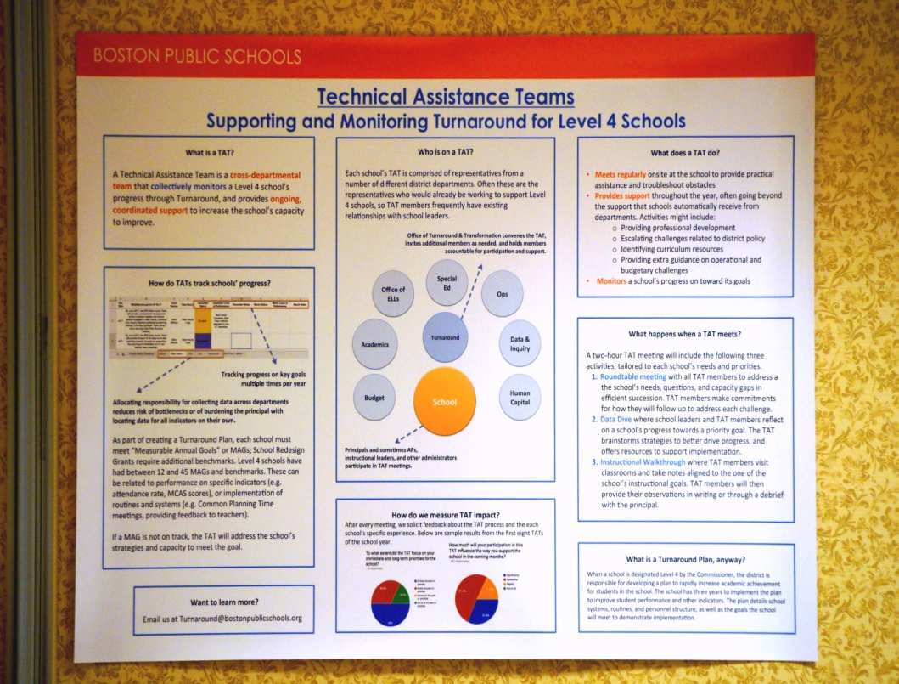
Boston Public Schools Turnaround
Technical Assistance Team (TAT)
Who is on a TAT?
What does a TAT do?
How do TATs track schools’ progress?
How do we measure TAT impact?
What happens when TAT meets?
What is a Turnaround Plan, anyway?
Want to learn more? Contact:
Turnaround@bostonpublicschools.org

Slide 3
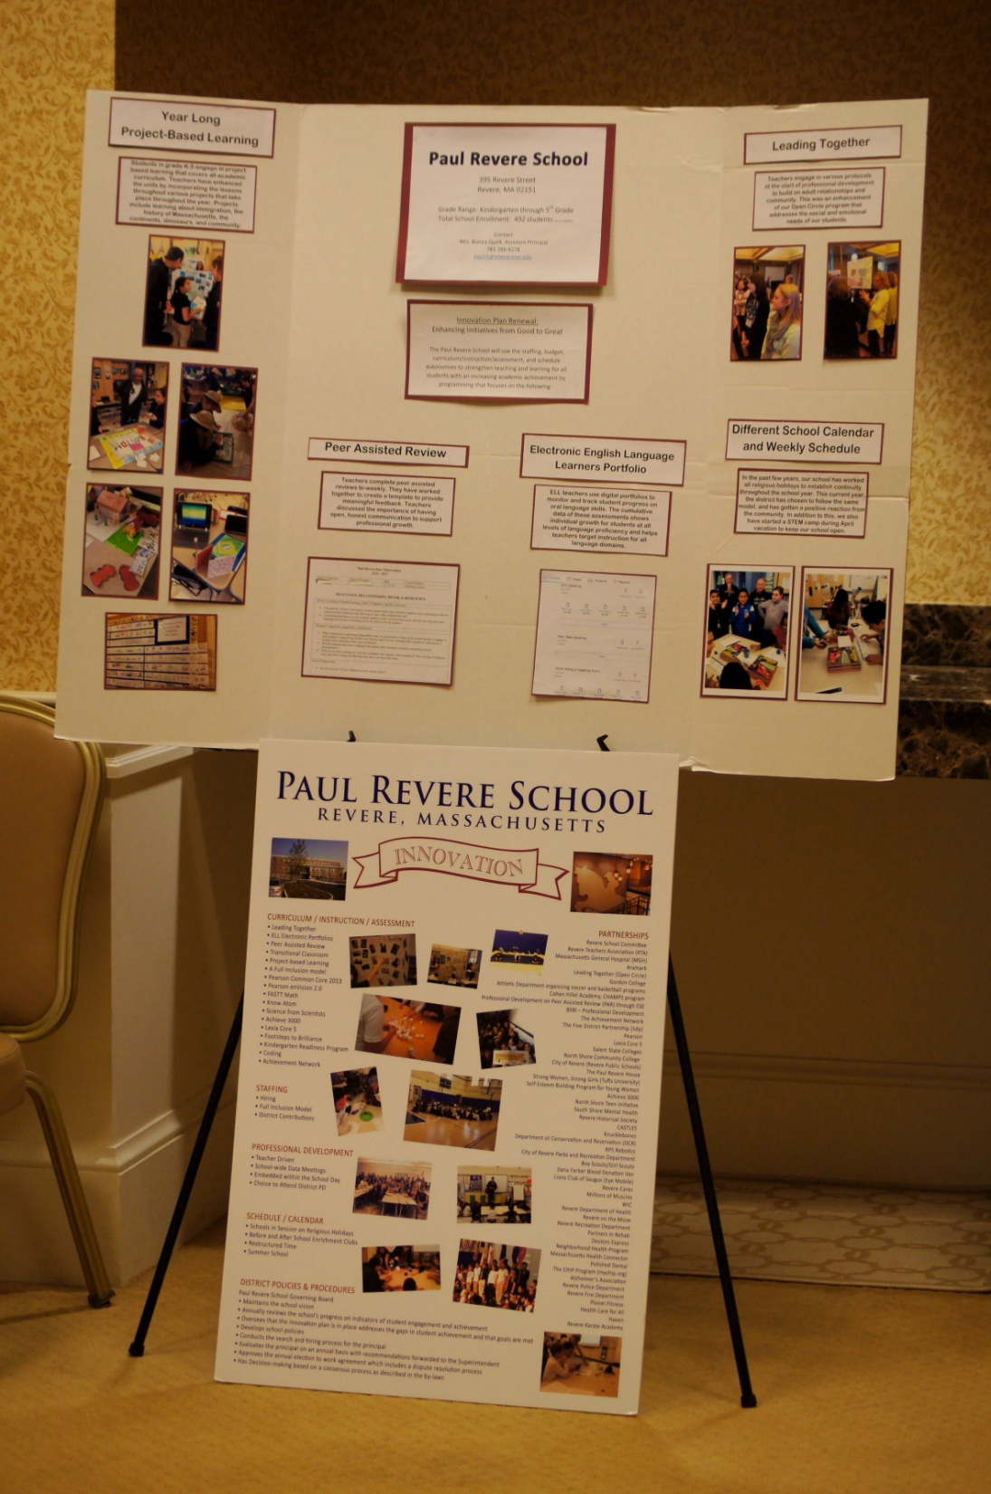
Paul Revere School (Revere K-5)
Innovation School
Year long project based learning
Peer Assisted Review
Leading Together
Electronic English language learning portfolio
Different school calendar and weekly schedule
Want to learn more? Contact:
bquirk@revere.mec.edu

Slide 4
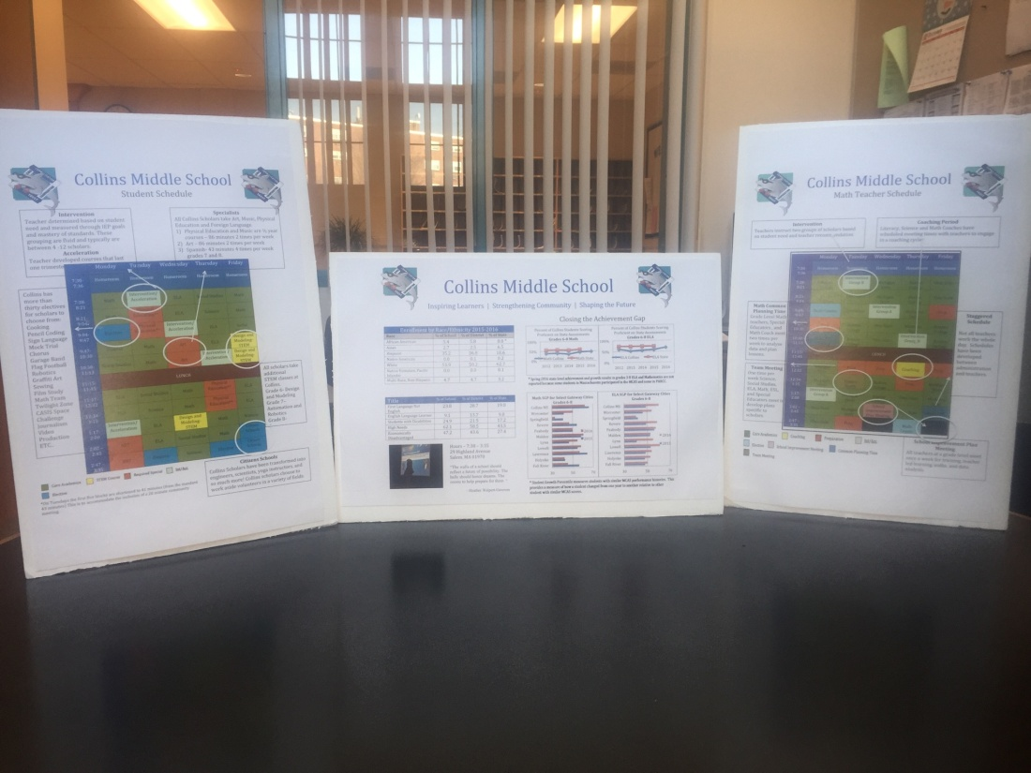
Collins Middle School (Salem 6-8)
Expanded Learning Time
Designing Teacher and Student Schedules
Embedded teacher collaboration time, intervention, and acceleration time.
Want to learn more? Contact:
glennburns@salemk12.org

Slide 5
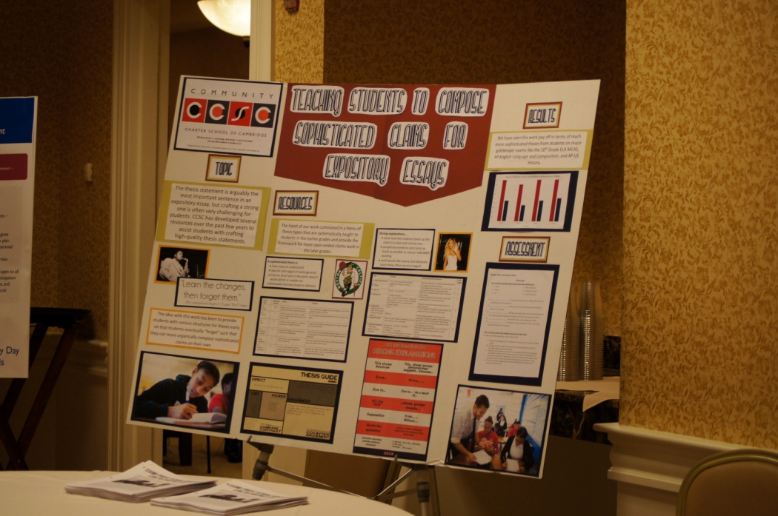
Community Charter School of Cambridge (6-12)
Teaching students to craft high quality thesis statements
Developing and presenting several resources
Systematically teaching a menu of thesis types
Want to learn more?
chursthiller@ccscambridge.org

Slide 6
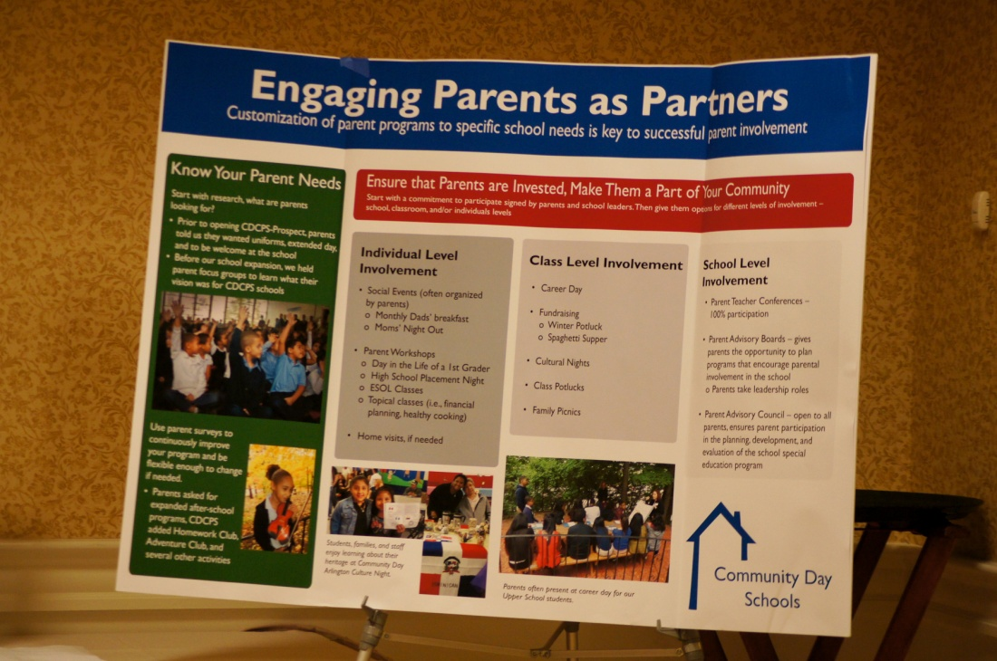
Community Day Charter School(s) (Lawrence K-8)
Engage parents as partners.
Ensure that parents are invested. Make them a part of your community.
Know your parents needs.
Want to learn more? Contact:

Slide 7
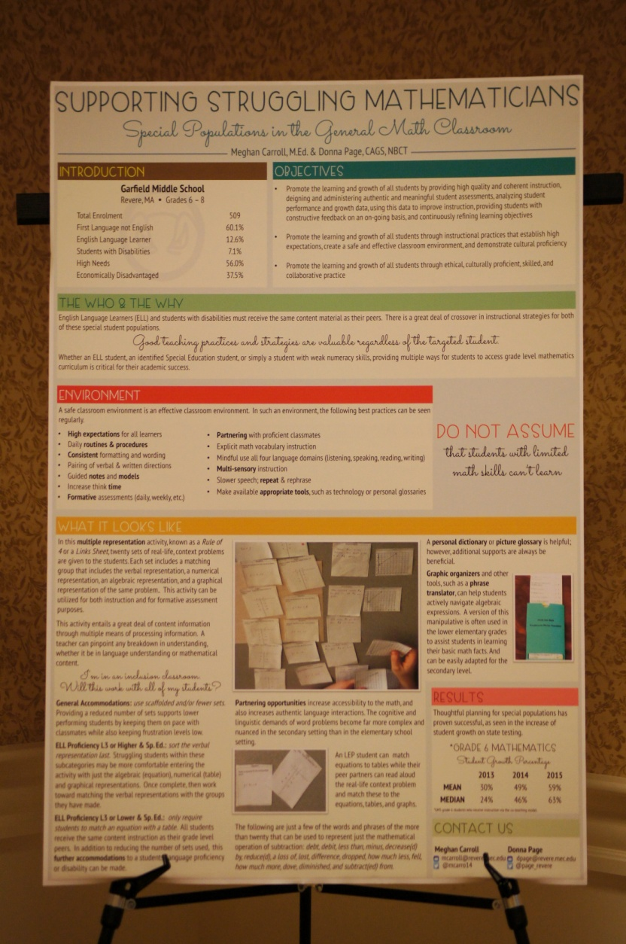
Garfield Middle School (Revere, 6-8)
Support struggling mathematicians
Work with special populations in the general math classroom
Focus on environment
Do not assume
Utilize multiple representations
Want to learn more? Contact: mcarroll@revere.mec.edu

Slide 8
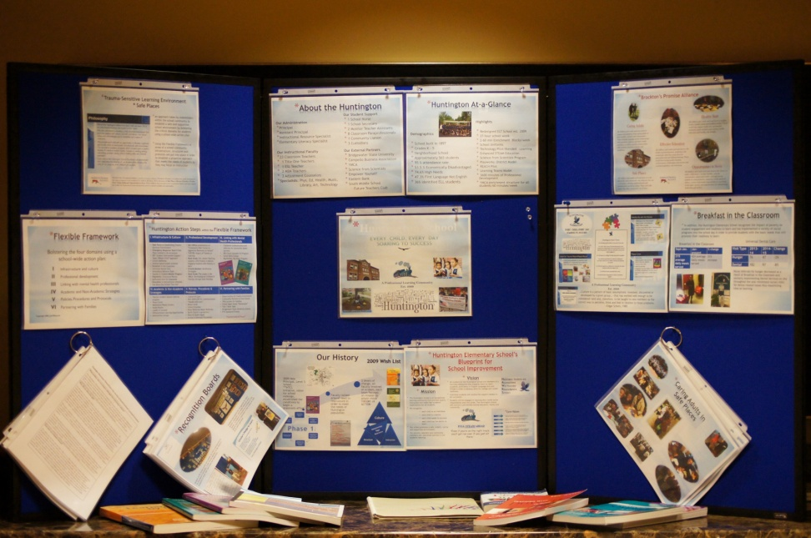
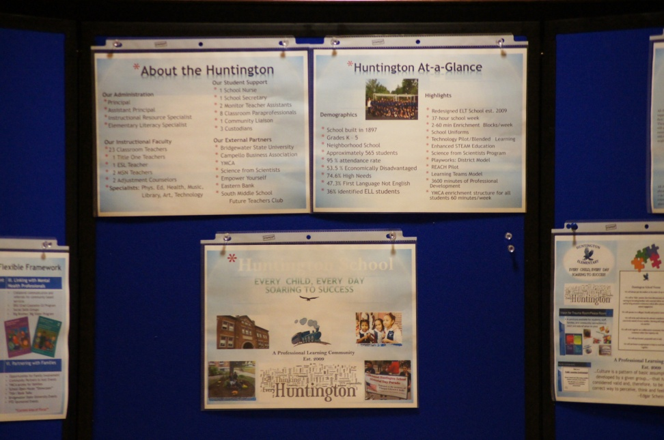
Huntington Elementary (Brockton K-5)
A closer look…
Trauma sensitive learning environment
Flexible frameworks
Recognition boards
Caring Adults in safe places
The Hawk’s Mentor Club
A Variety of Social-Emotional Programs
Want to learn more? Contact: marybethobrien@bpsma.org

Slide 9
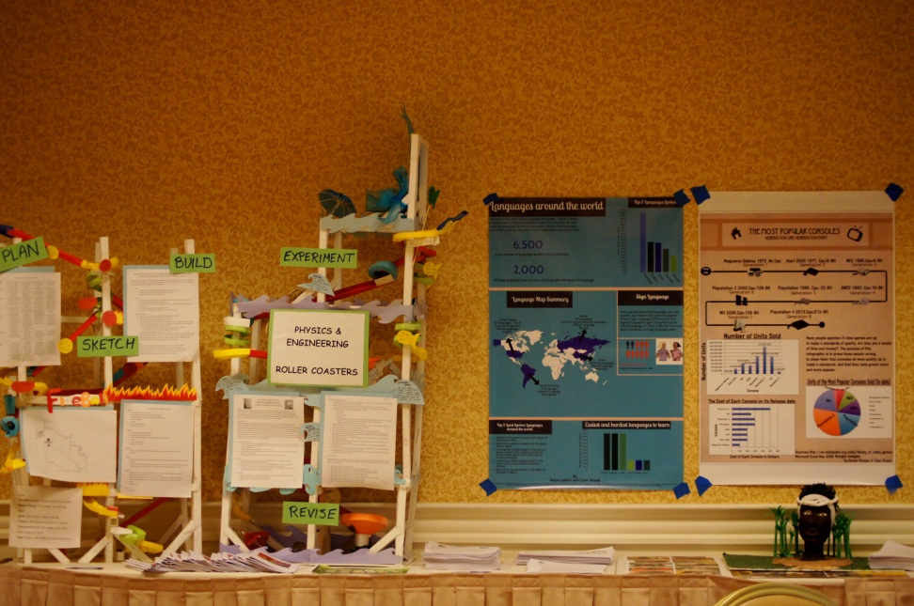
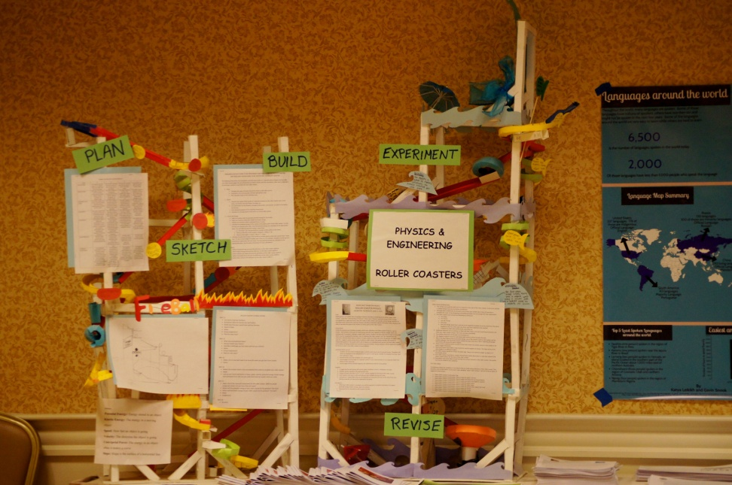
Marblehead Community Public Charter School (4-8)
Standards driven project-based learning
Ensuring students are learning deeply and remain fully engaged
Developing and using systems, tools and rubrics
Culminating exhibitions were PBL is celebrated across the school
Want to learn more? Contact:
nch@marbleheadcharter.com

Slide 10
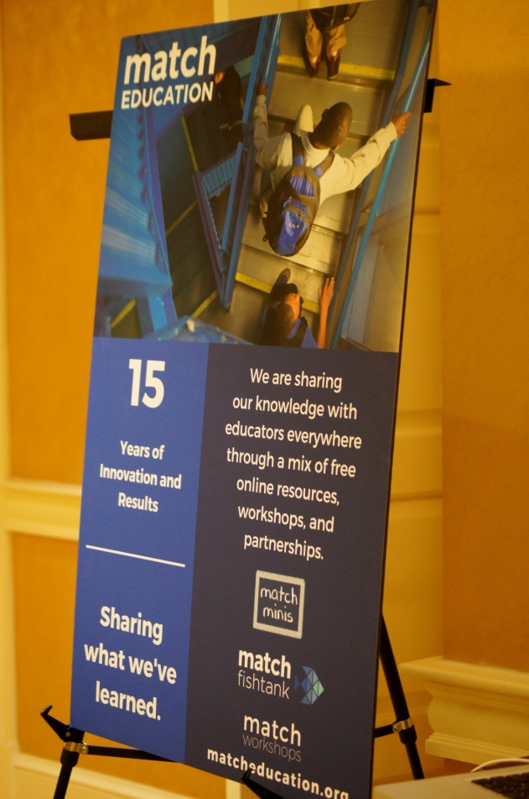
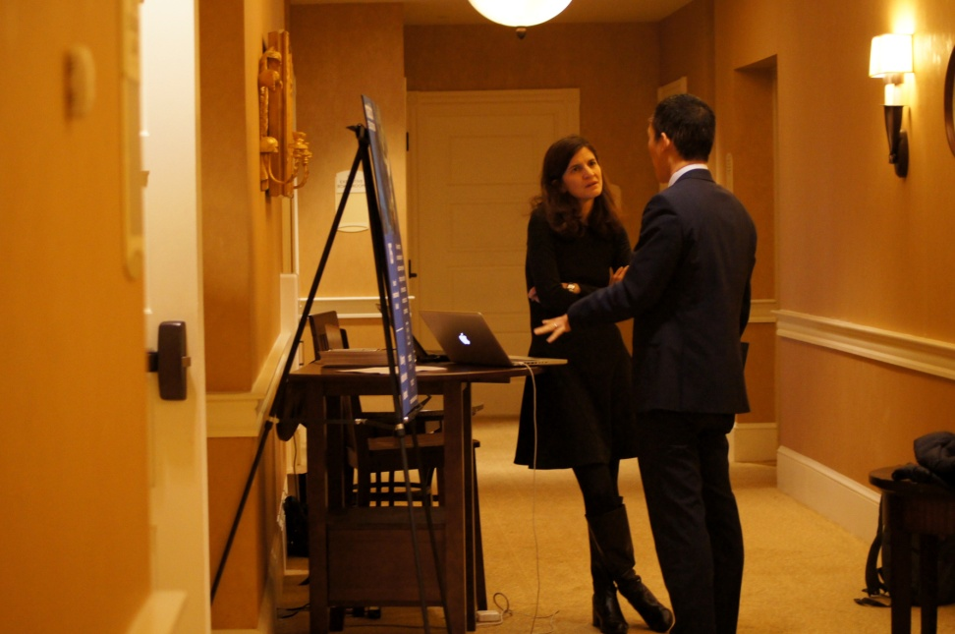
MATCH (Boston, PK-12)
Sharing knowledge with educators everywhere with a mix of free online resources, workshops, and partnerships
  MATCH minis
  MATCH fishtank
  MATCH workshops
  Download full courses, unit plans, daily lesson frames, assessments and more…
Want to learn more? Contact: claire.kaplan@matcheducation.org

Slide 11
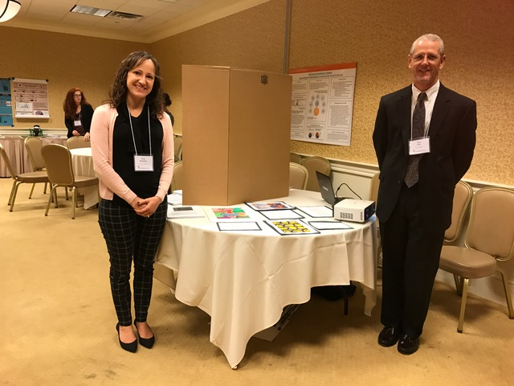
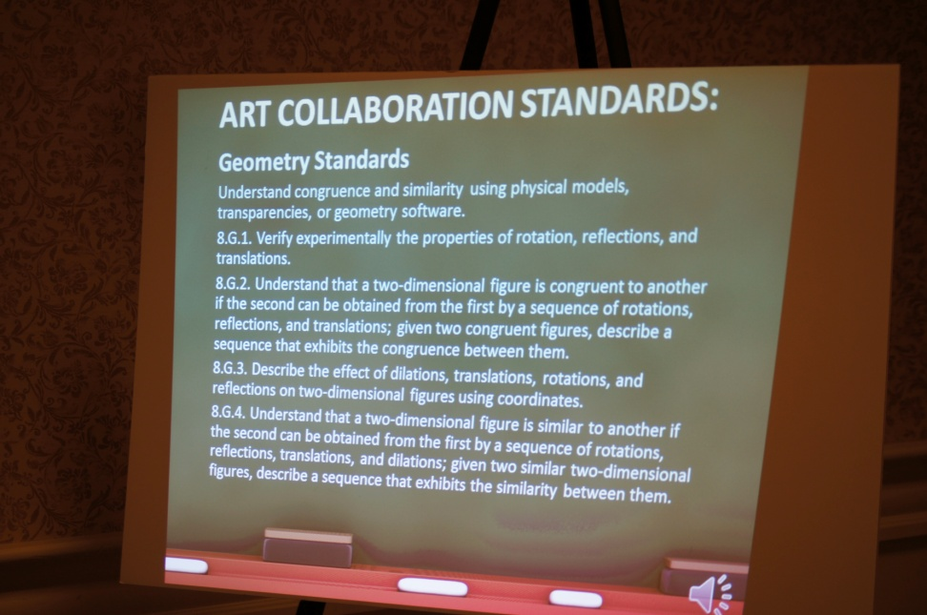
McKay Arts Academy (Fitchburg, PK-8)
Tessellations: An Arts Integrated Math Project
Math standards
Art standards
Want to learn more? Contact: ramirezl@fitchburg.k12.ma.us

Slide 12
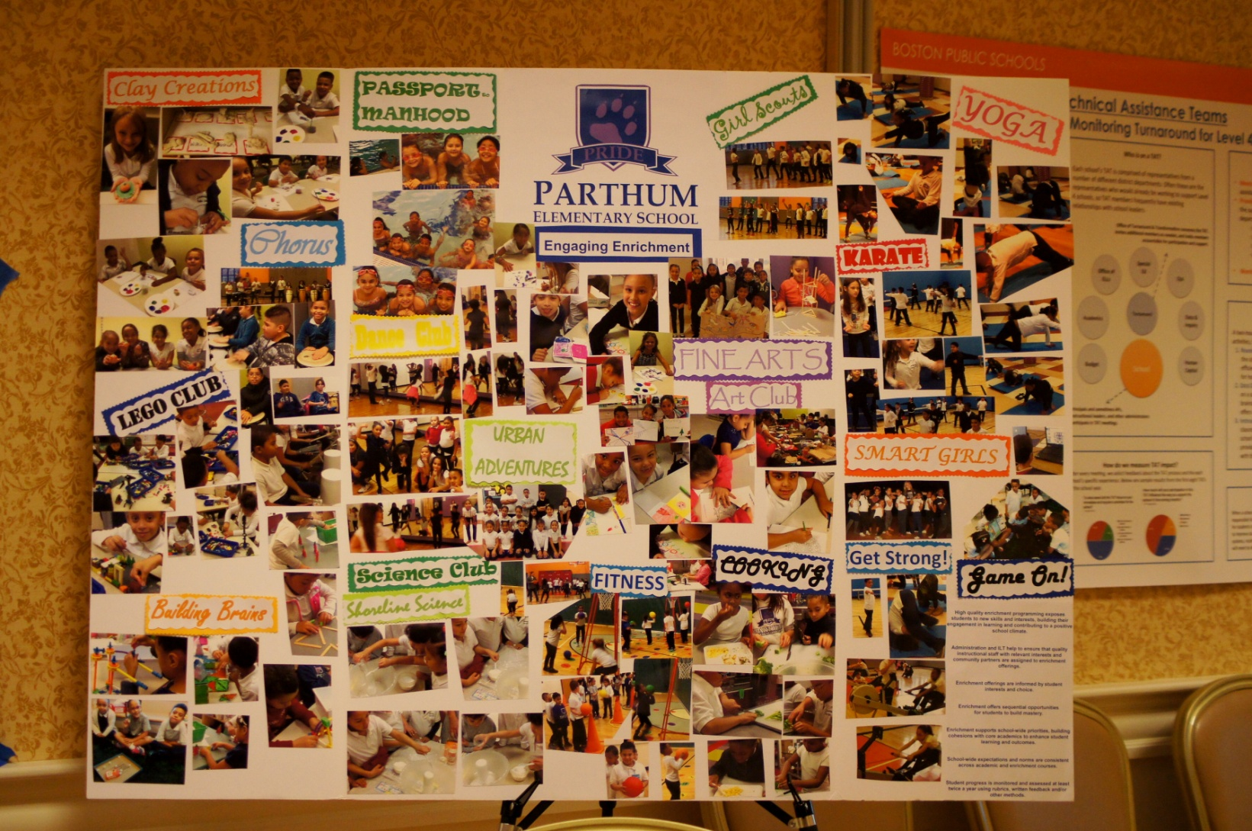
Parthum Elementary School (Lawrence, K-4)
21st Century Community Learning Center ELT
Maximize Teacher Collaboration Time
Create a professional learning community structure to support teachers
Engaging Enrichment
Want to learn more? Contact: maria.calobrisi@lawrence.k12.ma.us

Slide 13
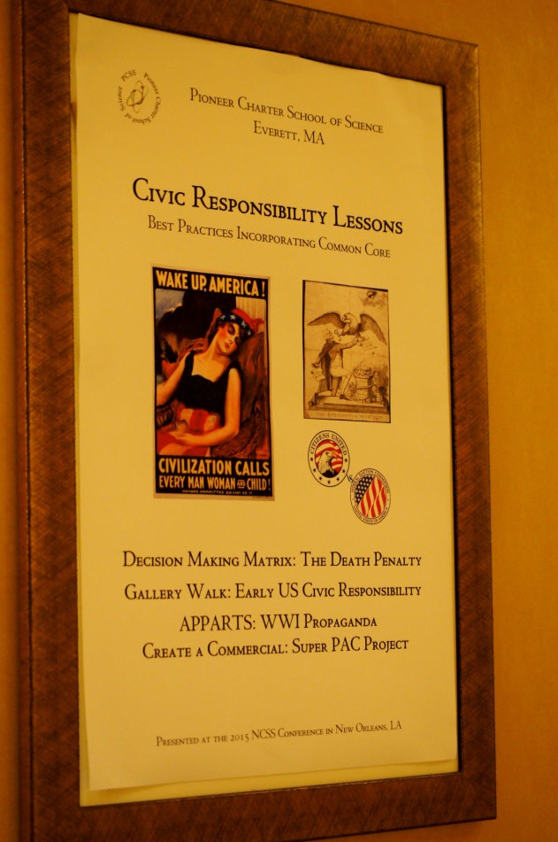
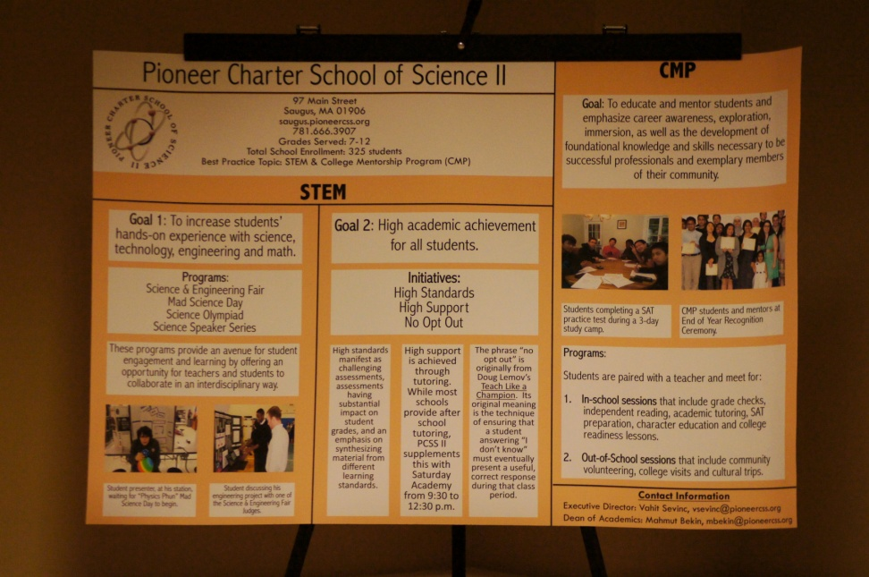
Pioneer Charter School of Science (Everett, 7-12)
STEM
  Mad Science Day
  Schoolwide Science & Engineering Fair
  Science Olympiad
  Science Speaker Series
CMT and teaching civic responsibility
Want to learn more? Contact: mbekin@pioneercss.org

Slide 14
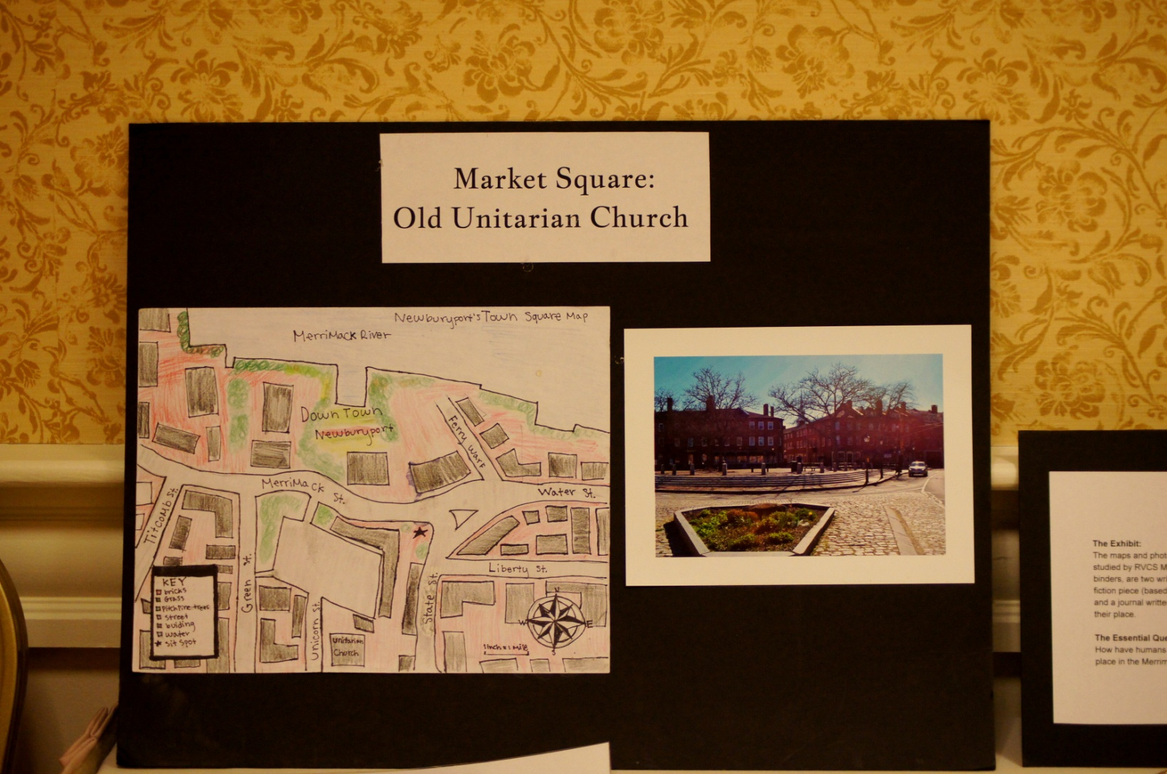
River Valley Charter School
(Newburyport, K-8)
“Montessori made public”
Introducing project based learning in core subjects
One of River Valley’s project based themes tries to answer the following essential question: How have humans and the natural environment shaped and changed our place in the Merrimack River Valley?
Want to learn more? Contact: awillemsen@rivervalleycharter.org

Slide 15
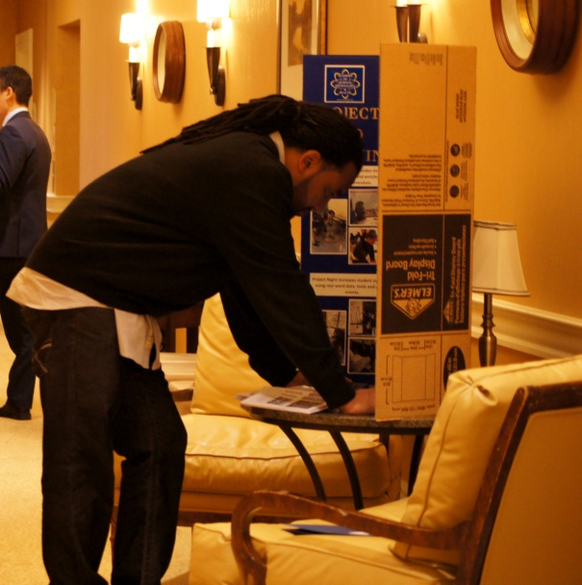
Academy of Science Technology & Health (Worcester East Middle School, 7-8)
Innovation Academy
Project block segments – time for structured extensions and enrichments to core curricula
Advisory
Want to learn more? Contact: dawkinsr@worc.k12.ma.us

Slide 16
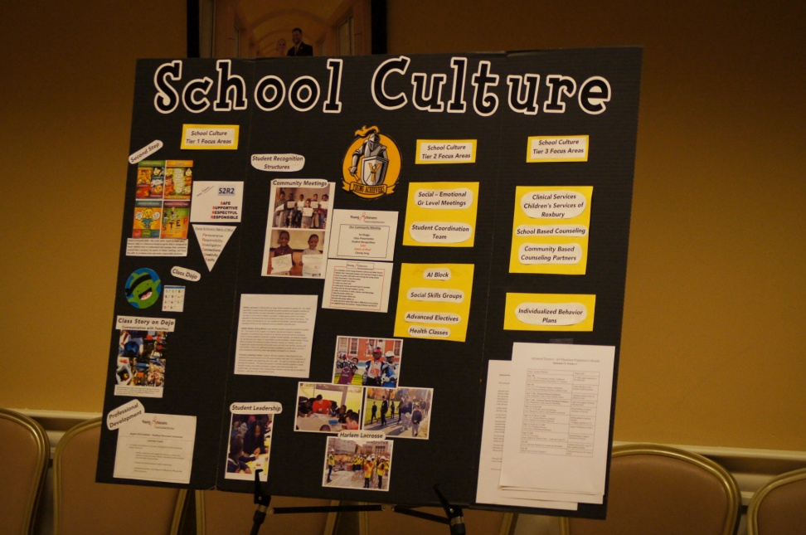
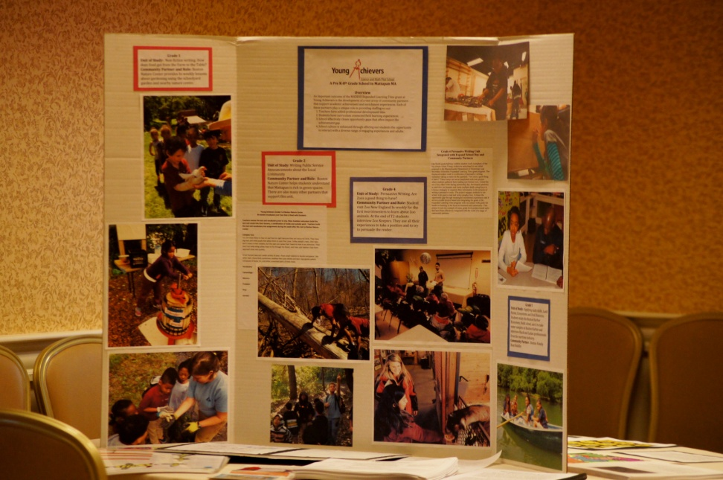
Young Achievers Science and Math Pilot School (Boston, PK -8)
Partners and Enrichment Experiences
Closing the Opportunity and Achievement Gaps
Focus on school culture
Want to learn more? Contact:
bhoppin@youngachieversschool.org

Slide 17
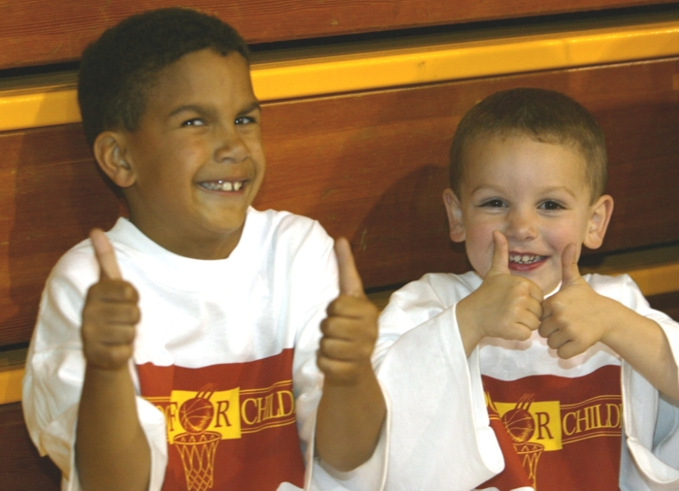
Dissemination: Let’s share what works!
If you have any questions, please contact: Ruth Hersh at rhersh@doe.mass.edu

