Slide 1
Social and Emotional Learning Indicator System (SELIS) Webinar
June 7, 2022

Slide 2
CONTENT
01
Introduction to SELIS Project
02
Melissa Maguire (Director of Student Services)/Melanie Collura (Sch. Adjustment Counselor): Monomoy Regional School District
03
Q & A_Dr. Linda Watt (School Psychologist): Taunton Public Schools
04
Kim Garrison (Behavioral Health Coordinator & Research Specialist): Martha’s Vineyard Public Schools
05
John Crocker (Director of School Mental Health and Behavioral Services): Methuen Public Schools
06
Dr. Chris Lord (Executive Director of Remote Learning & External Partnerships): Peabody Public Schools

Slide 3
Introduction: Context, SEL Framework, Survey Design & Reporting, Resources
01

Slide 4
SELIS Context: Evolution of SELIS Project
Monomoy Regional School District
Fall administration
Integrating SEL into Academic Learning Grant
SELIS Cohort 1 (Yr. 1 Pilot)
10 Districts
Spr. 2021 admin./Trainings
New Grant Opportunity:
Integrating SEL into Academic Learning Grant 22/23
Cohort 2: Year 1 (8-10 districts)
Cohort 1: Year 3
2018
2019
2020
2021
2022
SELIS survey development
Monomoy: Annual Fall and Spring Administrations
SELIS Cohort 1 (Yr. 2 Pilot)
8 Districts:
Fall 2021 admin.
Spring 2022 admin.
Trainings/Analyses

Slide 5
The CASEL* Five Framework: what we are measuring!
Self-Awareness: The ability to understand one’s own emotions, thoughts, and values and how they influence behavior across contexts.
Self-
Management
Self-Management: The ability to manage one’s emotions, thoughts, and behaviors effectively in different situations and to achieve goals and aspirations.
Self-Awareness
Responsible Decision-making
Social Awareness
Social and Emotional Construct
Social Awareness: The ability to understand the perspectives of and empathize with others, including those from diverse backgrounds, cultures, & contexts.
Responsible Decision-making: The ability to make caring and constructive choices about personal behavior and social interactions across diverse situations.
Relationship Skills
*Collaborative for Academic and Social and Emotional Learning
Relationship skills: The ability to establish and maintain healthy and supportive relationships and to effectively navigate settings with diverse individuals & groups.
Notes:
.

Slide 6
Survey Design: Examples of items measuring the 5 core competencies
Self-Awareness (SA): | Self-Management (SM):
Knowing ways to make myself feel better when I am sad | Staying calm when I feel stressed
Offering an answer even though I am not sure I am right | Working on assignments even when they are hard
Knowing what my strengths are | Thinking through the steps it will take to reach my goals
Social Awareness (SOC): | Relationship Skills (RSK):
Learning from people with different opinions than me | Being welcoming to someone I don’t usually eat lunch with
Knowing when someone needs help | Sharing what I am feeling with others
Responsible Decision-Making (RDM): | Responsible Decision-Making (RDM):
Thinking about what might happen before making a decision | Knowing when people’s actions are “right” or “wrong” (e.g., helpful or harmful)
SELIS is based on: The Social and Emotional Competency Assessment (Chowder et al, 2019; Davidson et al, 2018)
Four response options: “Very easy”, “Easy”, “Hard”, or “Very hard”
Total number of items: G3-G5 (45 items); G6-G8 (48 items); G9-G12 (50 items)

Slide 7
Reporting: Two types of data
  Overall social and emotional score or SE construct scaled score and five-dimension scores:
    Self-awareness (SA); Self-management (SM); Social awareness (SOC);
    Relationship skills (RSK); Responsible decision-making (RDM)
  All students and items are anchored on the same scale
Data visualization maps of individual students’ responses (SWON maps)
    Asset-based maps that highlight students’ social and emotional strengths and areas in need of support and development
1
400
5XX
600
999

Slide 8
Distribution of students’ SE scores (Spring 2022, N = 18,064)

Slide 9
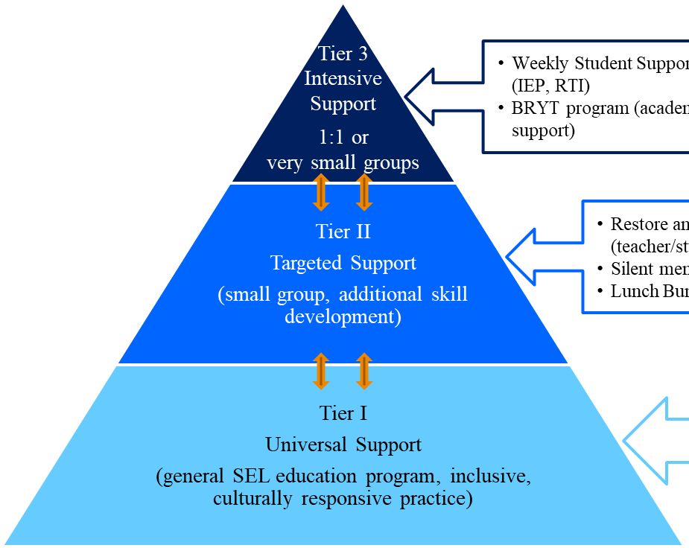
Multi-tiered systems of support (MTSS) framework
“MTSS is a framework designed to meet the needs of all students by ensuring that schools optimize data-driven decision-making, progress monitoring, and evidence-based supports and strategies with increasing intensity to sustain student growth. MTSS is not just about tiered interventions, but rather how all the systems in a school or district fit together to ensure a high-quality education for all students.” (DESE, 2019)
Increasing intensity of support

Slide 10
Resources:
2022/23: Integrating SEL into Academic Learning Grant Opportunity (will be posted soon!)
  Priority: Integrating SEL through Service Learning
  Priority: Measuring student’s SEL skills (SELIS project). DESE supports survey administration, data reporting, and provides data analyses trainings
  SELIS webpage
  SELIS Validity Study
  Survey Item Prompts
  Dimension-level interpretive narratives for five benchmark scores on the scale
    E.g., Self-awareness narrative
  DESE Supports (MTSS Academies)
        Social, Emotional, and Behavioral Academy (uses SEL and PBIS frameworks)
        June 14 application deadline

Slide 11
References:
Chowder, M. K., Gordon, R. A., Domitrovich, C. E., Brown, R. D. & Davidson, L. A. (2019). Linking social and emotional learning standards to the WCSD Social-Emotional Competency Assessment: A Rasch approach. School Psychology, 34 (3), 281 – 295.
Davidson, A. D., Crowder, M. K., Gordon, R. A., Domitrovich, C. E., Brown, R. D., Hayes, B. I. (2018). A continuous improvement approach to social and emotional competency measurement. Journal of Applied Developmental Psychology, 55, 93 – 106.

Slide 12
Melissa Maguire (Director of Student Services)/Melanie Collura (Sch. Adjustment Counselor): Monomoy Regional School District
02

Slide 13
Q & A_Dr. Linda Watt (School Psychologist): Taunton Public Schools
03

Slide 14
Q & A: Dr. Linda Watt (Taunton Public Schools)
  Why did your district decide to apply for the SELIS grant in 2020? What was the need that the SELIS data could help address?
  When Taunton joined the SELIS project in 2020-2021, it administered SELIS in the four required grades (G4, G5, G8, and G10). What went into this decision and what factors helped you decide to expand to grades 3 through 12 in the 2021-2022 school year?
  Taunton has 11 schools in the district. What do you need set up in the district to successfully administer SELIS in your schools? Logistics? People? Other resources?
  How do you use SELIS data in your district? Who uses the data? How do you use the data in your role as a School Psychologist? What kinds of decisions does the data help inform?
  How do you plan to use the data going forward?

Slide 15
Kim Garrison (Behavioral Health Coordinator & Research Specialist): Martha’s Vineyard Public Schools
04

Slide 16
BUILDING A CULTURE OF SEL (MVYPS)
Evaluation: MedStar Evaluation (2018) recommendation- focus on/improve SEL
Equity: Student voice/cultural responsiveness/youth development
Culture: Common working definition, language, and measure of SEL
Planning/Resource Allocation: Strategic recommendations for our schools
Practice: Integrating SEL into Academic Instruction (middle/high school)
“SEL is the process..acquire and apply the knowledge, skills, and attitudes to develop:”
“healthy identities;” | Self-Awareness
“manage emotions/achieve personal and collective goals;” | Self-Management
“feel/show empathy for others;” | Social Awareness
“establish/maintain supportive relationships; and” | Relationship Skills
“make responsible/caring decisions” | Responsible Decision Making
Notes:
SELIS project/data in your district?
Shared vision/buy-in?
What went well in your district’s role out of the project?
What was challenging?
Most effective/illuminating data use?
Surprised you when you analyzed the data?
Data confirm some suppositions you had about your students?

Slide 17
John Crocker (Director of School Mental Health and Behavioral Services):
Methuen Public Schools
05

Slide 18

Methuen Public Schools:
Incorporating SELIS into Our Screening Program

Slide 19

Defining Universal Mental Health Screening
“Using a tool or process employed with an entire population, such as a school’s student body, to identify student strengths and needs. Screening is often used to identify students at risk for a mental health or substance use concern.”
-National Center for School Mental Health and MHTTC Network Coordinating Office (2019)

Slide 20

Critical Components of Universal SEL/MH Screening
Successfully implementing universal social and emotional and mental health screening will require consideration of the following:
Developing a team to support screening
Generating buy-in from school and community stakeholders
Providing professional development and technical assistance to ensure SEL/MH staff readiness
Selection of the population to screen
Selection of a screening measure
Design and adoption of consent procedures
Planning for the administration of screening
Data collection, analysis, and warehousing considerations
Conducting a coordinated follow up to address the needs of identified students

Slide 21

Major Components of the MPS Screening System
SEL/MH screening is part of a much larger system of support - Methuen has developed a Comprehensive School Mental Health System (CSMHS)
K-12 screening is conducted multiple times per year (SELIS is fall and spring)
Screening measures focus primarily on internalizing concerns
Social emotional competence is measured using SELIS to generate a more comprehensive dataset that includes both symptom specific and prosocial data
Screening measures exclusively rely on student self report
Passive consent with opt-out procedures were adopted as screening was scaled up
Screening is administered using web-based tools (Google tools, SELIS supported by DESE) - Methuen is a Google Enterprise district (data is stored on our servers)
Students scoring in the moderate/severe range receive follow up; any indication of SI or self harm results in immediate follow up
School-based MH staff (school counselors, adjustment counselors/school social workers, and school psychologists) conduct the clinical follow up and enroll students in school-based MH services

Slide 22
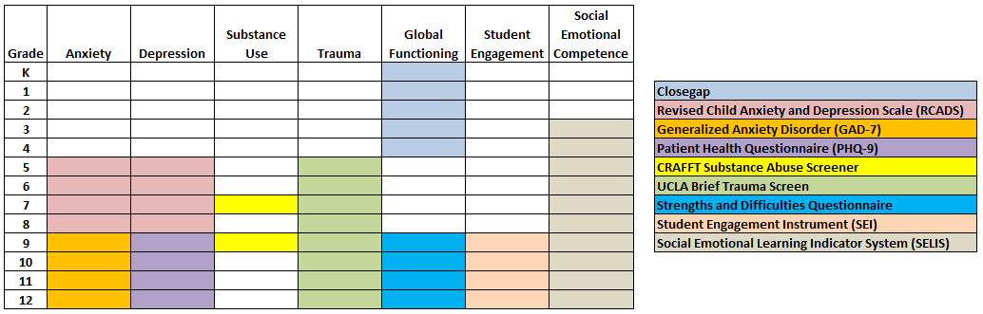
2021-2022: What do we screen for in Methuen?
Screening represents one of the only practices to proactively identify mental health concerns.
When we are sensitive to emerging concerns, we can provide preventative services and supports to reduce the likelihood that students will develop more serious mental health problems and reduce instances of crisis.
SELIS data provides us with a more comprehensive understanding of our students’ well-being.
According to NIMH, how long does it take, on average, for students to get care after they start to experience symptoms of a mental health concern?

Slide 23

Identifying Students, Fostering Prevention, Improving Collaborative Case Management
Screening fosters early identification of students with emerging social and emotional and mental health concerns and increases the opportunity for proactive services.
Assessing students’ social and emotional competence supports districts in monitoring the efficacy of their SEL curriculum.
Schools are the prevention arm of the mental health system writ large and do not need to wait for crisis and diagnosis to engage in services.
Early identification reduces instances of crisis through preventative care and decreases the larger impact of crises on the school as a whole.
MPS reported a 63% increase in the identification of students who were eligible for mental health services for internalizing concerns following implementation of mental health screening in 16-17.
Data can be shared with stakeholders after securing a release to improve collaborative case management and expedite access to care in a community-based setting if indicated.

Slide 24
SELIS Data Use: Assessing students’ overall social and emotional well-being in the district (Tier I)

Slide 25
SELIS Data Use: Assessing if student groups (Tier II) need support
Supported our understanding of the relative lack of disproportionality between student subgroups
Informed our approach to designing equitable SEL instructional opportunities

Slide 26
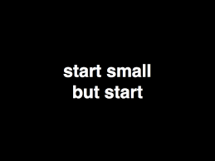
One student, one measure, one day…
Keeping your first test of change small (screening one student) does not mean it will yield negligible knowledge or data. Screening one student improves knowledge and practice related to:
Selection of measure
Administration and scoring
Consent procedures
Data warehousing
Interpretation of scores
Use of data to inform clinical decision making

Slide 27

Implementing Universal Screening: Starting Small
Rapidly testing at the micro-level allows the team to:
Identifies areas to improve
Establishes systems to make screening efficient and sustainable
Builds off of successes to ensure sustainability after scaling up
Allows the team to assess the utility of various measures/processes
Exposes the team to variations in the process of screening at a manageable scale

Slide 28
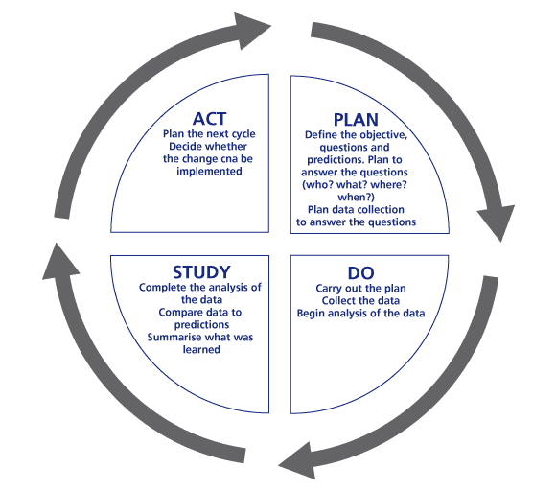
Action Planning and PDSA Cycles
Plan
  Define the objective, questions, and
  predictions
  Plan for data collection
Do
  Carry out the plan
  Collect and analyze data
Study
  Complete the analysis of the data and
  compare the results to the predictions
  Summarize what was learned
Act
  Determine whether the change will be
  abandoned, adapted, or adopted

Slide 29
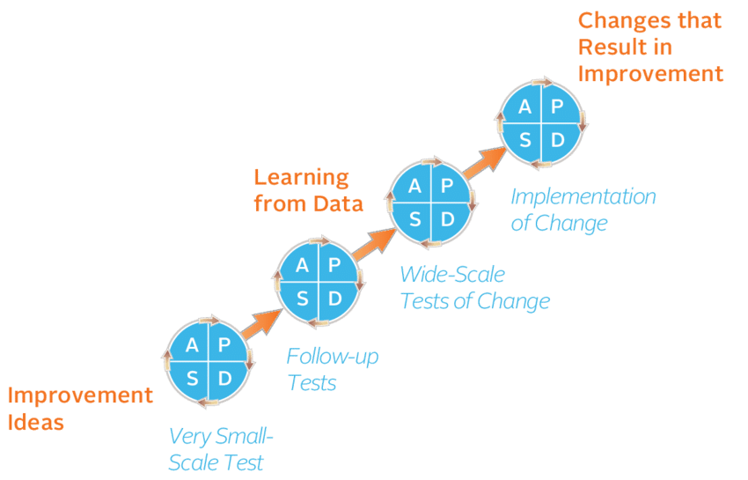
PDSA process

Slide 30
Evolving Practice: Seeking Innovative Strategies
Initial Phase of Implementation
Active Consent
Paper and pencil screening
Single-student or small group screening
Administration facilitated by SMH staff
Improved Practices
Passive Consent and Opt-out
Web-based screening
Grade-level or school-wide screening
Administration through advisory and tech courses

Slide 31
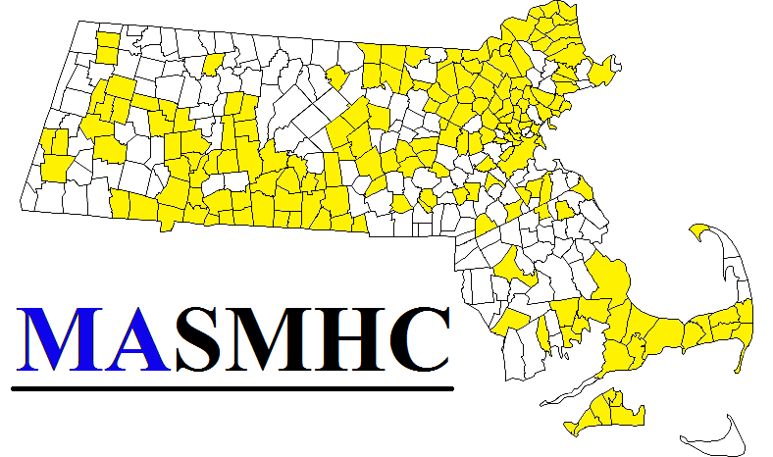
MASMHC Universal Mental Health Screening Resource Guide
&
MASMHC Universal Mental Health Screening Implementation Guide

Slide 32

MAssachusetts School Mental Health Consortium
@MassSMHC
www.masmhc.org
John Crocker: jncrocker@methuen.k12.ma.us
978-722-6000 ext: 1154

Slide 33
Resources
MASMHC Universal Mental Health Screening Resource Guide
MASMHC Universal Mental Health Screening Implementation Guide
National Center for School Mental Health: Screening Playbook
www.TheSHAPESystem.com
PDSA Worksheet
Methuen Public Schools: Screening Coordinated Follow-up Guide
www.masmhc.org
MPS CSMHS Resource Page
Video guide for prepping screening data in Google sheets
Progress monitoring templates
“Share seamlessly, steal shamelessly…”

Slide 34
Dr. Chris Lord (Executive Director of Remote Learning & External Partnerships): Peabody Public Schools
06

Slide 35
Social Emotional Learning in Peabody Schools 2021-22

Slide 36
Summer 2021 Planning
Spring 2021 SELIS Data
Guidance Scanning Student Records
Individual Interventions
SWON Maps to IEP/504/IST Meetings
Spring 2021 Self Manager Data
Perseverance

Slide 37
Social Emotional Learning in all School Improvement Plans
Staff presentations on CASEL Indicators
SEL Libraries to all elementary schools funded by PEF
Rob Surette–Hero Art presentation funded by the PEF for grades K-8
Grades 9-12 Advisory Focus on SEL
Guest Speaker Norm Bossio presentation funded by the PEF for grades 9-12

Slide 38
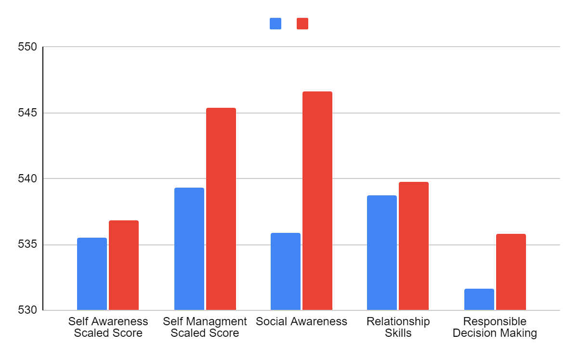
District SELIS Data Fall 2021 and Spring 2022
The Students Perspective of Themselves

Slide 39
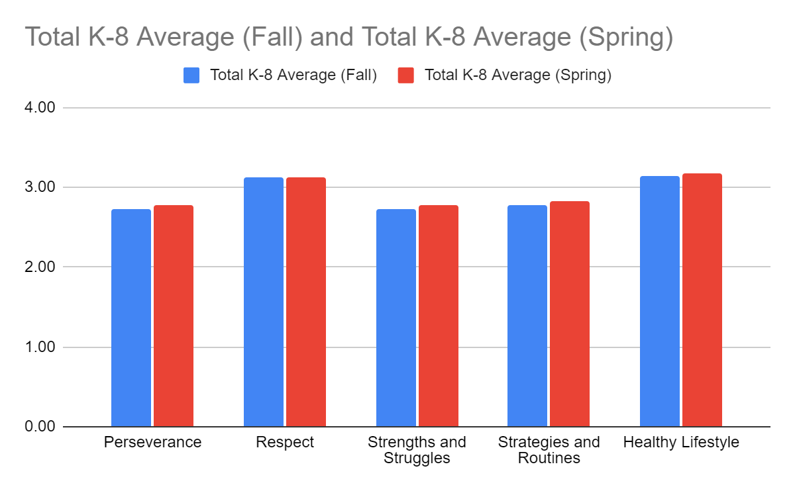
District Self Manager Data
Fall 2021 and Spring 2022
The Teacher’s Perspective of Their Students

Slide 40
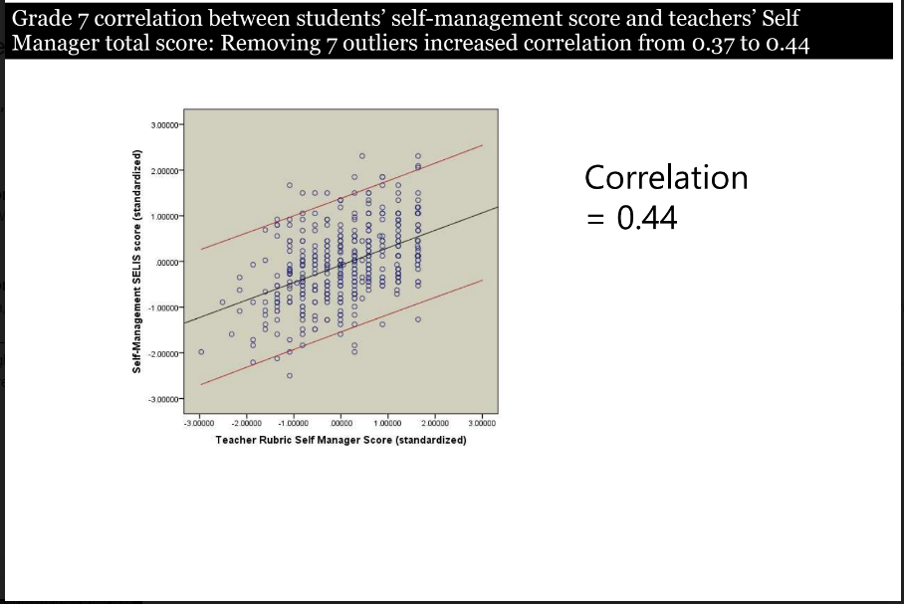
Grade 7 Correlation
Between Teacher and Student Perspective

Slide 41
Summer 2022 Planning
How will SELIS and Self Manager data inform your School Improvement Plans next year?
When will guidance staff review the latest individual SELIS student results for possible interventions?
Are SWON Maps of value to your teachers and if so, how will they get into the hands of next year’s homeroom teachers before school starts?
How will Self Manager data be presented to homeroom teachers before school starts?

Slide 42

Questions?

Slide 43


Questions? Thank you!
Shelagh Peoples, Psychometric Coordinator
781-338-3119
speoples@doe.mass.edu
vocalsurvey@doe.mass.edu

