Slide 1
Views on Climate and Learning Student Questionnaire
December 13th, 2023
Webinar for the interpretation and use of the

Slide 2
Agenda
Overview of the VOCAL framework
How does scoring work?
Suggested Workflow
Edwin Dashboard and Reports Demo
Additional Resources, Questions, Contact Info

Slide 3
Framework Overview

Slide 4
VOCAL Framework
Engagement Dimension
  Culture competence (CLC)
  Participation (PAR)
  Relationships (REL)
Environment Dimension
  Discipline (DIS)
  Instructional (INS)
  Mental health (MEN)
Safety Dimension
  Bullying/cyber-bullying (BUL)
  Emotional safety (EMO)
  Physical safety (PSF)

Slide 5
Data and Reporting
Index Scores
Range 1-99
High level summarization of student response patterns
Item Responses
#/% of students responding on response categories
Data available…
Dashboard
Visual enhancement
Tabular Reports
Large spreadsheets for custom reporting
In both these formats…
Aggregates at the school, district, and state levels by…
Various Student Groups
Grade-level, Economic Status, SWD, Gender, Race, EL

Slide 6
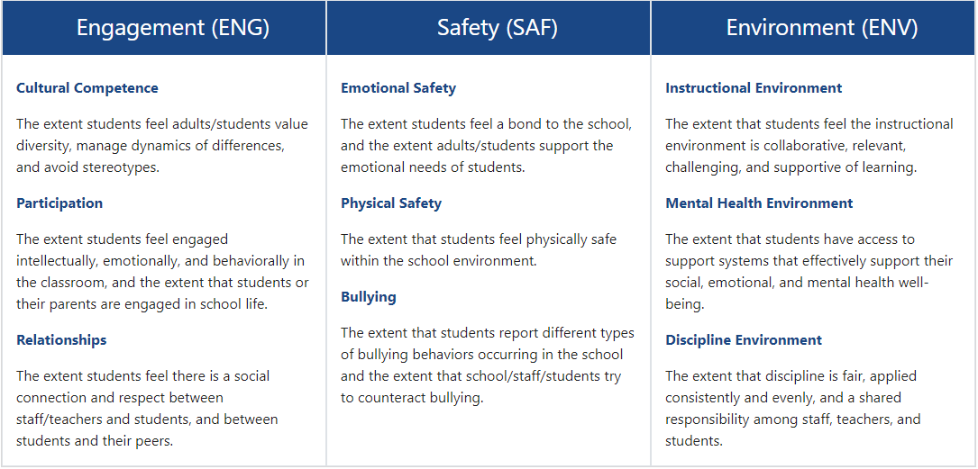
Overall School Climate (Score)
Typical Reporting Timeline
  Preliminary dashboard/report: Late June/early July
  Final dashboard/report: Early/Mid September
= Score reported all years
= Score reported as of 2022

Slide 7
Item Additions in 2022
  Topic Index Scores reported only for All Students group for school, district, state
  Participation (Engagement Topic) score at school level (N≥50)
    In my academic classes, students wrestle with problems that don't have an obvious answer. G8
    In my classes, students teach each other how they solved a problem. G5
  Instructional Environment (Environment Topic) score at school level (N≥50)
  Students are given multiple opportunities to show that they have mastered their classwork. G8
  In my classes, mistakes or even failure on an assignment are viewed as an important part of our learning. G10
Bullying (Safety Topic) score at school level (N≥50)
  In my school, groups of students tease or pick on one student. G4, G5, G8, G10
  Teachers, students, and the principal work together to prevent (stop) bullying. G4, G5, G8, G10
Dimension index score comparability maintained while adding new information

Slide 8
How does scoring work?

Slide 9
VOCAL is a student questionnaire
Response Categories
Never True Mostly Untrue Mostly True Always True
Thinking of the last 30 days in school...
My teachers care about me as a person.
School rules are fair for all students.
I feel as though I belong in my school community.
0
1
2
3
0
1
2
3
0
1
2
3

Slide 10
Index vs. Raw Scores
Student | Item Responses | Raw Score
Student 1 | 1,0,0,0,1 | 2
Student 2 | 1,2,2,1,3 | 9
Student 3 | 2,3,2,3,3 | 13
Difficult Item: Students help decide school rules.
  Most students say this is untrue
Easy Item: My teacher cares about me as a person
  Most students say this is true
  The distance between 1 and 2 is 1.
  What’s the distance between “Never true” and “Mostly untrue” on an item?
  What’s the distance between “Never true” on one the first item and “Always true” on the second?
Calibration converts the ordinal response scales to an interval scale where students are described by their probability of reporting the existence of school climate elements.
End up with something analogous to raw scores, but better suited for mathematical calculations (e.g. finding the mean).

Slide 11
Benefits of Scoring Method
More thorough estimates and comparisons of latent traits.
Generalize interpretations over different, if related, sets of items.
Convenient framework for establishing the comparability of scores.
  Grade-level
  Student groups
  Schools & Districts
  Years

Slide 12
Scaling
Measurement scale: Student-level data
Student-level (all grades):
Baseline average (2018)
30
50
70
1
SD = 20
99
A higher average score is indicative of a more positive climate for all dimensions and topic scores
All dimension and topic scores are on the same scale (1 to 99) allowing for comparisons

Slide 13
Suggested Workflow

Slide 14
Broadly speaking
Use mean index scores to identify meaningful differences in student responding across groups.
Use item response data to help explain why scaled scores differ.
Include other data sources to corroborate observations and test hypotheses.

Slide 15
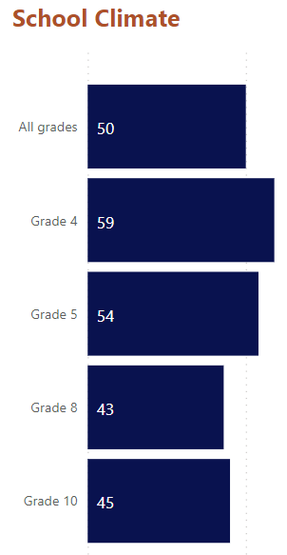
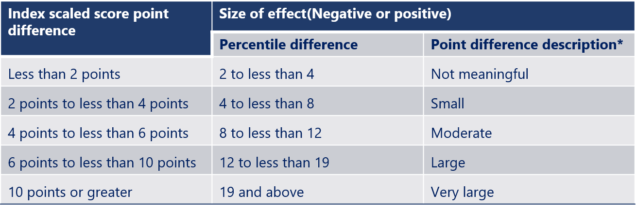
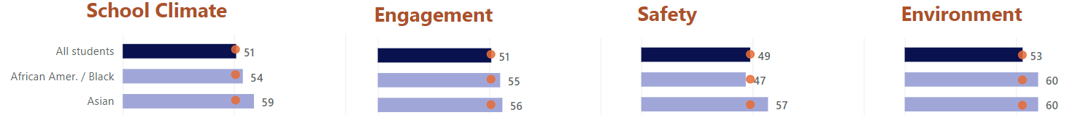
Aggregate Index Scores
*Rough guide to associated scaled score point differences

Slide 16
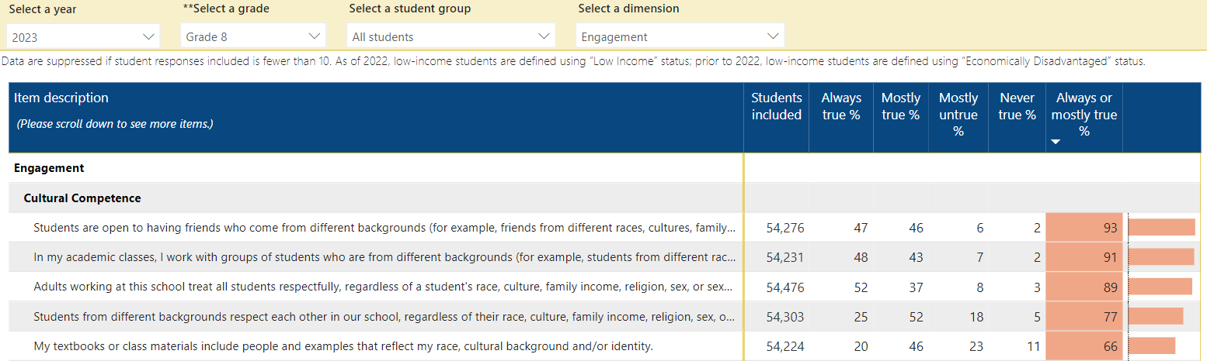
Item Response Rates
At a school or district level, be aware of the number of Students Included.
When the number of included students is small, a single student accounts for a large percentage.

Slide 17
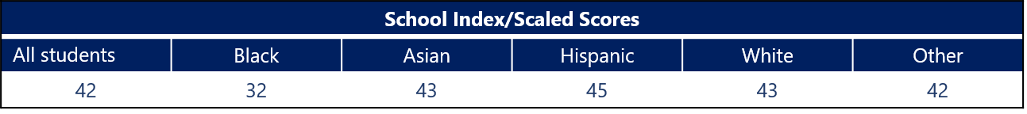
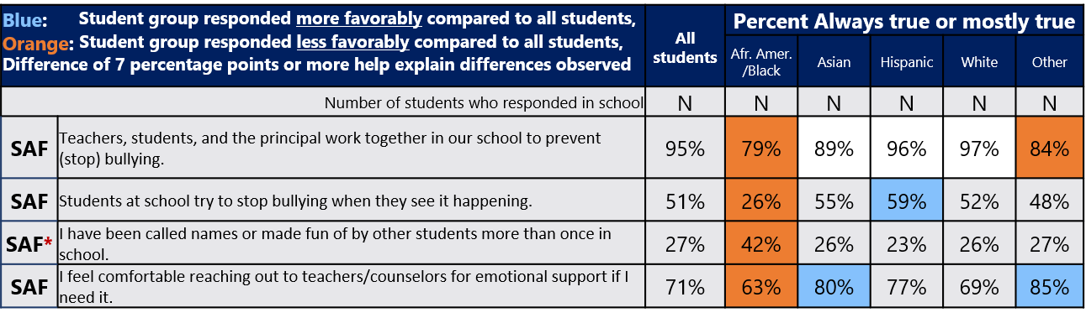
Item Responses by Group
Safety Index Scores – School Mean by Student Group
A higher percentage to this type of item indicates a less favorable response or less safe school climate
  Note that this is different from how these items work in index scores

Slide 18
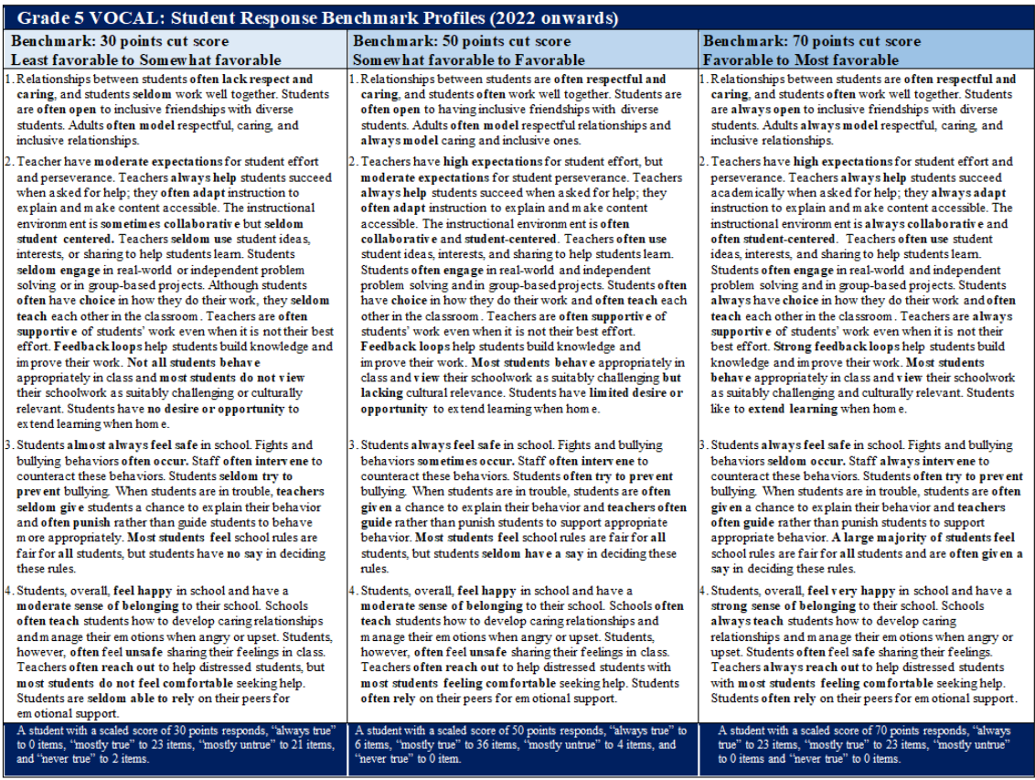
Student Climate Profiles
Classifications based on cut scores (30, 50, 70) to help think about the distribution of students.
  Recommend looking within a grade-level
State/District
School

Slide 19
Index Score Guidance
Do
Don’t
Compare, identify, and describe meaningful differences in student perceptions across schools, grades, dimensions (topics), student groups, and years.
Analyze patterns of index score differences year-to-year.
Monitor school climate scaled scores over time (Caution on 2021).
Calculate weighted index score averages.
Compare student favorability score distributions to district and state.
Use VOCAL data for administrative accountability purposes
  VOCAL data is designed to support schools in a continuous improvement process
Go from hypothesis to fact too quickly.
  VOCAL data are descriptive of student perspectives. Additional data sources are important in testing hypotheses that explain observations.
Forget about sample size.
  Small N sizes, especially for student group comparisons, small sample sizes more variability in mean estimates

Slide 20
Item Response Data Guidance
Dos
Don’ts
Use to make meaning of index score differences where there are common items
  Grade-to-grade comparisons are difficult given different items
  More success looking within a grade-level among groups
Keep qualifications in mind and lead with low inference
  E.g. “X% of 4th grade students reported that..” v.s. “Bullying is rampant”
Assess the distribution of student responses across four response options (variety versus consensus)
Rank-order items from most favorable to least favorable (always true or mostly true)
Average the response category codes (0, 1, 2, 3).
Directly compare the response percentages across dimensions or grades (i.e. uncommon items)
Don’t compare uncommon item response rates between groups

Slide 21
Additional Resources
Resources to support interpretation and use
VOCAL User Guide
Interpretive guide and action planning template
Crosswalk aligning VOCAL data to Social and Emotional Learning, Accessible Instruction and Positive Behavior Supports frameworks.
Copies of the questionnaires & past webinar slides

Slide 22

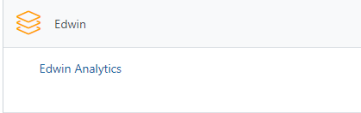
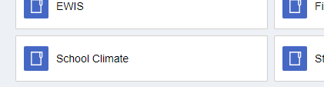
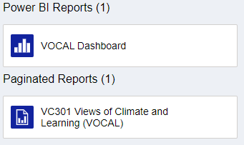
How to access results
1
2
3
Requires permissions granted by
your Directory Administrator
Both:
District-level
School-level

Slide 23
Edwin Demo
VC301 Tabular Reports
Dashboard

Slide 24
Questions & Contact
Brendan Longe
Psychometric Specialist for Non-Academic Outcomes
Email:
brendan.w.longe@mass.gov
Phone:
781-338-3526

